Slide 1
ETRTO Concept proposal for addressing wet grip on worn tyre requirements for C2 and C3 tyres
Document IWG WT-19-xx
Agenda item 7
IWG WGWT March 23rd 2021

Slide 2
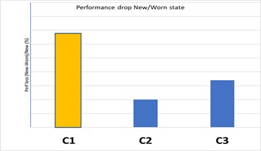
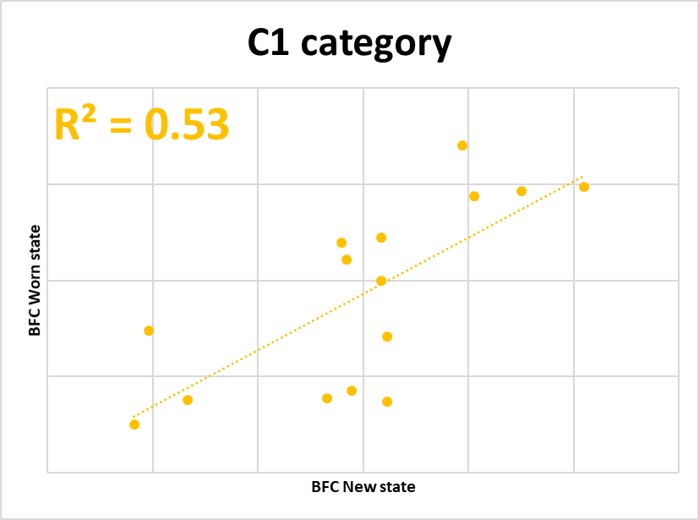
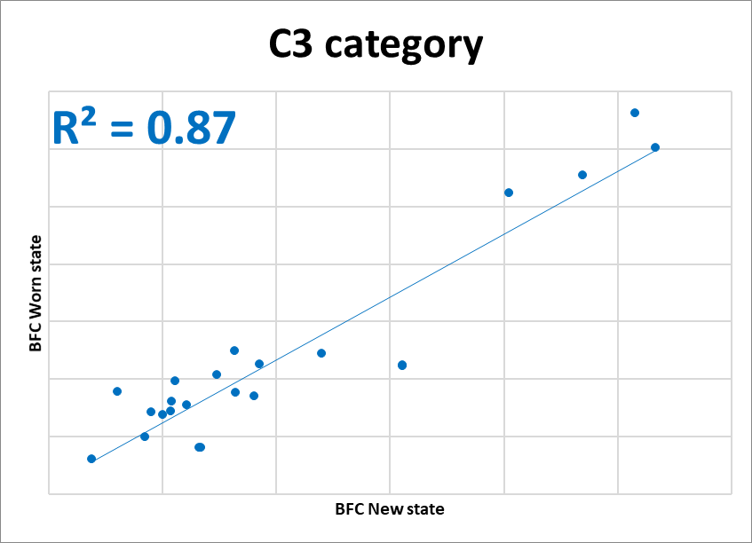
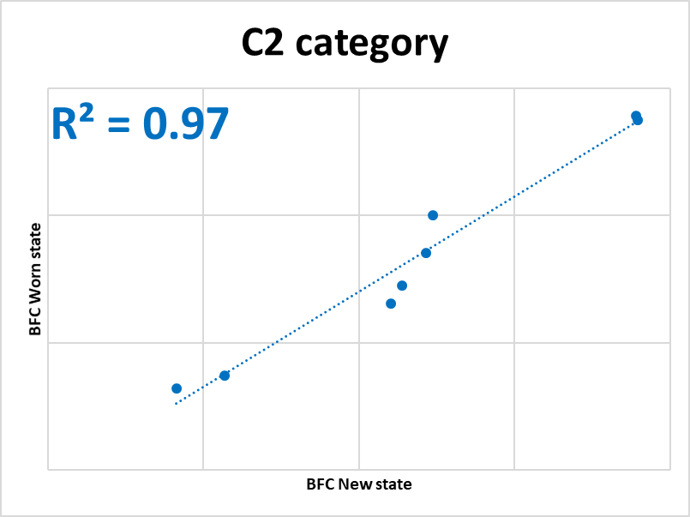
REMINDER ON THE WG PERFORMANCE EVOLUTION FOR C2/C3 tyreS
TI preliminary conclusions presented to GRBP
a. Comparison of average wet grip performance drop C1 (ref GRB-69-08), C2 and C3 (*)
b. Comparison of New / Worn ranking assessment for C1 (GRB-69-08, C2 and C3 (*)
The wet grip performance drop for C2 and C3 is significantly lower than for C1
The correlation factor R² for C2 and C3 is significantly higher than for C1 → strong wet grip performance correlation between new and worn stage

Slide 3
REMINDER ON THE WG PERFORMANCE EVOLUTION FOR C2/C3 tyreS
TI preliminary conclusions presented to GRBP
The Wet Grip performance drop for C2 and C3 is significantly lower than for C1
No significant difference in Wet Grip performance ranking between New and Worn tyre for C2 and C3 tyres (as found for C1 tyres)
The Wet grip performance of new C2 and C3 tyres is representative of the wet grip performance in worn state.

Slide 4
C2/C3: INDUSTRY PROPOSAL
2. Tyre Industry Proposal for C2 and C3 Wet grip on Worn tyres
Proposal to have worn tyres requirements based on the wet grip performance tested on new tyres. The wet grip performance in worn state is extrapolated from the wet grip performance of new tyres
A specific threshold to be defined for the wet grip on tyres at worn state.

Slide 5
C2/C3: PROPOSAL FOR EVALUATION OF WORN TIRES PERFORMANCE
Concept for Wet Grip on Worn tyre evaluation for C2 and C3
Defining the threshold of a tyre in worn state based on a tyre test
in new state
State of the art on wet grip performance decrease between New and Worn state
WGI
1
4
2
Threshold, example 1
3
Threshold, example 2
new tire
worn tire
Make a state of the art for a representative number and types of tyres for their Wet Grip performance in worn state and in new state(*).
Build a state of the art for the performance decrease.
Define acceptable thresholds for Wet Grip of worn tyres.
Starting from the new thresholds for worn tyres and using the average performance loss from point 2, define adapted thresholds for new tyres.
(*) Tyre Industry intends to perform additional tests for C2 tyres to confirm the preliminary results presented to GRBP depending with resources availability.

Slide 6
Conclusions and benefits of the Tyre Industry Concept proposal for C2 and C3
This proposal is based on the already presented specificity of C2/C3 tyres category, for which wet grip performance decrease behaviour between new and worn stages is different than for C1.
It maximizes the efficiency of the regulatory ambition:
  By providing an answer to the need to assess the wet grip performance for C2 and C3 tyres at worn state.
  Without adding unnecessary testing and waste.
The regulatory evolution should take into account the new and the worn conditions.

Slide 7
IWG WGWT comments?

