Slide 1
Submitted by the expert from Japan | TFRWS-20-02
Alternative test method for low level in case of BGN level is higher than low level minus 3dB
(Part II)
JASIC

Slide 2
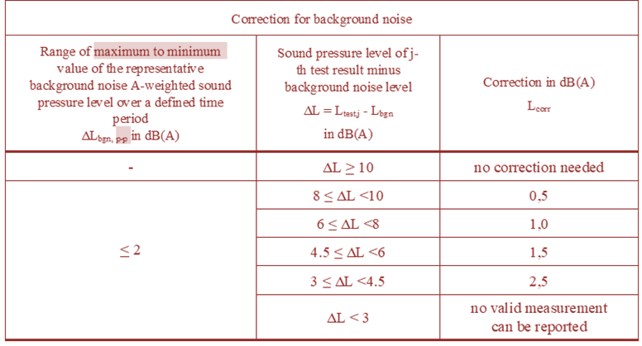
Background
In our current draft, lower limit of low level is 40dB.
Japanese technical service(NTSEL) has proving grounds. These BGN levels are 50 – 60dB. It is impossible to measure low level.
BGN level should be lower than low level minus 3dB. Generally speaking, it is hard to keep BGN level lower than low level minus 3dB at open site.

Slide 3
Proposal
Based on the backgrounds, Japan proposes alternative test method for part II test in case BGN level is higher than low level minus 3dB.
At first, low level and normal level are measured by part I test. Then, normal level is measured by part II test. At the end, lower level of part II test is calculated by following formulae.
L_{Low, part II} = L_{Normal, part II} – (L_{Normal, part I} – L_{Low, part I})
If BNG level is lower than low level minus 3dB, test should be conducted by present test method.

