Slide 1

TFRWS-20-05
Issues between Reverse Warning Sound
and other alerts
27 May 2021
China Automotive Technology and Research Center Co., Ltd.
1
Notes:
1

Slide 2
Introduction
A new standard plan for “Requirements and testing methods of warning sound for vehicle reversing” has been set up in China this April.
There are several standards of exterior warning sound published and relevant standards are on the way. These standards may have relationships with the new UN Regulation on RWS, which will be helpful for the future work of TFRWS.
2

Slide 3
Contents
GB/T 37153-2018 for AVAS (UN R138, NEQ)
GB/T 38694—2020 for Turning Right Sound (TRS)
GB/T 21155-2015 for Earth Moving Machinery (ISO 9533:2010, IDT)
Conclusions
3

Slide 4
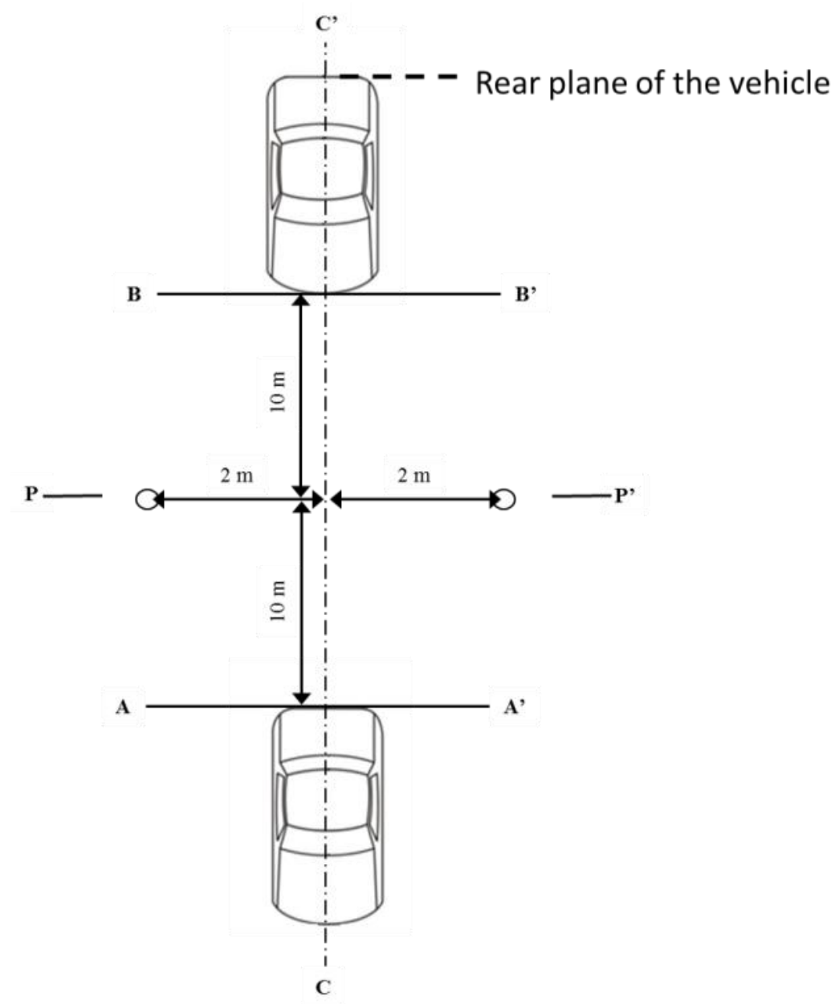
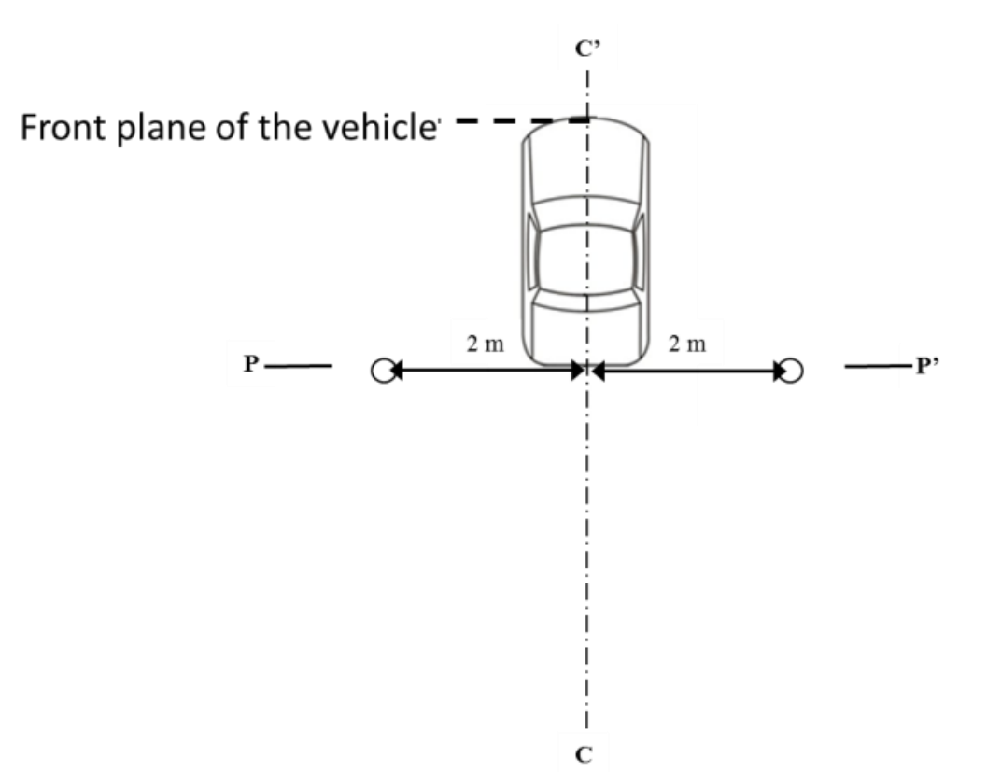
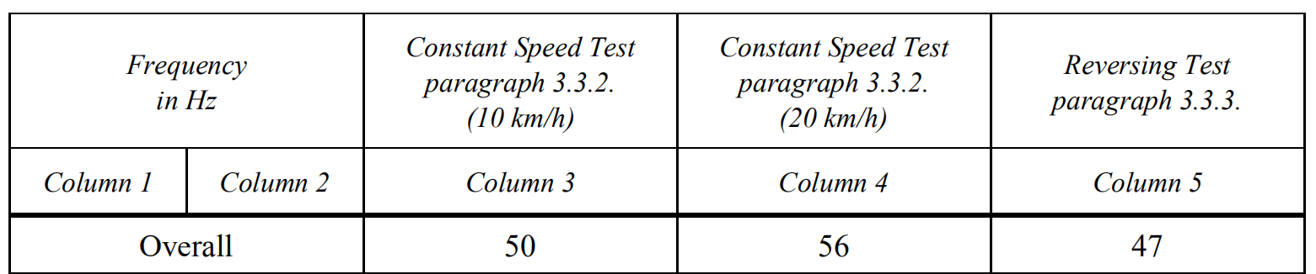
RWS vs. AVAS
Reversing sound of R138:
The vehicle shall alarm a sound that has a minimum overall sound pressure level.
Sound mode: recomand ICE style.
Test condition: motion or standstill, on test track or simulated indoor.
Relationships:
AVAS of EVs will be active during reversing or moving forward with speed under 20km/h.
Q1:How to deal with the two kinds of sounds when reversing?
Indoor
Outdoor
GB/T : 49 dB(A), both are lower than RWS.
*Figure from: UN Regulation No. 138 Uniform provisions concerning the approval of Quiet Road Transport Vehicles with regard to their reduced audibility
4

Slide 5
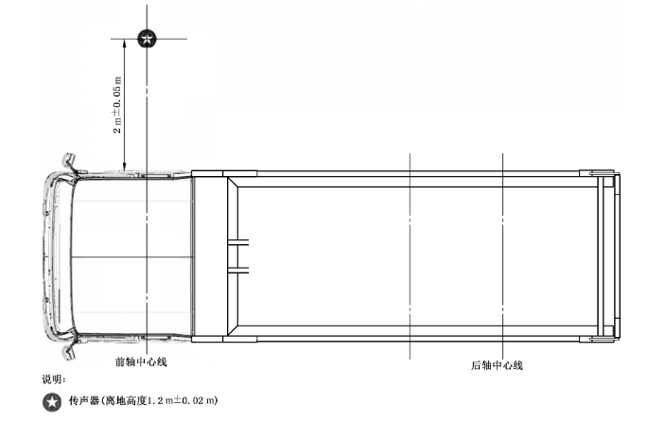
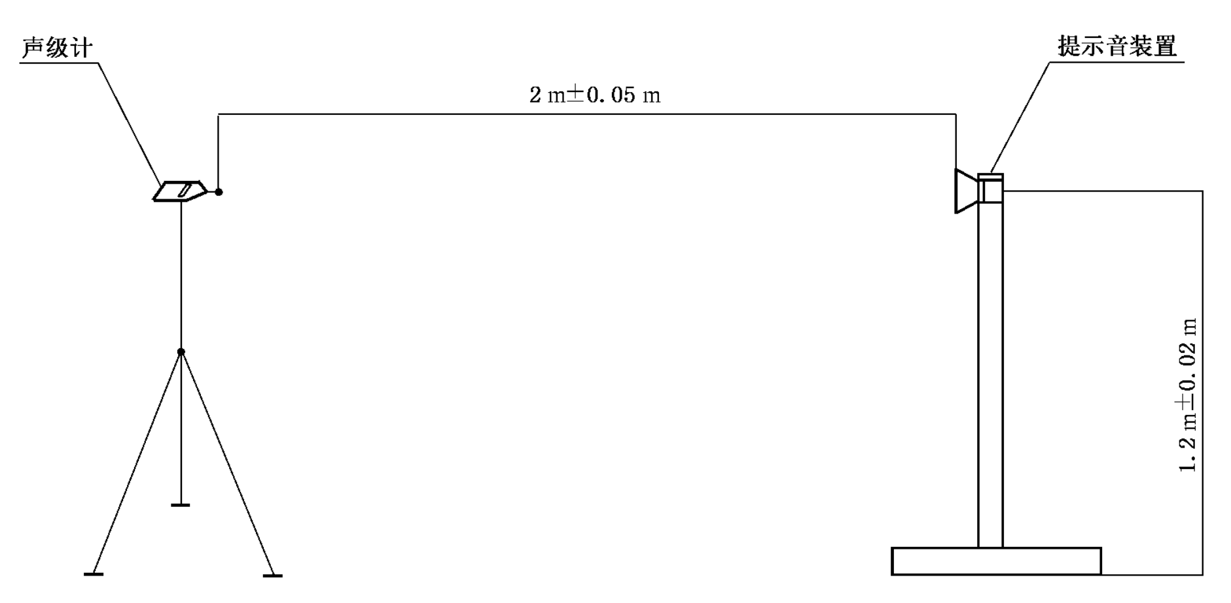
RWS vs. TRS(GB/T 38694)
TRS limits (distance:2m)
RWS limits (distance:7m):
TRS is applicable for N3 category.
Relationships:
With considering the different test distances:
Low level of RWS is just below the nighttime mode of TRS.
Normal level of RWS is between the nighttime & daytime modes of TRS.
High mode of RWS is much higher than daytime mode of TRS(6-16dB(A)).
Q2: Is it possible to harmonize the sound levels of RWS and TRS?
 | Complete vehicle | Spare parts
Daytime mode | 85±5 | 87±5
Nighttime mode | 70±5 | 72±5
Low level | [40] | [55]
Normal level | [60] | [75]
High level | [85] | [95]
*Figure from: GB/T38694—2020 Requirements and test methods of alert for vehicle turning right.
5

Slide 6
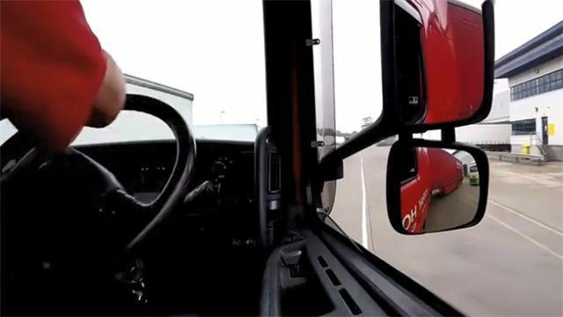
RWS vs. TRS(GB/T 38694)
Working condition
Some types of heavy duty vehicles also emit RWS under back-right turnning condition.
Q3:How can VRUs distinguish whether the vehicle is forwarding or reversing if the RWS is covered by TRS?
6

Slide 7
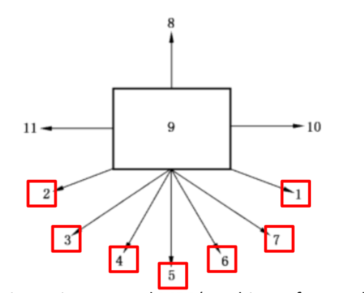
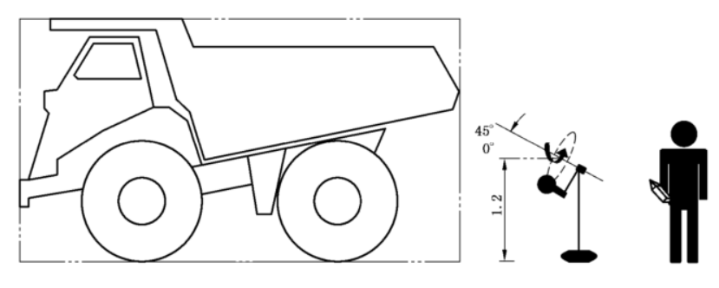
Information from Earth Moving Machinery
Reverse warning alarms test for
Earth Moving Machinery
Testing points around MRB(Machine Reference Box)
External test: Fixed sound level alarm: “Alarm On” ≥ “Alarm Off”
Self-adjusting sound level alarm: “Alarm On” ≥ “Alarm Off”+3dB(A) [RWS draft: +5dB(A)]
Internal test: operator location “Alarm Off”≤“Alarm On” ≤ “Alarm Off”+3dB(A)
Q4: Is “+3dB(A) ” a more reasonable sound limit for self-adjusting alarm?
Q5: Need to cosider internal test and driver loaction sound limit for RWS also?
*Figure from: GB/T 21155-2015 Earth moving machinery-Machine mounted audible travel alarms and forward horns-Test method and performance criteria
7

Slide 8
Conclusions
Distinguish and harmonize RWS and AVAS when reversing;
Harmonize the sound levels of RWS and TRS;
Distinguish RWS and TRS under back-right turnning condition;
Harmonize the self-adjusting sound limits with Earth Moving Machinery;
Consider the necessarity of internal tests.
8

Slide 9


Thanks for your attention
9

