Slide 1
Fuzzy-logic based performance model for motorway traffic scenarios
FRAV-12-06, submitted by the European Commission
12th FRAV session, 8 April 2021
Description and first results
K. Mattas, B. Ciuffo
08 April 2021

Slide 2
Assessment of ADS safety in GRVA/VMAD*
FRAV-12-06, submitted by the European Commission
12th FRAV session, 8 April 2021
* VMAD-16-06 NATM MASTER DOCUMENT

Slide 3
What type of Requirements?
FRAV-12-06, submitted by the European Commission
12th FRAV session, 8 April 2021
Behavioural/Operational Requirements affect parameters of ADSs operations (e.g. target speed, acceleration, deceleration, headway, etc.)
  Pros. -> clear and easily verifiable
  Cons. -> limit OEMs’ freedom, may hinder innovation, side effects possible, difficult to be linked with overall safety/efficiency targets
Performance Requirements define situations that the ADS shall be able to handle (e.g. should be able to avoid collision, have a collision probability of X etc.) without saying how to handle them
  Pros. -> give freedom to OEMs and foster innovation, focus on safety/efficiency targets
  Cons. -> not always easy to be verified

Slide 4
Use of performance requirements
FRAV-12-06, submitted by the European Commission
12th FRAV session, 8 April 2021
Performance Requirements can be used to:
  Identify those scenarios that the vehicle shall be able to handle (deterministic use)
    Pros -> no need to take into account severity and likelihood of the scenario
    Cons -> too much related to the correctness of the performance criteria
  Define the probability of an accident occurrence among the scenarios considered in the assessment (probabilistic use)
    Pros -> uncertainty in performance requirements better handled
    Cons -> need to complement the probability with other risk-related measures like severity and likelihood

Slide 5
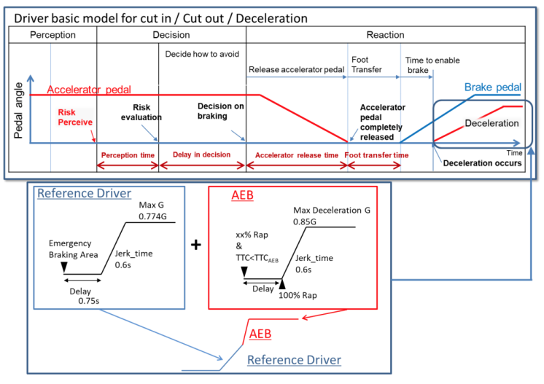
Example. Cut-in scenarios in Reg 157
FRAV-12-06, submitted by the European Commission
12th FRAV session, 8 April 2021
Paragraph 5.2.5 introduces two performance requiremet models for car-following, cut-in and cut-out. In particular:
  5.2.5.2. defines the performance model for cut-in,
  5.2.5. refers to Appendix 3 to Annex 4 for the performance model for cut-in, car-following and cut-out
Cut-in
Cut-in, car-following and cut-out

Slide 6
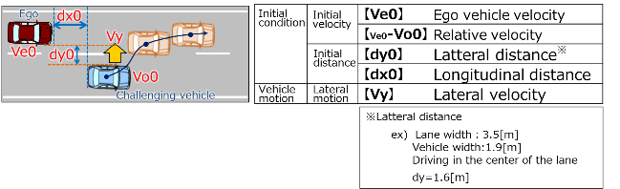
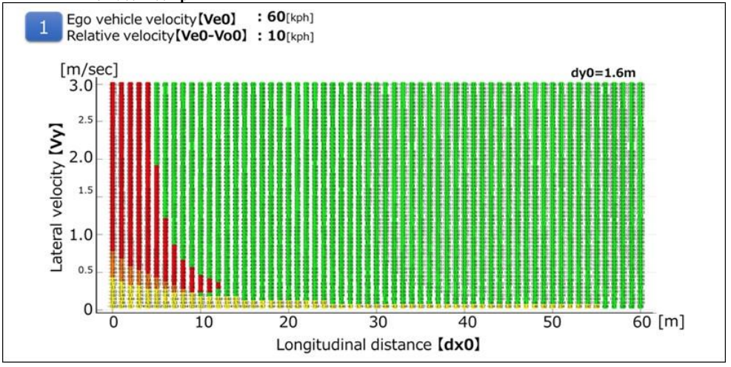
Example. Cut-in scenarios in Reg 157
Appendix 3 model
FRAV-12-06, submitted by the European Commission
12th FRAV session, 8 April 2021

Slide 7
Example. Cut-in scenarios in Reg 157
FRAV-12-06, submitted by the European Commission
12th FRAV session, 8 April 2021
The two proposed performance models are equally valid approaches to determine “unpreventable” cut-ins
Their only limitation is to always treat the cut-in as an “emergency” situation in which the vehicle has either to do nothing or to apply maximum deceleration capabilities
In reality humans (as well as the future ADSs) apply proportionate reactions and count very much on anticipation (tactical safety)

Slide 8
Assessment of current performance requirements
FRAV-12-06, submitted by the European Commission
12th FRAV session, 8 April 2021
In order to understand whether the two approaches are ambitious enough we have compared them with other two approaches recently being presented
  The Intel’s Mobileye Responsibility-Sensitive Safety (RSS)*
  The JRC Fuzzy-logic based Model**
Parameters used in the two models for the comparison (system reaction time, acceleration, deceleration, jerk) are the same proposed by the Reg157 Appendix 3 model
* Shalev-Shwartz, S., S. Shammah, and A. Shashua (2017) On a Formal Model of Safe and Scalable Self-Driving Cars. arXiv:1708.06374 [cs, stat]
** Mattas et al. (2020) Fuzzy Surrogate Safety Metrics for real-time assessment of rear-end collision risk. A study based on empirical observations. Accident Analysis and Prevention 148

Slide 9
New model based on fuzzy SSMs
FRAV-12-06, submitted by the European Commission
12th FRAV session, 8 April 2021
The new model has 3 main differences with the previous ones
Different calculation of lateral safe distance
Longitudinal safe distance according to Fuzzy SSMs
Capacity for calm proactive reaction

Slide 10
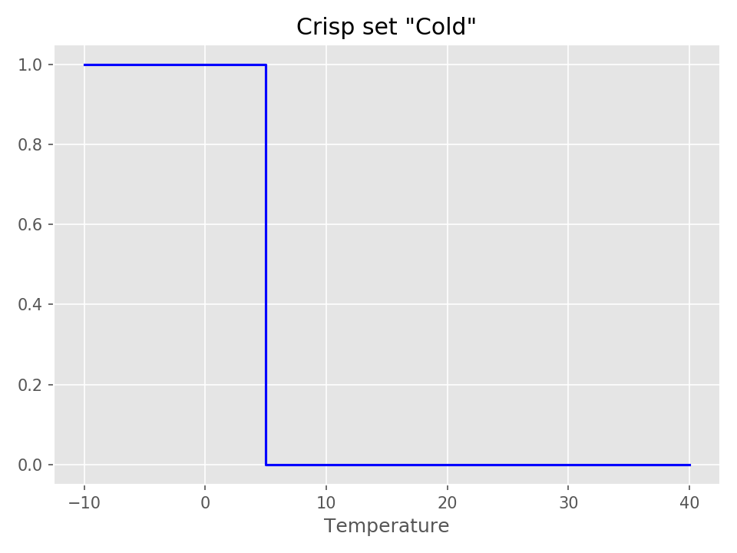
What is Fuzzy Logic? Crisp sets
FRAV-12-06, submitted by the European Commission
12th FRAV session, 8 April 2021
Classical set is a collection of distinct objects. Any element is either in a set or not.
We can describe a set by its characteristic function. It takes the value 1 for elements that are in the set and the value 0 for elements that are not in the set
The sets are ‘Crisp’

Slide 11
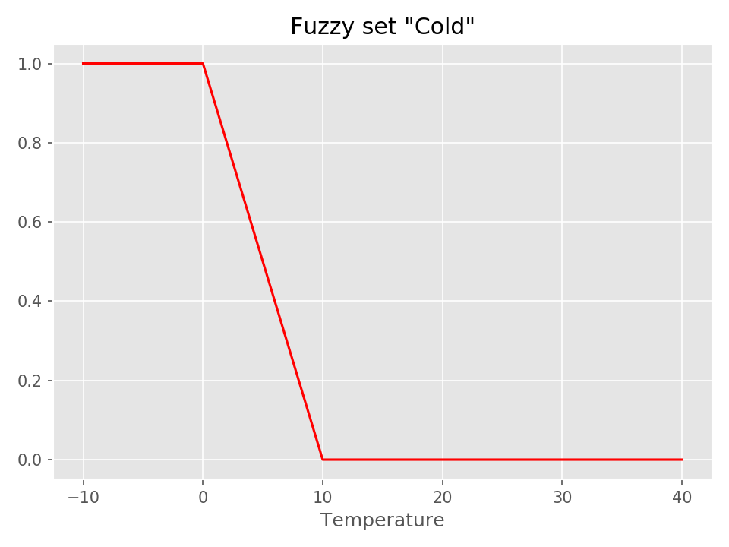
What is Fuzzy Logic? Fuzzy sets
FRAV-12-06, submitted by the European Commission
12th FRAV session, 8 April 2021
Characteristic functions of Fuzzy sets can take all values from 0 to 1
This can be helpful in many cases to better describe a situation
Based on those we can create fuzzy rules

Slide 12


Why Fuzzy logic
FRAV-12-06, submitted by the European Commission
12th FRAV session, 8 April 2021
Two vehicles with known speeds. What is a safe distance?
Safe
Unsafe

Slide 13
Why Fuzzy logic
FRAV-12-06, submitted by the European Commission
12th FRAV session, 8 April 2021
Two vehicles with known speeds. What is a safe distance?
Safe
Do nothing
Unsafe
Decelerate hard

Slide 14
Why Fuzzy logic
FRAV-12-06, submitted by the European Commission
12th FRAV session, 8 April 2021
Two vehicles with known speeds. What is a safe distance?
Safe
Do nothing
Unsafe
Decelerate hard

Slide 15
Why Fuzzy logic
FRAV-12-06, submitted by the European Commission
12th FRAV session, 8 April 2021
Two vehicles with known speeds. What is a safe distance?
Safe
Unsafe
Safe
Fuzzy
Unsafe

Slide 16
Why Fuzzy logic
FRAV-12-06, submitted by the European Commission
12th FRAV session, 8 April 2021
Two vehicles with known speeds. What is a safe distance?
Safe
Unsafe
Safe
Fuzzy
Unsafe
The more unsafe, the harder the vehicle must decelerate

Slide 17
New model based on fuzzy SSMs
FRAV-12-06, submitted by the European Commission
12th FRAV session, 8 April 2021
The new model has a number of differences with the previous ones
Different calculation of lateral safe distance
Longitudinal safe distance according to Fuzzy SSMs
Capacity for calm proactive reaction

Slide 18
Different calculation of lateral safe distance
FRAV-12-06, submitted by the European Commission
12th FRAV session, 8 April 2021
The cutting in vehicle has to be in front of the ego vehicle
The cutting in vehicle has lateral speed towards the ego vehicle
The lateral net time headway < The longitudinal gross TTC + 0.1 sec
If all three restrictions apply, then we have to check the situation for the longitudinal safe distance

Slide 19
Different calculation of lateral safe distance
FRAV-12-06, submitted by the European Commission
12th FRAV session, 8 April 2021
The lateral net distance the space between the vehicles laterally
The longitudinal gross distance is the longitudinal space from the rear of the ego vehicle to the front of the cutting in vehicle
To calculate headway, they have to be divided to the cutting in vehicle lateral speed and the approaching speed respectively
Lateral net distance
Longitudinal gross distance

Slide 20
Different calculation of lateral safe distance
FRAV-12-06, submitted by the European Commission
12th FRAV session, 8 April 2021
Lateral net distance
If the lateral net time headway > The longitudinal gross TTC+ 0.1 sec, the cut-in is very slow and the ego vehicle will not have to decelerate
Longitudinal gross distance

Slide 21
Different calculation of lateral safe distance
FRAV-12-06, submitted by the European Commission
12th FRAV session, 8 April 2021
Else, if the longitudinal distance is long and the cut-in speed is slow, it goes to the longitudinal safety part and may be considered safe at the end
Lateral net distance
Longitudinal gross distance

Slide 22
Different calculation of lateral safe distance
FRAV-12-06, submitted by the European Commission
12th FRAV session, 8 April 2021
Advantages
Less parameters needed
Less information that may induce errors (lane markings)
Cases when the vehicles deceleration causes an accident are avoided
Slow lane changes for vehicles in a distance are also considered

Slide 23
Longitudinal safe distance according to Fuzzy SSMs
FRAV-12-06, submitted by the European Commission
12th FRAV session, 8 April 2021
Two different definitions of unsafe:
If the leader vehicle decelerates, the follower vehicle cannot avoid an accident (Vienna Convention on Road Traffic)
If nothing changes, there will be a collision in x sec (TTC)
We calculated the Proactive Fuzzy SSM (PFS) and the Critical Fuzzy SSM (CFS)

Slide 24


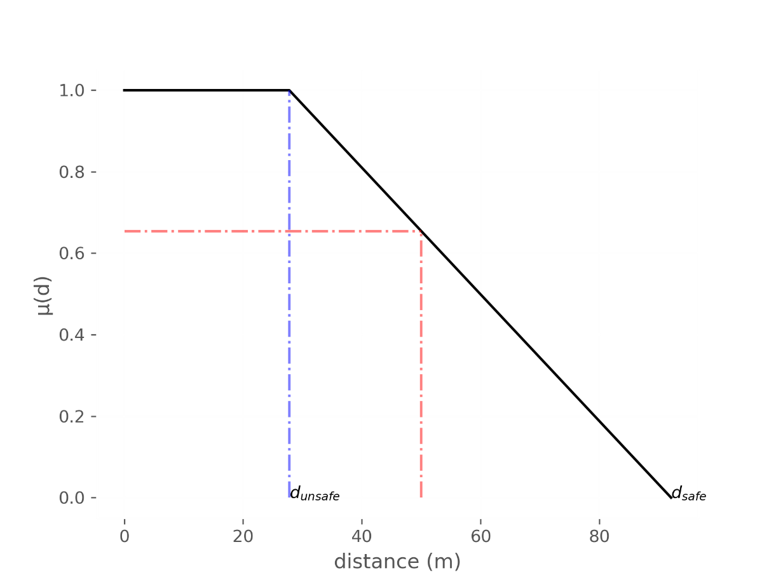
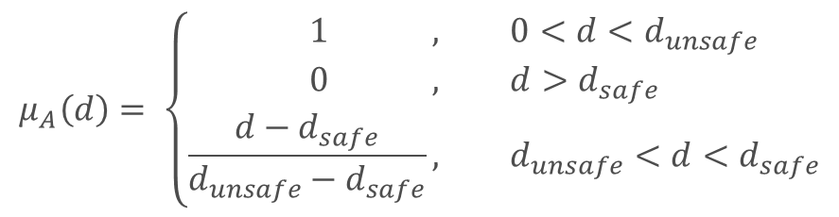
Longitudinal safe distance according to Fuzzy SSMs
FRAV-12-06, submitted by the European Commission
12th FRAV session, 8 April 2021
Maximum
Unsafe
distance
Minimum
Safe
distance
$$μ_{Α}\left(d\right)= \left\{\begin{aligned}1 , &0<d<d_{unsafe} \\ 0 , &d>d_{safe} \\ \frac{d−d_{safe}}{d_{unsafe}−d_{safe}}, &d_{unsafe}<d<d_{safe}\end{aligned}\right.$$

Slide 25
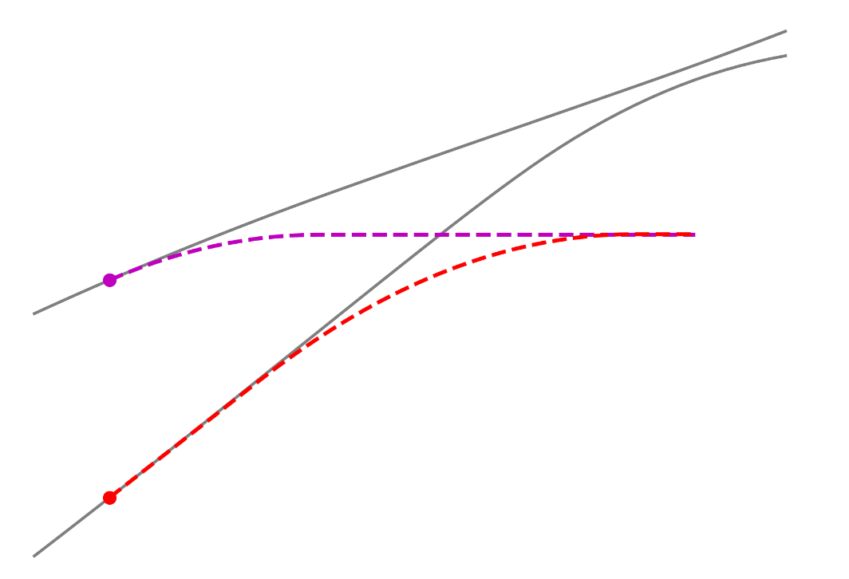
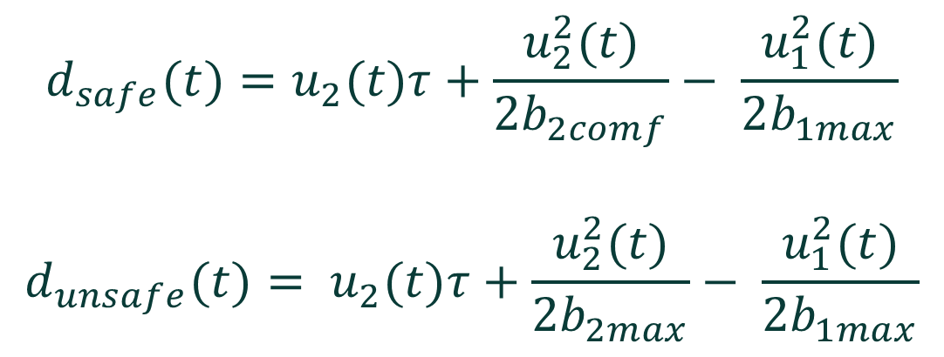
Longitudinal safe distance according to Fuzzy SSMs
FRAV-12-06, submitted by the European Commission
12th FRAV session, 8 April 2021
PFS: If the leader vehicle decelerates, the follower vehicle cannot avoid an accident
$$d_{safe}(t)=u_{2}(t)τ+\frac{u_{2}^{2}(t)}{2b_{2comf}}− \frac{u_{1}^{2}(t)}{2b_{1max}}$$
$$d_{unsafe}(t)= u_{2}(t)τ+\frac{u_{2}^{2}(t)}{2b_{2max}}− \frac{u_{1}^{2}(t)}{2b_{1max}}$$

Slide 26
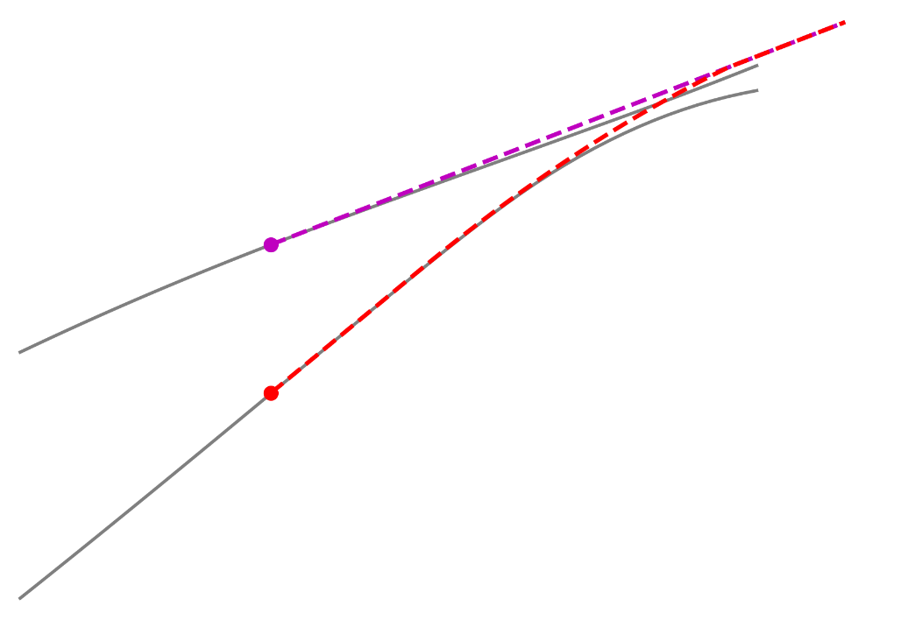
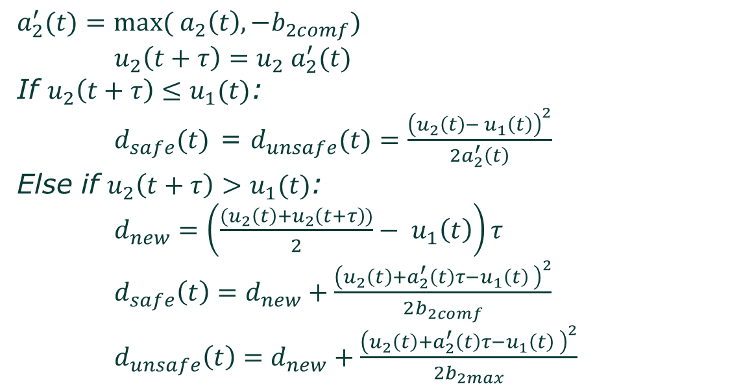
Longitudinal safe distance according to Fuzzy SSMs
FRAV-12-06, submitted by the European Commission
12th FRAV session, 8 April 2021
CFS: If nothing changes, there will be a collision
$a_{2}^{′}(t)=max( a_{2}\left(t\right), {−b}_{2comf})$
$u_{2}\left(t+τ\right)=u_{2} a_{2}^{′}(t)$
If $u_{2}\left(t+τ\right)≤u_{1}(t)$:
$d_{safe}(t)$ = $d_{unsafe}(t)=\frac{{\left(u_{2}\left(t\right)− u_{1}\left(t\right)\right)}^{2}}{2a_{2}^{′}\left(t\right)}$
Else if $u_{2}\left(t+τ\right)>u_{1}(t)$:
$d_{new}=\left(\frac{{(u}_{2}\left(t\right)+u_{2}\left(t+τ\right))}{2}− u_{1}\left(t\right)\right)τ$
$d_{safe}\left(t\right)=d_{new}+\frac{{\left(u_{2}\left(t\right)+a_{2}^{′}\left(t\right)τ−u_{1}\left(t\right) \right)}^{2}}{2b_{2comf}}$
$d_{unsafe}\left(t\right)=d_{new}+\frac{{\left(u_{2}\left(t\right)+a_{2}^{′}\left(t\right)τ−u_{1}\left(t\right) \right)}^{2}}{2b_{2max}}$

Slide 27
Capacity for calm proactive reaction
FRAV-12-06, submitted by the European Commission
12th FRAV session, 8 April 2021
The deceleration is relative to the values of PFS and CFS
PFS value of 1 induces full comfortable deceleration (e.g. 3 m/s²)
CFS value of 1 induces full deceleration (e.g. 6 m/s²)
PFS value of 0.2 induces 20% of comfortable deceleration (e.g. 0.6 m/s²)
The suggested model has the ability to apply a calm deceleration proactively, to avoid getting into a more serious (and possibly unavoidable) conflict

Slide 28
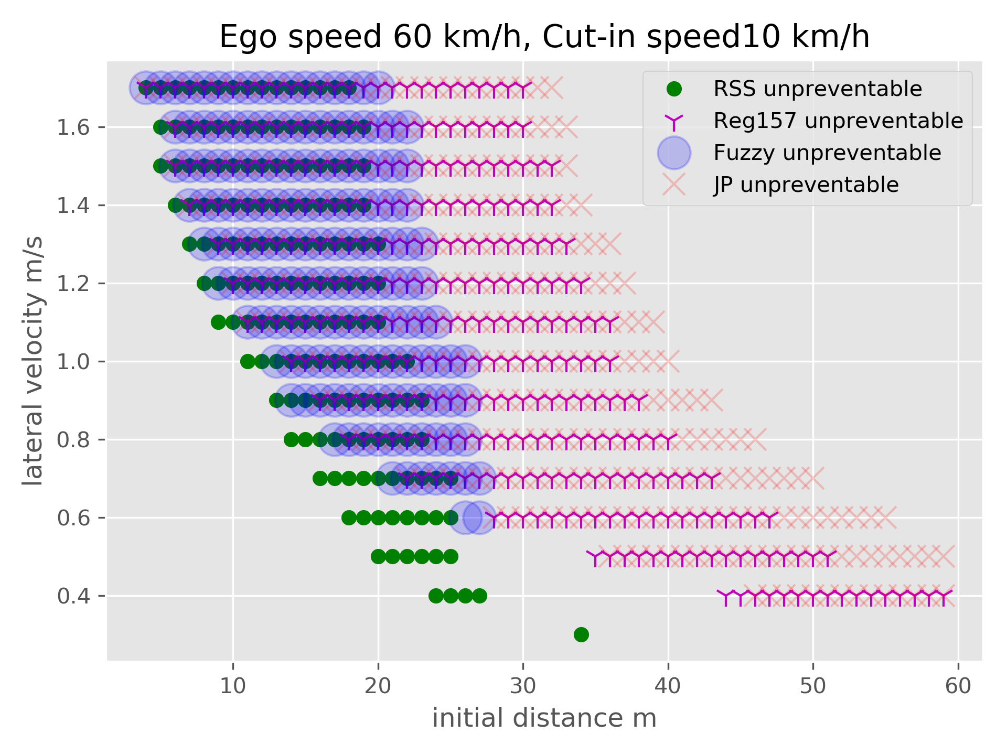
Results
FRAV-12-06, submitted by the European Commission
12th FRAV session, 8 April 2021
The parameters are to be discussed, and they may change the picture
We see the new Fuzzy model being close to the intersection between the others

Slide 29
Results
FRAV-12-06, submitted by the European Commission
12th FRAV session, 8 April 2021
Two areas of interest
The first is about cases when the deceleration of RSS vehicles causes an accident
Other models do not decelerate and avoid the accident

Slide 30
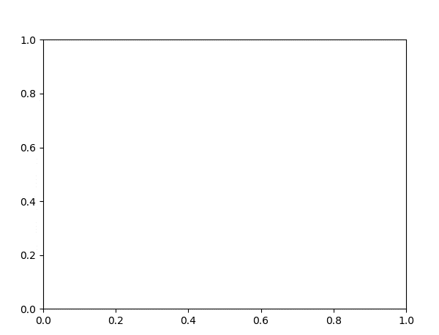
Results
FRAV-12-06, submitted by the European Commission
12th FRAV session, 8 April 2021
RSS
Reg157

Slide 31
Results
FRAV-12-06, submitted by the European Commission
12th FRAV session, 8 April 2021
Two areas of interest
The second is for vehicles in large distance and small lateral speed
Those cases are avoidable by decelerating in a proactive manner

Slide 32
Results
FRAV-12-06, submitted by the European Commission
12th FRAV session, 8 April 2021
RSS
Reg157

Slide 33

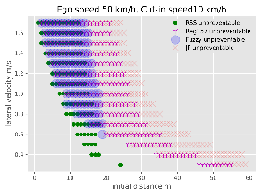
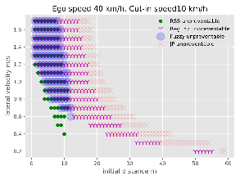
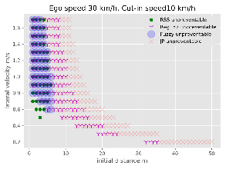
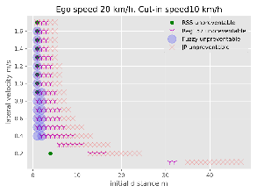
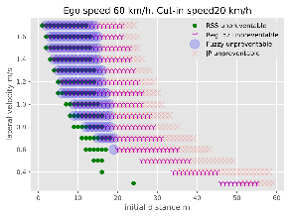

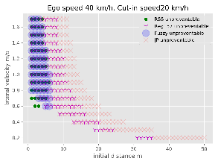

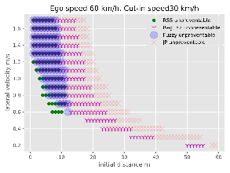



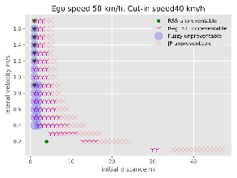
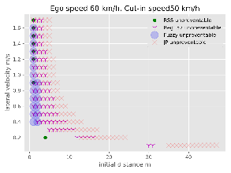
Results
FRAV-12-06, submitted by the European Commission
12th FRAV session, 8 April 2021
The model is tested for a number of cases of different ego vehicle and cutting-in speeds.
There are no obvious problems for those cases.

Slide 34
Conclusions
FRAV-12-06, submitted by the European Commission
12th FRAV session, 8 April 2021
Performance models for setting the safety requirements of future ADSs seem more appropriate than operational requirements
Current approaches suggested by first Regulation on ADSs base accident avoidance on the capability to handle emergency situations
  Anticipation capability by humans (and also by AVs) have also an important role in defining driving safety (tactical safety)
  A model based on fuzzy-logic is proposed and compared with existing models available in the literature. It shows its capability to address limitations of existing approaches
The use of performance models in deterministic rather than probabilistic settings is to be further explored

Slide 35

Thank you
FRAV-12-06, submitted by the European Commission
12th FRAV session, 8 April 2021
© European Union 2020
Unless otherwise noted the reuse of this presentation is authorised under the CC BY 4.0 license. For any use or reproduction of elements that are not owned by the EU, permission may need to be sought directly from the respective right holders.
Slide xx: element concerned, source: e.g. Fotolia.com; Slide xx: element concerned, source: e.g. iStock.com
Notes:
Update/add/delete parts of the copy right notice where appropriate.
More information: https://myintracomm.ec.europa.eu/corp/intellectual-property/Documents/2019_Reuse-guidelines%28CC-BY%29.pdf

