Slide 1
Assessment of target lane
ACSF C: Concept of defining “critical situation”
Submitted by the experts of Germany
UNR157-06-09
s_{critical}
$s_{critical}=\left(v_{rear}−v_{ACSF}\right)∙t_{reaction}+ \frac{{\left(v_{ACSF} − v_{rear}\right)}^{2}}{2 ∙ a_{rear}}+v_{ACSF}∙t_{G}$
Parameter |  | Values for ACSF C (UNR79 para. 5.6.4.7.)
v_{Rear} | actual speed of rear vehicle | variable (≤130 km/h)
t_{Reaction} | reaction time (of driver) in rear vehicle = time after the start of the LCM at which the deceleration of the rear vehicle starts | 0.4 s*
a_{Rear} | deceleration of rear vehicle | 3 m/s²
v_{ACSF} | actual speed of the ACSF vehicle | variable
t_{G} | time of safety gap of ACSFvehicle | 1 s
»
Example:
v_{Rear} = 130 km/h
v_{ACSF} = 80 km/h
→ s_{critical} = 59.9 m
* +continuous lateral movement of the vehicle before crossing the lane marking.

Slide 2
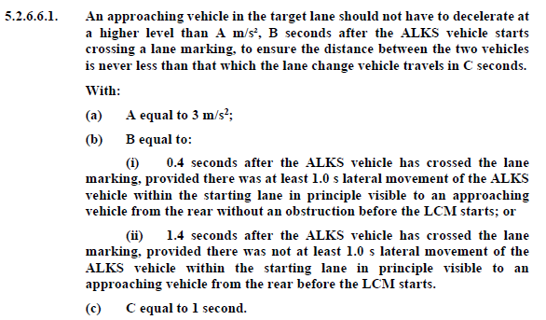
Assessment of target lane
Proposal for ALKS lane change (GRVA/2020/33)
s_{critical}
$s_{critical}=\left(v_{rear}−v_{ALKS}\right)∙t_{reaction}+ \frac{{\left(v_{ALKS} − v_{rear}\right)}^{2}}{2 ∙ a_{rear}}+v_{ALKS}∙t_{G}$
Parameter | Values for ALKS (2020/33 para. 5.2.6.6.1.)
v_{Rear} | variable (≤130 km/h)
t_{Reaction} | 0.4 s or 1.4 s
a_{Rear} | 3 m/s²
v_{ACSF} | variable
t_{G} | 1 s
»
B
A
C

Slide 3
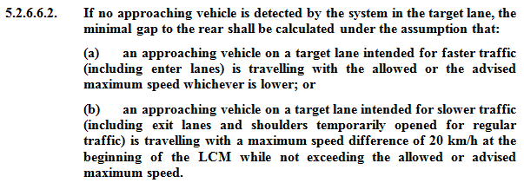
Assessment of target lane
Proposal for ALKS lane change (GRVA/2020/33)
In case no approaching vehicle in target lane (same concept to ACSF C):
s_{critical}
$s_{critical}=\left(v_{rear}−v_{ALKS}\right)∙t_{reaction}+ \frac{{\left(v_{ALKS} − v_{rear}\right)}^{2}}{2 ∙ a_{rear}}+v_{ALKS}∙t_{G}$
Parameter | Values for ALKS (2020/33 para. 5.2.6.6.2.)
v_{Rear} | e.g. 130 km/h
t_{Reaction} | 0.4 s or 1.4 s
a_{Rear} | 3 m/s²
v_{ACSF} | variable
t_{G} | 1 s
»

