Slide 1
Children in Buses and Coaches
Clepa Comments on Informal Document GRSG-121-02
GRSG 121 Session
April 12-16 2021
Informal Document GRSG-XX

Slide 2
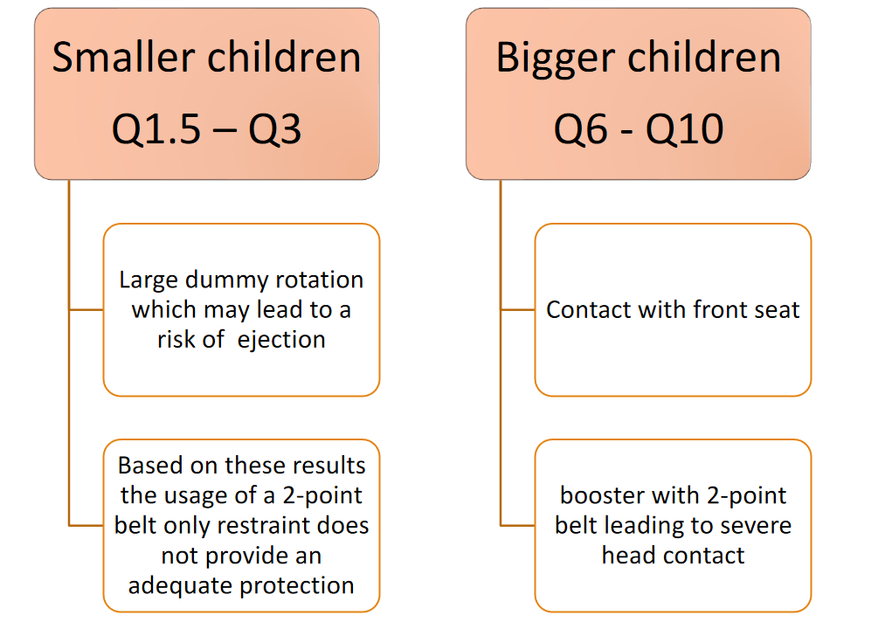
Status of STCBC IWG tests investigations
Discussed at the 68th GRSP Session – December 2020 -Informal document GRSP-68-03
Frontal Sled Tests were carried out with various dummy sizes using R80 test environment
Important to investigate a 3-point belt system

Slide 3
Comments to Informal GRSP-121-02
Child Restraint Systems (CRS) that are approved according to UN-R129 would not seem to be compatible with Bus interior regulation according to UN-R 107.
  Larger seat spacing: OICA analysis that was presented at the last IWG STCBC did include installation of the largest forward facing CRS fixture ISO F3 and Rear F ISO Fixture R2. Space between seats would increase for Classes I, A, B and II, III. The loss of space will be function of how many seats in buses and coaches will be required to receive both ISOP F3 and ISO R2 fixture.
  The fixture by OICA ISO/F3 is relevant for “Specific to Vehicle” approved ECRSs only. It would be interesting to see the analysis expanded, to use the fixture mandated in R129 for the assessment of i-size and Universal ECRSs F2X.
  It would be interesting to see the analysis expanded with the assessment using Reg.129 approved universal ECRSs (i.e. Belted ECRS).
Permitted intrusion above a seating position
  We understand that a contact has been identified between the CRS fixture (equipped with ISOFIX) and the intrusion point above the bus/coach seat
  Installation of belted only CRS might provide more flexibility with regards to this contact
That statistically the injury risk is with children above 9 years old. It is unlikely therefore that the use of a CRS would have a positive impact on this age group.
  Transport of children in buses and coaches of different ages can’t be excluded. Providing adequate restraint addressing ejection and potential occupant contacts with the interior is important.

Slide 4
Comments to Informal GRSP-121-02
Requirements for the use of multiple CRS’s in buses would lead to a significant reduction of the number of passenger seats in the vehicle.
  The reduction of the passenger seats will depend upon how many seats will be dedicated to which child population size.
Given the size of current CRS’s used in passenger cars, it may cause practical issues for the movement of passengers inside the vehicle.
  UN R107 Gangway dimensions and moving a CRS within the bus Class B: There are ways to move the CRS within the bus for example above the bus seat cushion.
Next Steps That Were Considered by the IWG STCBC
ISO envelops compatibility
Physical trials in bus/coach environment
Additional dynamic tests using 3-point belt system

