Slide 1

13th Session
Status Review and Session Orientation
Document FRAV-13-03
Web Conference
6-7 May 2021

Slide 2
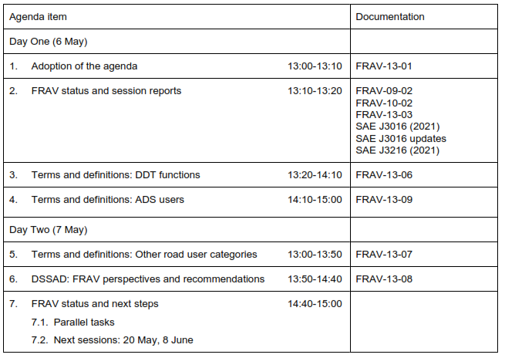
Agenda item 1
Adoption of the agenda

Slide 3
Agenda item 2
FRAV status
FRAV-12-08 consolidated comments on the safety topics
FRAV identified three workstreams proceeding in three steps
  Prepare a list of DDT functions with description of each function
  Prepare a list of terms and definitions regarding ADS users based on their roles and responsibilities
  Prepare a categorical list of “other road users” that may encounter an ADS vehicle or an ADS may encounter
FRAV agreed to consider input for EDR/DSSAD
  Prepare FRAV input for EDR/DSSAD regarding ADS vehicles
Session Objective
Sense of FRAV on the initial workstream results and next steps

Slide 4
Agenda item 3
Definition of DDT functions
DDT → functions required to operate a vehicle in traffic
ADS must be capable of performing the entire DDT
What are the functions that would constitute the entire DDT?
Open questions regarding “strategic, operational, and tactical”
General aim to have a common understanding of the DDT and its components
Describe the DDT in a manner suitable for defining verifiable requirements that an ADS drives safely
  Verification that an ADS can perform the entire DDT
  Verification that an ADS safely performs the DDT

Slide 5
Agenda item 4
Definition of ADS users
ADS are designed for various uses
ADS vehicles may or may not be designed to carry occupants
ADS designs may or may not include a human driver as a fallback
ADS designs may involve various degrees of interactions with a user
General aim to have a common understanding of “user” to support work on requirements for ensuring correct use and user safety
Define “user” in a manner suitable for developing requirements to ensure safe interactions between the ADS and the user
  Verification that an ADS meets user-related safety requirements
  Enable determinations on user/HMI requirements applicable to an ADS

Slide 6
Agenda item 5
Definition of ORU categories
ADS should interact safely with other road users (ORU)
Diverse interactions depending upon nature of the ORU
ORU interactions may vary depending upon the ODD
ADS responses may vary depending upon vehicle configurations
General aim to have a common understanding of the ORU an ADS vehicle may encounter
Define ORU in a manner suitable for developing requirements to ensure safe interactions between the ADS and other road users
  Verification that an ADS will respond safely to the presence and behaviors of other road users
  Enable determinations on ORU-related requirements applicable to an ADS

Slide 7
Agenda item 6
FRAV input on EDR/DSSAD
EDR/DSSAD informal group request
  EDR/DSSAD mandate to define technical requirements for Data Storage Systems for Automated Driving (DSSAD)
  FRAV presumably will require ADS vehicles to be equipped with DSSAD capability
  EDR/DSSAD would like FRAV views on DSSAD requirements for ADS
FRAV views or recommendations for EDR/DSSAD
  FRAV interests in data recording/storage for ADS vehicles
  Impact of EDR/DSSAD work on FRAV development of ADS safety requirements
Consider whether the task input covers FRAV interests and should be passed on to EDR/DSSAD

Slide 8
Agenda item 4
Outlook for next steps (thru September)
Upcoming sessions
  Session 14 (20 May): Endorse consensus views?
  Session 15 (8 June): Safety needs/topics
  Session 16 (6 July): General requirements
Consensus on general requirements, justifications, terms and definitions by July
Two months to prepare submission to GRVA-11 (27 September-1 October)
Four months to prepare submission to GRVA-12 (February 2022)
Are we on task? Any course corrections?

