Slide 1

Intentions for today’s meeting
Submitted by SG4 Leader
VMAD-SG4-07-08
SG4 Meeting 24 June 2021

Slide 2

Agenda….
Minutes of the previous (6th) SG4 meeting (information; no remarks received.)
Any suggestions?

Slide 3
Report on Overview Available Methods, Practices and Tools
Inventory document
Comments received: China, Japan, AVL (inserted)
  Addition comments received from Japan (not yet inserted)
Flexible document
Still open for methods, practices and tools “discovered”.
As concept available for NATM.
Further comments welcome
To be discussed in upcoming SG4 meeting (or at the end, if time allows)
3

Slide 4
FRAV list of ADS safety topics
FRAV’s Topics for (functioning of) ADS (functional requirements)
Commented in general by SG4 (previous to last VMAD meeting)
“Content” for Track- and Real world testing
Things to be done:
Discussion of the (40) topics: what could be assessed using TT and RWT?
“Criteria” to be used for testing on TT and RWT…
Specifications: what is exactly meant by each safety topic (description to be developed by FRAV). Result: specified test protocols for TT and RWT
Is this list complete?
4

Slide 5
Test matrix
Presented earlier…..Tokio 2020
Suitable tool for testing?
…..
5

Slide 6
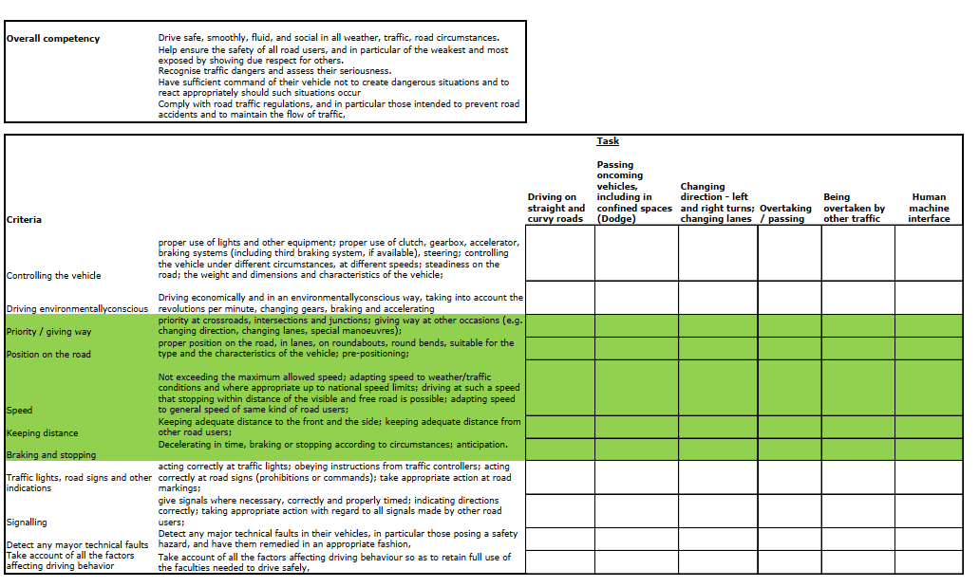
Proposal for test matrix
6

Slide 7
Next steps
Comments on VMAD-SG4-07-03 to be considered
Close communication with FRAV: topics to be elaborated by FRAV (specifications). What is exactly meant by….
Development of matrix (method and tools to be used) and test protocols with pass / fail criteria for TT and RWT based on FRAV input (SG 4) also using “best practices”?
Also try-outs and validation…
7

