Slide 1
An Outlook on Thermal Runaway Initiation & Propagation Testing
UN GTR No. 20 – EVS22
October 2021

Slide 2
GTR No. 20 Background
Phase 1
Documentation Requirements for Manufacturers
Phase 2
Thermal Runaway (TR) Propagation Test is under consideration
The methods of thermal runaway initiation under consideration are:
(1) Rapid Heating Method
(2) Nail Penetration Method

Slide 3

Thermal Runaway Propagation Test Methods
A
B
Localized Rapid External Heating Method
Nail Penetration Test
New: ISO 6469-1:2019/CD AMD1 (Section 6.7.7)
Thermal Runaway Initiation Method (TRIM)
  Developed by National Research Counsel (NRC) Canada²
A high-powered heat pulse is applied to a small area on the cell’s external surface until TR is achieved
New: GTR 20 Phase 1 Test Procedure
Drill Hole position and direction are selected
Hole is drilled in the enclosure of the battery system
Nail is inserted
Nail perforates the cell causing TR
² Source: “Localized Rapid Heating Methodology and Testing Fully Operational Vehicles” Presented by Transport Canada to NHTSA, February 23, 2021.

Slide 4
Thermal Runaway Test Methods - Possible Challenges
Possibly Intrusive & potentially compromises the battery pack
May not be representative of the heat output, gas emissions, and ignition characteristics
Cell Selection for TR Initiation - Difficult
TR Initiation Methods may not be representative of actual fault conditions and lack objectivity
General
Rapid Heating Method
Nail Penetration Test
A
B
Rechargeable Electrical Energy Storage System (REESS) Modification for Surface Mounting:
  Risk potentially altering REESS functionality
May result in heating more than one cell
If heater is inserted between 2 cells, risk TR initiation in 2 cells simultaneously
Heater Selection (power & size) dependent on cell size & type
Perforation Depth of Nail & Direction may vary
Nail penetration may damage more layers
  Result: higher heat output than in an actual fault condition
Unclear if these Test Methods Achieve: Feasibility, Objectivity (Repeatability & Reproducibility), Practicability across all EV Makes & Models

Slide 5
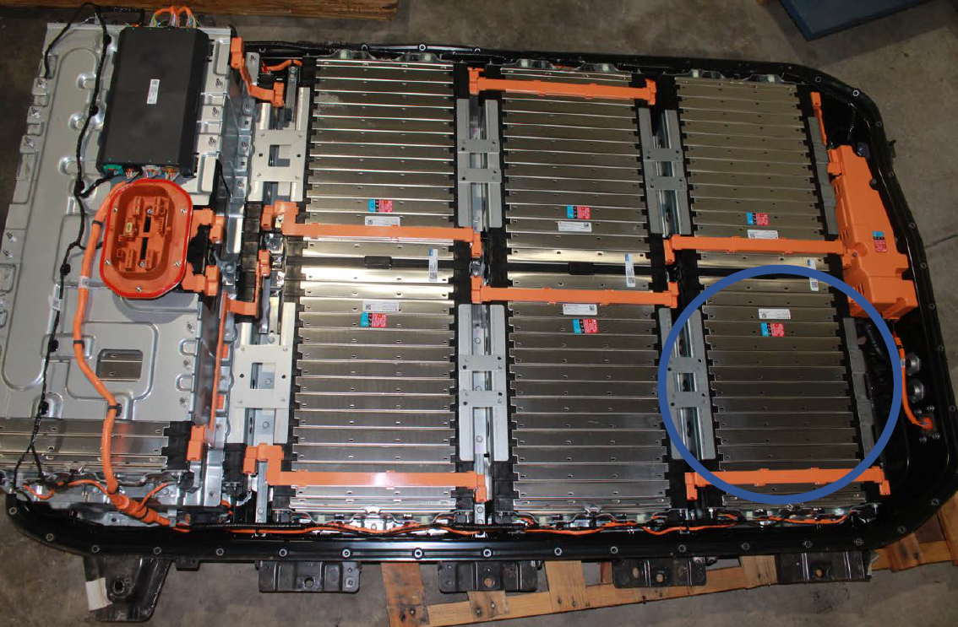
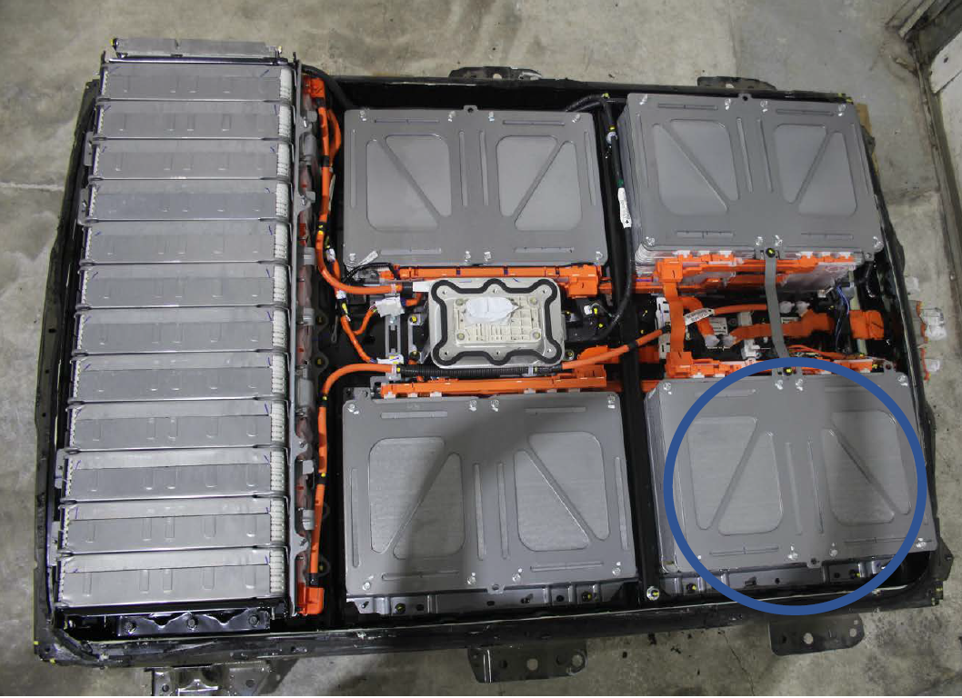
Research Objectives
Evaluate
Feasibility, Objectivity, and Practicability of test methods on different REESSs
Compare
Test results from the heating method with results from the nail penetration method

Slide 6
Test Matrix
I.
4 Vehicle Models with different battery cell technology (e.g. cylindrical, prismatic, etc.)
Vehicle Model | Rapid Heater Test | Nail Penetration Test
A | 2 | 0
B | 1 | 1
C | 1 | 1
D | 1 | 1
III.
Repeated on 1 Vehicle Model twice to evaluate repeatability
II.
II.
I.
III.
Conducted on 3 (new) EVs
IV.
IV.
Comparison of heating method & nail penetration test results for the same (but new) vehicle models

