Slide 1
Visibility of a safety sign under darkness or opaque conditions

Slide 2
luminescence : Passive vs. Active
Criteria | Fluorescent technology | Phosphorescent technology | LED/lighting Technology (based on XM-L3 cree)
Type | Passive – light reflection | Active – light energy stored | Active – production of light
Light production | Need external lighting source & pointed to the fluorescent area | Continuous | Pulse of 7ms each 3 seconds Pulse of 20ms each second
Light power | N.A. | - Useful illumination, 30 min with Xenon type D65 500 W, with 1m² of classe C material: 10 minutes = 211mcd (0,211cd), 60 minutes = 30mcd (0,03cd). - Useful illumination, 30 min with Fluo lamp 4000K 36W, with 1m² of classe C material: 10 minutes = 77,43mcd (0,077cd), 60 minutes = 10mcd (0,010cd). | 152 lm (nominal) = 45 000mcd (with wide viewing angle: 125° ) or 45cd *360 lm (nominal) = 106 447mcd (with wide viewing angle: 125° ) or 106,4cd
Autonomy | N.A. | Few hours in the dark | 8 568h or 357 days
Surface for equivalent luminous characteristics (360 lm / 106,45cd) | N.A. | around 20m² | 5mm x 5mm (25mm diameter with driving system & power supply)
Maintenance | Cleaning | Replacement each 10 years | Battery replacement each year
Cost | Initial cost < 1,50 € | Initial cost < 2,50 € | Initial cost < 5€ Then 2€ each year

Slide 3
luminescence : Passive vs. Active
Criteria | Fluorescent technology | Phosphorescent technology | LED technology
Avantages | Low cost No maintenance | - Low cost - Few maintenance | No loss of luminosity Visible in smoke atmosphere at distance > 3m Visible in the dark through the entire vehicle’s cabin Very small dimensions Choice of the color
Disavantages | - Need additional lighting source - No gain in the dark or atmosphere with smoke | - The stored energy is very dependent to the useful illumination. Inside vehicle’s cabin the illumination power is equivalent to a fluo lamp. - Very quick loss of luminosity after 30 min the gain is null in case of smoke After 2 hours the gain is close to zero in the dark Visible at few centimeters in smoke atmosphere (< 30cm) during the first hour only. No color choice | - Need maintenance

Slide 4
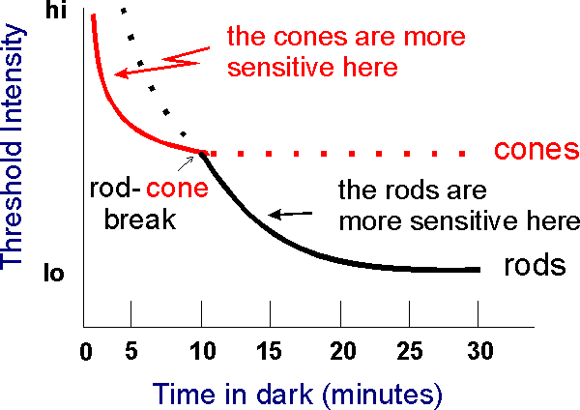
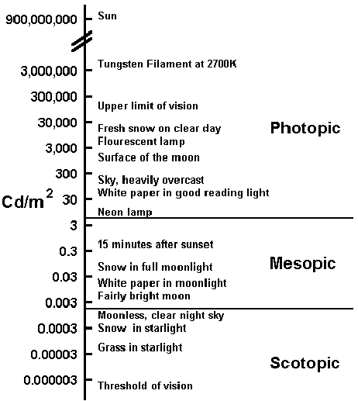
Eye Adaptation vs smoke & darkness
Photopic vision is the vision of the eye under well-light conditions (luminance level 10 to 108 cd/m2). In humans and many other animals, photopic vision allows color perception, mediated by cone cells, and a significantly higher visual acuity and temporal resolution than available with scotopic vision.
Scotopic vision is the vision of the eye under low-light levels; Scotopic vision occurs at luminance levels of 10−3 to 10−6 cd/m2 without color distinction.
The eye takes approximately 20–30 minutes to fully adapt from bright sunlight to complete darkness […]. In this process, the eye's perception of color changes as well (this is called the Purkinje effect). […] Dark adaptation is far quicker and deeper in young people than the elderly.
@ 0.03 cd/m²
Fire black smoke fills the entire cabin in less than 4min after fire starting point. So potentially, under day light, the eyes are not ready to distinguish low contrast.
In case of Fire during night travel; expecting passengers are reading using roof lamp, using their smart phones, tunnel entrance, etc., the vision adaptation are the same.
Luminence in fire black smoke under day light condition drops from Photopoic vision to Mesopic vision.
So, signs shall have a luminescent compliant with the photopic vision
References:
https://en.wikipedia.org/wiki/Adaptation_(eye)
https://en.wikipedia.org/wiki/Photopic_vision
https://en.wikipedia.org/wiki/Scotopic_vision
https://www.visualexpert.com/Resources/nightvision.html

Slide 5
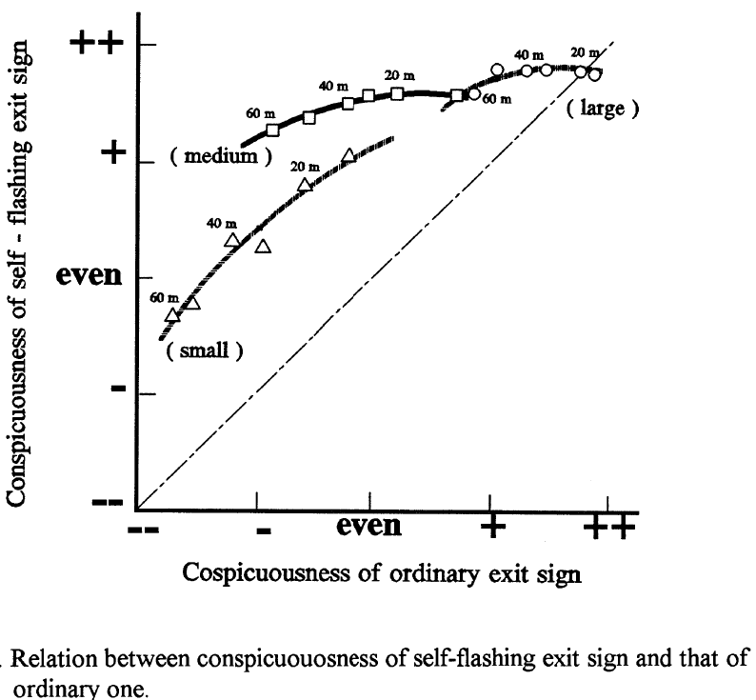
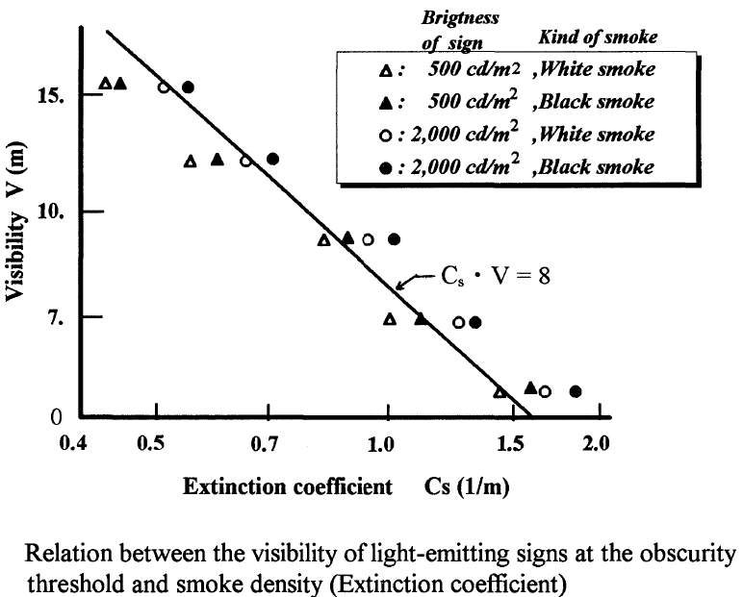
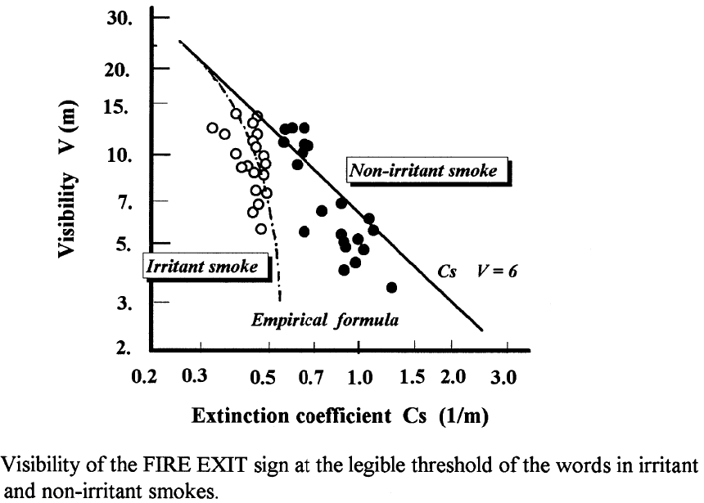
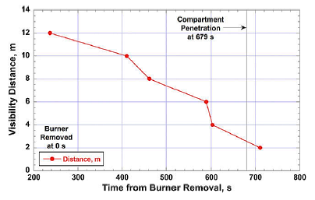
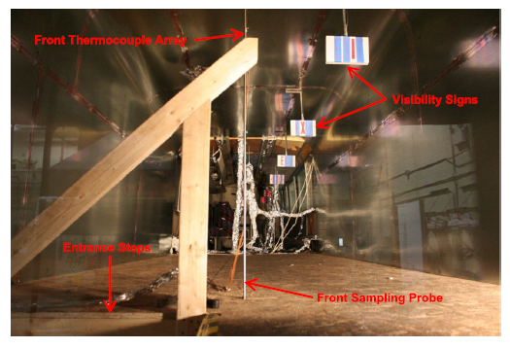
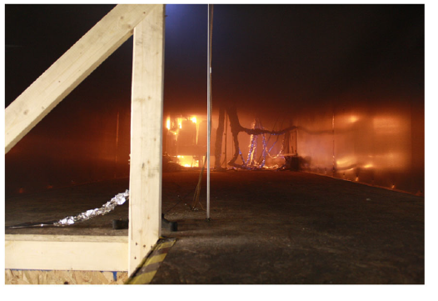
practice cases studies
Study #1
1
2
Study #2
3
Studies conclusions:
The smoke toxicity impact the visibility due to the irritability of the smoke component in addition of the smoke opacity itself.
Non-luminescent signs are not visible in smoke environment or in the dark
The result indicates that visibility is almost constant when luminance of white part of the exit sign is over 300 cd/m2 [For visibility higher than 20m]. This observation is true for every size of the exit sign. When visibility is expressed in terms of the visual angle (height of pictograph) it is independent of the size of the sign.
The improvement of conspicuousness by the flashing light in the sign […] is more effective to improve conspicuousness.
View the results, for a visibility at 3m inside a coach (against 20m in the study), a minimum luminance of 45 cd/m² is necessary.
A phosphorescent material only is not enough luminescent (max. 0,21cd/m²) and need additional system.
References:
BMFE-06-06 (PlasticsEurope) johnsson_FAM bus fires 2018 - estimation on the tenability conditions in a fire.pdf
Studies on Human Behavior and Tenability in Fire Smoke (TADAHISA JIN, Fire Protection Equipment & Safety Center of Japan 2-9-1 6 Toranomon, Minato-ku, Tokyo 105, Japan)

Slide 6
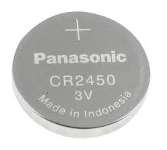
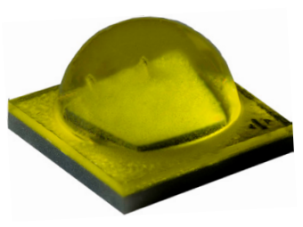

LED consideration
Visibility of the device by LED is possible. A high luminous intensity LED can reach 800 lumens with a simple 3V lithium battery. By equivalence, a 40W household filament bulb produces up to 340 lumens depending on the technology.
For example, a single CREE XM-L3 type LED of size (5mm x 5mm x 3mm) used for 1 light flash of 7ms every 3 second and powered by a single CR2450 (24.3mm x 5mm) 3V battery would past over 357 days of continuous functioning (excluding consumption of the control circuit).
Summary:
Battery capacity | LED consumption | Luminous Flux | Pulse width | Autonomy
600mAh | 30mA (300mA @ PWM 10%) | 152lm | 7ms each 3 seconds | 8 571h or 357,14 days*
 | 70mA (700mA @ PWM 10%) | 360lm | 5ms each 5 seconds
 | 150mA (1500mA @ PWM 10%) | 800lm | 3ms each 6,5 seconds | 8 667h or 361,11 days*
Math Explanation:
$\frac{Battery capacity (mAh)}{LED Consumption (mA)}×$ $\frac{Pulse interval (ms)}{Pulse width (ms)}=Autonomy (h)$
*Remark:
Minimum eye response 2ms

Slide 7
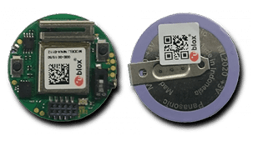
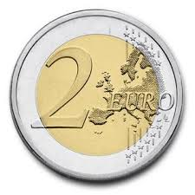
Existing products
Integration is possible in a very small volume of 30mm x 30mm x 6mm (battery and complete electronics) and can withstand temperatures from -40 ° C to 85 ° C (automotive standard) with zero electro-magnetic risk and low cost (production <5 € in large series).
In a similar volume, it is possible to carry out a wireless remote triggering, for example from the driving position: low consumption radio system authorizing with a great autonomy (> 5 years).
For example, the Bluetooth 5.2 module in example(newest release) consumes 2,2µA in standby so without communication and without flash lighting, with a CR2430 battery, the lifetime is over 15years. So, the module doesn’t impact the power consumption like the flashing system.
The extra cost in large series with this module reference is < 4,5€. Other modules are <3,5€ in BT5.0* and less if BT4.0*
Example of existing product with communication module (Blueprint B200 from U-Blox):
20,4mm
25,7mm
The form factor of the Blueprint B200 is circular with a diameter of 20.4 mm. The size of B200 matches the size of a coin cell battery (CR2020). The PCB has a 4-layer stack-up, with only through-hole vias. Thickness is 1.12 mm. All the components are placed on topwhile the rechargeable battery is soldered on the backside.
*BT = Bluetooth and 5.0 or 4.0 is the release of the transmission protocol; 5.0 is the most recent version (2 years old) and consumes less energy than 4.0.

Slide 8
Activation of the flashing light
To be compliant with the requirement of the paragraph §7.8.3 « when the emergency lighting is activated » the activation of this lighting system could be:
Always flashing: very simple and easy to be implemented and doesn’t depend from any other system. In building, emergency signs are always lighting; idem for defibrillators in order to identify and to localized the device. The aim is to function like a lighthouse for boats in fog.
Activated on a level of darkness : Sensors detect a drop of ambient lighting; identical to the current automatic vehicle lighting activation system (e.g. When vehicle enters into a tunnel).
Activated on collision: Sensors detect a high shock; similar to the current airbag system. Shock sensors used for airbag system are calibrated for this kind of shock. Other vehicle manufacturers include collision tests and fix the acceleration level to qualify their equipments (e.g. General Motors fixes it at 100G)
Activated when the emergency lighting is activated: need to be interfaced with the current system; directly on the sensors/command harness or to the CAN network. As it’s only in read-only configuration, existing solution allow to read CAN network without any physical connection but by contactless technology.
Activated by the driver via a dashboard command: the driver activates the lighting via a dashboard command. Dedicated wired or wireless command can activate by distance the flashing system.
All the previous points are existing, and the technology today is enough reliable, energy saver and cheap to be taken in account. Obviously, this list is not exhaustive and other systems can answer to any activation principle.

Slide 9
Conclusion
Today, all buildings and public areas have conspicuousness signs to improve visibility.
A lot of studies in this way demonstrate the gain of a lighting system compared to usual system.
In case of fire, the opacity becomes quickly and avoids all sign view upper 2 meters. It’s why, studies conclude on the interest of a big contrast between the darkness and the safety signs; the best way being conspicuousness signs.
Compared to the human vision adaptation, a fire smoke dives the passengers into darkness and it’s difficult to view small luminescent systems before the fire overruns the vehicle's cabin. Moreover, the toxicity significantly increases the loss of visibility.
The recommended system luminescence of the device shall be > 45cd / m² without drop of lighting performance in time.
Today, the technology is ready, power saver, smart, reliable and cheap to be integrate in very small packages keeping a high lighting power over years.

Slide 10
Conclusion
Taking into account all considerations, in a technology neutral way and if the group agrees the previous conclusion, we propose to modify the draft proposal from France and Germany by replacing phosphorescent technology by lighting technology to ensure the good visibility of the device even in case of smoke and add a minimum requirement for the luminescence.
“7.6.8.2.2. Be made of readily-breakable safety toughened glass. This latter provision precludes the possibility of using panes of laminated glass or of plastic material. An easy-to-operate device for breaking the glass shall be provided permanently fixed adjacent to or on each emergency window, readily available to persons inside the vehicle., to ensure that each window can be broken. The glass pane or glass panes shall break after a single positive action of any person operating the device so that the emergency window can easily be removed. The technical service shall verify by testing the operation of the device.
7.6.8.2.2.1 To ensure a good visibility of the device for breaking the glass it shall be positioned in the upper third of the height of the window surface, and shall be marked in red, supplemented by a safety sign and a flashing light. The system luminescence of the device shall be >45cd / m². The flashing light shall be active activate when the emergency lighting is activated §7.8.3.

Slide 11
Questions
Thank you

Slide 12
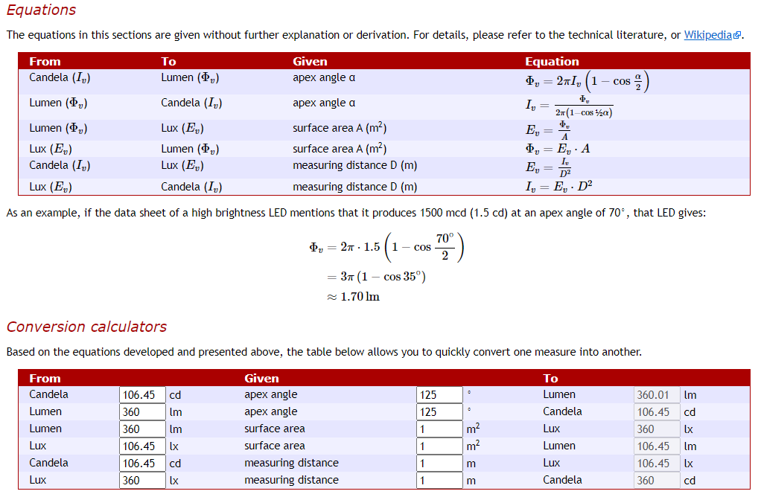
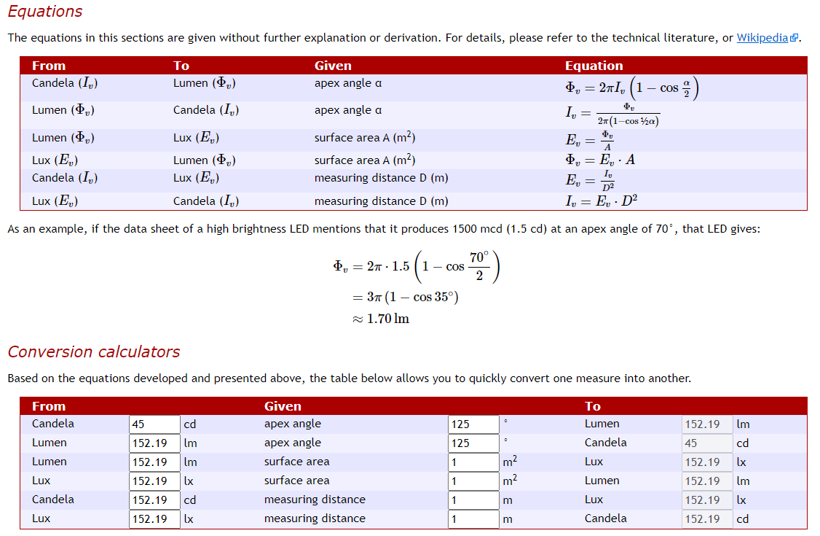
ANNEX #1: Candela, Lumen, Lux: the equations
References:
https://www.compuphase.com/electronics/candela_lumen.htm

Slide 13
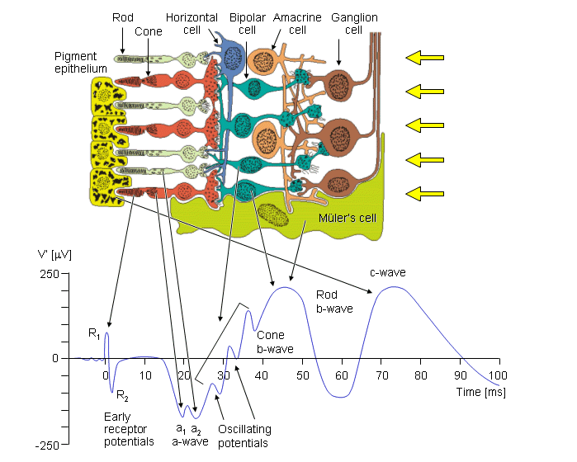
ANNEX #2: ELECTRORETINOGRAM – Eye temporal impulse response
Fig. 28.6 The cells of the retina and their response to a spot light flash. The photoreceptors are the rods and cones in which a negative receptor potential is elicited. This drives the bipolar cell to become either depolarized or hyperpolarized. The amacrine cell has a negative feedback effect. The ganglion cell fires an action pulse so that the resulting spike train is proportional to the light stimulus level.
The earliest signal is generated by the initial changes in the photopigment molecules of the photoreceptors due to the action of the light. This usually gives rise to a positive R₁ deflection followed by a negative R₂ deflection, together making up the early receptor potential (ERP). This is followed, after around 2 ms, by the late receptor potential (LRP) mentioned earlier, which (combined with the remainder of the ERP) forms the main constituent of the a-wave, a corneo-negative waveform (see Figure 28.6). Both rods and cones contribute to the a-wave; however, with appropriate stimuli these may be separated. For example, a dim blue flash to the dark-adapted eye results in a rod ERG, whereas a bright red flash to a light-adapted eye results in a cone ERG.
References:
The Electric Signals Originating in the Eye: https://www.bem.fi/book/28/28.htm

