Slide 1

May 2021
P R E S E N T A T I O N O F
INTERNATIONAL ORGANIZATION OF MOTOR VEHICLE MANUFACTURERS
Considerations on Future Road Traffic Noise Regulations
Status of Vehicle Sound Emission Regulations and
their Contribution to lower Environmental Noise

Slide 2
Objective
Environmental noise is a society pressing important problem and OICA is well aware about the need to implement effective and efficient measures to reduce environmental noise.
The presentation provides background information to explain and justify industry’s position towards a future development of UN R51.03, especially regarding phase 3 limits and eventual enforcement considerations beyond phase 3 limits.
The technical basis for this assessment is a forecast from today’s situation into a future based on vehicles compliant with phase 2 limits and conformity with RD-ASEP.
More detailed analysis is in preparation based on databases established by ACEA in 2010 and OICA in 2020 on type approval of vehicles and by the ongoing ACEA study from which we expect interim results for the next GRBP in September 2020.

Slide 3
OICA Position on Future Limits and Regulation Enforcement
OICA does not expect a meanigful contribution of phase 3 limits of UN R51.03 to lower environmental noise.
OICA suggests to subject UN R51.03 Phase 3 limits and EU 540/2014/EC to a moratorium.
  Manufacturers have already started to prepare for Phase 3 limits and more products coming to the market which will be close to phase 3 limits.
  Automotive Industry is in a transient towards new technologies and faces conflicts in handling the politically request technology change towards electric mobility. Electric vehicle compliance with Phase 3 limits is not assured for all vehicles.
  Phase 3 limits interfere in product planning and will lead to “short-run” interim products design, with great restrictions to become cost efficient.
Research is needed to solve pending issues
  Tyres face a double regulation of their rolling sound emission by UN R51.03 and UN R117.02. What is the interdependency?
  What is the future contribution of EVs towards lower environmental noise, as their power train sound emission is primarily defined by the minimum sound requirements on UN R138.01.
  Optimization of uncertainties of 3rd octave measurements for minimum sound in UN R138.01 might provide further potentials to design more quiet AVAS systems.
OICA supports the completion of RD-ASEP
  We agree to an introduction of the revised requirements as outlined by the IWG ASEP to further optimize the effectiveness of UN R51.03 / UN R51.04.

Slide 4
REPRESENTATIVENESS OF
UN R51.03 ANNEX 3
VIA SOUND MODELLING

Slide 5
Objective
UN R51.03 was designed between 2002 and 2010 and provides three phases of limit compliance, over almost 10 years between 2016 and 2027, to enable to industry a long-term development plan.
  Are the type approval test procedures of UN R51.03 Annex 3 still representative of urban conditions?
  Is the selected test road according to ISO 10844:2014 suitable for the future?
The analysis is mostly based on the Sound Expectation Model under development in the IWG ASEP for M1/N1 vehicles in combination with real driving cycles data of vehicles.
For heavy commercial vehicle N2/N3 a simplified model has been used to enable global traffic simulations
The models enable to
  Analyze the sound emission of vehicles at conditions representative for urban and motorway conditions
  Analyze the part source composition at various operation conditions of the vehicle categories.
  Investigate the potentials of RD-ASEP.
  Explore further potentials towards more quiet vehicles by Regulation enforcement

Slide 6
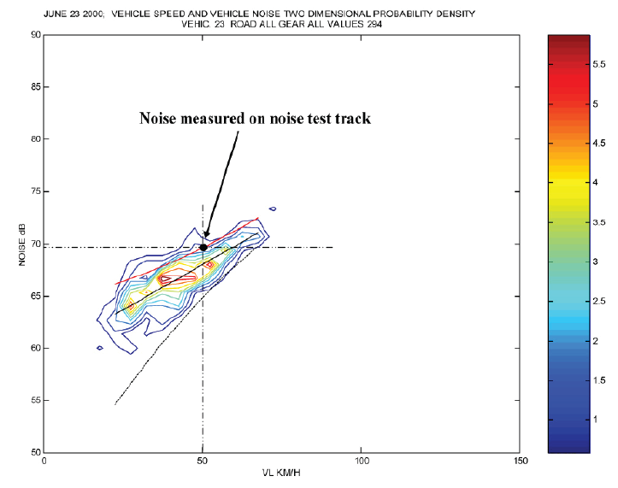
The actual scope of UN R51.03 is Based on the Statistical background of ISO 362-1 on the Representativeness of the Test Method
Excerpt of ISO 362-1 Annex A (informative):
“The measured sound pressure level corresponds to the 90th percentile of the maximum noise emitted during the acceleration phases in urban traffic.
The method provides excitation of all significant vehicle noise sources to provide the 90th percentile estimate of a vehicle’s noise emission in an urban environment.
This method takes into account real driving behaviour, which depends on the acceleration potential and on the power-to-mass ratio of a vehicle.”
Source: ISO 362-1 Informative Annex A

Slide 7
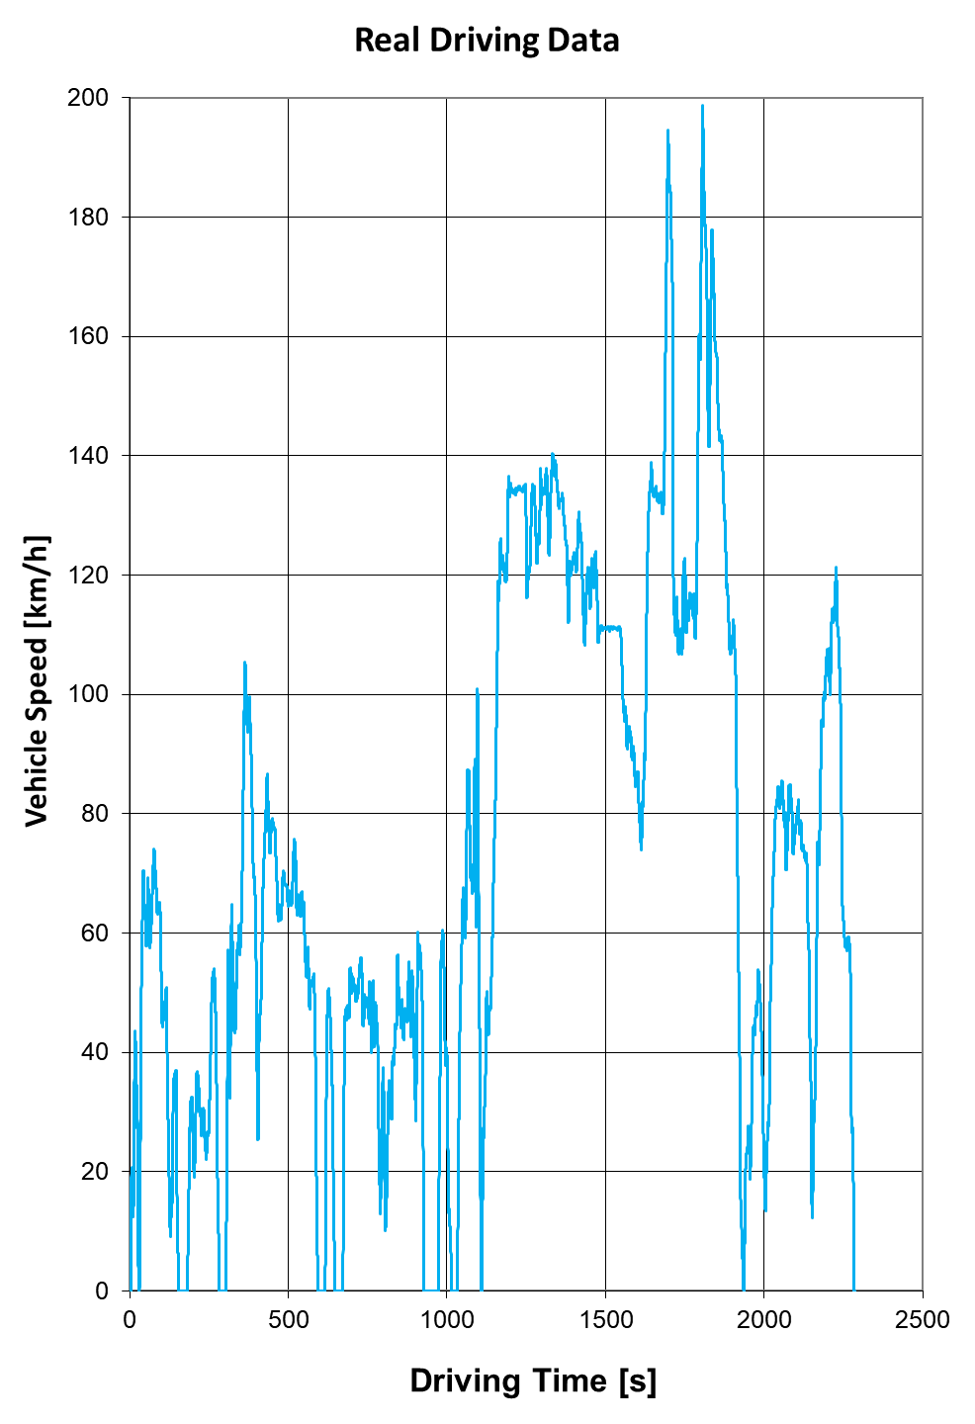
Real Driving Cycles
Driving data have been gathered by ISO project groups for purposes different of exterior noise.
  Vehicles have been equipped with data storage systems to record vehicle speed and engine speed while driving.
  The vehicles have been operated in cities, suburban and rural conditions, and on motorways.
  Various driving styles have been reported, to enable an analysis of the driving style on the sound emission of the vehicle.
Such data can be linked to the RD-ASEP Sound Expectation Model to estimate the sound emission L(t) of the vehicle representative for a distance of 7.5 m as function of time.
The model enables determination of the maximum sound level L_{max} of the whole cycle, the average sound emitted by the vehicle L_{A,eq} and even a statistical distribution curve of the emitted sound.
Source: ISO WG 42 Project Group on ISO5128

Slide 8
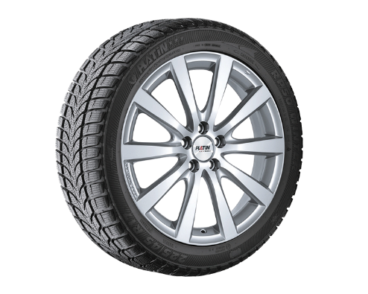
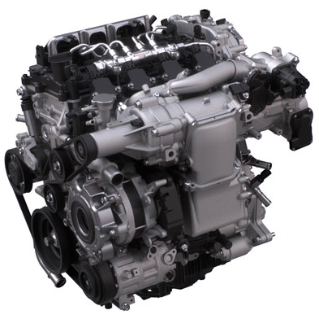
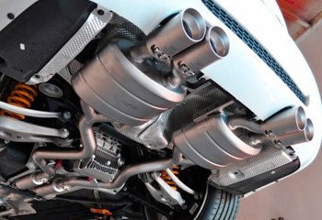
RD- ASEP Based on a Sound Expectation Model (SEM)
The IWG-ASEP is working since 2017 on an assessment method for M1/N1 vehicles to improve the 2016 implemented ASEP provisions of Annex 7 of UN R51.03.
The RD-ASEP SE-Model can predict the sound under almost any driving condition based on type approval test result of UN R51.03 Annex 3. The RD-ASEP model splits the measured sound into 3 part sources:
Tyre
Base Mechanic
Dynamic
1
2
3
Source: Pictures indicative, various sources of the internet
An expectation behaviour based on physical principles is assigned to each part source over its operation range. For every operation condition defined by vehicle speed, engine speed, load and performance an expected sound level L_{EXP}(v, n, a, v_{x}a) can be calculated.

Slide 9
Assessment Possibilities
By combining the Sound Expectation Model with Real Driving time data, it is possible to analyze segments of a driving cycle to focus on specific situations
  Urban conditions ➔ v < 55 km/h
  Residential areas ➔ v < 30 km/h
  Suburban and rural conditions ➔ 30 km/h < v < 80 km/h…100km/h
  Motorways ➔ v > 80 km/h
It is possible to focus on specific subcategories of vehicles and on the sound sources. It is possible to simulate different source compositions.
  Vehicle subcategories (M1-a, M1-b, …)
  Propulsion types (ICE, EV with or without AVAS)
  Road Surface Variations

Slide 10
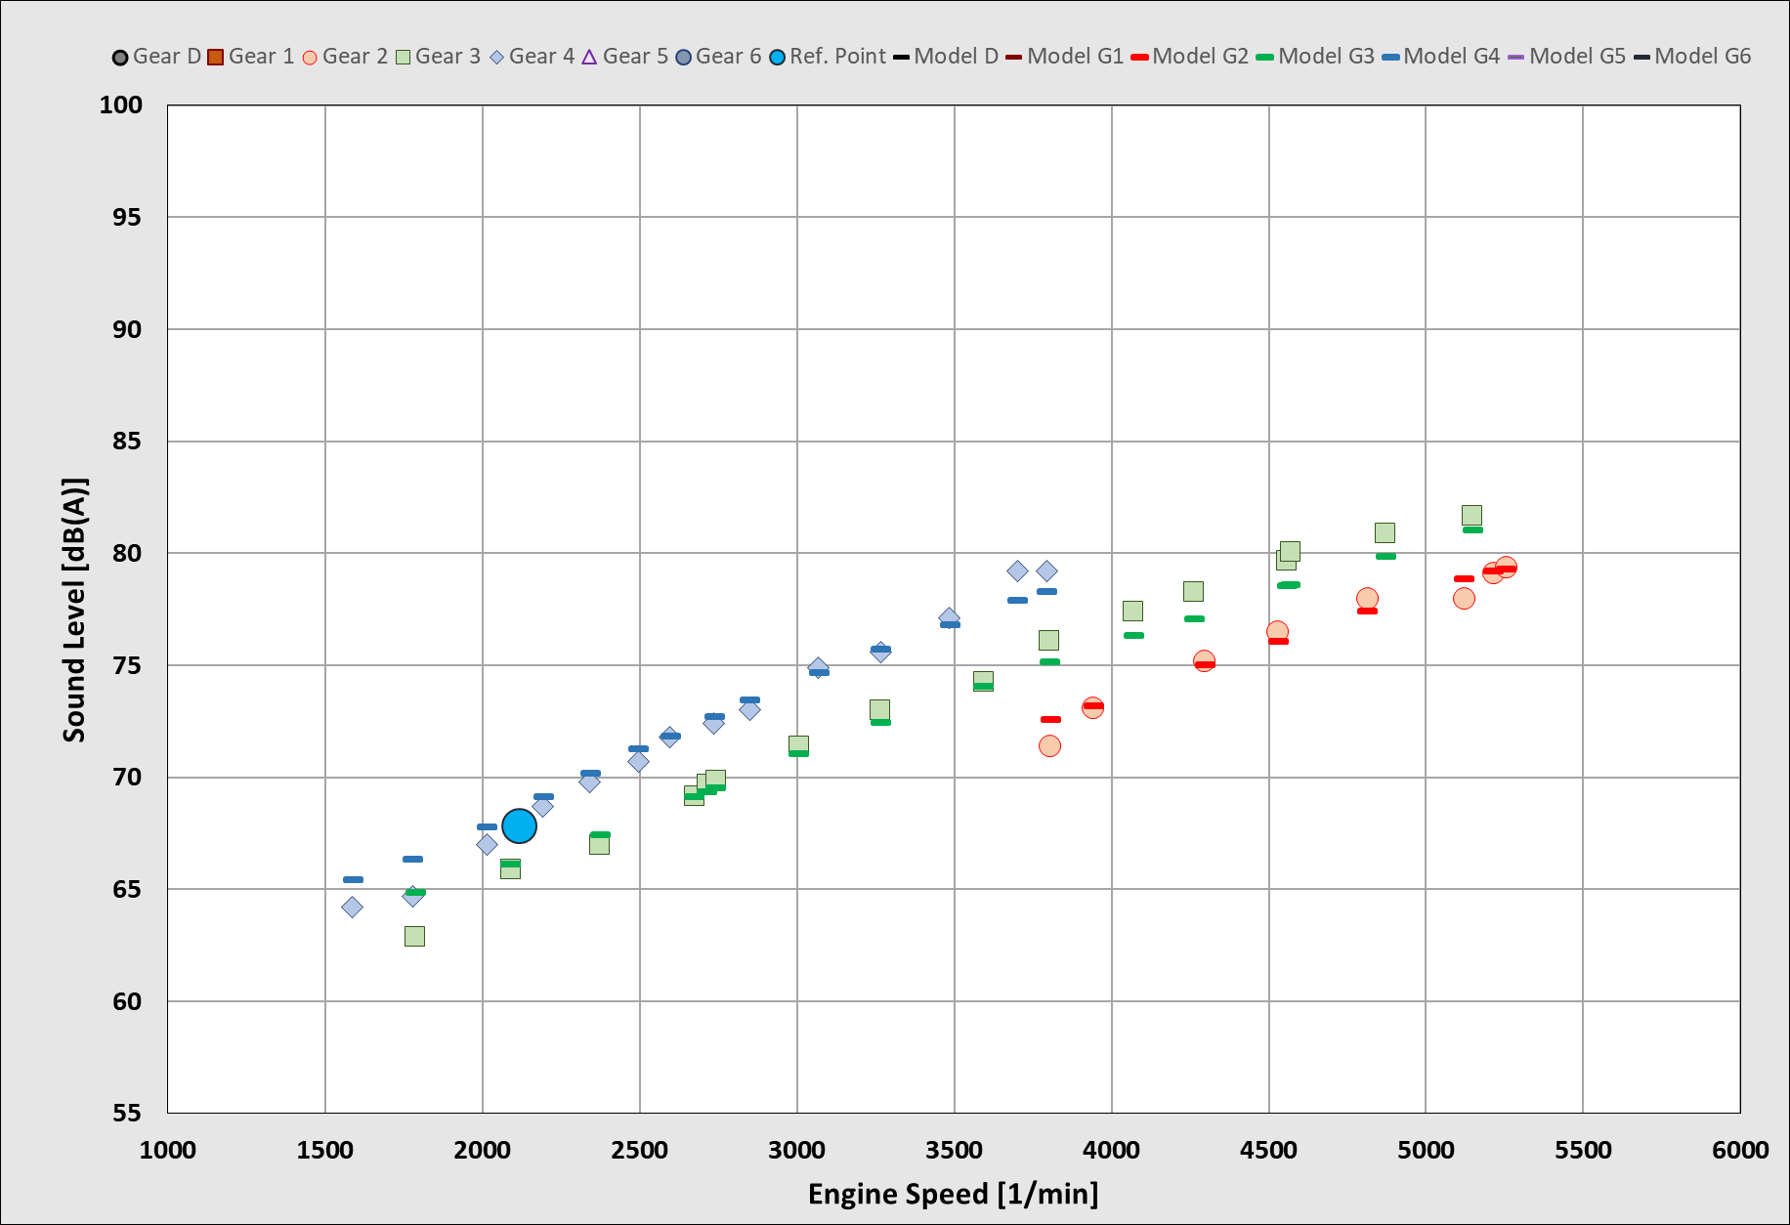
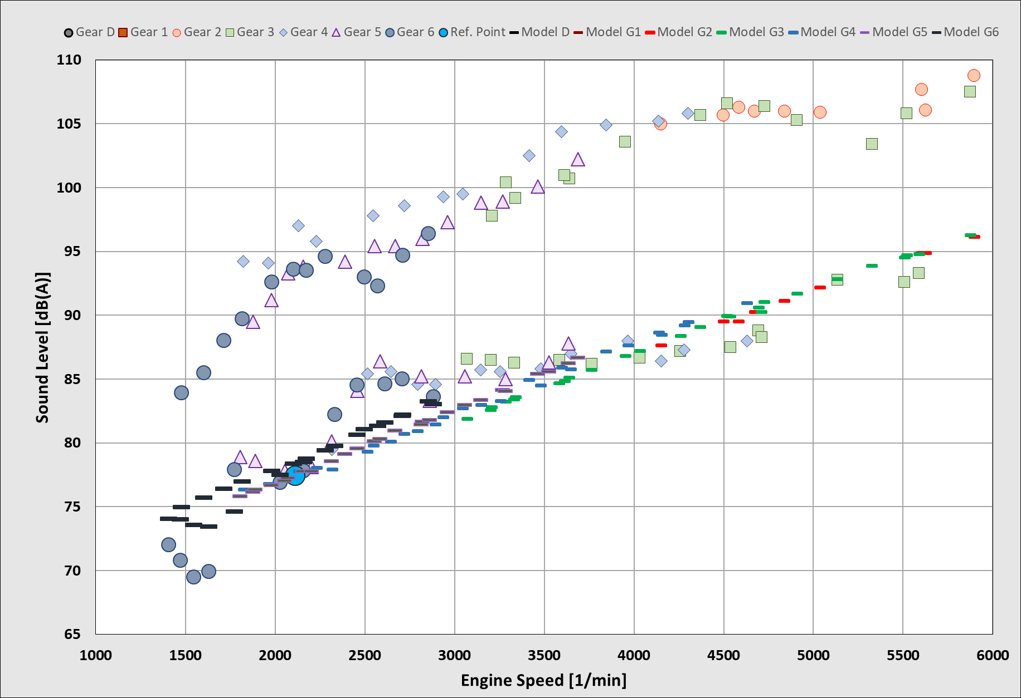
Expected Physical Sound Behavior – Examples
Vehicle No. 15
IWG ASEP Database
Vehicle No. 47
IWG ASEP Database
Vehicles with an unphysical behaviour are incompatible to the model.
This example shows a UN R51.02 approved with sound emission up to 15 dB(A) higher than the expected sound behavior.
The SEM covers almost all driving conditions. Once introduced on a mandatory basis all M1/N1 vehicles can be described by this model. Sound deviations as shown on the right diagram will no longer be feasible.

Slide 11
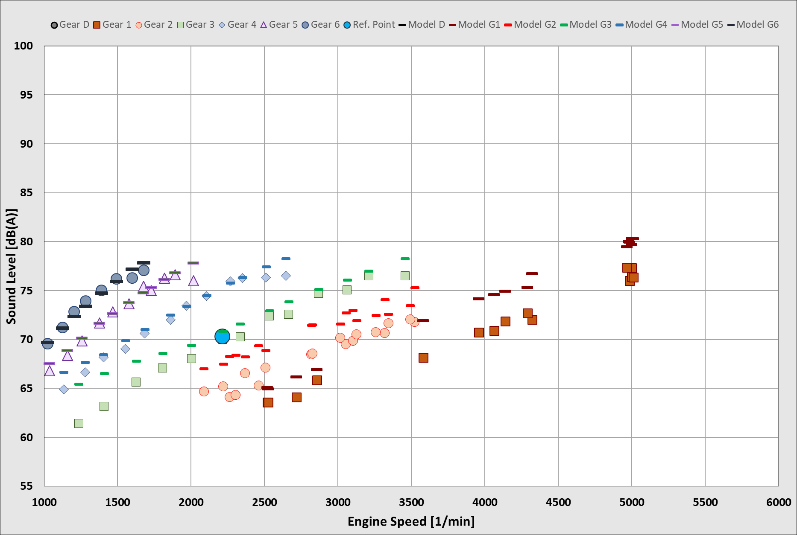
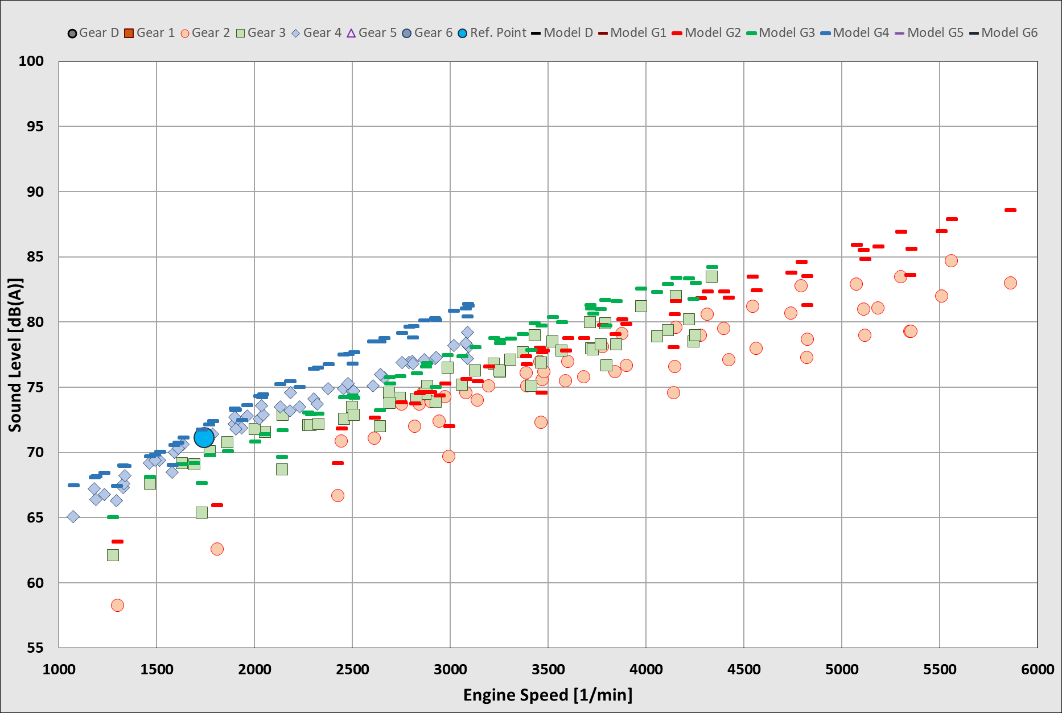
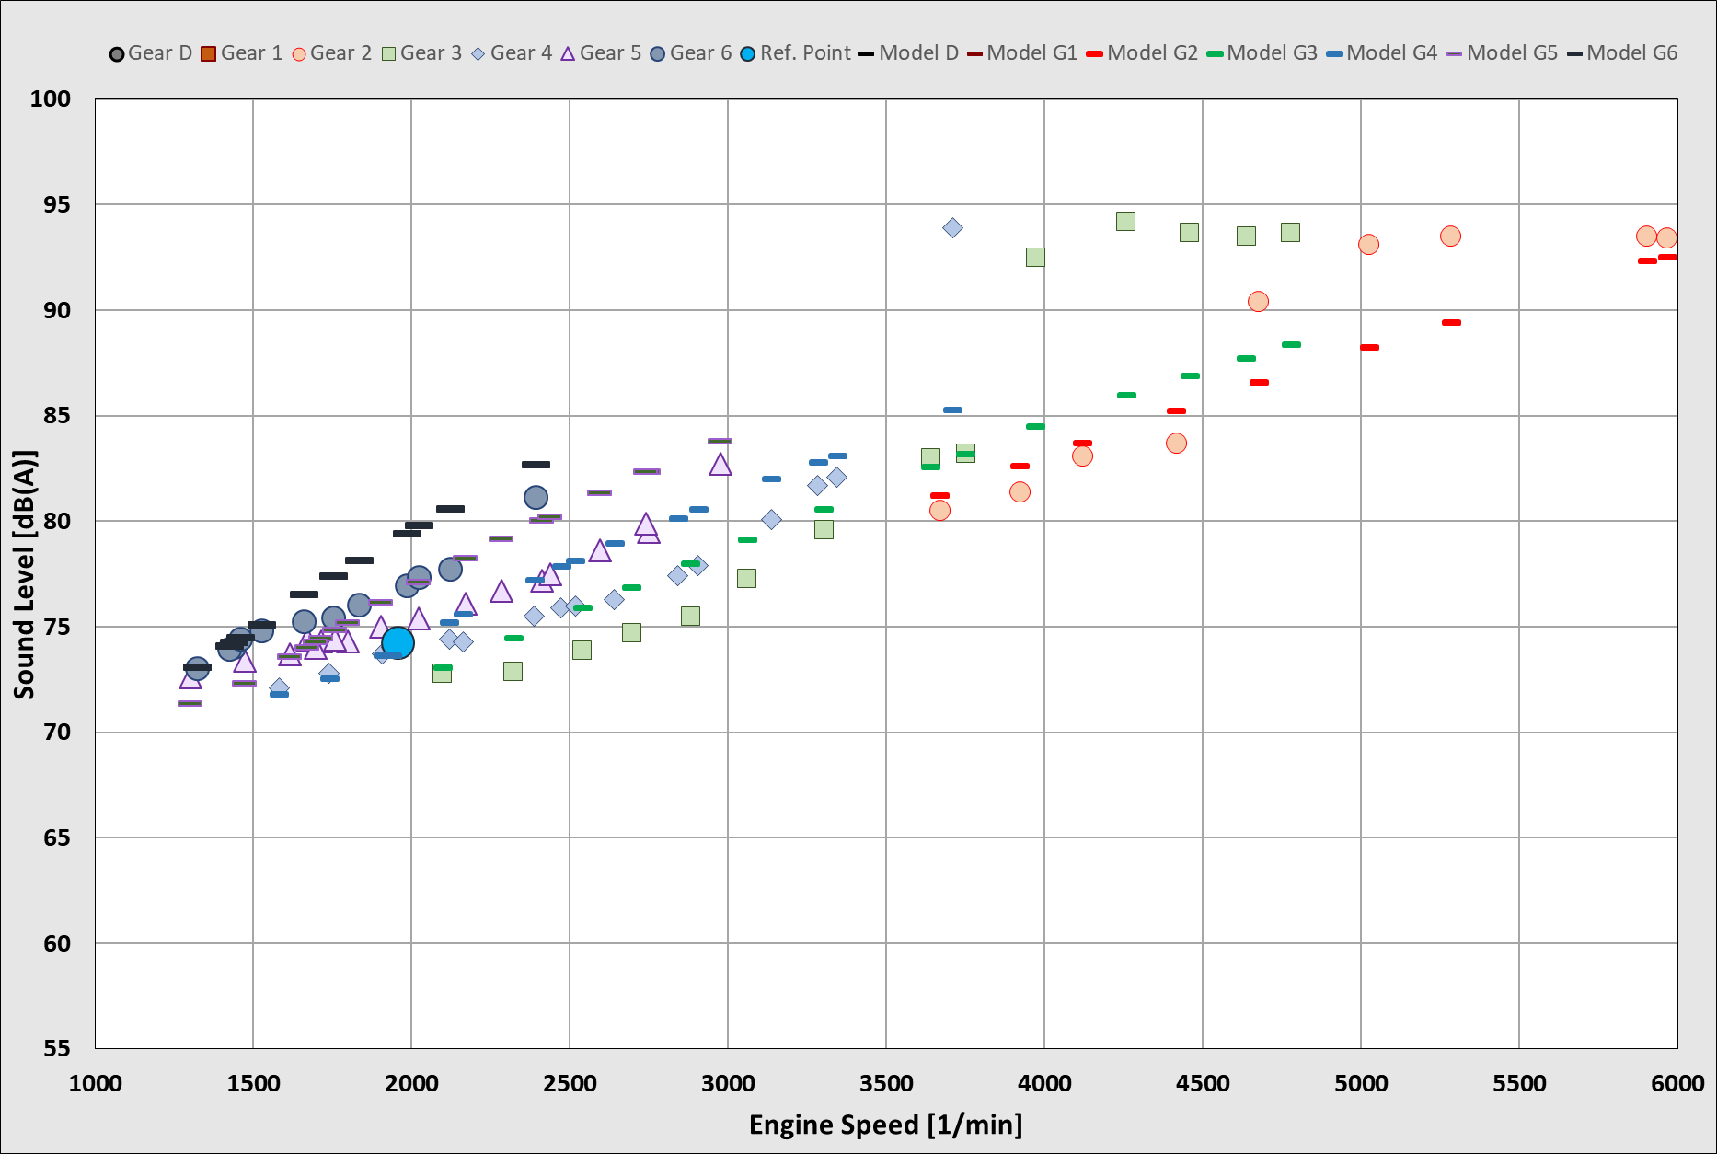
Vehicles Selected for this Investigation
The Informal Working Group on ASEP works for the development of future ASEP provisions with a database to validate the RD-ASEP Model.
From this database, three vehicles have been selected:
Vehicle No 3 IWG ASEP Database
Vehicle Category M1-A
Vehicle No 11 IWG ASEP Database
Vehicle Category M1-B
RD-ASEP
non-conform
Vehicle No 6 IWG ASEP Database
Vehicle Category M1-D
Standard Vehicle
Represents 97% market
Performance Vehicle
Represents 3% market
Top Performance Vehicle
Represents << 0.1% market
!
The study assumes, that vehicles will have to comply to this future RD-ASEP model. Deviations as occurring with the top performance vehicle are not allowed.

Slide 12
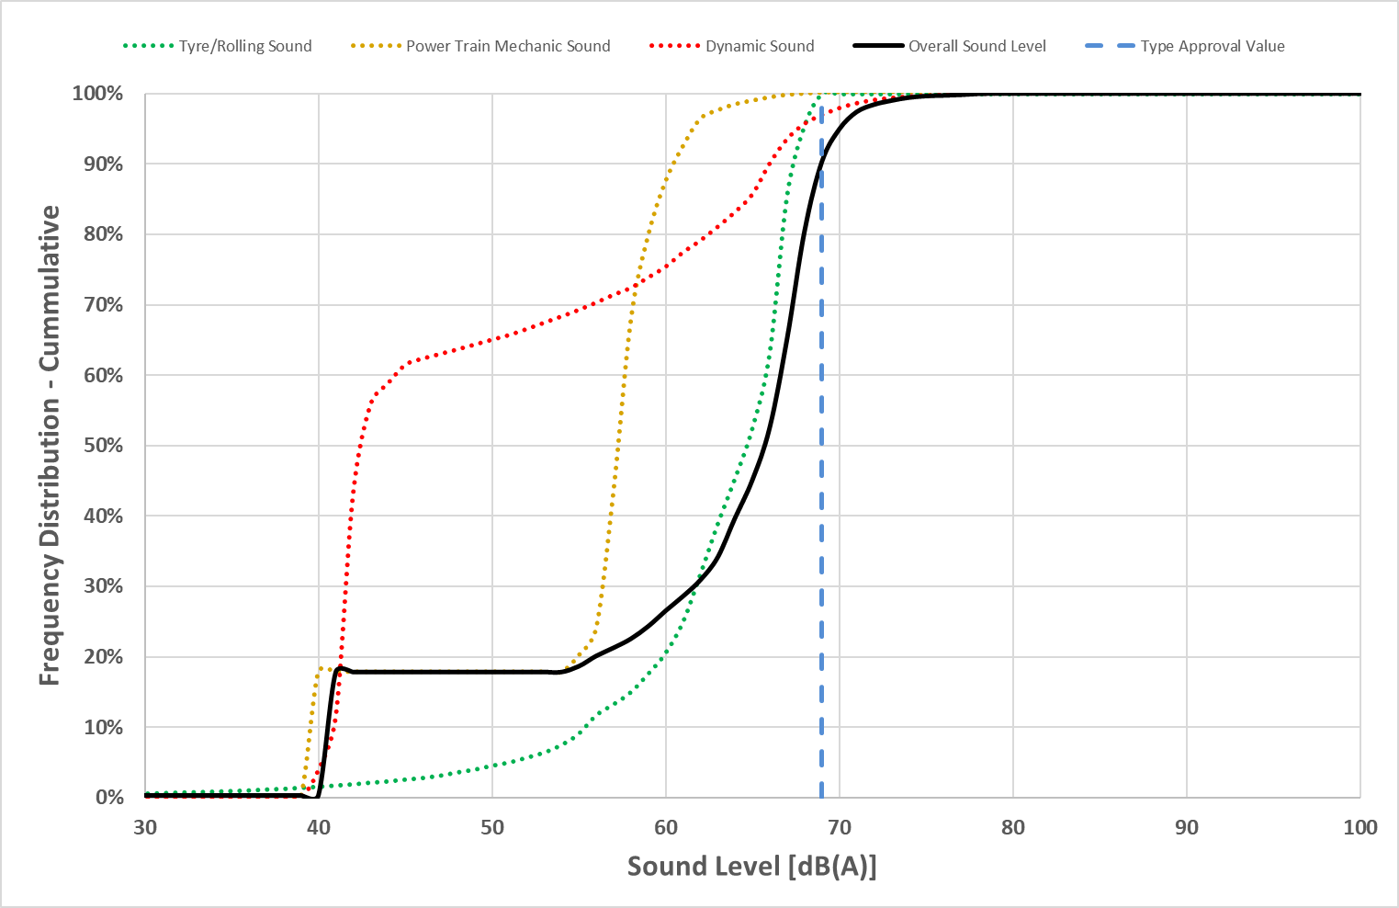
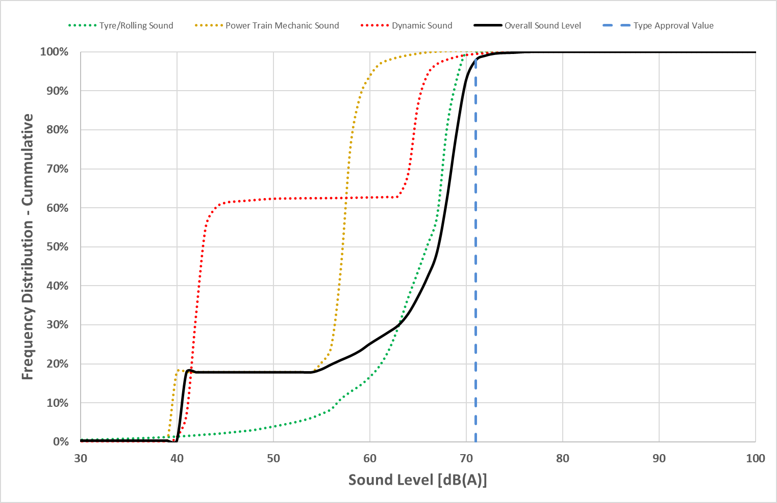
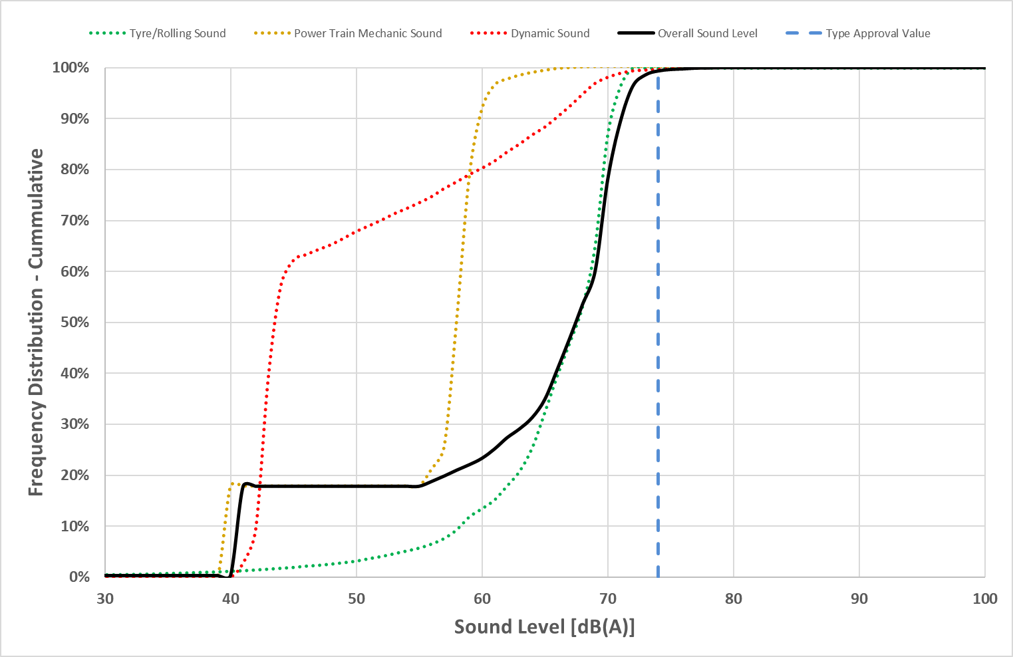
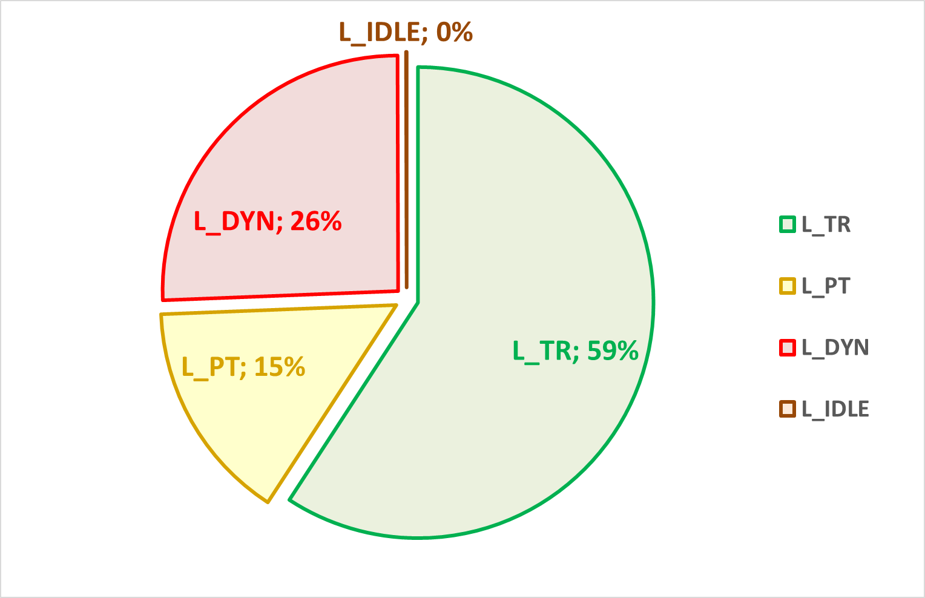
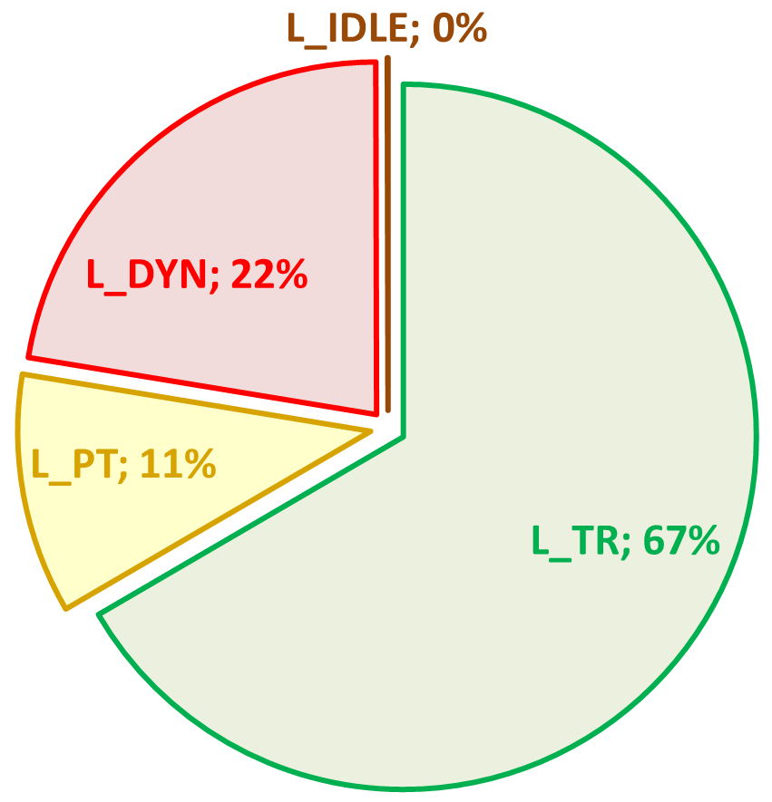
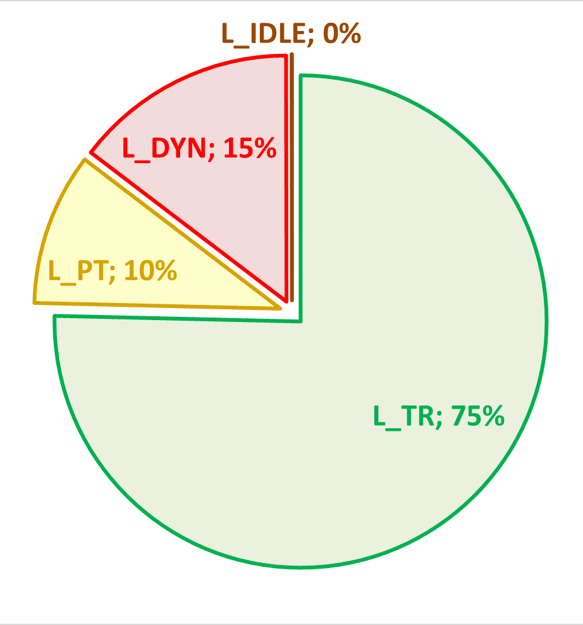
Sound Level Part Source Analysis M1 vehicles (Various PMR)
97% market share
<3% market share
L_{max} = 77 dB(A)
<0.1% market share
L_{max} = 79 dB(A)
L_{max} = 79 dB(A)
L_{A,eq} = 66 dB(A)
L_{A,eq} = 67 dB(A)
L_{A,eq} = 68 dB(A)
L_{A,eq}
L_{A,eq}
L_{A,eq}
L_{urban}
L_{urban}
L_{urban}
Limit = 70 dB(A)
Limit = 71 dB(A)
Limit = 74 dB(A)
Vehicle No: 3 / 801
Vehicle No: 12 / 601
Vehicle No: 6 / 501
The differences between the vehicles are small for the parameters L_{max} and L_{A,eq}.
The type approval values L_{urban} represent at least 90% of the sound emitted.
The average sound L_{A,eq} is at least 3 dB lower than the type approval value L_{urban}.
Tyre rolling sound is the dominant sound.

Slide 13
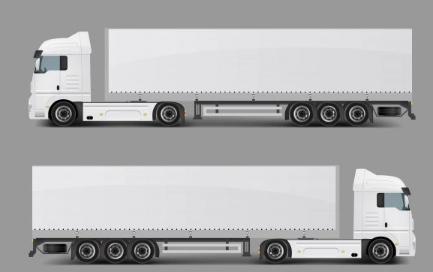
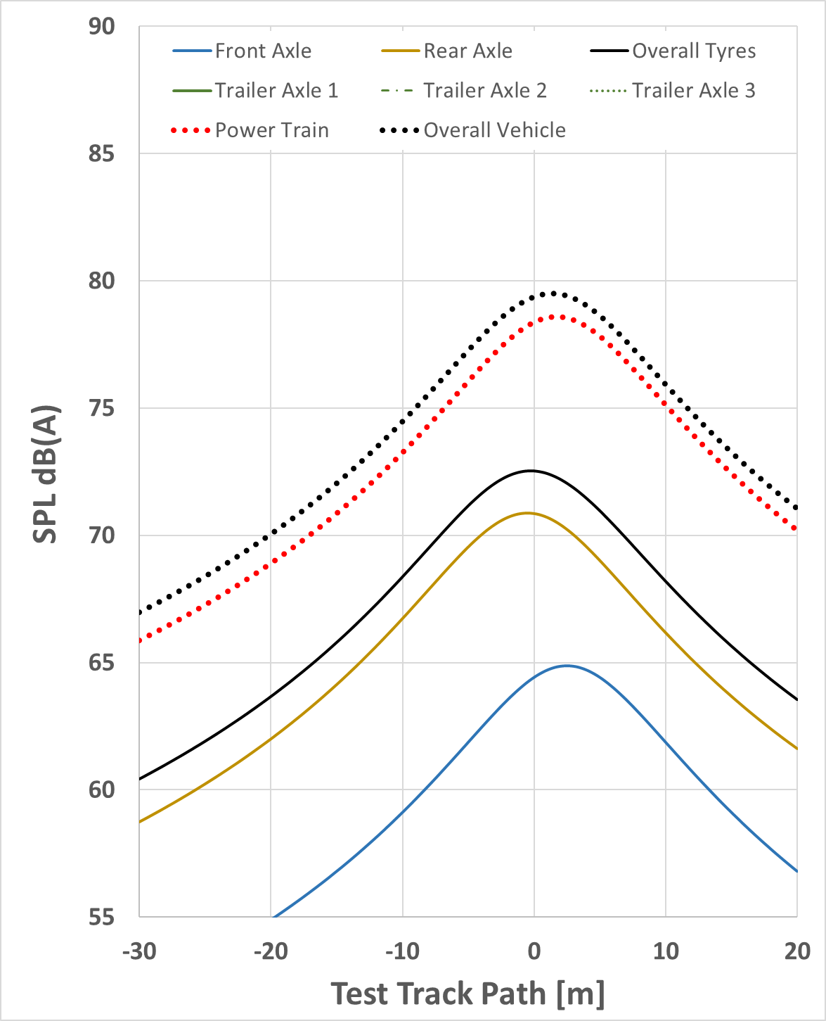
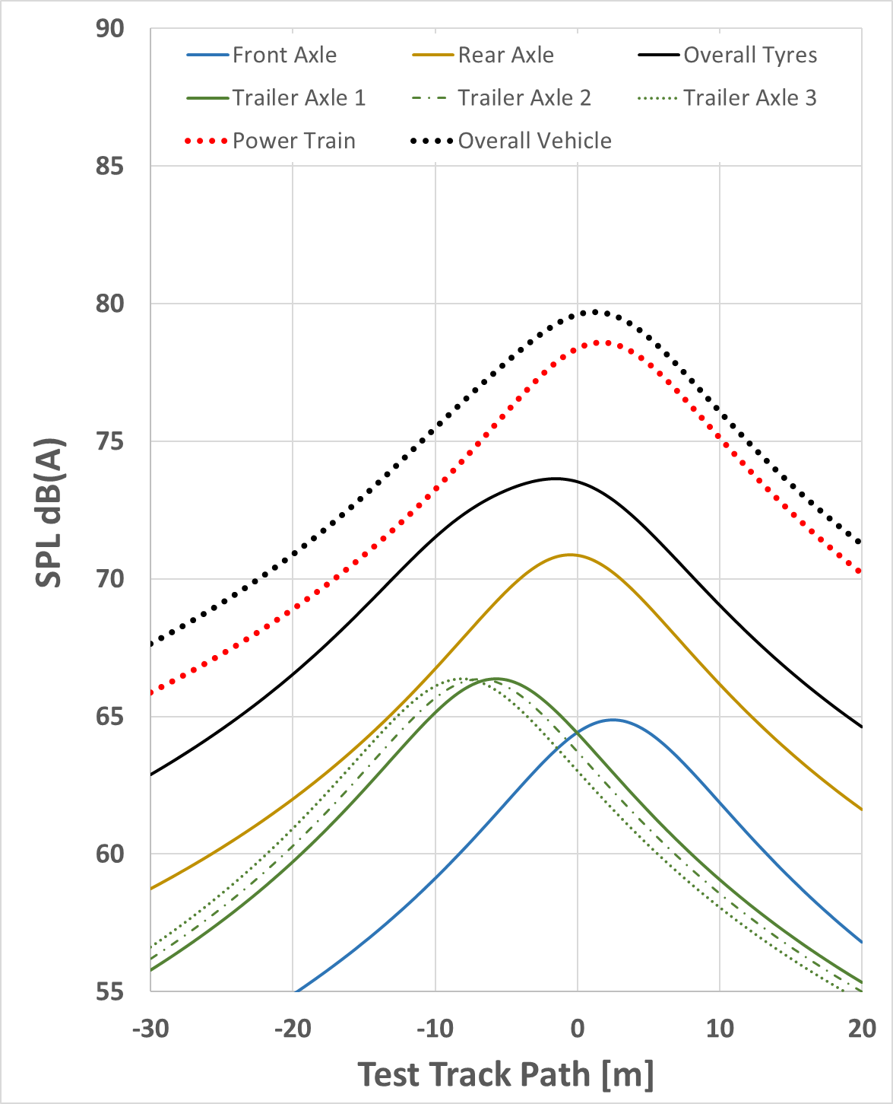
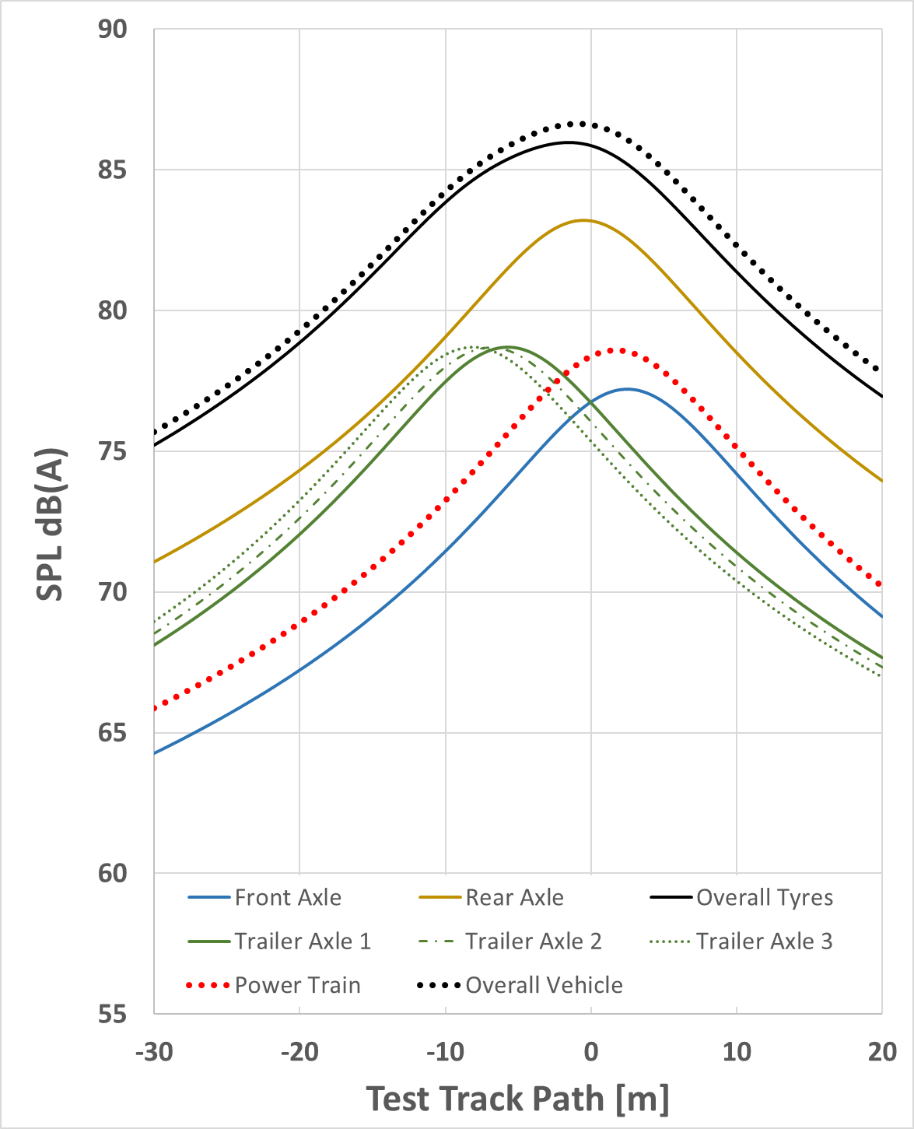
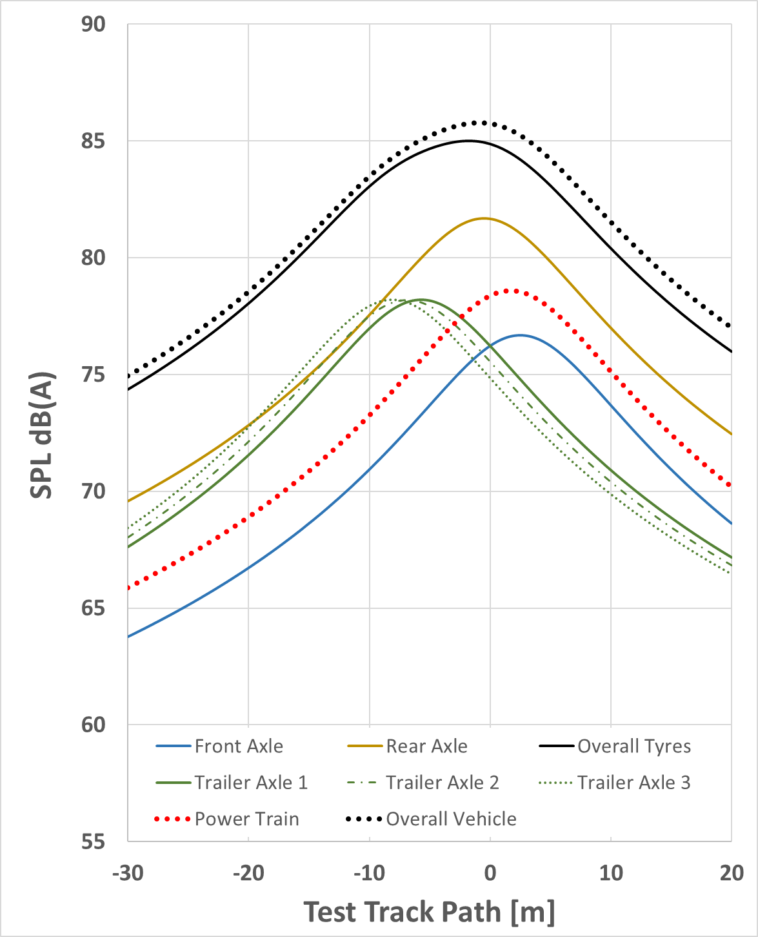
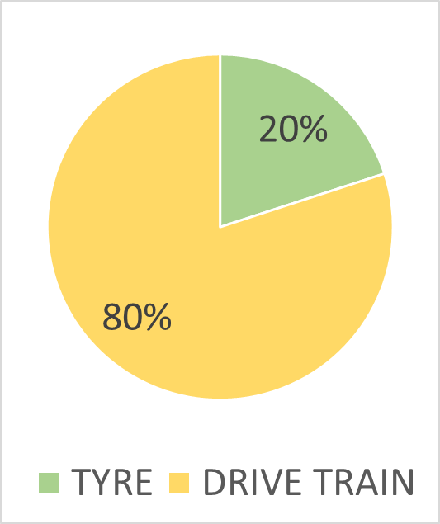
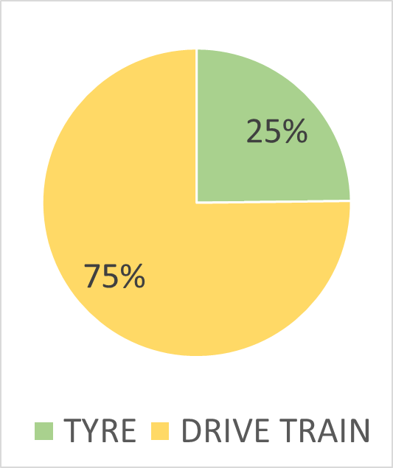
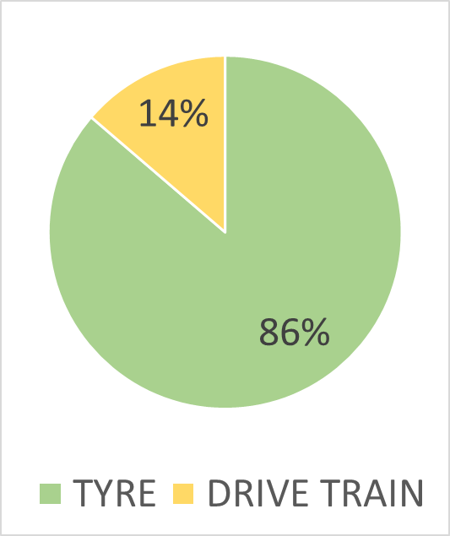
Sound Level Part Source Analysis N2 and N3 vehicles
m_{x,load}
Type Approval Condition
Real Urban Condition
Motorways
35 km/h
35 km/h
85 km/h
UN R51.03 test condition for trucks is focusing on power train testing which is compatible to real urban driving.
Power train noise reduction would make HDV vehicle more quiet as single event in an urban environment, but these vehicles are rarely seen in urban environments and thus do little contribute to urban noise.
On motorways the tyre rolling sound becomes the dominating source for the overall sound emission.

Slide 14
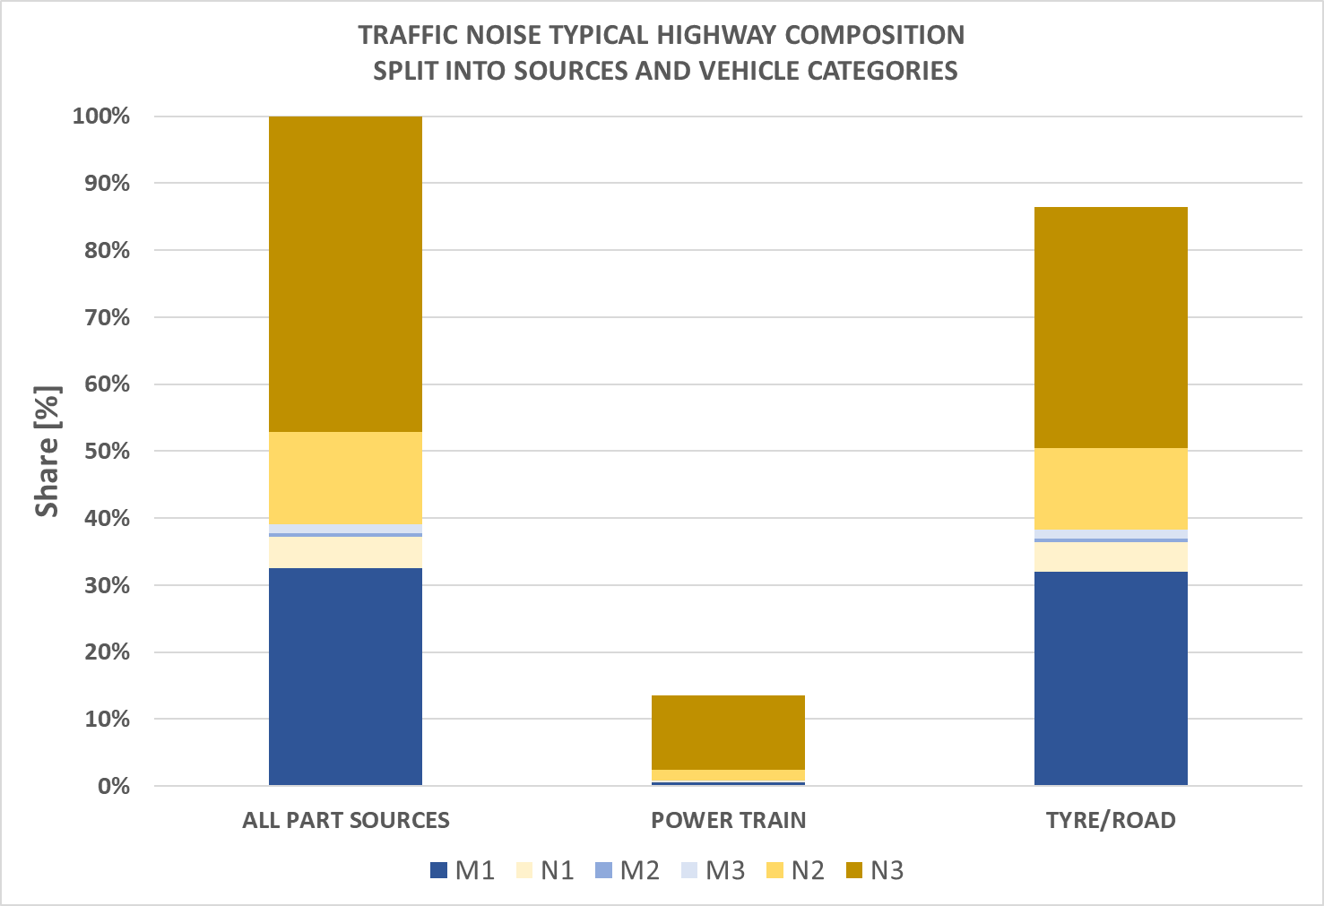
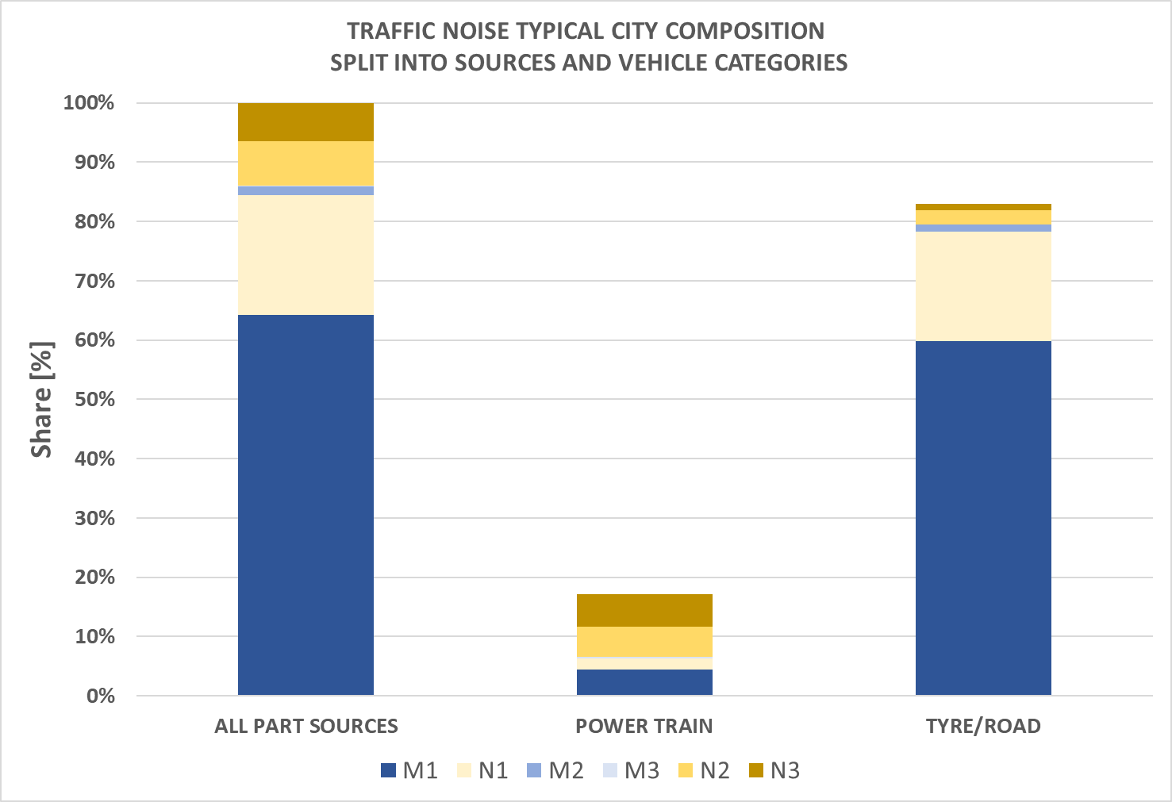
Sound Level Part Source and Vehicle Category Analysis – URBAN AREA
M1 and N1 vehicles:
  Tyre rolling is the predominant source. Could be addressed via UN R117.
  Power train sound share is low, further optimization will not provide progress.
  Single Events require a separate consideration.
N2 and N3 vehicles:
  Big trucks are rarely seen in urban areas.
  Power train sound is higher compared to other vehicle categories, but less important compared to tyres.
  Lower limits for trucks will have little impact in urban conditions.
M2 and M3 vehicles:
  Do not contribute to Leq traffic noise in a significant way. Are relevant to single event consideration
City Main Street: 20.000 vehicles per day with 1% HDV
Traffic Noise Based of Flowing Traffic in Cities
(without Single Event Contribution)
Source: OICA 2021 internal calculations

Slide 15
Sound Level Part Source and Vehicle Category Analysis – MOTORWAYS
Motorways Scenario: 50.000 vehicles per day with 13% HDV
Traffic Noise Based of Flowing Traffic on Motorways
(without Single Event Contribution)
Tyre rolling sound is the dominant for all vehicles categories on motorways.
Truck tyres are not covered by UN R51.03
With a share of 10%-15% of heavy commercial vehicles on motorways during daytime, trucks create the major source for environmental noise.
Powertrain sound from trucks contributes little to the overall sound situation.
Lower powertrain limits for trucks will not result in a comparable improvement on highway situation.
Source: OICA 2021 internal calculations

Slide 16
Conclusions
Although UN R51.03 (Annex 3) has been designed already in the years 2000-2005 based on real in-use driving statistics of the 1990’s and products representative for that time, the test procedure does still cover the urban relevant sound sources for all vehicle categories in a representative way.
The sound behavior under different driving situations is still covered by the test procedures of Regulation UN R51.03 for passenger cars.
  UN R51.03 ASEP has already brought a significant progress for the sound emission in driving situations other than type approval condition. RD-ASEP will further optimize ASEP.
  The major sound source on motorways is tyre rolling sound from truck tyres, which are not covered by UN R51.03.
UN R51.03 alone cannot cover environmental noise in a holistic way. Within the frame of the UN type approval system, more regulations address environmentally relevant sources
  AVAS for electric vehicles in urban areas
  UN R117 for especially C2 and C3 tyres (retreaded tyres?)
  UN R28 on the horn (see data analysis by BRUITPARIF)
  UN R59 for NORESS (Non-original replacement silencer systems)

Slide 17
SINGLE EVENTS
RD-ASEP

Slide 18
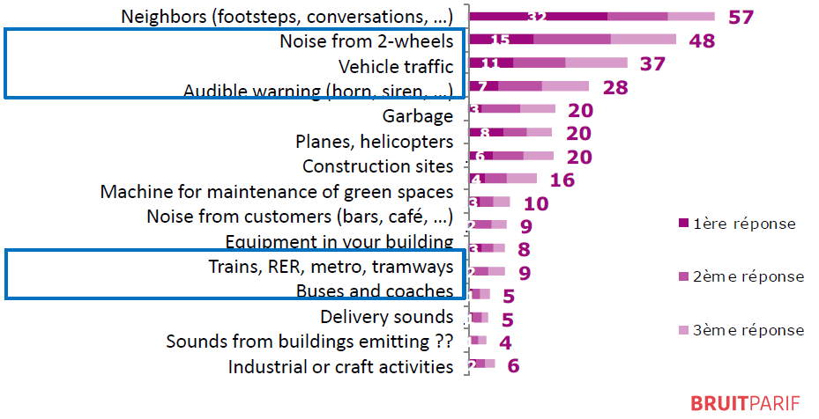
Single Events in the Environment
Noise annoyance from a single event is well known to everybody. Single events have very different natures, some are loud and of short time duration, others are long in time duration but less loud.
The perception of “annoyance” is context dependent and cannot be generalized.
Discussion about single events is difficult, as those are related to emotional positions, pushed by media and often enough controversially discussed.
WHO does not provide by now any recommendation, “as a relationship between single events and long-term negative health effects could not been proven”.
Single Events can have a sound emission that influences average noise indicators L_{A,eq} used for noise maps (like L_{den} for Europe).
SOURCE:
PRÉSENTATION DE BRUITPARIF « LE BRUIT ROUTIER DANS L’ENVIRONNEMENT »
COMMUNAUTÉ D’EXPERTS NVH, SIA, 4 OCTOBRE 2019
The vehicle sound emission regulation UN R51.03 shall ensure that type approved vehicles have a sound performance consistent with physics and in line with the type approved sound character.

Slide 19
Progress of UN R51 in Covering Single Event Related Sound Emission
Extremely Restricted

Slide 20
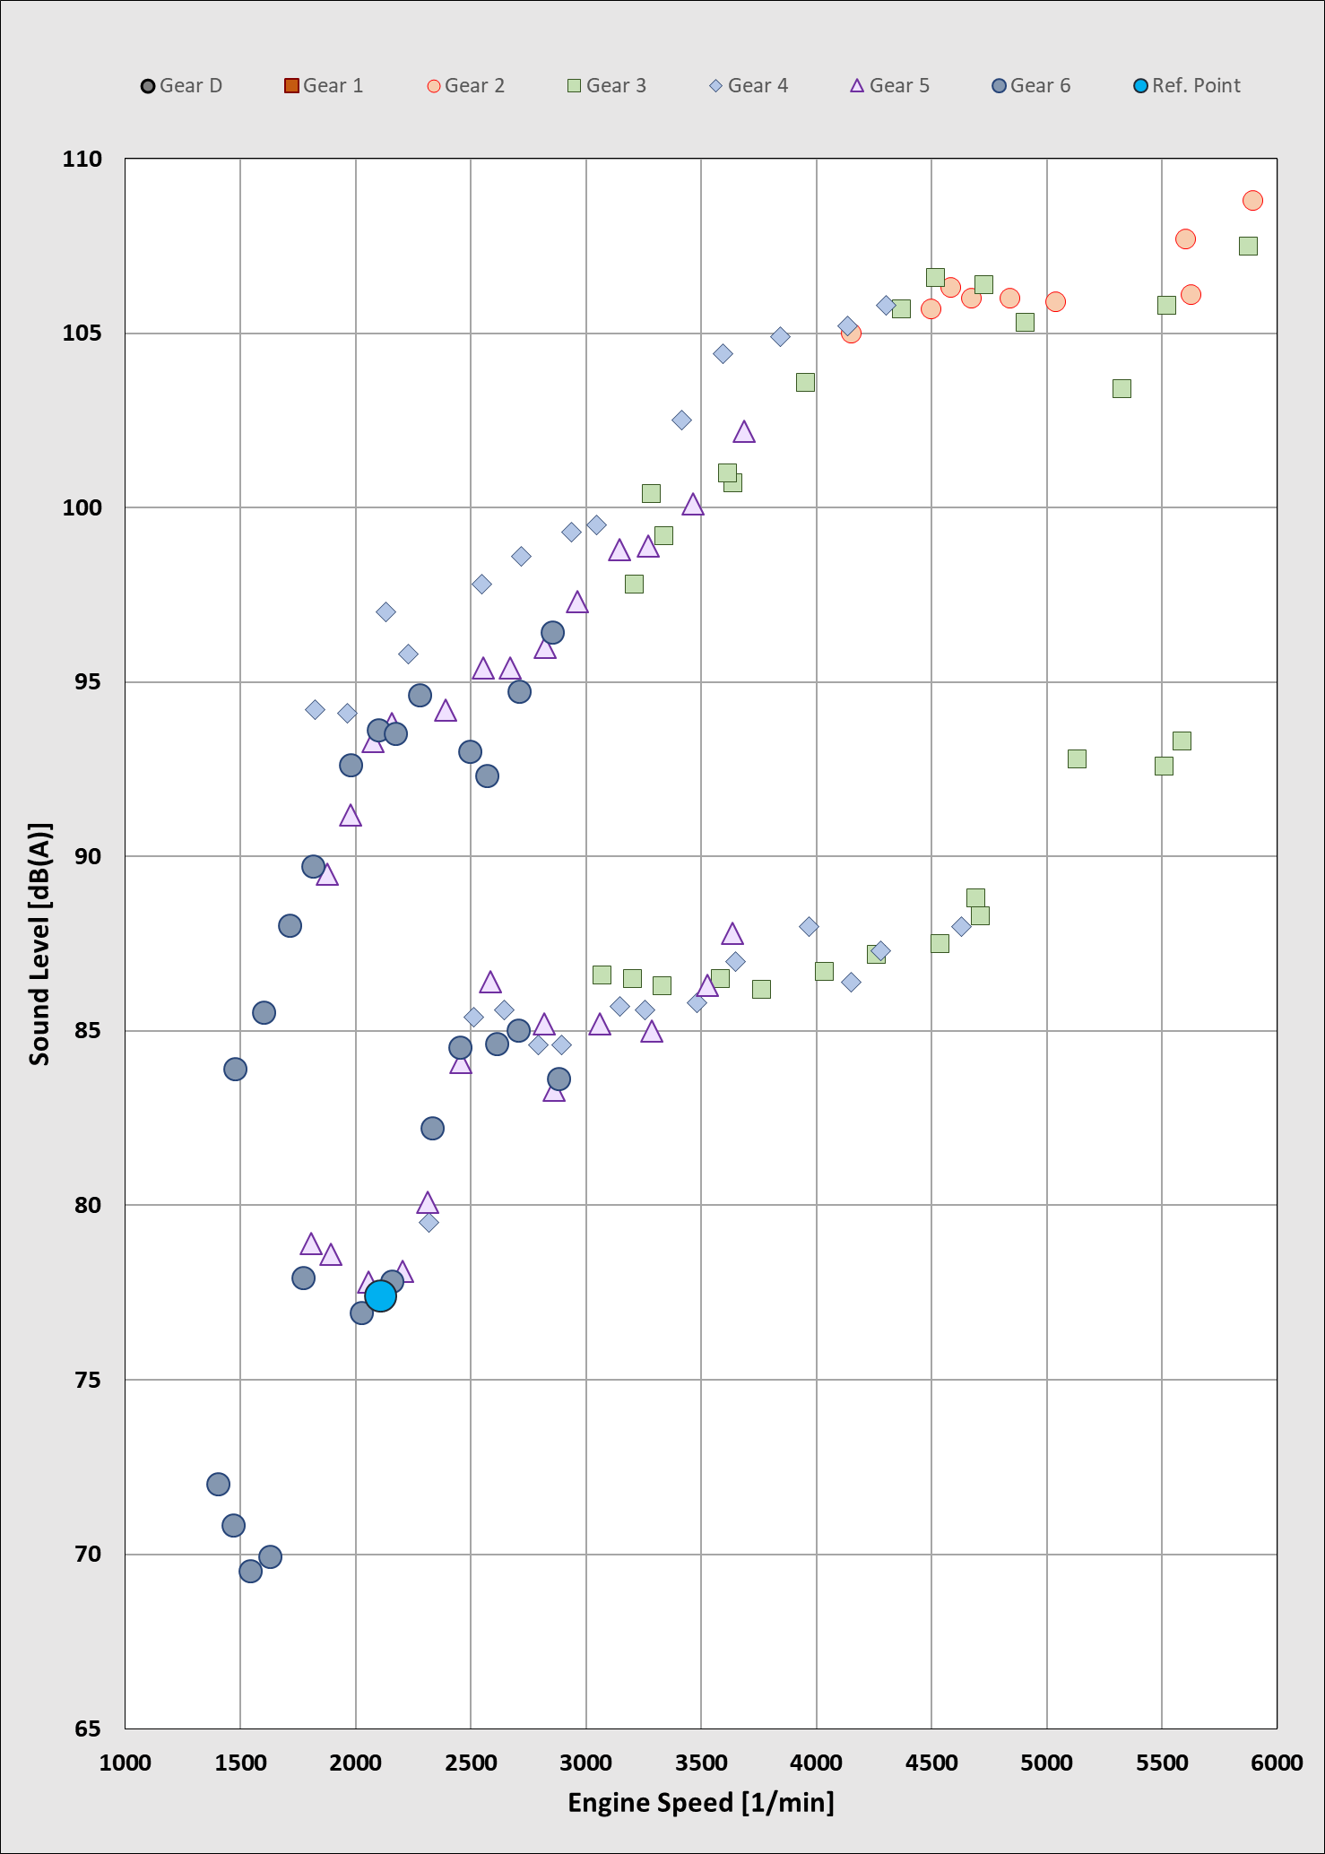
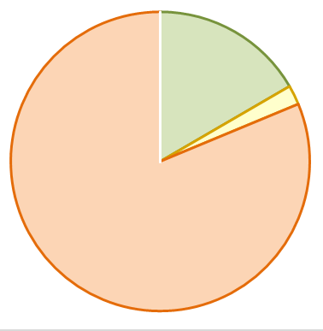
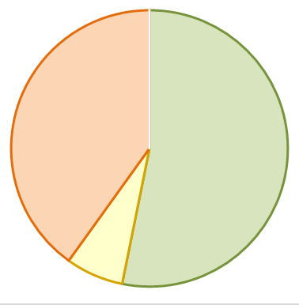
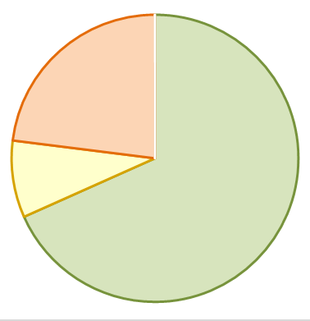
Sound Behaviour in Real Driving Under UN R51 Series
The IWG ASEP Database on vehicles provides as well examples, which can be used to simulate a sound emission compliant to the various series of amendments.
UN R51.02
Approved
UN R51.03
Conform
UN R51.04
Conform
Engine
SOURCE:
Diagrams based on real driving data
in combination with RD-ASEP Model
Exhaust
Tyres
L_{max} = 93,2 dB(A)
L_{A,eq} = 75,2 dB(A)
L_{max} = 86,7 dB(A)
L_{A,eq} = 70,1 dB(A)
L_{max} = 81,0 dB(A)
L_{A,eq} = 69,2 dB(A)
Vehicle No 47
IWG ASEP Database
The provisions on ASEP introduced with UN R51.03 provide already a good step forward, but RD-ASEP with its holistic approach will provide further progress especially on the maximum sound emission.

Slide 21
Sound Dynamic of EVs compared to ICE vehicles
Electric vehicles have a lower sound dynamic under high engine loads compared to ICE vehicles.
More pure electric vehicles in traffic will help to reduce potential annoyance as single event from vehicles under extreme driving conditions.
The public generally expects a quickly increasing market contribution of xEVs and a fade-out of ICE. However, among xEVs many HEVs will still be needed for long distance travelling.
RD-ASEP is the right interim solution, to make sure that vehicles perform as technically foreseeable from the type approval and their sound emission will be dynamic limited.

Slide 22
Conclusions on Single Events
UN R51.03 introduced extended requirements to cover not only urban driving situations, but as well other typical on road driving situations inclusive aggressive driving.
ASEP has brought already significant improvements and RD-ASEP will provide further improvements.
The UN Regulation R51 is a type approval regulation on original equipment.
  It cannot handle abuse of a vehicle and reckless driving behavior.
  It does neither address nor cover aftermarket parts, such as replacement tyres or silencers.
An increase of the market share of xEVs will help to reduce annoyance by single vehicles as their sound dynamic is much lower compared to combustion engine vehicles.
OICA does not support a fixed limit on all driving conditions nor a limit on the acceleration test result similar to UN R41.
  Both ideas are not technically justified and will not provide a substantial benefit for the environment especially when looking to the wide field of “single events”.

Slide 23
ELECTRIC VEHICLES (xEVs)
and AVAS

Slide 24
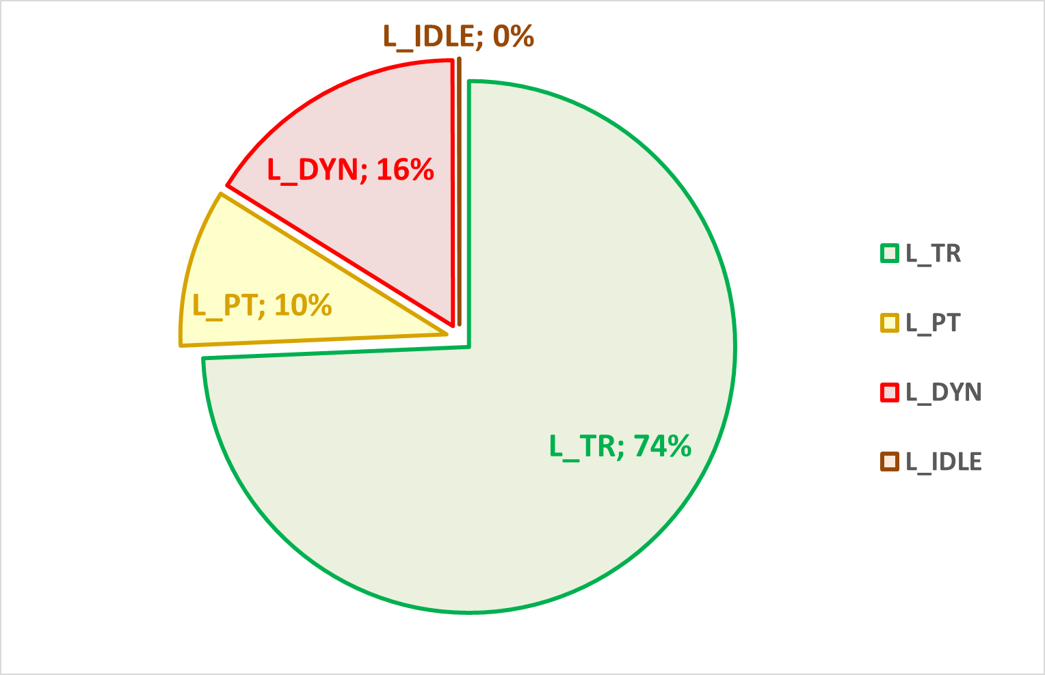
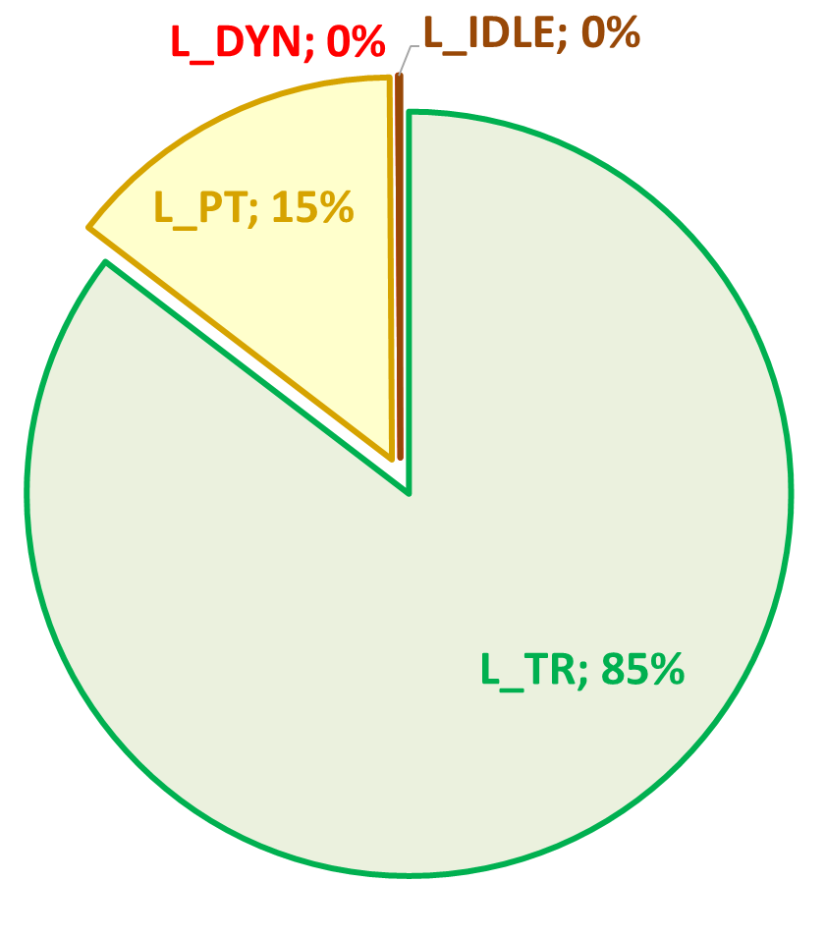
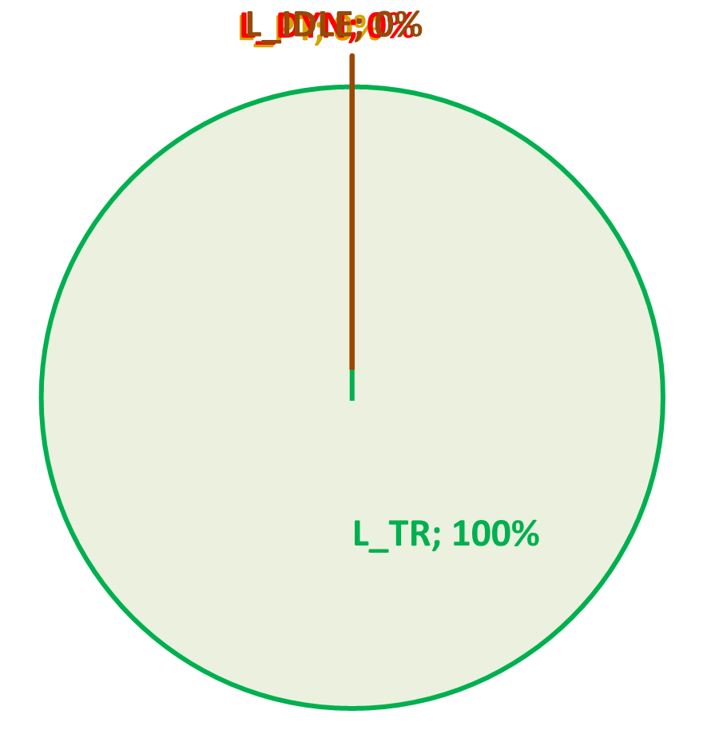
URBAN CONDITION (< 55 km/h) – Impact of Electric M1 Vehicles
ICE Vehicle have typically 25% power train contribution.
Completely removed…
Engine
However, power train noise is not ZERO for Electric vehicles (EVs).
AVAS determines the minimum “mechanical sound” of a vehicle
AVAS is needed in low vehicle speeds to alert pedestrians and cyclist.
Exhaust
Tyres
SOURCE:
Diagrams based on real diring data
in combination with RD-ASEP Model
L_{A,eq,SMA11}
68,1 dB(A)
L_{A,eq,SMA11}
67,5 dB(A)
L_{A,eq,SMA11}
66,8 dB(A)
A complete replacement of all ICE vehicles by electric vehicles (with AVAS) will in best case provide a benefit of 0,6 dB(A) for speed ranges below 55 km/h.
Even this is questionable given that xEVs have typically more rolling sound, because their heigher weight results in wider or extra load tyres.

Slide 25
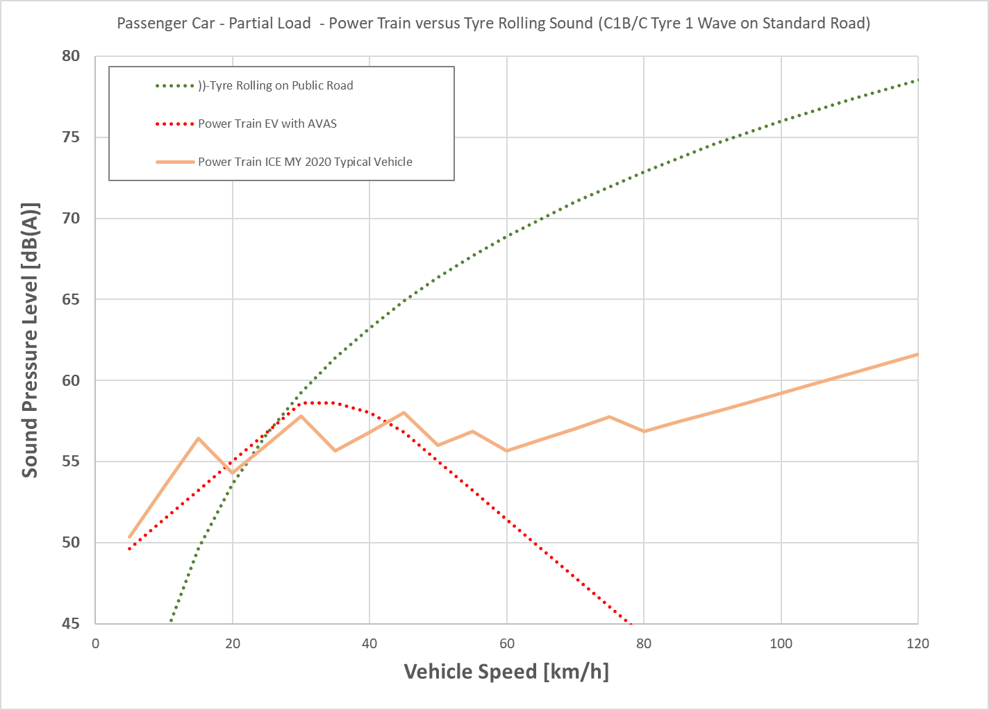
Electrically Driving Vehicle – Contribution to Road Traffic noise
UN R138 philosophy: At speeds up to 20 km/h (US: 32 km/h) AVAS is needed for recognition, above that speed tyres will ensure sufficient recognition.
Tyre rolling sound will not become significant different for EVs compared to ICE vehicles.
EVs will not change traffic noise in situations where tyre rolling sound is dominant.
Traffic in cities will in future mostly happen at speed up to 30 km/h due to speed limits, reduced lanes for motor vehicles to give way to alternative mobility and resulting traffic jams.
At low driving speeds, EVs equipped with AVAS will not provide a substantial benefit to traffic noise, their “powertrain noise” is determined by regulations.
How quiet shall a noise source powertrain become?
Do we need to lower AVAS minimum sound levels?
2-Wave tyre on public road
ΔL > 12 dB(A)
MY 2020 representative vehicle
AVAS sound
(compatible UN and US)
An EV equipped with AVAS has about the same power train sound contribution to traffic noise likely up to 40 km/h.

Slide 26
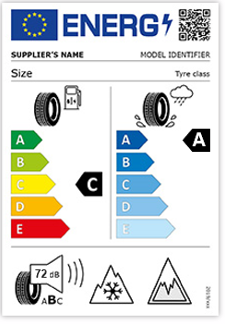


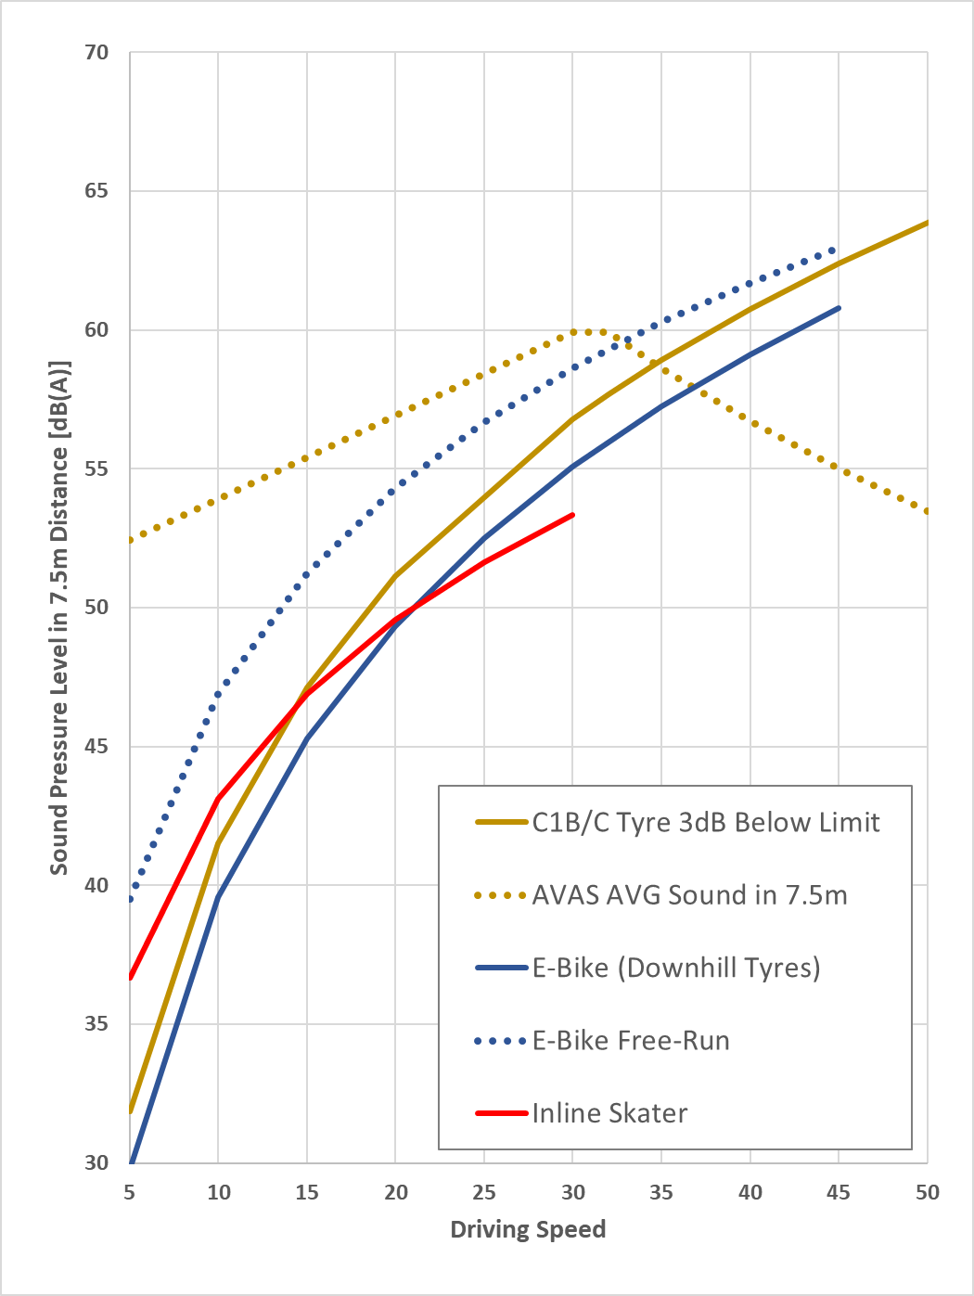
URBAN Condition Other Transportation Means in Comparison to EVs
Tyres of the noise label class A are almost as quiet
as rolling sound from other transportation means.
A-labelled tyres will effectively require a shift of the
cross point between AVAS and tyre rolling sound for
the safe recognition of vehicles from today 20 km/h
to at least 30 km/h.
Tyres with rolling sound even better than A-label will be quieter than rolling sound of most other transportation means.
A-label tyres will require an operation of AVAS above 30 km/h vehicle speed for safe recognition of the vehicle.
AVAS will replace the tyre rolling sound by artificially created sound as it already replaces essential powertrain sound.
Pictures: Private Photographs

Slide 27
Conclusions on Electric Vehicles
Pure electric vehicles will help to reduce potential annoyance from high powertrain noise due to high engine speed driving from ICE, as their sound dynamic is much lower.
Electric vehicles will have the same sound emission and contribution to environmental noise as ICE vehicles whenever tyre rolling sound is dominant (road surface dependent > 50 km/h).
The contribution by xEVs in urban areas is limited, as ICE vehicles complying to phase 2 limits of UN R51.03 are already as silent as xEVs equipped with AVAS.
  AVAS jeopardizes achievements of low powertrain sound and will in future jeopardize tyre rolling sound improvements in cities as well (speed range < 40 km/h).
  The trade-off between a minimum sound of a single vehicle for safe recognition and environmental noise coming from the global traffic (inclusive other transportation means) and the consequences shall be considered.

Slide 28
TYRES, PUBLIC ROADS
AND TRAFFIC

Slide 29
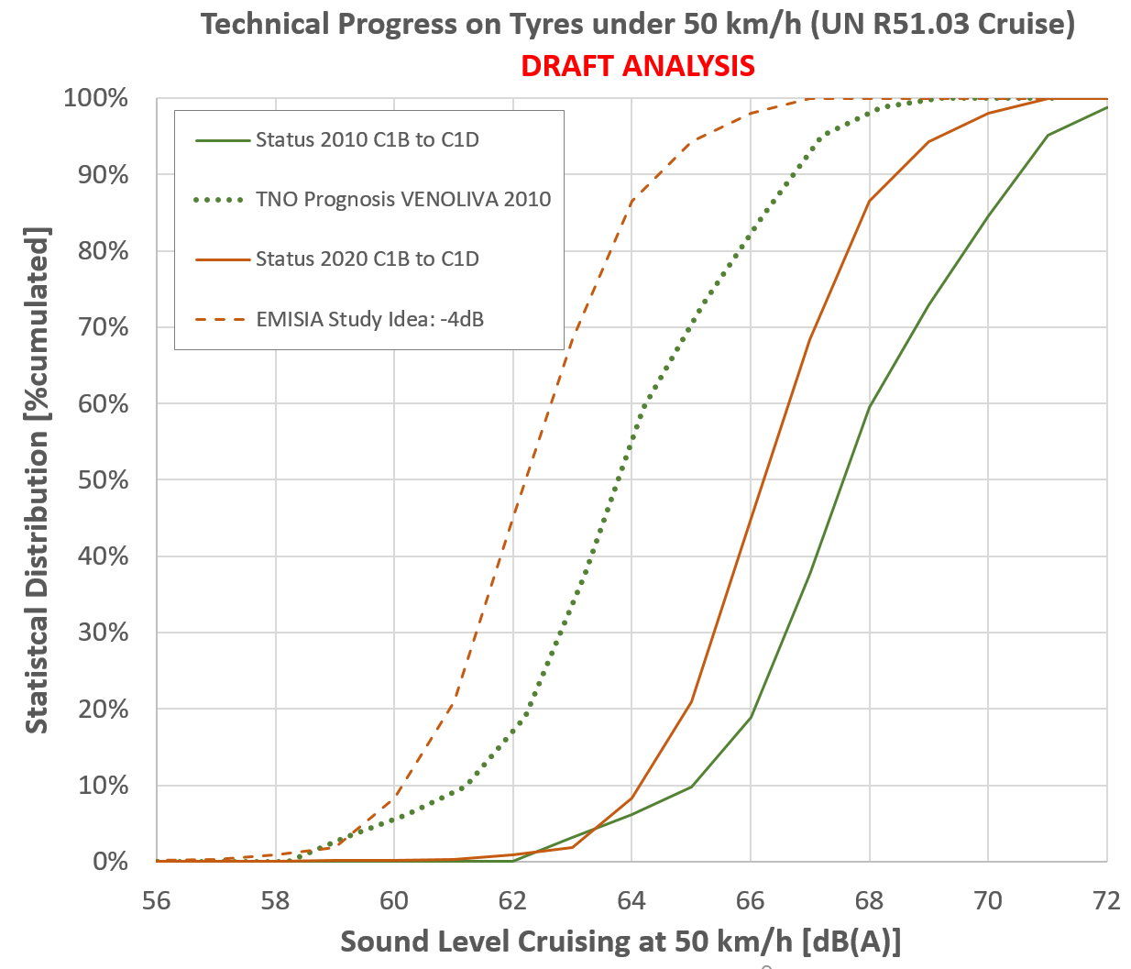
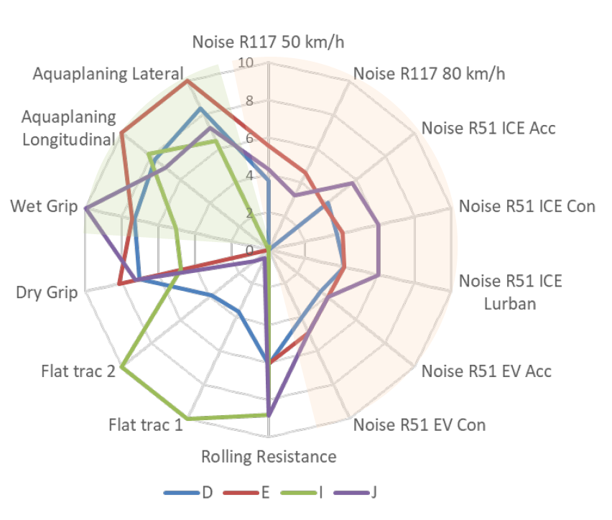
Technical Progress of Tyres Rolling Sound in the last 10 Years
Tyres have to serve many very important aspects, which makes it difficult to estimate technical progress into the future:
Tyre performance challenges:
  GRIP
  (wet/dry braking)
  WEAR
  (Lifetime and Particulates)
  ROLLING RESISTANCE
  (CO2 and particulate sizes)
  NOISE
  MATERIAL
ETRTO TYRE Study 2019 GRBP-73-11
φ Real Drift:
-1.3 dB
Souce: OICA TA database 2020 and ACEA Database 2010
Only little progress for most quiet tyres
Good Wet Grip, poor rolling sound
In the last ten years the population of quietest tyres has not become bigger.
Trade-offs with other disciplines has brought tyres to a technical border.
Forcing more quiet tyres is hardly justified, when benefits and drawbacks of all tyre disciplines are considered together.

Slide 30
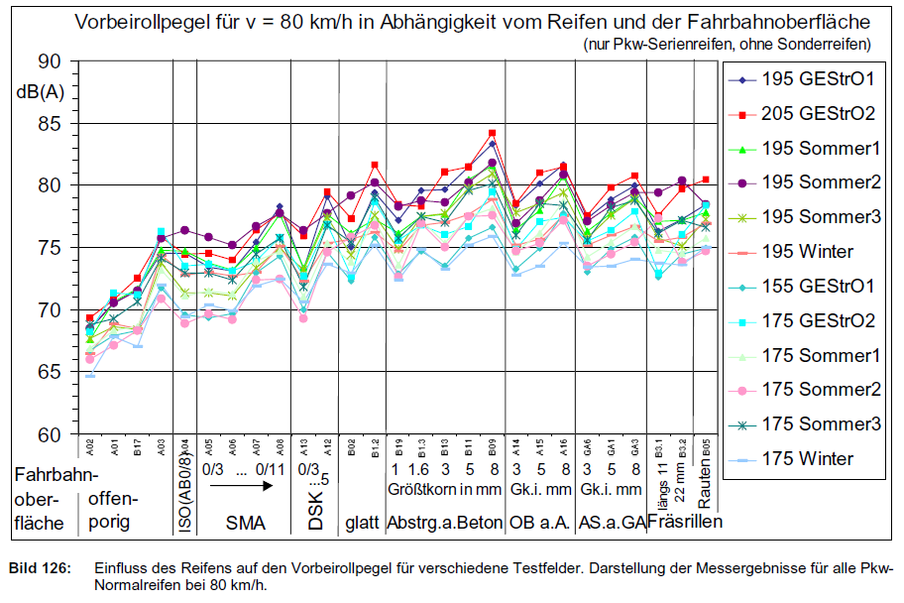
Representativeness of ISO 10844:2014 for Public Roads
ISO 10844 asphalt concrete (AB) belong to the quieter surfaces.
Standard asphalts, such as SMA 0/11 and SMA 0/14 are up to 5 dB louder.
Open porous asphalts (OPA1 and OPA2) are in average 2-3 dB(A) quieter than ISO 10844.
Nano asphalts (see next slide) are latest technologies designed for urban roads and typically 5 dB quieter than ISO 10844.
Source: Sperenberg 1995/2001, Report by BASt, Germany
Road Surfaces have different excitation mechanism. Tyres have a sound behaviour, dependent on the individual surface texture, texture geometry and absorption.

Slide 31
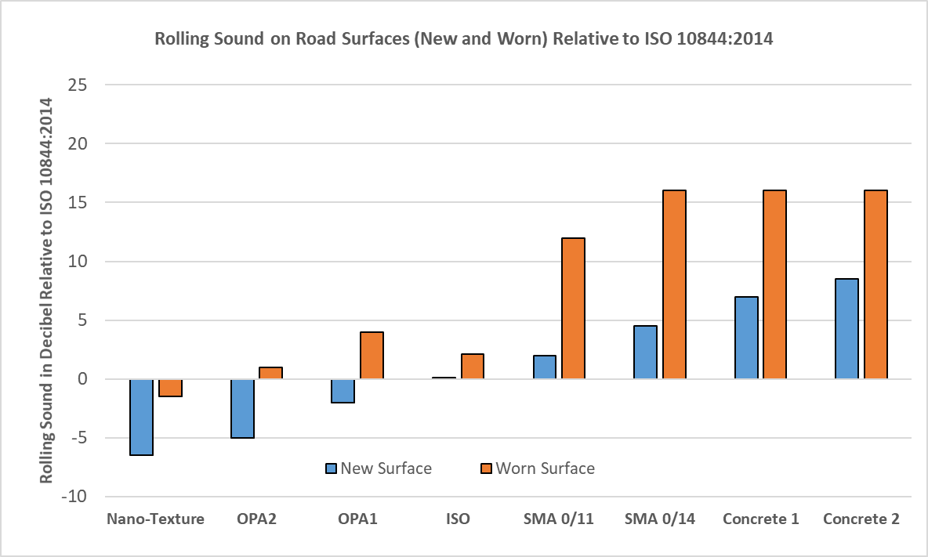
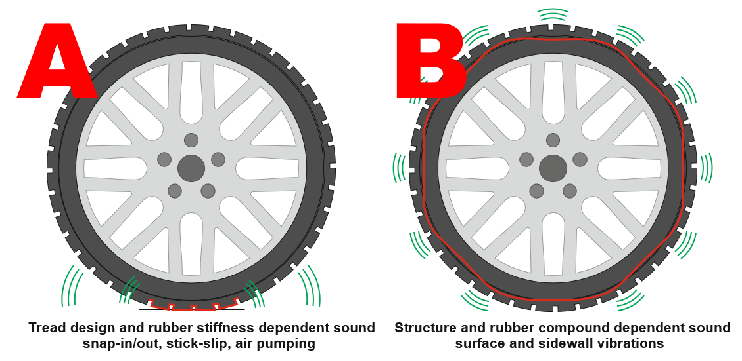
ISO Cannot Represent Every Road Due to Different Excitation Models
A>>B
A=B
A<B
A<<B
A<B
A<<B
Degradation inclusive decades old un-renewed surfaces
Diagram based on various sources:
SINTEF 2011, JAPAN GRB46-2, SPERENBERG 1995, BAFU&ASTRA 2013
ISO 10844:2014 provides a definition for a test surface which balances between important tyre excitation models
A: primarily tread design
B: primarily structure dependent
Tyres optimized for quiet surfaces provide best capability for noise abatement.
Tyres optimized of rough surfaces will not provide further noise abatement potentials.

Slide 32
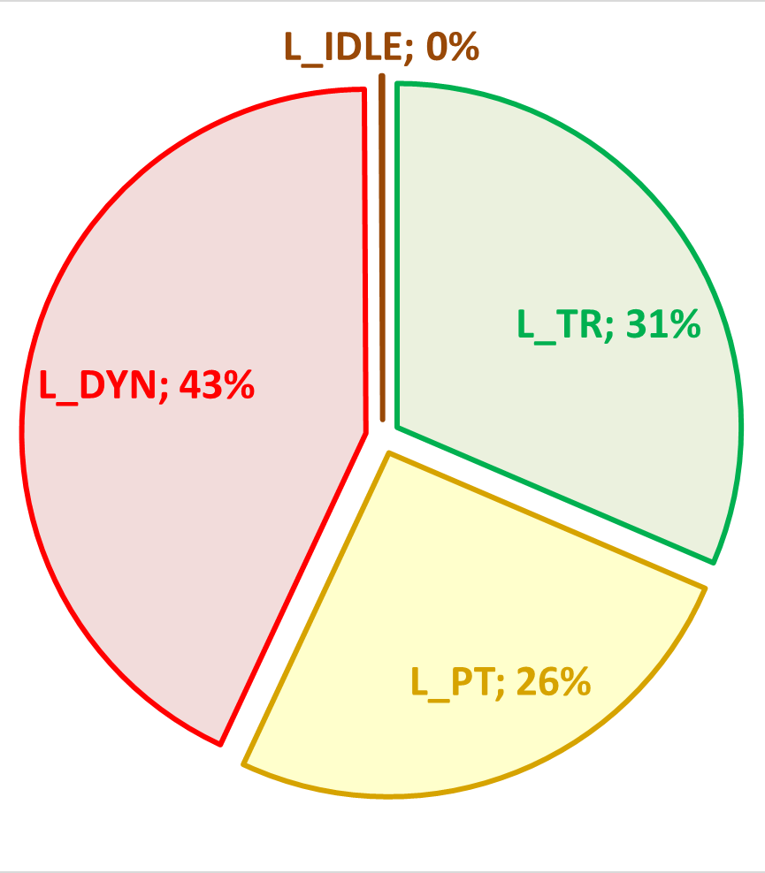
Impact of Road Surfaces on the Sound Source Composition and L_{A,eq}
Nano-Asphalt
ISO-Asphalt
SMA 0/11-Asphalt
Engine
Exhaust
Tyres
SOURCE:
Diagrams based on real diring data
in combination with RD-ASEP Model
L_{A,eq,NANO}
63,9 dB(A)
L_{A,eq,ISO}
66,1 dB(A)
L_{A,eq,SMA11}
68,1 dB(A)
ΔL = 4,2 dB(A)
Low noise asphalts are beneficial to all vehicles and tyres, not only to future vehicles.
Low noise asphalts improve at local hot spots the situation where needed.
Low noise asphalts AND low noise tyres provide best performance ➔ WIN-WIN for Environment

Slide 33
Conclusion on Tyres and Roads
Tyres have to serve many aspects and the conflicts have been clearly studied.
Further potential towards more quiet tyres on the basis of today’s vehicle designs are not available to industry and there is not time perspective to overcome the design conflicts.
The benefits of low noise road surfaces shall not be neglected.
  Low noise asphalts are beneficial to all vehicles and tyres (current and future).
  Low noise asphalts improve at local hot spots the situation where needed.
  A sound reduction achieved by low noise roads follows the same benefit calculation schemes as sound reduction achieved on tyres and power trains.
In a holistic approach different disciplines must join forces to enable best performance result.
  Low noise asphalts AND low noise tyres provide best performance and create a WIN-WIN situation for the environment and the society.

Slide 34
OICA POSITION

Slide 35
OICA Position on Future Limits and Regulation Enforcement
OICA does not expect a substantial further contribution of phase 3 limits of UN R51.03 to lower environmental noise.
OICA suggests to subject UN R51.03 Phase 3 limits and EU 540/2014/EC to a moratorium.
  Manufacturer have already started to prepare for Phase 3 limits and more products coming to the market which will be close to phase 3 limits.
  Automotive Industry is in a transient towards new technologies and faces conflicts in handling the politically request technology change towards electric mobility.
  Phase 3 limits interfere in product planning and will lead to “short-run” interim products design, with great restrictions to become cost efficient.
Research is needed to solve pending issues
  Tyres face a double regulation of their rolling sound emission by UN R51.03 and UN R117.02. What is the interdependency?
  What is the future contribution of EVs towards lower environmental noise, as their power train sound emission is primarily defined by the minimum sound requirements on UN R138.01.
  Optimization of uncertainties of 3rd octave measurements for minimum sound in UN R138.01 might provide further potentials to design more quiet AVAS systems.
OICA supports the completion of RD-ASEP
  We agree to an introduction of the revised requirements as outlined by the IWG ASEP to further optimize the effectiveness of UN R51.03 / UN R51.04.

Slide 36
BACKUP SLIDES

Slide 37
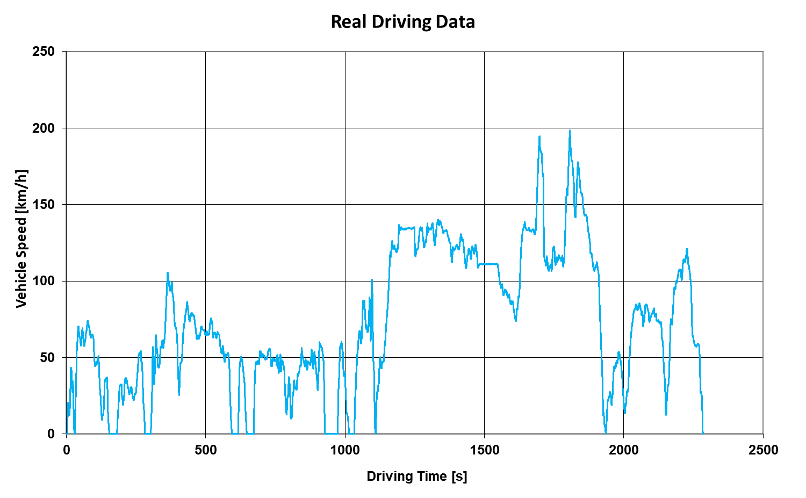
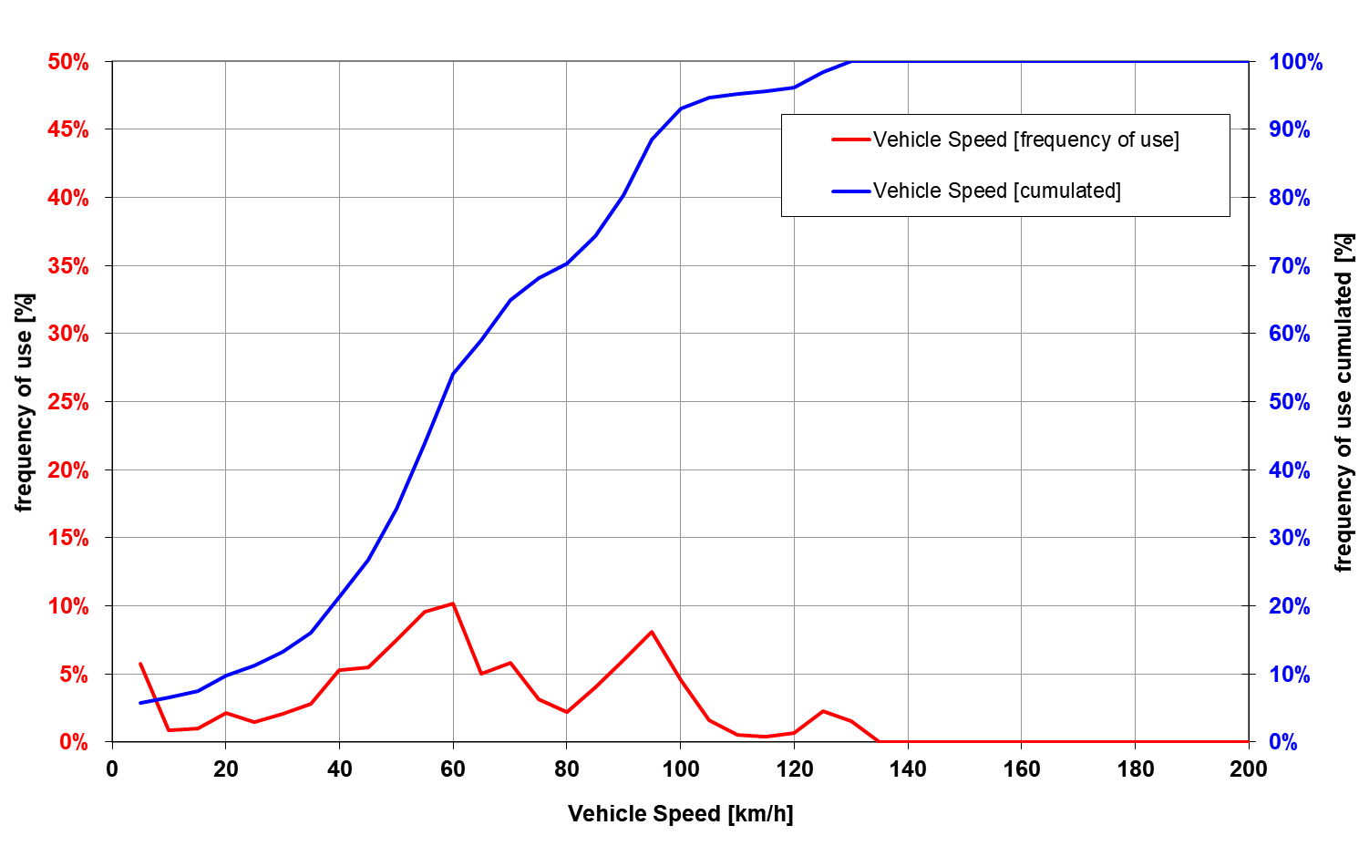
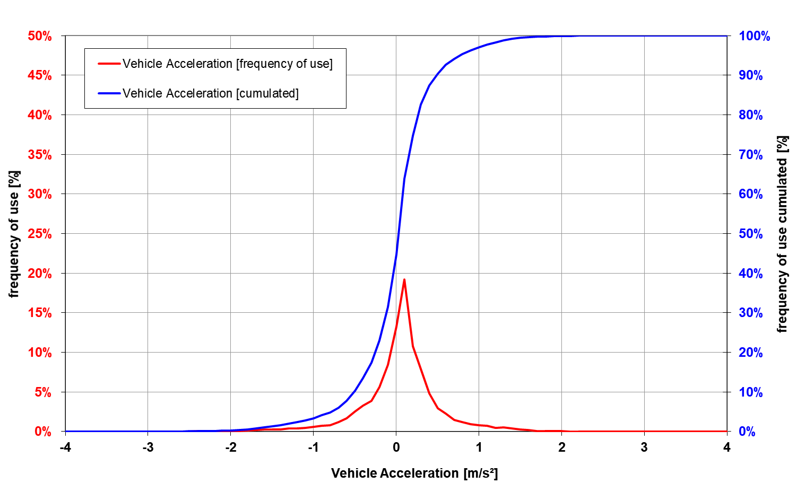
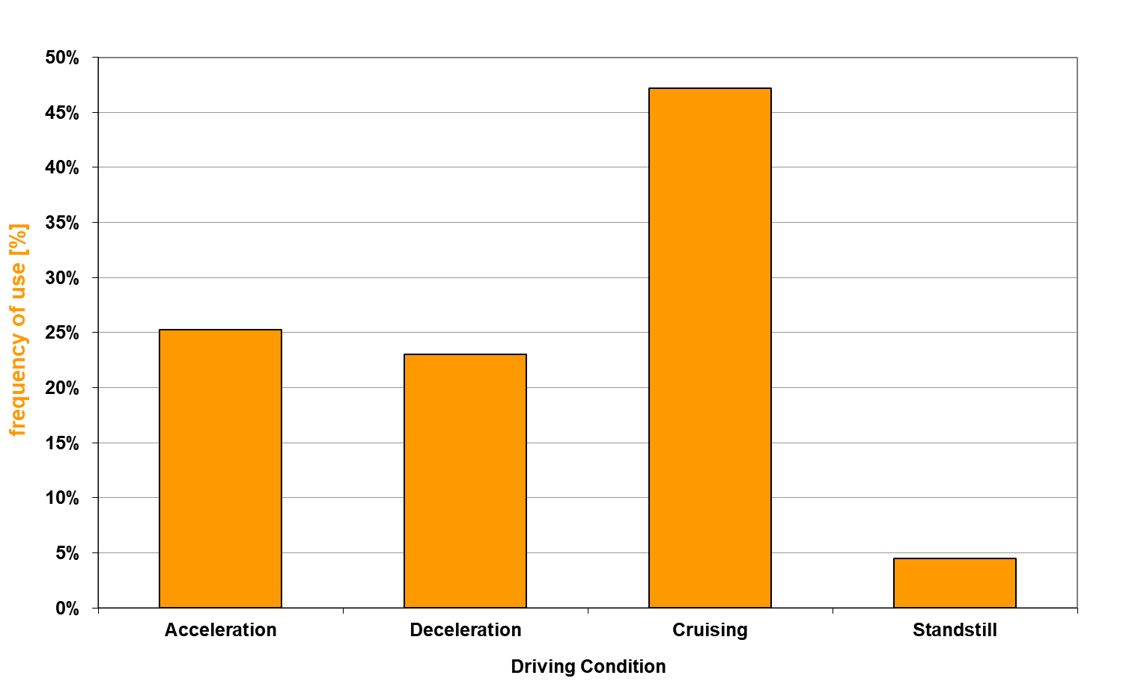
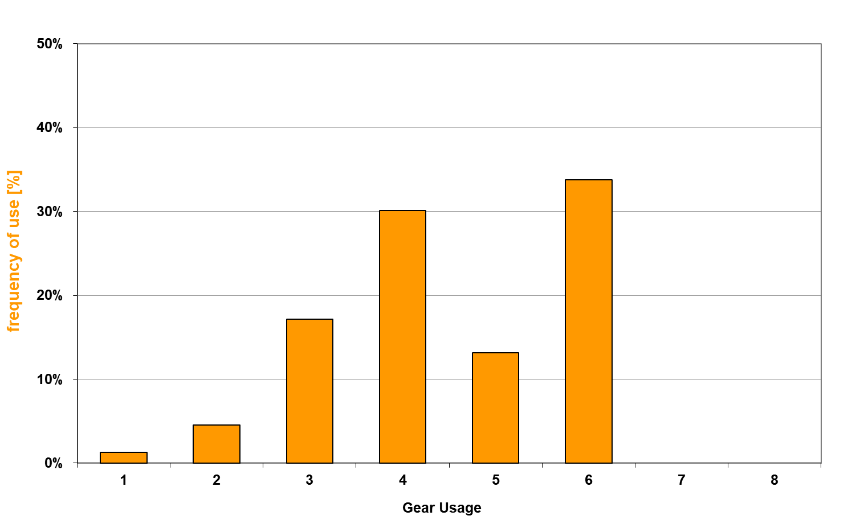
Statistical Analysis of a Driving Cycle
The selected driving cycle represents normal driving. This cycle is applied to the vehicles in this investigation, so all vehicle drive exactly the same way.
For the analysis of the representativeness, of UN R51.03 for urban traffic, the vehicle speed is restricted to typical urban speeds below 55 km/h (ISO indicated speed).

Slide 38
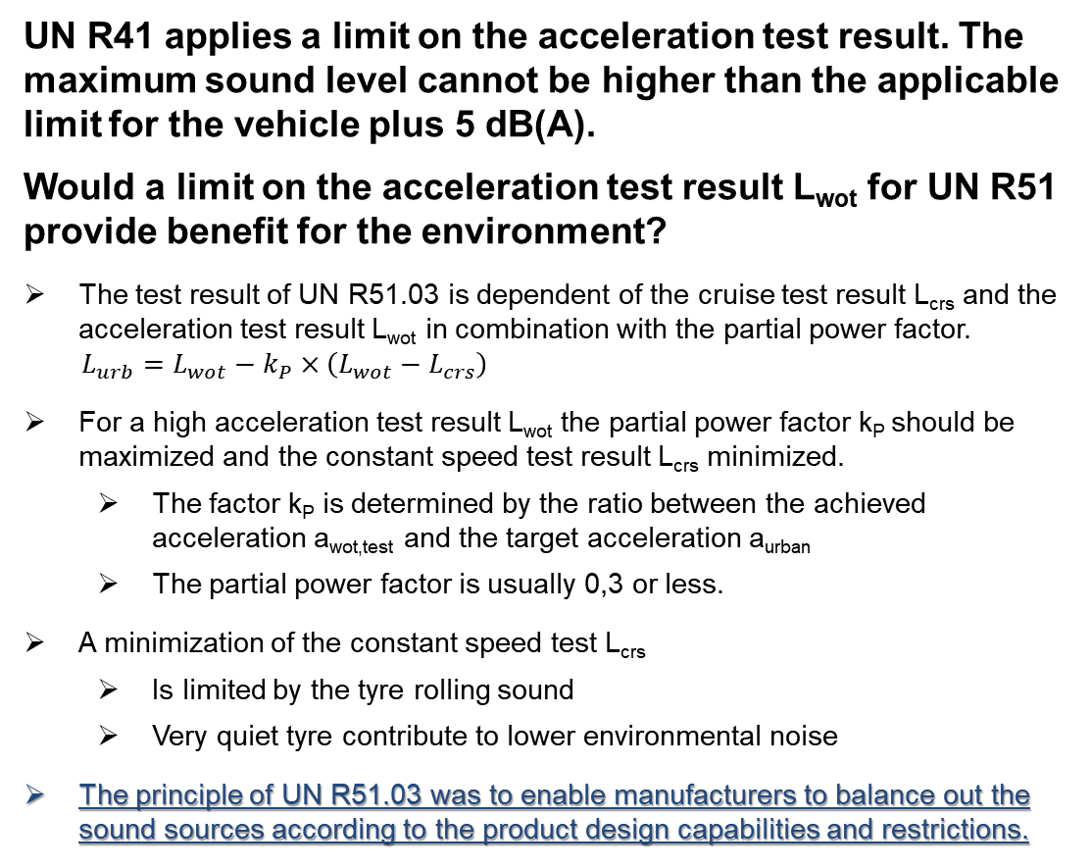
Considerations Regarding a Limit on Acceleration Test Result as applied in UN R41
UN R41 applies a limit on the acceleration test result. The maximum sound level cannot be higher than the applicable limit for the vehicle plus 5 dB(A).
Would a limit on the acceleration test result L_{wot} for UN R51 provide benefit for the environment?
The test result of UN R51.03 is dependent of the cruise test result L_{crs} and the acceleration test result L_{wot} in combination with the partial power factor.
$$L_{urb}=L_{wot}−k_{P}×\left(L_{wot}−L_{crs}\right)$$
For a high acceleration test result L_{wot} the partial power factor k_{P} should be maximized and the constant speed test result L_{crs} minimized.
  The factor k_{P} is determined by the ratio between the achieved acceleration a_{wot,test} and the target acceleration a_{urban}
  The partial power factor is usually 0,3 or less.
A minimization of the constant speed test L_{crs}
  Is limited by the tyre rolling sound
  Very quiet tyre contribute to lower environmental noise
The principle of UN R51.03 was to enable manufacturers to balance out the sound sources according to the product design capabilities and restrictions.
Possible Increase of the acceleration test result L_{wot} relative to the applicable limit of the vehicle category
  There is no benefit for a limit on the acceleration test result.
  Manufacturer aiming for a low sound emission under cruise provide benefit to the environment.

Slide 39
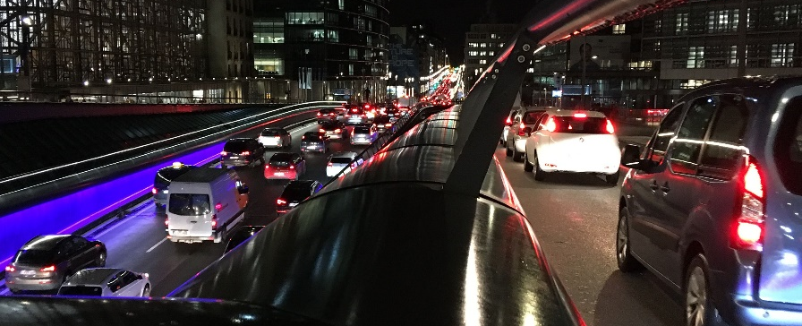

Impact of Increased Traffic Volume on Environmental Noise
Traffic volume has increased in the last decades and a further increase is forecasted for the next decades.
Trend scenarios indicate that transportation of goods will increase stronger compared to M1 vehicles passenger transportation.
Without active measures to enable the road network for that increased traffic volume, the average driving speeds will decrease, as the increased traffic volume will lead to more congestions.
Increased noise by higher traffic volume is buffered by lower traffic speed. Actually it is not clear, which one is dominant.
Where roads (e.g. motorways) are re-constructed to enable more traffic volume, locally active measures are applied to make sure, that road traffic noise is within locally applicable target.
If noise abatement is a holistic network of measures, we have to take improvements achieved by other measures into account as well.
Source: Private Picture
Source: EU Reference Scenario 2016 – Energy, transport and GHG emissions
Trends to 2050

Slide 40
Conflict between UN R51.03 and UN R117.02
For M1/N1 vehicles tested under UN R51.03 the tyre rolling sound is the dominant source. There is a conflict between UN R51.03 and UN R117.02 as both address the same source.
It is unclear which regulation should be seen as the leading regulation.
  Both Regulation must be understood as a package and cannot be treated separately.
Improvements on tyres coming via UN R51.03 on new OEM vehicle will only be effective as long as these tyres are mounted.
  Tyres are typically replaced after 4 years (EU), in many countries two different set of tyres are needed (GERMANY: summer/winter).
  OEM tyres have a time limited contribution to the environment
GRBP needs to assign a higher priority to this conflict.

Slide 41

Industry in Transition Towards a New Mobility Technology
There is a strong political will that vehicles with combustion engines are replaced by new energy vehicles (NEVs). Many countries/markets announces already plans for a prohibition of sales for ICE vehicles between 2030 and 2040.
The phase-in is dependent on many factors, like the economic, pandemic and infrastructure situation, which makes it difficult to estimate the development of the market share for NEVs into the future.
Automotive Industry is facing huge invest costs and struggles with introduction scenarios for NEVs and phase-out timing of ICE vehicles.
In this transition period, an enforcement of the noise regulation is an additional handicap, for which it will become difficult to justify sufficient benefits.
Any benefit considerations related to environmental noise after 2030 are subject to greater uncertainties.
According to trend estimates, NEVs will become the majority of new sold vehicles after 2030.

Slide 42





Proposal for a Sound Emission Regulation Cross Matrix
R117 Tyres
R51 with replacem. tyres
R117 Tyres
Impact to Sound Emission L_{A,eq}
R138 AVAS
R51 Limits
R59 Limits
R51 Limits
Residential
urban
rural
motorways
R28 Horn
All Vehicles
Impact to Single Events L_{A,max}
R59 RD-ASEP
R59 ASEP
M1/N1-Vehicles
R51 RD-ASEP
N2/N3, M3-Vehicles
R51 ASEP

