Slide 1


AEBS-HDV IWG
Input from industry
AEBS-HDV-04
May 17, 18, 19 - 2021

Slide 2
Content
Brake performance
V2C collisions
    LCVs
    HCVs
V2P collisions
V2B collisions
Summary

Slide 3
Brake performance

Slide 4
Deceleration
References:
  Industry document AEBS-HDV-03-05
  Type approval test reports (type 0)
Summary
  A solo 4x2 Tractor can have a deceleration between 5.75 and 7.5 depending on the architecture of the vehicle (risk of tilting over)
  A laden 4x2 tractor typically reaches 6.5 m/s², in some cases 7m/s²
  Other vehicle variants reaches lower deceleration due to different architecture (leaf suspension, multi-axles, construction vehicles with higher COG and “rough” tyres with drums etc.), typically 5.5m/s² or 6m/s²

Slide 5
Time to 1g
AEBS M1N1 IWG took as an assumption that the time-to-1g (T1g) was applicable immediately once the brake demand starts
This assumption is not realistic for HCVs with pneumatic braking:
Due to the long pneumatic response time (0.6s maximum) and to threshold pressure values (typically 0.3 to 0.5 bar), an absolute brake delay time of around 150ms should be taken into account between the brake demand and the actual deceleration built-up.
See data on next slides.

Slide 6
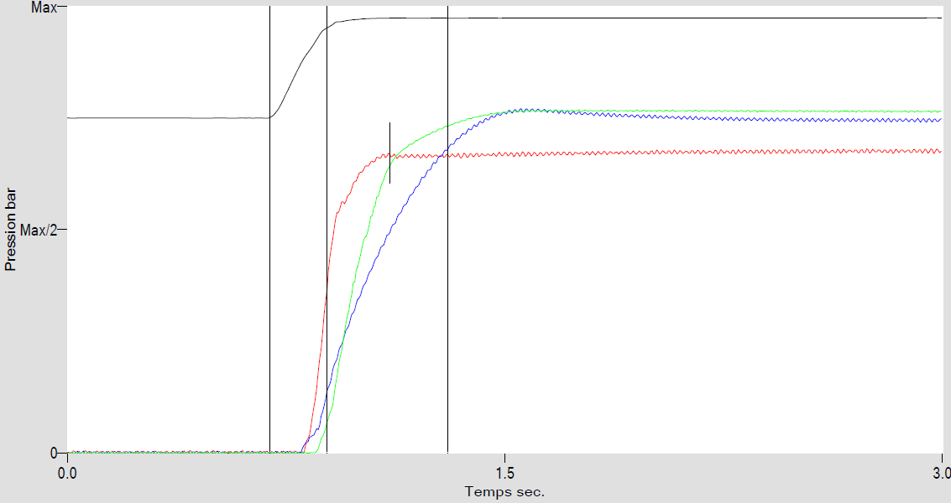
Time to 1g - brake delay (pneumatic braking)
4x2 T
These values (160ms and 190ms) are only accounting for the delay between brake pedal actuation and pressure built-up to counter the threshold pressure of the brakes.
The same delay should be observable in case of an automatically commanded braking demand (as generated by AEBS).
Brake pedal actuation
Asymptotic
value 100%
Trailer control line 8.11 bar
0.4b (typical threshold pressure)
Tractor Front axle 8.95 bar
Tractor Rear axle 9.18 bar
160ms
190ms

Slide 7
Time to 1g - industry proposal for pneumatic braking
a_{vehicle}
_{in m/s²}
t0: pedestrian enters corridor and brake intervention requested by AEBS
t1: vehicle starts to decelerate in real
Assumption of Excel tool “shark fin”
MFDD
Proposed assumption by industry
Industry proposal for HDVs with pneumatic braking:
Assuming an absolute delay time t1-t0 of 150ms is used in the calculation model, a T1g of 1s can be considered as relevant.
_{t}
t0
t1

Slide 8
Time to 1g - Hydraulic braking
Pressure build up time of hydraulic brake
(Delay 0.4 s)
1.5 s
Acceleration m/s2
Time sec
System activation
Vehicle: N2 GVW 8tons with disk brake, fully loaded
Using a value of 2.5s in the shark fin calculation reflects in a good way the reality of these hydraulic braking vehicles

Slide 9

V2C - LCVs

Slide 10
LCVs - Proposed approach
The proposal is to base the requirements on the actual vehicle tests performed in 2012 on different vehicle types.
These tests have been performed to measure the Last Point to Steer (LPS), to feed the AEBS-LDWS IWG with actual data.

Slide 11
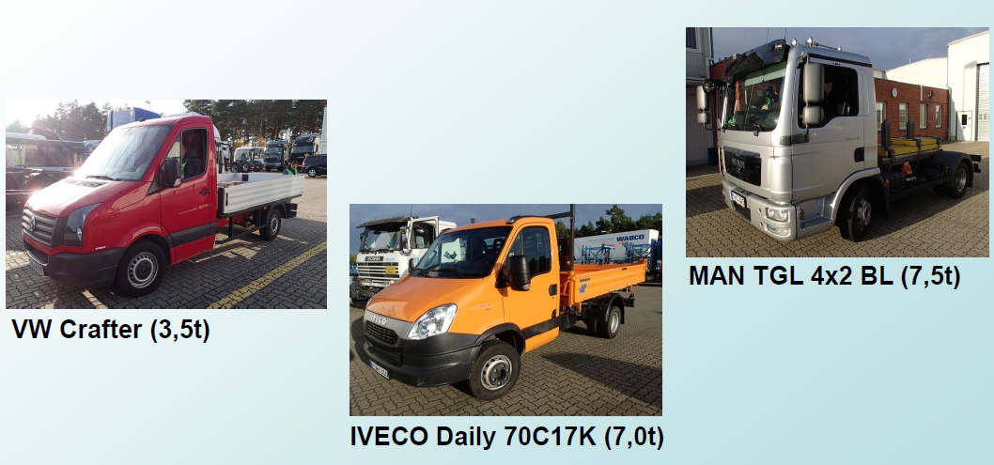
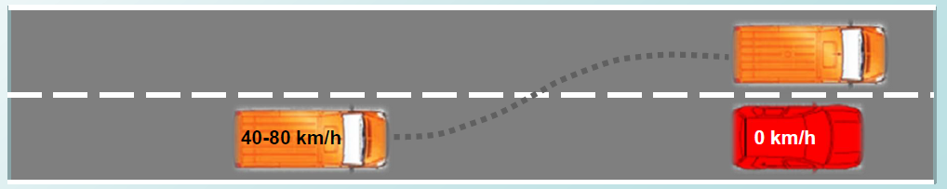
LCVs - LPS measurement
Measurements of LPS were performed in 2012 in Germany (Jeversen)
All results are available in document AEBS-LDWS-18-03. On next slide is an extract.
Collision avoidance without ESC intervention
The avoidance manoeuvers were actually not extreme manoeuvers (no ESC intervention).

Slide 12
LCVs - LPS measurement data

Slide 13
LCVs - Averaging of measurement data

Slide 14
LCVs - LPS
Average LPS | Min | Max
1,2 | 1,0 | 1,3
Average LPS | Min | Max
1,4 | 1,1 | 1,6
Average LPS | Min | Max
1,2 | 1,0 | 1,3
LCVs derived from M1N1
LCVs derived from “heavies”
Average LPS | Min | Max
1,2 | 1,0 | 1,3
Average LPS | Min | Max
1,3 | 1,0 | 1,6

Slide 15
LCVs - Peak avoidance - calculations
 | M2 and N2<8t
 | Vehicles derived from M1N1 |  |  | Vehicles derived from / based on “heavies”
 | Hydraulic braking |  |  | Pneumatic braking |  |  | Hydraulic braking **
LPS | Average 1.2s | Min 1s | Max 1.3s | Average 1.3s | Min 1s | Max 1.6s | Average 1.3s | Min 1s | Max 1.6s
LPS - 0.15s * | - | - | - | 1.15s | 0.85s | 1.45s | - | - | -
Deceleration | 7m/s² |  |  | 6m/s² |  |  | 6m/s²
Time to 1g | 0.6s |  |  | 1s |  |  | 2.5s
Peak avoidance (km/h) | 50 | 40 | 55 | 37 | 24.5 | 50 | 26.5 | 16 | 38.5
Proposal */ brake delay of pneumatic braking | 50 km/h R152 as an Alternative (to the choice of the manufacturer); or delete these vehicles from R131 scope and add them in R152’s) |  |  | 68 km/h on highway 40 km/h in city see justifications in the section about HCVs |  |  | 26.5 km/h Limit the requirements to city use (requirements only for speed 10-60 km/h). ** This column also applies to M3 with hydraulic braking.

Slide 16
V2C - HCVs

Slide 17
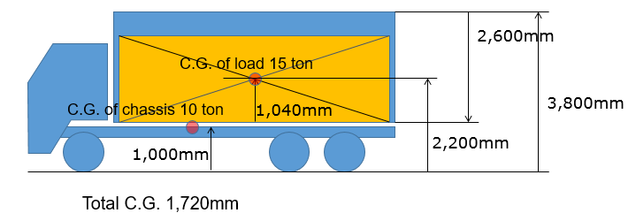
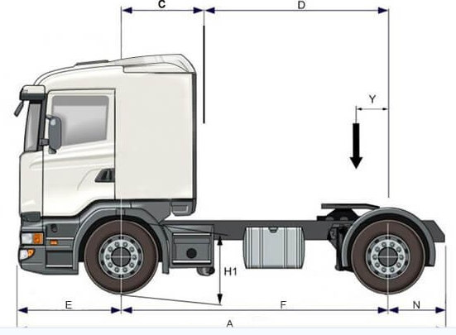


HCVs - LPS - COG height
Fully laden truck
(Values from JAMA’s presentation)
Tractor 4x2 solo (or chassis-cab truck)
(typical value 90 – 100cm)
$h_{CoG}$ = 172 cm
$h_{CoG}$ = 100 cm

Slide 18
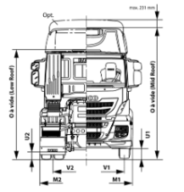
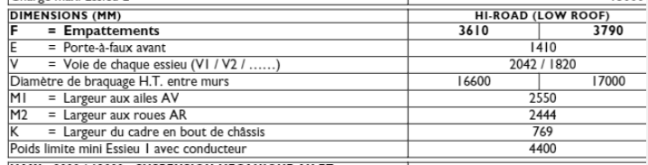

HCVs - LPS - Track width
Values from one typical 4x2T heavy
The proposal is to take a simple average of FA and RA tracks:
$w$ = $\frac{2042+1820}{2}$ = 193 cm

Slide 19






HCVs - LPS - Lateral acceleration
Fully laden vehicle
Unladen vehicle
$h_{CoG}$ = 172 cm
$h_{CoG}$ = 100 cm
$w$ = 193 cm
$w$ = 193 cm
$$\ddot{y}=\frac{w}{2∙h_{CoG}}g=\frac{193}{2∙172}= 0,56.g$$
$$\ddot{y}=\frac{193}{2∙100}= 0,97.g$$
(formula taken from Germany’s document AEBS-HDV-03-03)
In practice, lateral acceleration of 3.5 to 4.5 m/s² can be easily reached, between a high and low COG. The proposal is to take 4m/s².
In practice, the maximum lateral acceleration of a solo vehicle is limited by the adhesion. The proposal is to take 5m/s².

Slide 20
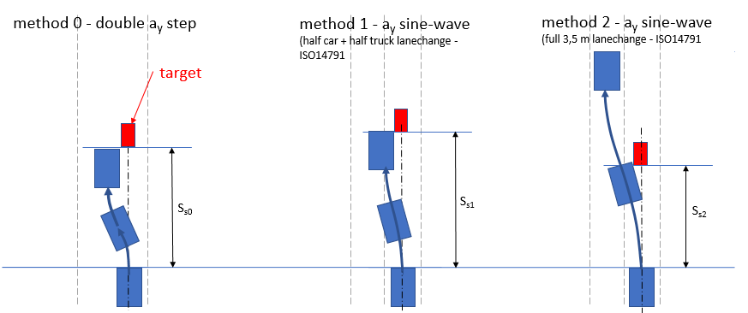




HCVs - Considerations about the method
Method “-1”
?
?
$$\ddot{y}$$
$$\ddot{y}$$
$$\ddot{y}$$
$$\ddot{y}$$
  M1N1 and their derived vehicles
  M1N1 LPS was considered with the most extreme possible manoeuver, without considerations of the space needed to counter-steer. The method “-1” was chosen.
  LCVs derived from M1N1 should follow the same logic.
  The “square shape” red lateral acceleration is physically impossible to reach.
Reality probably lies in between a square and a sine shape…
(Would a simple average be enough?)
  The “sine shape” lateral acceleration is a “smooth” lane change manoeuver, not consistent with a collision avoidance manoeuver.
  “HCVs should not use more lateral space than what is strictly needed to avoid the collision”
  → why not using the same space as M1N1 ?
The positive effect of ESC on the LPS is not considered
(ESC intervention should reduce LPS).

Slide 21
HCVs - LPS
Videos supporting LPS

Slide 22



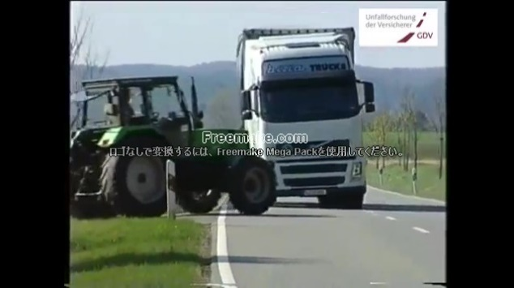

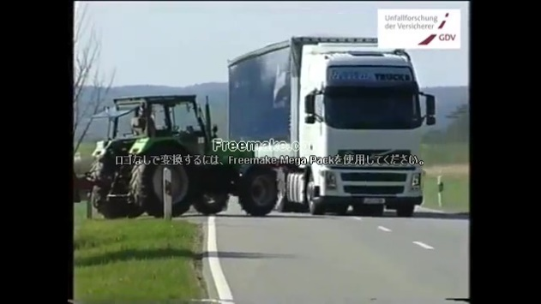
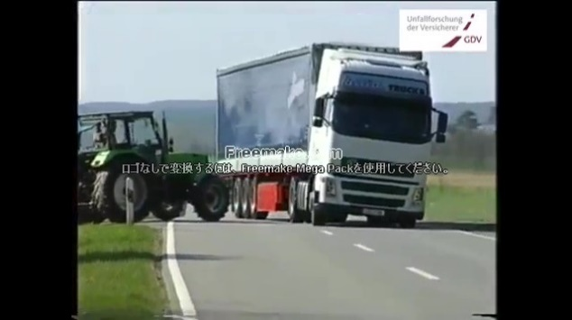
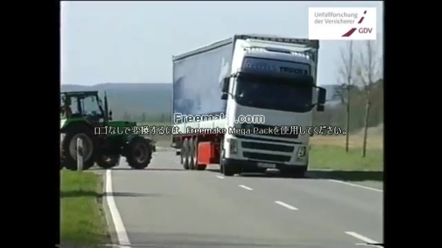
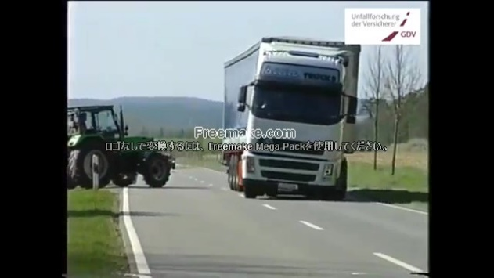



HCVs - Parameters - LPS
00:45.97
00:46.38
00:46.55
00:46.90
LPS = 1 s
LPS = 1.7s
00:47.24
00:47.59
00:48.05
00:48.40
00:48.74
00:49.14
00:49.96
00:50.42
Volvo tractor steering avoidance with ESC
Source
https://www.youtube.com/watch?v=vtM_Q0foQXM

Slide 23
HCVs - Parameters - LPS
Volvo “double lane change”
Modular vehicle combination: truck + center-axle-trailer + center-axle trailer
Speed 80 km/h
Weight 64 tons
COG height, approx 2.1 m

Slide 24
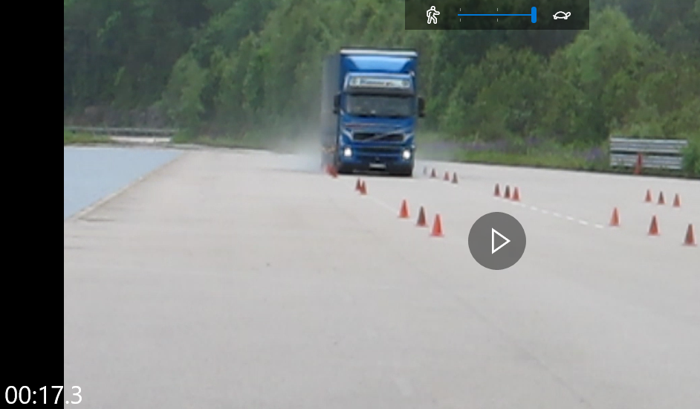
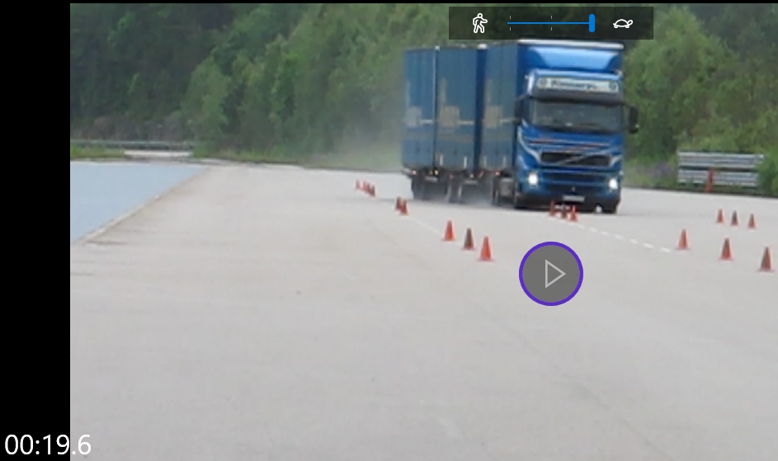
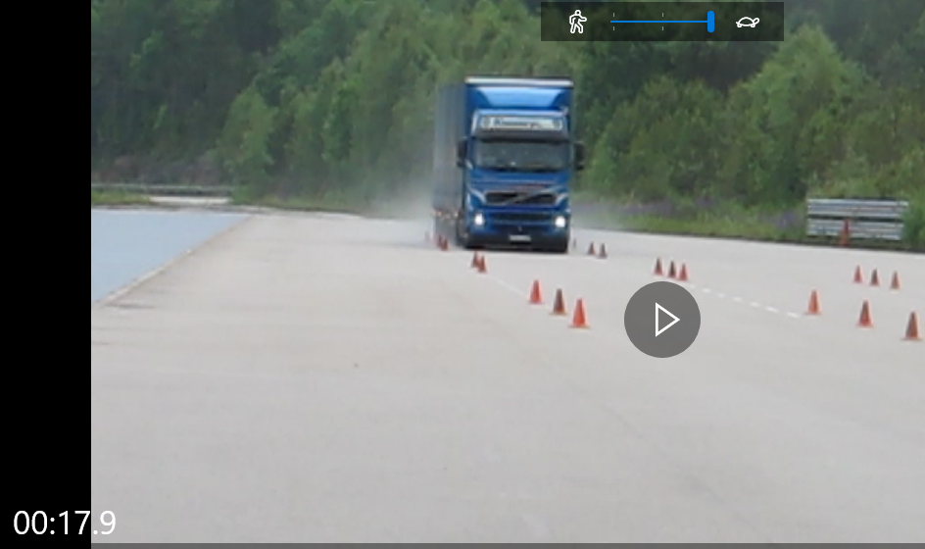
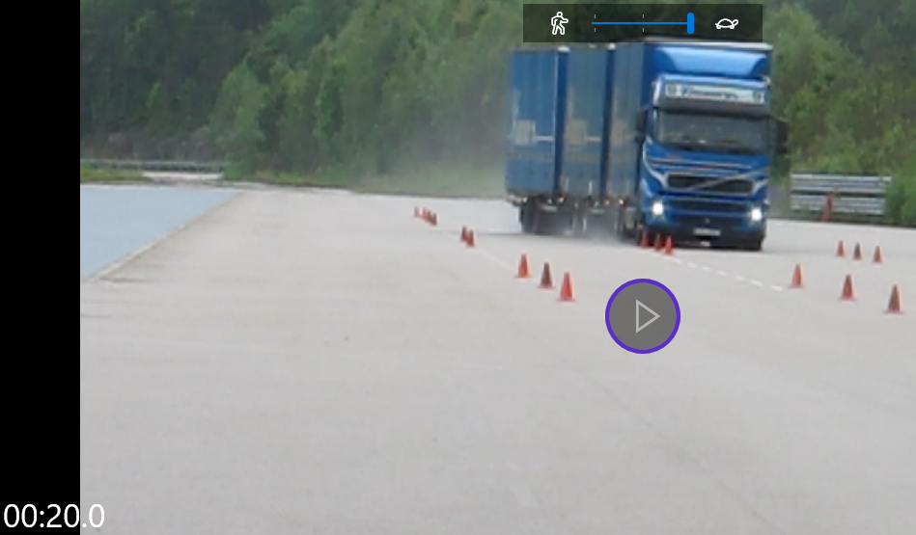
1
3
Doted lane marking
Left edge of the truck
right edge of the truck
Doted lane marking
The obstacle is avoided
(even if the lane change is not completed)
Vehicle drives straight in the lane
2
4
LPS = 1.7s
Doted lane marking
right edge of the truck
Steering manoeuver starts
(even if the vehicle already drifted a bit towards the left lane)
The front axle has completed the lane change

Slide 25
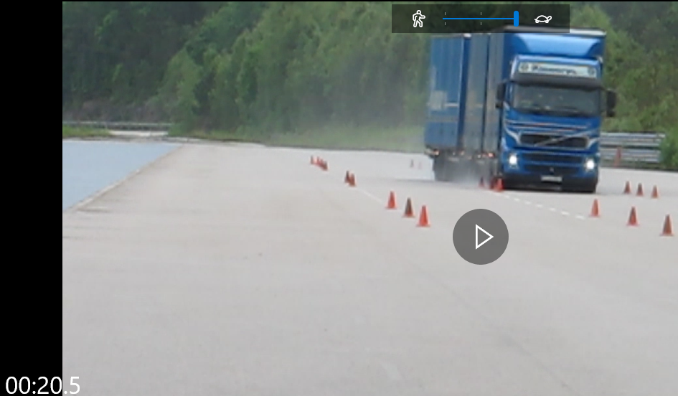
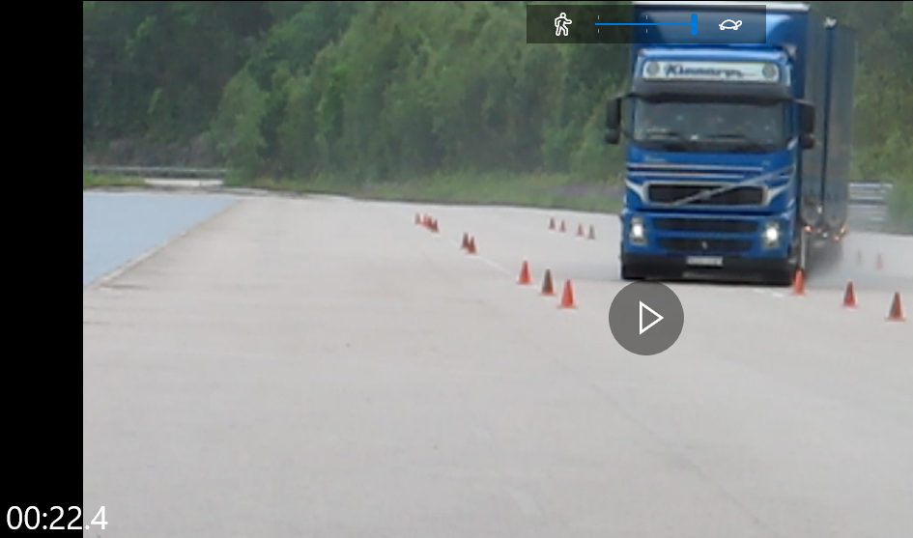
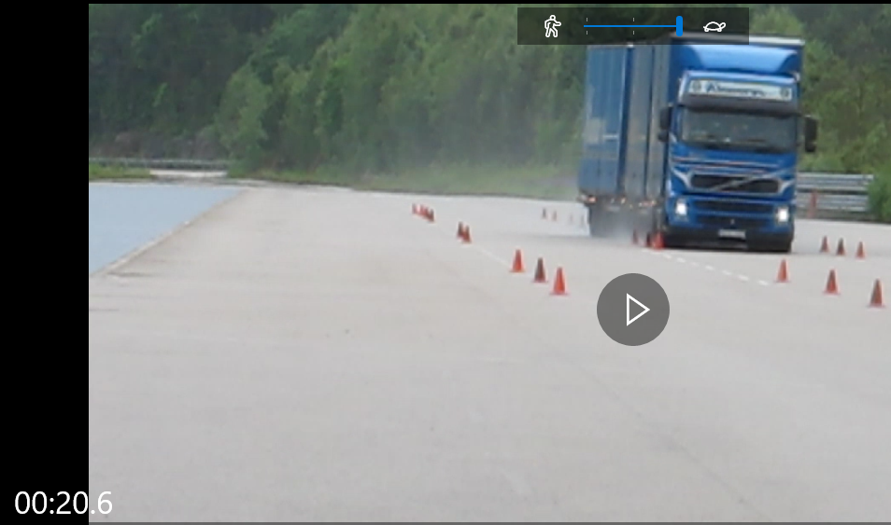
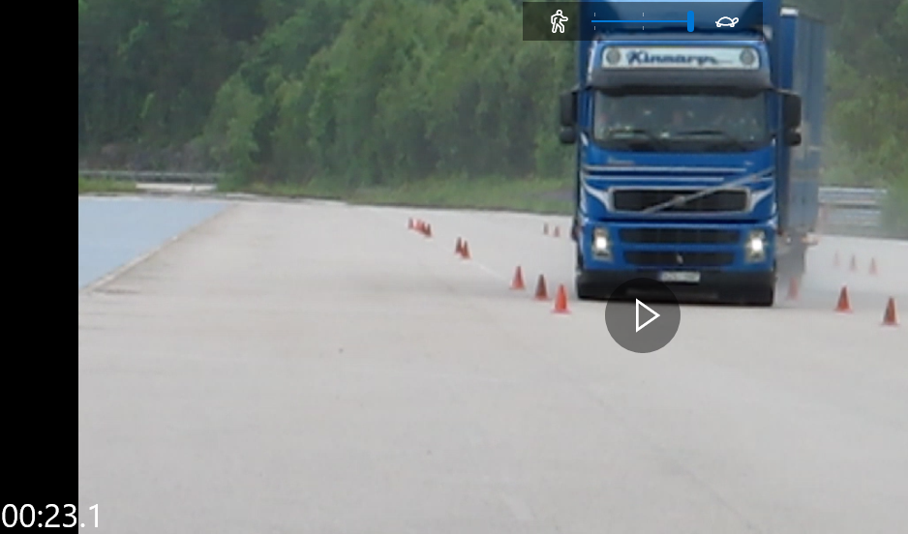
1
3
Same position (inside the lane) as the right edge of the truck on picture 2
right edge of the truck
Vehicle drives “almost straight” in the lane
(almost straight because this comes right after a first LC)
The obstacle is avoided
(even if the lane change is not completed)
2
4
right edge of the truck
LPS = 1.8s
Position of the last cone
Steering manoeuver starts
(the front axle is before the last cone)
The front axle has completed the lane change

Slide 26
HCVs - Peak avoidance - calculations
Lateral displacement | 2,275m
Method | Method 0 |  |  |  |  |  | Method 1
Lateral acceleration | 3.25 m/s² |  | 4 m/s² (laden) |  | 5 m/s² (unladen) |  | 3.25 m/s² |  | 4 m/s² (laden) |  | 5 m/s² (unladen)
LPS (calculated) | 1.67s |  | 1.51s |  | 1.35s |  | 2.1s |  | 1.89s |  | 1.69s
LPS (calculated) - 0.15s brake delay | 1.52s |  | 1.36s |  | 1.2s |  | 1.95s |  | 1.74s |  | 1.54s
Time to 1g | 1s
Deceleration (m/s²) | 6 | 7 | 6 | 7 | 6 | 7 | 6 | 7 | 6 | 7 | 6 | 7
Peak avoidance (km/h) | 53 | 59.5 | 46 | 51.5 | 39 | 43.5 | 71.5 | 81 | 62.5 | 70.5 | 54 | 60.5

Slide 27
HCVs - Peak avoidance - calculations
Lateral displacement | 2,275m
Method | Method 0 |  |  |  |  |  | Method 1
Lateral acceleration | 3.25 m/s² |  | 4 m/s² (laden) |  | 5 m/s² (unladen) |  | 3.25 m/s² |  | 4 m/s² (laden) |  | 5 m/s² (unladen)
LPS (calculated) | 1.67s |  | 1.51s |  | 1.35s |  | 2.1s |  | 1.89s |  | 1.69s
LPS (calculated) - 0.15s brake delay | 1.52s |  | 1.36s |  | 1.2s |  | 1.95s |  | 1.74s |  | 1.54s
Time to 1g | 1s
Deceleration (m/s²) | 6 | 7 | 6 | 7 | 6 | 7 | 6 | 7 | 6 | 7 | 6 | 7
Peak avoidance (km/h) | 53 | 59.5 | 46 | 51.5 | 39 | 43.5 | 71.5 | 81 | 62.5 | 70.5 | 54 | 60.5
Reality lies between method 0 and 1 (the assessed LPS is indeed lower than 1.8s in the diverse videos of previous slides) → proposal to take the average = 62 km/h (with 7m/s², the average is 70km/h)
Proposal:
Moving target: 68 km/h as today
Stationary target: increase from 20 to 68km/h
“Special case” for solo 4x2 tractors
Based on the assumptions of previous slides, a 4m/s² lateral acceleration provides a 62.5km/h value

Slide 28
HCVs - Issue of city vs highway driving
R131 regulation is primarily focussed on highway (unlike R152).
HDV manufacturers have low experience on city-AEB.
Industry is concerned with the increased risk of false positive in a city environment, especially if the required avoidance speed would be higher than passenger cars.
Additionally, the warning strategy could differ between highway (high speed) and city (low speed). Indeed at highest speed, it makes sense to warn before braking in order to keep a chance to get the driver attention; the situation is different at lower speeds.
Industry recommendation would be to split the requirements according to vehicle speed, see example on next slide.

Slide 29
HCVs - Issue of city vs highway driving
Proposal for N3 |  |  | Speed reduction
target ego | 0 | 10 | 20 | 30 | 40 | 50 | 60 | 70 | 80 | 90 | 100
0
10 | 10
20 | 20
30 | 30
40 | 40
50 | 40
60 | 40 | 40
70 | 70
80 | 50 | 70
90 | 46 | 50 | 70
100 | 44 | 46 | 50 | 70
Peak avoidance = 69 kph --> rounded at 70
Example of a possible solution:
Vehicle speed 10 – 60kph (Urban/city):
  speed reduction of 40kph
speed above [70kph] (Motorway):
  follow the shark fin curve for speed above [70kph]
  [with 0.8 sec warning phase mandatory]
Speed between 60 and 70
  transition
Green = collision avoidance
Yellow = collision mitigation
Collision speed
target ego | 0 | 10 | 20 | 30 | 40 | 50 | 60 | 70 | 80 | 90 | 100
0
10 | 0
20 | 0
30 | 0
40 | 0
50 | 10
60 | 20 | 10
70 | 0
80 | 30 | 0
90 | 44 | 30 | 0
100 | 56 | 44 | 30 | 0
Green = collision avoidance
Yellow = collision mitigation

Slide 30

V2P

Slide 31
R152 logic
Step 1
00 series
Step 2
01 series
Safety zone
5kph
1.39 m/s
5kph
1.39 m/s
TTC=1/1.39
=0.72 s
TTC=(1+0.3)/1.39
=0.94 s
1 m
1.3 m
M1, N1
M1, N1
0.3 m
2 m
2 m
Vehicle width
Vehicle width

Slide 32
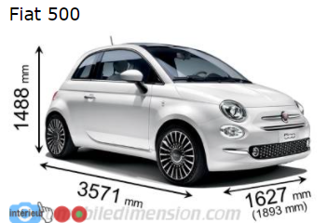
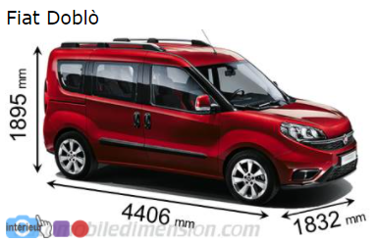

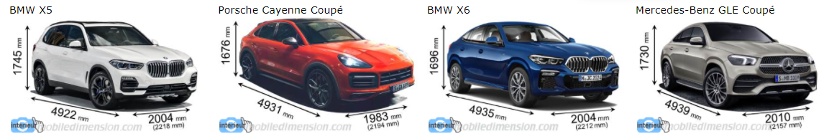
Actual vehicle width (examples)
AutoKatalog 2019, 20, 21: Range Rover Sport: width = 2073mm

Slide 33
R152 logic*
(* same TTC whatever the actual vehicle width)
Step 1
Step 2
5kph
5kph
0.72 s
0.94 s
1 m
1.3 m
M1, N1
M1, N1
0.3 m
2 m
2 m

Slide 34
R152 logic* applied to a Fiat 500
(* same TTC whatever the actual vehicle width)
Step 1
Step 2
5kph
5kph
0.72 s
0.94 s
1 m
1.3 m
Fiat
500
Fiat
500
0.3 m
1.627 m
1.627 m

Slide 35
R152 logic* applied to a Range Rover Sport
(* same TTC whatever the actual vehicle width)
Step 1
Step 2
5kph
5kph
0.72 s
0.94 s
1 m
1.3 m
Range Rover Sport
Range Rover Sport
0.3 m
2.07 m
2.07 m

Slide 36
R152 logic* applied to a HDV
(* same TTC whatever the actual vehicle width)
5kph
5kph
0.72 s
0.94 s
1 m
1.3 m
HDV
HDV
0.3 m
2.55 m
2.55 m

Slide 37
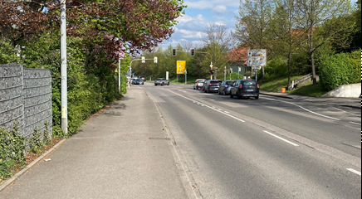
Safety zone for HDVs in „real life“ conditions
HDVs are wider than passenger cars, thus are driving closer to the sidewalk, which is increasing the risk of getting false positives.
Additionnaly:
A vehicle cannot be driven 100% in the center of the lane. Small drifts with e.g. +/- 15cm or 20cm to both sides are normal for a HDV. (Reminder: R131 specifies a „target centreline offset of not more than 0.5 m”, in test section 6.4.1).
Lanes in urban areas are often narrower than the 3.5m considered during the M1N1 discussions (3m or 3.30m are more common).
A lot of roads in urban areas don‘t have lane markings in the middle (leading to some tendency to drive closer to the sidewalk).
In general, it should be avoided to brake on pedestrian on the sidewalk (to limit the risks of false positive).
3.00 m
3.20 m

Slide 38
Safety zone for HDVs in „real life“ conditions
3.20m
Sidewalk
Safety zone
In general, it should be avoided to brake on pedestrian on the sidewalk (to limit the risks of false positive).
?
HDV
3.00 m
3.20 m
2.55 m
HDVs safety zone should not be more than 10 or 20 cm
Small drifts of +/- 15cm to maintain the vehicle in the path
2.85 m

Slide 39
Safety zone for HDVs in „real life“ conditions
In general, it should be avoided to brake on pedestrian on the sidewalk (to limit the risks of false positive).
Conclusions:
HCVs are driving closer to the side of the road compared to passenger cars.
This creates a higher risk of getting false positive, which is a challenge HDV industry cannot take, given our low experience on V2P collisions.
3.00 m
3.20 m

Slide 40
Proposed approach for HDVs
Whereas:
  HDV Industry has little experience on VRU and city-AEB;
  Very few systems are available on the market, e.g. to support IWG discussions with actual measurements (as during the AEBS M1N1 IWG);
  Available systems does not provide a comparable performance with those of the passenger cars available on the market.
Industry proposes to define HDVs requirements on the base of R152 step 1.
The values could be reviewed once practical experience will be available.

Slide 41
Proposed approach for HCVs
5kph
1.39 m/s
Important notes:
Industry document AEBS-02-04 provides information about HDV technical complexity being higher than PCs, creating volatility in brake and AEB performance (e.g. load span between solo and fully laden condition, sensor installation).
This reality leads to a need for a bigger “design margin” (compared to PCs) to cover a complete HDV range, in order to always ensure the type approval test is passed.
In order to account for those for “real life” parameters, industry would recommend taking a margin of e.g. 10% on the calculated peak avoidance values.
1.275 m
TTC=1.275/1.39 – 0.15
=0.92s – 0.15s *
=0.77s
*/ Brake delay = 0.15s
(for pneumatic braking only)
HCV
2.55 m
Vehicle width

Slide 42
LCVs and HCVs – Peak avoidance - Calculations
 | M1N1 (step 1) | LCVs (M2 and N2<8t) |  |  | HCVs (N2>8t M3 N3)
 |  | derived from M1N1 | derived from / based on “heavies” |  | 4x2T N3 |  | Multi-axles, construction…
 | Hydraulic braking | Hydraulic braking | Hydraulic braking | Pneumatic braking | Pneumatic braking |  | Pneumatic braking
Vehicle width (m) | 2 | 2 | 2 | 2 | 2.55 |  | 2.55
TTC (s) | 0.72 | 0.72 | 0.72 | 0.72 | 0.92 |  | 0.92
TTC - 0.15s * | - | - | - | 0.57 | 0.77 |  | 0.77
Decel (m/s²) | 9 | 7 | 6 | 6 | 7 (laden) | 5.5 (solo) | 6 (disc) | 5.5 (drum)
T1g (s) | 0.6 | 0.6 | 2.5 | 1 | 1 | 1 | 1 | 1
Peak avoidance (km/h) | 30 | 26 | 6 | 12.5 | 22.5 | 20 | 21 | 20
 |  | R152 as an Alternative (to the choice of the vehicle manufacturer) | This column also applies to M3 with hydraulic braking |  | “Special case” for solo 4x2 tractors |  | This column does not apply to M3 with hydraulic braking

Slide 43

V2B

Slide 44
Proposed approach for HDVs
Industry is not in a position to make a proposal for this session of the IWG, thus suggests focusing the efforts on V2C and V2P for the time being.

Slide 45
Summary

Slide 46
Summary
Vehicle category |  |  | V2C | V2P | V2B | Comment
M2 N2 < 8t | derived from M1N1 | Hydraulic braking | 50 km/h | 26 km/h | - | R152 as an Alternative
 | derived from / based on “heavies” | Hydraulic braking (including M3) | 26.5 km/h | 6 km/h |  | Limit the requirements to city use only (10-60km/h)
 |  | Pneumatic braking | 68 km/h (highway) 40 km/h (city) | 12.5 km/h | -
N2 > 8t M3 (except hydraulic braking) N3 |  |  | 68 km/h (highway) 40 km/h (city) | 20 → 22.5 km/h | - | Special case for 4x2 solo tractors

