Slide 1

15th Session
Status Review and Session Orientation
Document FRAV-15-03
Web Conference
8 June 2021

Slide 2
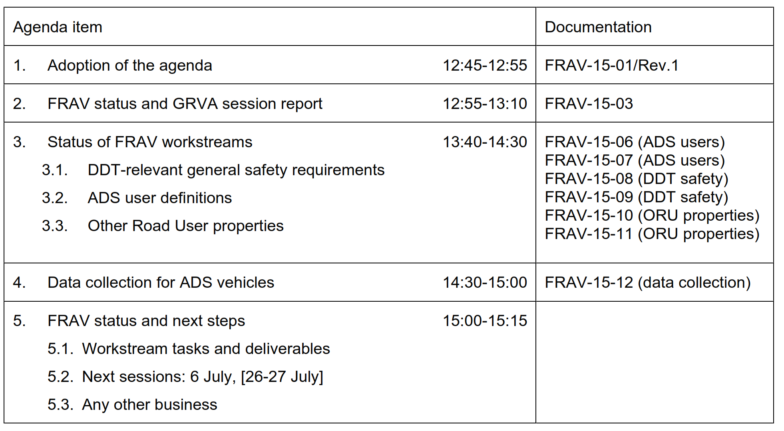
Agenda item 1
Adoption of the agenda

Slide 3
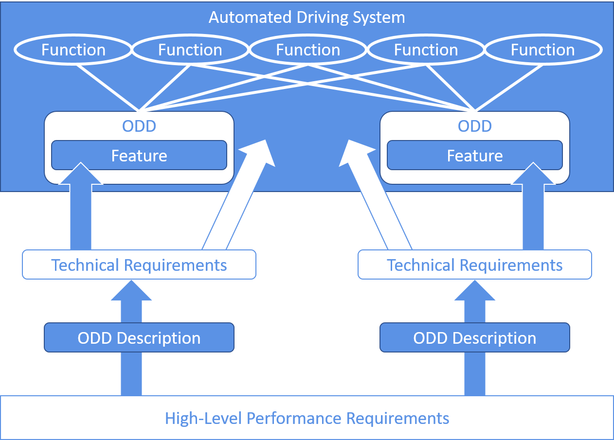
Agenda item 2
FRAV report to GRVA (GRVA-10-33/Rev.1)
Diversity of ADS and ODD
142 safety proposals
Five “Starting Points”
List of “Safety Topics”
ADS drives safely
ADS interacts safety with user(s)
ADS responds safely to critical events/conditions
ADS safely manages damage/malfunction
ADS maintains safe operational state
Originally, 40 topics related to safety needs and goals for ADS performance across the five dimensions covered by the starting points
FRAV initially addressed the diversity of ADS applications and developed a framework to enable the application of safety requirements to any ADS configuration.
FRAV gathered input from across all stakeholders, including national and regional guidelines to develop a framework covering the full range of anticipated safety needs.

Slide 4
Agenda item 2
FRAV report to GRVA (GRVA-10-33/Rev.1)
Safety topics review
Tasks/Objectives
Common Understanding
Safety Needs
19 pages of comments on interpretation and elaboration of safety topics, covering 43 topics (FRAV-12-08). Multiple references to “DDT”, “ADS user(s)”, and “other road users” indicated need to reach common understanding. Comments included concept for “guardrails approach” to ADS driving requirements.
Three workstreams:
Dynamic Driving Task
ADS users
Other road users
Three milestones:
Common understanding
Application to define safety needs
General requirements to address safety needs
DDT: FRAV-14-07/Rev.1
ADS users: Working on descriptions of user roles/ responsibilities
ORU: Definition of common and special physical, functional, and/or behavioral properties based on ORU cases
New task: Apply DDT understanding to relevant safety topics with aim to propose safety requirements
Identify safety needs relevant to the diverse roles human users may have across ADS configurations and to ORU based on the common and special properties, based on elaboration of safety topics.
Consensus on approach(es) to addressing safe ADS performance of the DDT (nominal and safety-critical conditions) building from safety topics.

Slide 5
Agenda item 2
FRAV report to GRVA (GRVA-10-33/Rev.1)
General Requirements
Specifications
ADS descriptions
Package Delivery
General safety requirements addressing safety needs based on starting points framework and elaboration of safety topics. “General safety requirements” means definition of what should be verified for what reasons. Specifications (e.g., criteria, limits, formulas) would follow.
FRAV has discussed several approaches to defining specifications, especially related to ADS performance of the DDT:
Careful & Competent Human Driver
State of the technologies
Mathematical formulas (e.g., “safety envelopes”)
Positive statistical risk balance
Specifications need to address traffic efficiency and safety (such as “string stability”) so combinations of methods are likely in finding optimal solutions.
Based on understanding of requirements, FRAV can return to its original framework to develop guidelines regarding documentation required to understand each ADS (e.g., configuration, intended uses, and limitations on use) and application of requirements.
Package consisting of guidelines for ADS documentation, safety requirements, and other guidance as needed to understand application of safety requirements to individual ADS applications.
(GRVA-11 September 2020)
(GRVA-12 February 2021)

Slide 6
Agenda item 2
FRAV report to GRVA (GRVA-10-33/Rev.1)
Purpose of Data Collection | Applicability of Data | Data Set | General Description
Accident analysis/ reconstruction | All vehicles | A | Data on vehicle state/performance
 | Conventional vehicles (no ADS) | B | Data on actuation of manual driver controls
 | Vehicles equipped with an ADS | C1 | ADS data on DDT performance
 | Vehicles equipped with an ADS designed to interact with a user | C2 | Data on user behavior/interactions with ADS
Evaluation of system operations/research/ assistance with accident analysis ( L3-L5) | Vehicles equipped with an ADS | D1 | Non-crash ADS operational performance data
 | Vehicles equipped with an ADS designed to interact with a user | D2 | Non-crash user interactions with ADS
CONCEPT ILLUSTRATION ONLY
Elements in the data sets are mutually exclusive (i.e., no duplication) and may be combined depending upon the vehicle configuration, for example:
Conventional (manual only) vehicle → A + B
ADS with human driver controls → A + B + C1 + C2 + D1 + D2
Driverless passenger vehicle → A + C1 + C2 + D1+ D2
Driverless commercial vehicle (no occupants) → A + C1 + D1

Slide 7
Agenda item 2
FRAV status: Tasks
Agreed on description of Dynamic Driving Task
Agreed on concept to based ORU safety on ORU common and special properties
Agreed on concept for categorization of data collection
Task to reach consensus on essential “user definitions”
Task to apply DDT to general safety requirements
Task to identify common and special ORU properties
Task to apply data categorization concept to known data elements

Slide 8
Agenda item 3
FRAV workstream updates
DDT-relevant safety requirement
  Documents FRAV-15-08 and FRAV-15-09
ADS user definitions
  Documents FRAV-15-06 and FRAV-15-07
ORU physical, functional, and behavioral properties
  [Documents FRAV-15-10 and FRAV-15-11]
Data collection input for EDR/DSSAD
  [Document FRAV-15-12]

Slide 9
Agenda item 4
Outlook for next steps (thru September)
Upcoming sessions
  Session 16 (6 July): Initial general requirements
  Session 17 (26-27 July): Consolidation/initial GRVA-11 preparation
  Session 18 (9 September): 3rd review general requirements status
  Session 19 (16 September): Review GRVA submission
GRVA-11: 27 September-1 October
Four months to prepare submission to GRVA-12 (February 2022)
Are we on task? Any course corrections?

