Slide 1
ORU Properties
Submitted on behalf of the task pilot
Document FRAV-15-11
15th FRAV session, 8 June 2021
Preliminary feedback

Slide 2
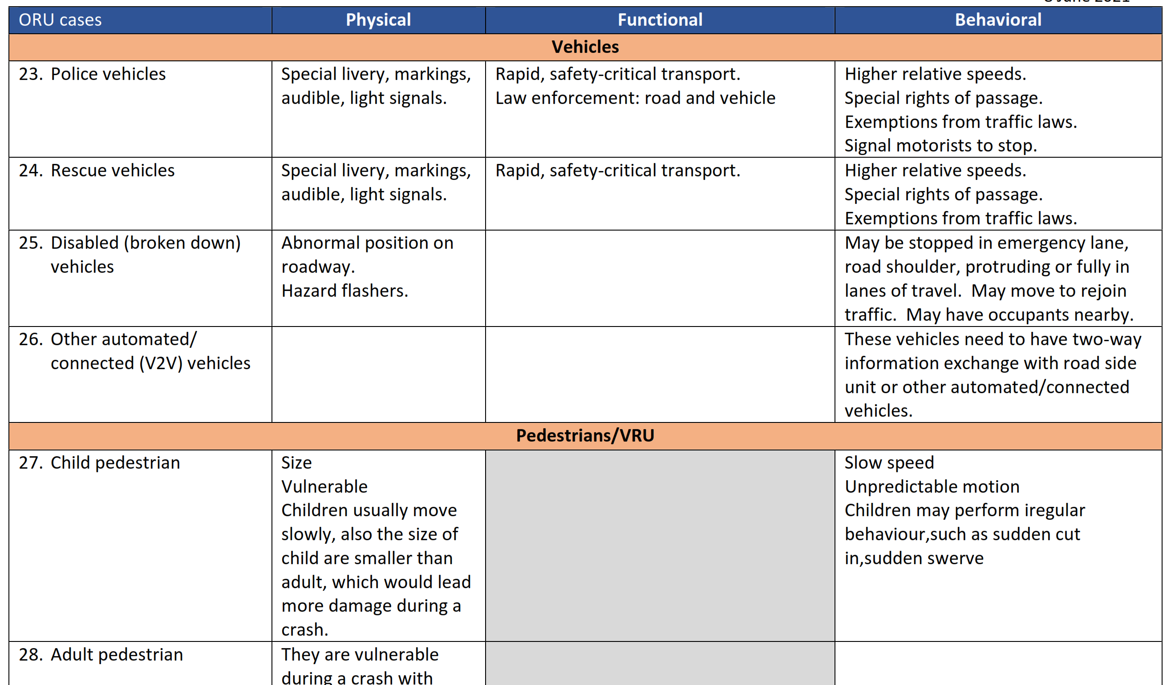
ORU properties data table
Common and special properties
Basis for safety needs/requirements
Request input to improve table

Slide 3
Performance-relevant ORU properties
Physical
Functional
Behavioral
Mobility (fixed/mobile)
Dimensions
Path (fixed/free)
Visual markings
Audible signals
Light signals
Visibility
Vulnerability
Location
Personal transport
Mass transit
Transport of children
Commercial goods
Dangerous goods
Exceptional cargo
NRMM
Emergency
Law enforcement
Relative speeds
Trajectories
Predictability
Authority
Legal exemptions
V2V relationships

Slide 4
Next steps
Preliminary input is indicative of a possible framework linking property-based classifications to performance requirements.
For example, subsets of vehicles have distinctive markings and signals to warn drivers of possible exceptional behaviors. This fact suggests a need for ADS to detect such markings and signals in order to classify the vehicles and thereby respond in accordance with the information the markings and signals are intended to convey.
The task pilot proposes to continue discussions of the properties and their relevance to ADS performance towards proposing possible ADS safety requirements for FRAV consideration.

