Slide 1
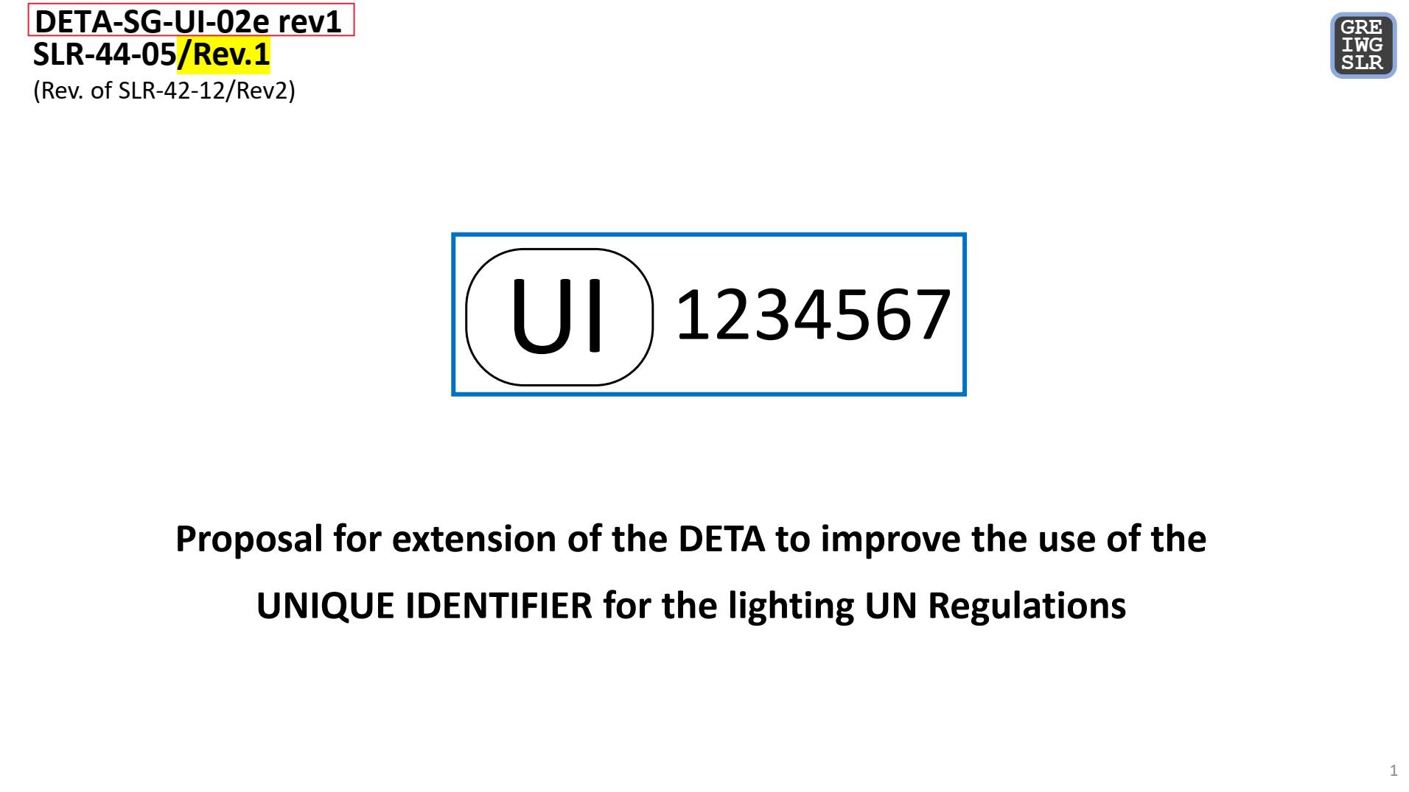
UNIQUE IDENTIFIER / DETA Database
SLR requests for improvement – Update usage and management of DETA
SLR-48-01
(Rev. of SLR-47-16)

Slide 2
UNIQUE IDENTIFIER / DETA Database
SLR requests for improvement – New document “Summary”
Proposal Part A: Document management (Example)
Summary
Headline
UI
270650
The Unique Identifier marking as on the device
R1 S1 2a F1 AR
E1
MINIMUM CONTENTS (depending on GRs decisions).
The alternative marking as in the Regulation / Explaining text for the device
Consider adding explanation on „how to read the markings“
3169
3170
148R00
Add this to the short description of the various functions.
The important is to provide equivalent information to the existing marking
The above information, except for the alternative marking, is available somewhere in the existing documents in DETA. According to the currently proposed usergroups matrix, this information could be found by authorised experts only, but not by anyone else. The existing documents also contain a lot of information that is not for public view in any case!

Slide 3
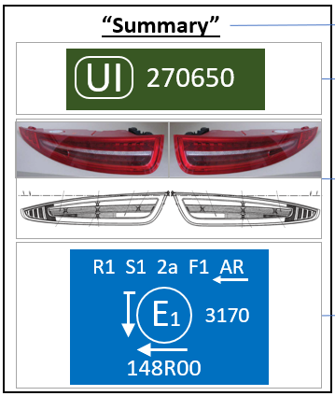
All decisions made by each GR separately for each Regulation
YES
UI available?
NO
Marking on the parts
UI
R1 S1 2a F1 AR
Marking on the parts
270650
OR
E1
3170
Summary document necessary?
NO
Summary
148R00
YES

Slide 4
UNIQUE IDENTIFIER / DETA Database
SLR requests for improvement – New usergroup(s) and access rights for DETA
Proposal Part B: Usergroup management
DOCUMENTS AVAILABLE IN DETA
+
Explanation:
R = read
W = read + write + delete
 | CERT (communication on type approval) | TR (test report) | IF (information document) | OTHER (other document)
Approval granting TAA (for granted approval) | W | W | W | W
CP applying the UN Reg. for which the approval was granted **) | R | R | R | R
CP applying UN Reg. 0 (access to the approvals of R0 and the annexed UN Regulations) | R | R | R | R
CPs not applying that UN Reg. | R | - | - | -
Manufacturer *) (only for own approvals) | R | R | R | R
“Summary” (PDF)
W
R
R
R
R
USERGROUPS DETA
Existing access rights
And documents (177th + 183rd WP.29)
Additional summary document
Additional usergroup
Periodical technical inspection, Law enforcement bodies, Repair shops, Vehicle owners, End-users / Public | - | - | - | -
R
The new usergroup has only read access right of the new document „Summary“
+
*) Manufacturers get access upon request to the DETA Administrator.
**) The DETA focal point may provide access to the Market Surveillance Authority of his/her Country,
subject to adherence with para. 91 of ECE/TRANS/WP.29/1145.

