Slide 1
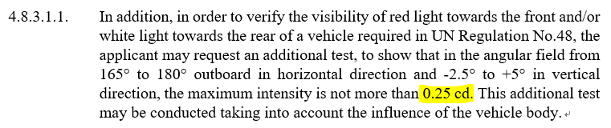
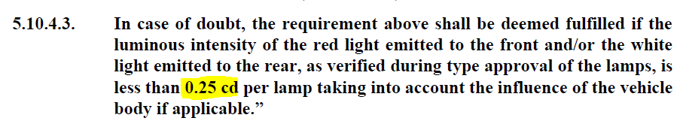
SLR-48-08
No. | 1 | Document | SLR-47-12 | Page | 19
Potential Editorial Error
Suggestion | 0.25cd → 2.5∙10⁻¹cd (confirmed)
Reference | I ask you if ‘0.25cd’ is needed to revised as ‘2.5∙10⁻¹cd’ in Paragraph 5.10.4.3. of GRE-84-05 too. R48 is not yet transferred to scientific notation.- necessary?

Slide 2
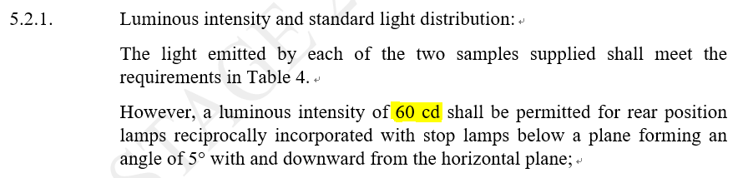
No. | 2 | Document | SLR-47-12 | Page | 21
Potential Editorial Error
Suggestion | 60cd → 6.0∙10¹cd

Slide 3
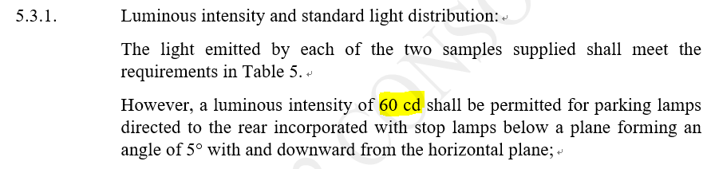
No. | 3 | Document | SLR-47-12 | Page | 22
Potential Editorial Error
Suggestion | 60cd → 6.0∙10¹cd ( confirmed)

Slide 4
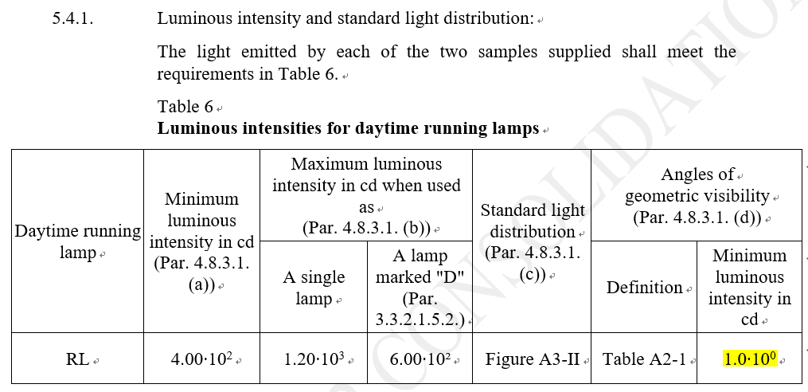
No. | 4 | Document | SLR-47-12 | Page | 2
Potential Editorial Error
Suggestion | 1.0∙10⁰cd → 1∙10⁰ (has been in the past 1.0 cd → not confirmed)

Slide 5
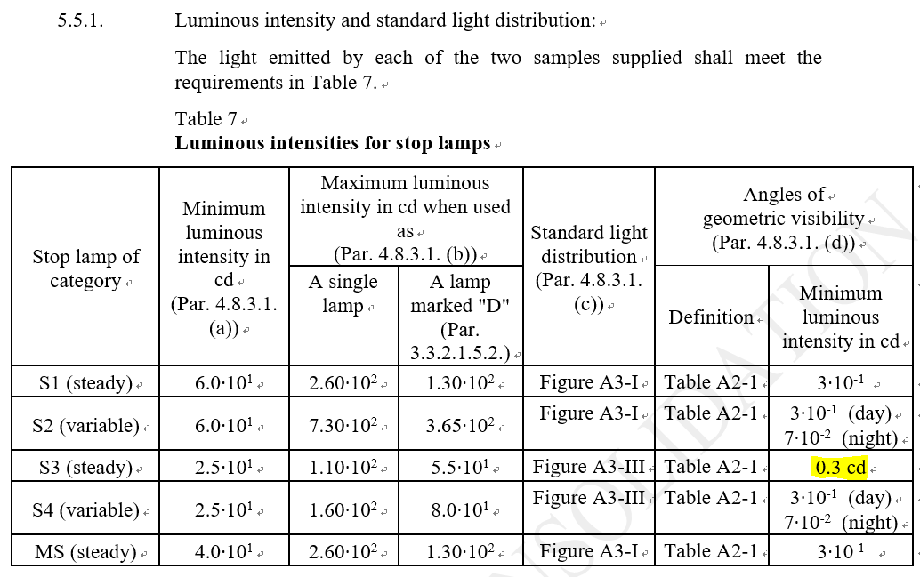
No. | 5 | Document | SLR-47-12 | Page | 24
Potential Editorial Error
Suggestion | 0.3cd → 3∙10⁻¹ (confirmed)

Slide 6
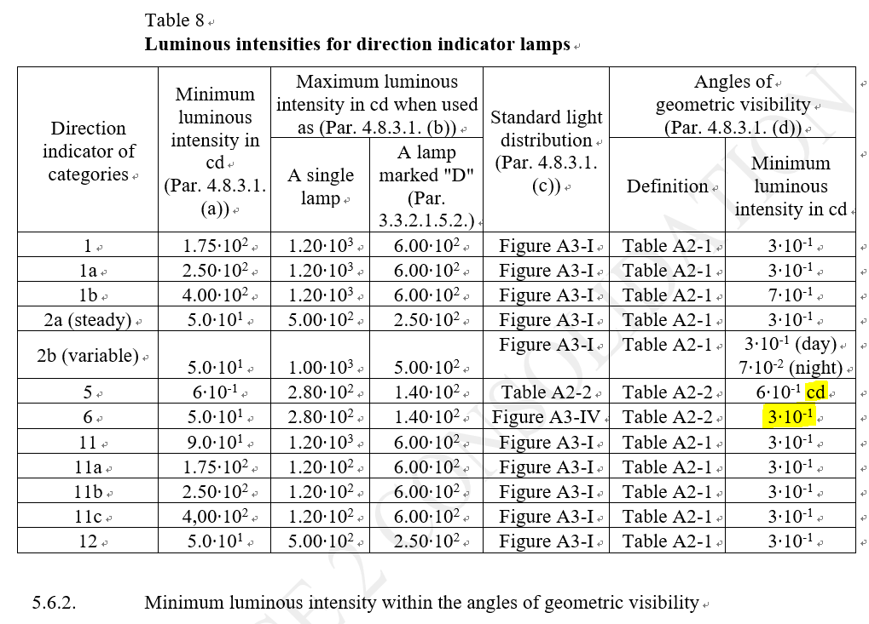
No. | 6 | Document | SLR-47-12 | Page | 25
Potential Editorial Error
Suggestion | ① 6∙10⁻¹cd → 6∙10⁻¹ ② Please check if there is requirement of the geometric visibility for Category 6 0.6 cd are defined throughout the complete field of visibility for cat.5 and the grid covers the complete visibility for cat. 6. → should be deleted in both cases

Slide 7
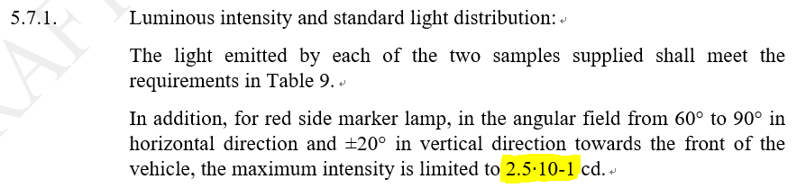
No. | 7 | Document | SLR-47-12 | Page | 26
Potential Editorial Error
Suggestion | 2.5∙10-1 → 2.5∙10⁻¹(confirmed)

Slide 8
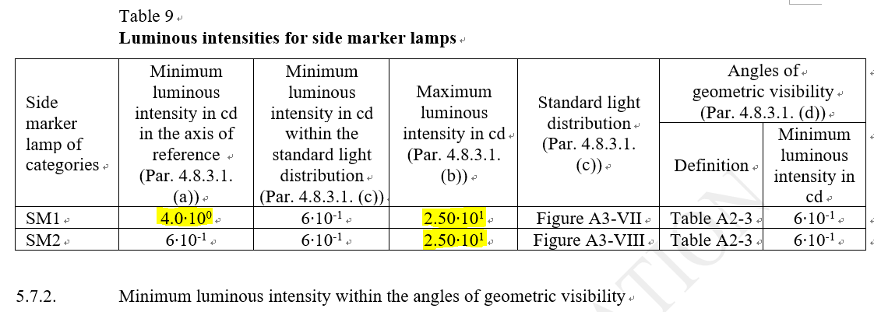
No. | 8 | Document | SLR-47-12 | Page | 27
Potential Editorial Error
Suggestion | ① 1. 4.0∙10⁰ → 4∙10⁰ ₍has been 4.0 cd → not confirmed⁾ ② 2.50∙10¹ → 2.5∙10¹₍has been 25.0 cd → not confirmed

Slide 9
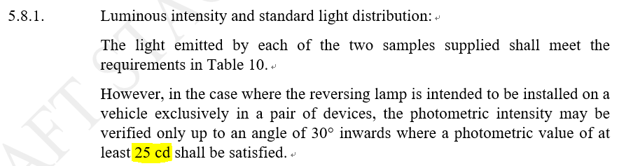
No. | 9 | Document | SLR-47-12 | Page | 27
Potential Editorial Error
Suggestion | 25cd → 2.5∙10¹cd (confirmed)

Slide 10
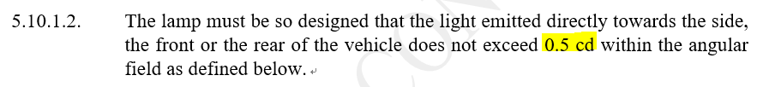
No. | 10 | Document | SLR-47-12 | Page | 29
Potential Editorial Error
Suggestion | 0.5cd → 5∙10⁻¹cd (confirmed)

Slide 11
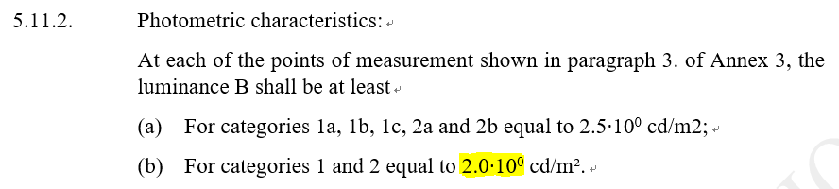
No. | 11 | Document | SLR-47-12 | Page | 30
Potential Editorial Error
Suggestion | 2.0∙10⁰ → 2∙10⁰ (has been 2 cd/m² → confirmed) (I’m not sure if Luminance also needs to be written with the scientific notation.)

Slide 12
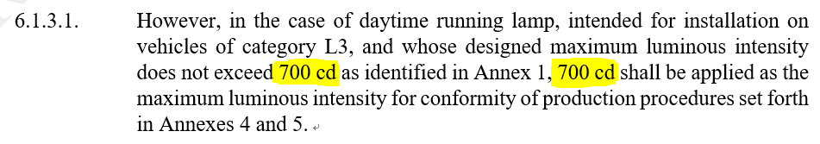
No. | 12 | Document | SLR-47-12 | Page | 31
Potential Editorial Error
Suggestion | 700cd → 7.00∙10²cd (confirmed)

Slide 13
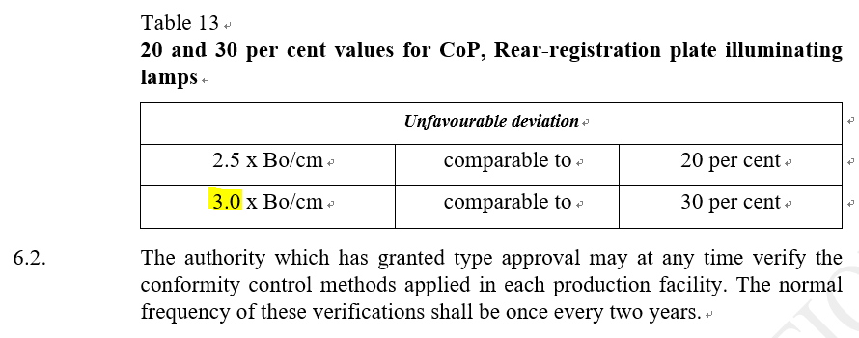
No. | 13 | Document | SLR-47-12 | Page | 32
Potential Editorial Error
Suggestion | 3.0 → ? It is not a measurement, but a calculation – no scientific notation necessary (I’m not sure which is suitable between 3.0 or 3 too.)

Slide 14
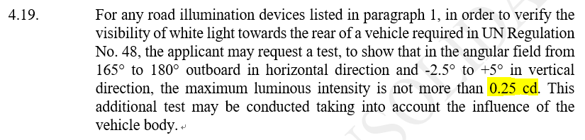
No. | 14 | Document | SLR-47-13 | Page | 24
Potential Editorial Error
Suggestion | 0.25cd → 2.5∙10⁻¹cd (confirmed)

Slide 15
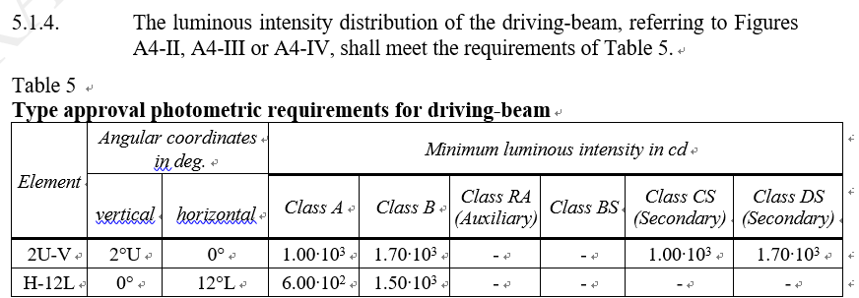
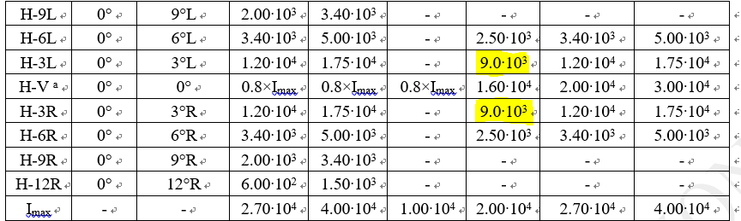
No. | 15 | Document | SLR-47-13 | Page | 25
Potential Editorial Error
Suggestion | 9.0∙10³ → 9.00∙10³ (confirmed)

Slide 16
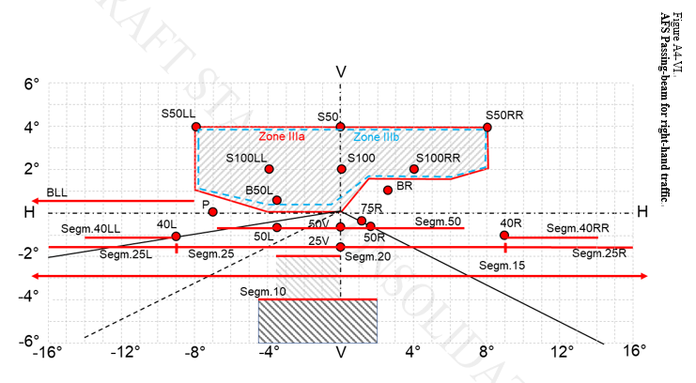
No. | 16 | Document | SLR-47-13 | Page | 71
Potential Editorial Error
Suggestion | I wonder if a point of ‘125R’ has to be included in the figure.(agree)

Slide 17
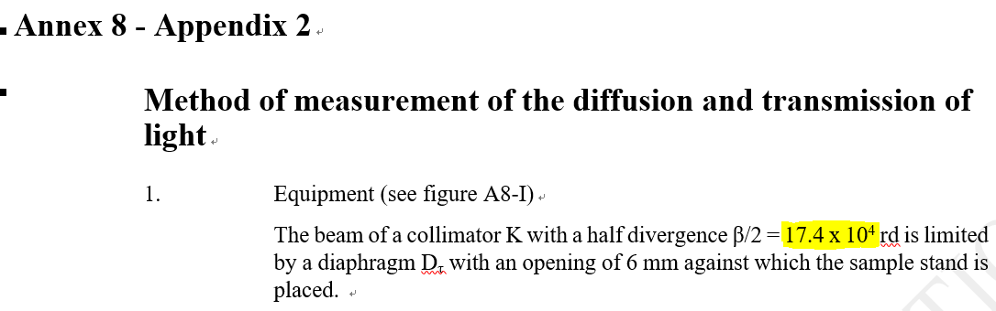
No. | 17 | Document | SLR-47-13 | Page | 107
Potential Editorial Error
Suggestion | I know the text is same with R149.00. However, I just ask you to check if it is correct notation. Identical to original text from Reg. 112.and in line with the scientific notation procedure: 3 significant digits. The value may be today written as 1.74∙10⁵
▶ R149 Series 00

Slide 18
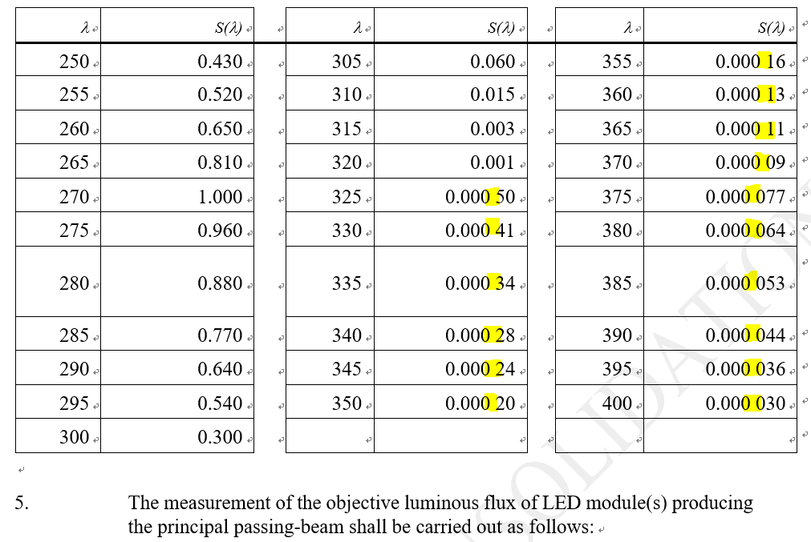
No. | 18 | Document | SLR-47-13 | Page | 113
Potential Editorial Error
Suggestion | I think it is better to get rid of spaces. Original data from ICNIRP – better readability - not agrree

Slide 19
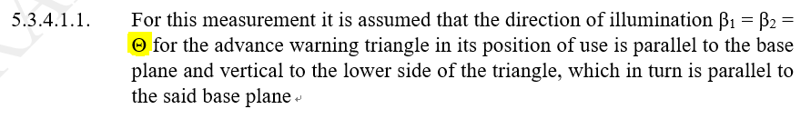
No. | 19 | Document | SLR-47-14 | Page | 25
Potential Editorial Error
Suggestion | Actually, I’m not familiar with R150 regulation. I just ask you to check it is correct notation. Text from Reg. 27 → o.K.

