Slide 1
SG2 on Simulation/Virtual Testing
Progress report
VMAD-19-04
VMAD-19
12-13 July 2021
B. Ciuffo, B. Simkin

Slide 2
List of outstanding issues
Subgroup | Outstanding questions/issues/activities to address/develop | Target Completion date
Subgroup 2 (Simulation and virtual testing) | Provide an example of a simulation toolchain for virtual testing | January 2021
 | Define requirements and methods for simulation tool-chain validation. This includes: i) defining different approaches for ADAS and ADS (in case SG2 will also need to deal with ADAS virtual testing); ii) defining appropriate metrics evaluating toolchain accuracy; and iii) defining the type of scenarios used for toolchain validation | April 2021
 | Define documentation requirements for vehicle manufacturers and ADS developers (including the establishment of a clear link with the audit pillar) | June 2021
 | Define standardization requirements to allow authorities performing in-house virtual testing (following activities carried out by ASAM and other associations) | December 2021+

Slide 3
SG2 meetings
6 SG2 meetings from last VMAD (1 per week)
  SG2 reached the 24° meeting last week
Collected all the inputs already, SG2 focused on better defining the credibility assessment framework and discussing its content
All presentations on UNECE-VMAD wiki page: https://wiki.unece.org/pages/viewpage.action?pageId=117508578

Slide 4
Assessment of ADS safety in GRVA/VMAD*
* VMAD-13-03 NATM MASTER DOCUMENT

Slide 5
Focus on Virtual Testing
Requirements
ADS Validation
ADS response to safety critical scenario (es. cut-in, deceleration, …)
Detection capabilities (detection range, object recognition, classification, … )
…
ADS driving logic (safety distance, lane-change decisions, string stability, …)
Virtual testing
ViL
HiL
SiL
ODD Analysis
Scenarios

Slide 6

Focus on Virtual Testing
Requirements
ADS Validation
ADS response to safety critical scenario (es. cut-in, deceleration, …)
Detection capabilities (detection range, object recognition, classification, … )
…
ADS driving logic (safety distance, lane-change decisions, string stability, …)
Virtual testing
ViL
HiL
SiL
ODD Analysis
Scenarios
Valid
Are there established and general practices to validate virtual testing toolchains for ADSs?
  NO!

Slide 7
Credibility rather than validation
US Naval Air System Command, 2014
NASA Standard and Hanbook on Simulation

Slide 8
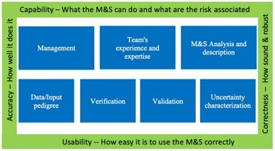
Credibility assessment
The framework identified goes beyond the toolchain validation and is based on the concept of “Models and Simulations Credibility”
  “Credibility. The quality to elicit belief or trust in Models and Simulations results.” (NASA-STD-7009A.)

Slide 9
Model and simulation (M&S) properties
1) Capability – what the M&S can do, and what are the risks associated;
2) Accuracy – how well M&S does reproduce the target data;
3) Correctness – how sound & robust are M&S data and algorithms;
4) Usability – what training and experience is needed and what quality of the process applied to it.
5) Fit for Purpose – how suitable the M&S is for the ODD and ADS assessment.

Slide 10
Credibility assessment framework applied to ADS validation

Slide 11
Structure of the new NATM Chapter (VMAD-SG2-22-02_Credibility_Assessment.docx)
Example of virtual tool-chain for ADS validation
Introduction, motivation and scope
  Difference between ADS validation and virtual toolchain validation
  Why is the credibility assessment needed to use virtual testing in ADS validation
Components of the Credibility Assessment Frameworks
Documentation structure
Interdependices with SG1 and SG3

Slide 12
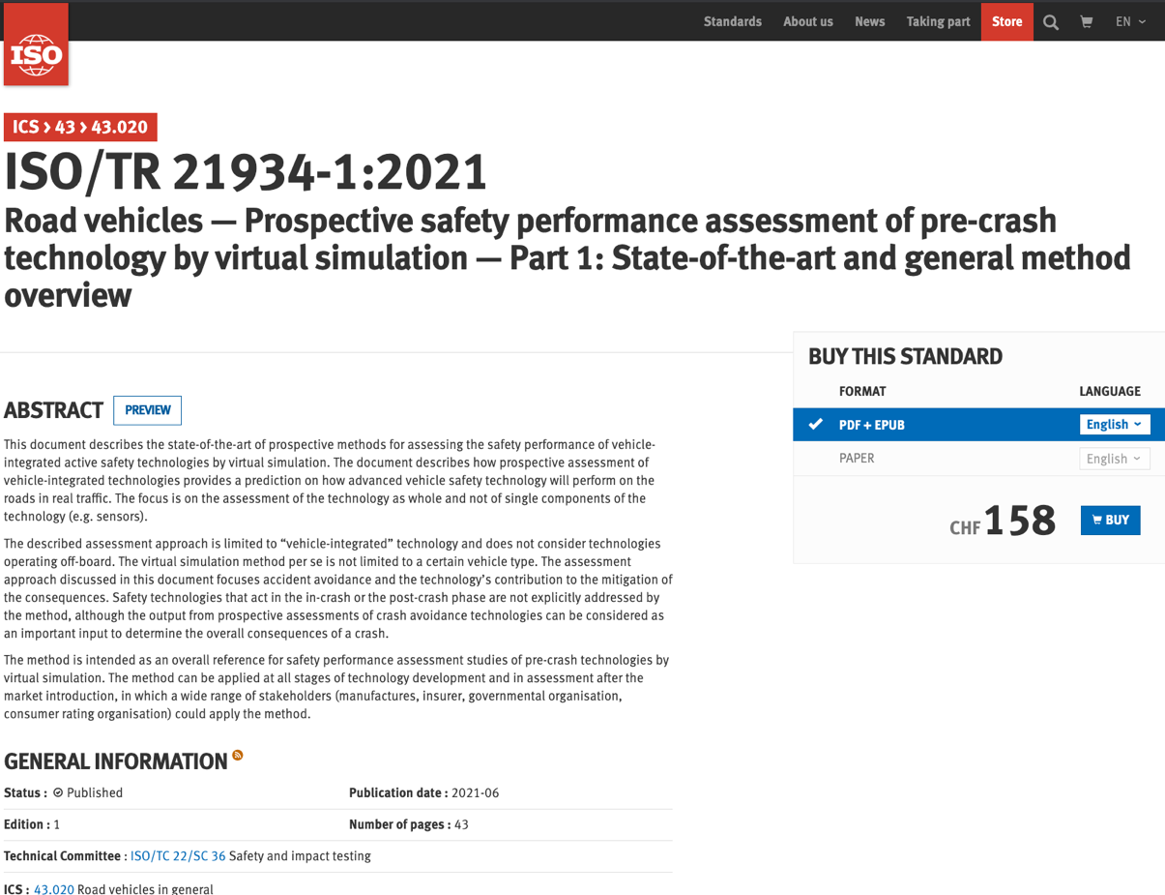
ISO/TR 21934-1:2021

Slide 13
SG2 High Level Work-Plan
First complete amendment of NATM Chapter 6 -> 09/2021
Finalisation of the new version of NATM Chapter 6 following WP29 comments -> 12/2021

Slide 14
Next steps
12-13/07
  Presentation of on-going activities to VMAD and collection of feedback
14/07
  SG2 not taking place
  Presentation about ISO/TR 21934-1:2021 to be shared within SG2 https://www.iso.org/standard/76497.html
21-28/07 (invitation to be provided)
  Discussing about validation chapter and remaining open issues
  21 is National Holiday in Belgium. Anyone concerned?
01-08/09
  Fine tuning of the document for submission to VMAD and GRVA

Slide 15
Thank you
Biagio.CIUFFO@ec.europa.eu
bsimkin@nvidia.com
Notes:
Update/add/delete parts of the copy right notice where appropriate.
More information: https://myintracomm.ec.europa.eu/corp/intellectual-property/Documents/2019_Reuse-guidelines%28CC-BY%29.pdf

