Slide 1

Report SG4 Activities
VMAD-19-05
VMAD Meeting 12 & 13 July 2021

Slide 2

Report on Overview Available Methods, Practices and Tools
Inventory document
Comments received: China, Japan, AVL (inserted)
Flexible document
Still open for methods, practices and tools “discovered”.
As concept available for NATM.
2

Slide 3
Test methodology: Test Matrix
Presented earlier…..
Suitable tool for testing?
As a start for development of methodology; a possible approach
Input asked from members how to elaborate and develop
  Or alternatives?
Still ongoing
3

Slide 4
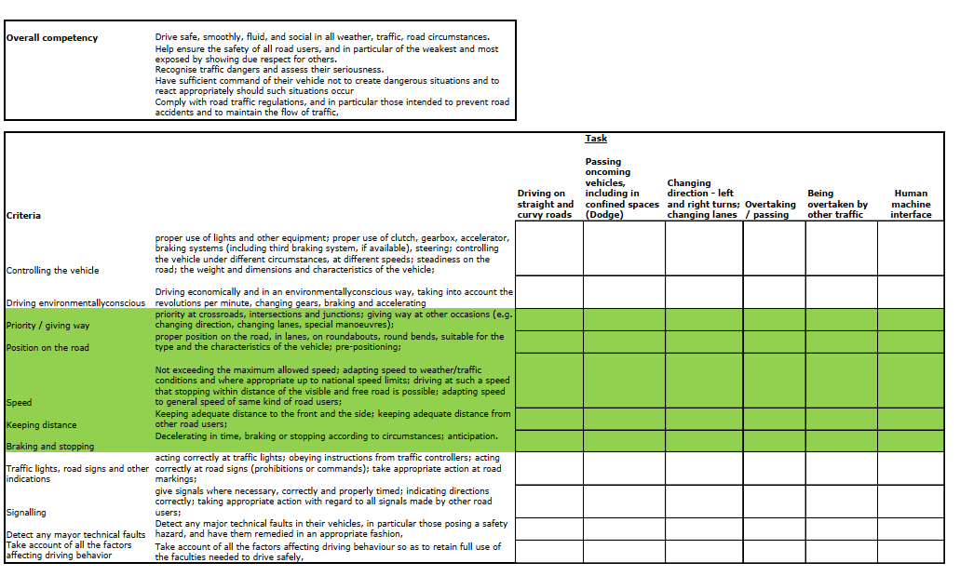
Possible approach for a test matrix
4

Slide 5
”Content” of the test methodology: FRAV list of ADS safety topics
FRAV’s Topics for (functioning of) ADS (functional requirements)
Commented in general by SG4 (previous to last VMAD meeting)
“Content” for Track- and Real world testing
Things to be done:
Discussion of the (40) topics: what could be assessed using TT and RWT?
“Criteria” to be used for testing on TT and RWT…
Specifications: what is exactly meant by each safety topic (description to be developed by FRAV). Result: specified test protocols for TT and RWT
Is this list complete?
5

Slide 6
Next steps
Meeting (in short term) with FRAV: get an understanding of what to expect when and schedule SG4’s work around it.
Development of test methodology (method and tools to be used) and test protocols with pass / fail criteria for TT and RWT based on FRAV input also using “best practices”?
  Next SG4 Meeting: 28 July 2021
In September: General description of test approach
Medium term: Also try-outs and validation…
6

