Slide 1
VMAD SG3
Audit & Assessment
In-use monitoring and reporting
VMAD-19-06
19th VMAD Meeting
M. C. Galassi, A. Lagrange
12 July, 2021

Slide 2
Work accomplished by SG3
We drafted requirements for audit and safety assessment
Draft documents:
  VMAD-SG3-09-05-Rev1 Building blocks AUDIT SMS (3).docx
  VMAD-SG3-09-06-Rev1 Building blocks ADS Safety Assessment.docx
Proposed building blocks for ISM (VMAD-SG3-10-04) and possible way forward (VMAD-SG3-11-04)
Asked for written comments to SG3 participants

Slide 3
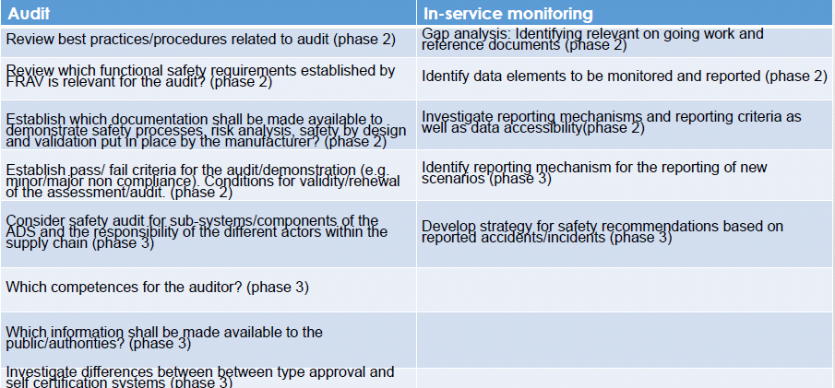
“Outstanding Issues” (VMAD-18-06)

Slide 4
Status update – AUDIT&ASSESSMENT
Target completion date: September, 2021
Establish documentation necessary to demonstrate safety by the manufacturer
Establish pass/ fail criteria for audit/ demonstration. Establish conditions for validity/ renewal of assessment/ audit
For the safety assessment documentation, we are waiting for the written input by SG3 participants and we will submit a revised text for the Sept session of VMAD for review
For the AUDIT of the SMS, we committed to merge our text with the text submitted by NL

Slide 5
Status update – IN-SERVICE MONITORING
Target completion date: September, 2021
Identify data elements to be monitored and reported
Investigate reporting mechanism and reporting criteria as well as data accessibility
ISM still in the scoping phase: difficult to dive into more detailed discussion than what is done at present
Big differences between motorway applications and other applications
We may have to downgrade our level of ambition at this stage in particular because the safety target is still not clear: we need ASAP clear input from FRAV

Slide 6
Next Steps
We will send a revised text for the September session of VMAD for review
Written input by SG3 participants is needed
NEXT MEETING: July 20th 2021

Slide 7





Keep in touch
EU Science Hub: ec.europa.eu/jrc
@EU_ScienceHub
EU Science Hub – Joint Research Centre
EU Science, Research and Innovation
Eu Science Hub
Notes:
Delete/update as appropriate

Slide 8

Thank you
© European Union 2021
Unless otherwise noted the reuse of this presentation is authorised under the CC BY 4.0 license. For any use or reproduction of elements that are not owned by the EU, permission may need to be sought directly from the respective right holders.
Notes:
Update/add/delete parts of the copy right notice where appropriate.
More information: https://myintracomm.ec.europa.eu/corp/intellectual-property/Documents/2019_Reuse-guidelines%28CC-BY%29.pdf

