Slide 1


OICA/CLEPA Input
to the
TF ADAS - 05
with regard to
Align an approach to a more detailed
use case description

Slide 2
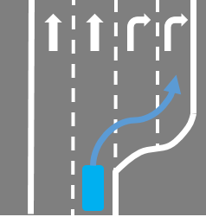
Examples of a more detailed use case description
Use Case
Assisting changing lanes in a non-highway environment
Description
Assisting the driver in performing a lane change in urban or inter-urban scenarios (e.g. changing from one lane to another at a fork/intersection)
ODD
Domain:
Urban
Inter-urban
Speed:
< [70]km/h
Assumed driver supervision/involvement:
To be ensured
General Tasks (in that scenario, regardless of who (system/driver) performs them)
Identify need to change lanes
Identify correct lane
Identify availability of target lane
Change into appropriate lane
React to other road users
Research/Data/Statistics
Accidentology (DESTATIS 2019)
Urban roads: 35 Fatalities, 1241 serious injuries, 11083 slight injuries
Rural roads: 39 Fatalities, 743 serious injuries, 2916 slight injuries
occur between vehicles moving parallel in the same direction.
→ 4.4% of accidents with personal injuries.
Max. system support
Min. system support
System identifies need to change lanes
System identifies correct lane
System initiates change into appropriate lane
System reacts to other road users
to assist the driver in changing into the correct lane.
Driver initiates lane change
System supports driver in changing lanes
General Requirements to address this use case
Ensure driver supervises the vehicle behavior and environment
Ensure vehicle behavior is predictable to the driver (e.g. informations and warnings) .
Ensure vehicle behavior remains controllable by the driver.
Ensure system has sufficient environmental perception/information

Slide 3
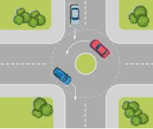
Examples of a more detailed use case description
Use Case
Assisting Driving through roundabouts
Description
Assisting the driver in driving through a roundabout
ODD
Domain:
Urban
Inter-urban
Speed:
< [70]km/h
Assumed driver supervision/involvement:
To be ensured
General Tasks (in that scenario, regardless of who (system/driver) performs them)
Approach roundabout at appropriate speed
Yield to other road users before/when entering/exiting the roundabout
Drive through the roundabout
Take the right exit
Research/Data/Statistics
Accidentology (DESTATIS 2019)
Urban roads: 6 Fatalities, 566 serious injuries, 4627 slight injuries
Rural roads: 8 Fatalities, 236 serious injuries, 1349 slight injuries
occur at roundabouts.
→ 2% of accidents with personal injuries.
Max. system support
Min. system support
System adapts vehicle speed to lane geometry and other road users
System plans appropriate trajectory and provides corresponding steering support
to assist the driver in driving through the roundabout.
System supports driver before and after roundabout
General Requirements to address this use case
Ensure driver supervises the vehicle behavior and environment
Ensure vehicle behavior is predictable to the driver.
Ensure vehicle behavior remains controllable by the driver.
Ensure system has sufficient environmental perception/information

Slide 4
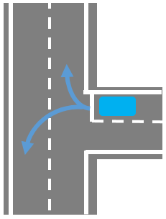
Examples of a more detailed use case description
Use Case
Assisting Turning at an intersection
Description
Assisting the driver in turning at an intersection
ODD
Domain:
Urban
Inter-urban
Speed:
< [70]km/h
Assumed driver supervision/involvement:
To be ensured
General Tasks (in that scenario, regardless of who (system/driver) performs them)
Approach the intersection at an appropriate speed
Yield to other road users in the intersection if necessary (right of way by traffic lights?)
Make the necessary turn
Research/Data/Statistics
Accidentology (DESTATIS 2019)
Urban roads: 155 Fatalities, 6973 serious injuries, 46392 slight injuries
Rural roads: 121 Fatalities, 4393 serious injuries, 18601 slight injuries
occur when turning into road.
→ 20% of accidents with personal injuries.
Specifics:
With/without traffic lights
Max. system support
Min. system support
System adapts vehicle speed when approaching the intersection
System stops at traffic lights if necessary
System plans appropriate trajectory and provides corresponding steering support
to assist the driver in making the necessary turn
System supports the driver in steering the vehicle through the intersection
General Requirements to address this use case
Ensure driver supervises the vehicle behavior and environment
Ensure vehicle behavior is predictable to the driver.
Ensure vehicle behavior remains controllable by the driver.
Ensure system has sufficient environmental perception/information

Slide 5
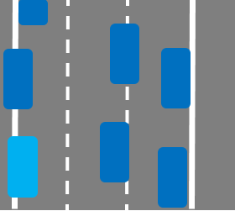
Examples of a more detailed use case description
Use Case
Forming an emergency corridor
Description
Assisting the driver in the formation of a corridor for emergency vehicles at low speed
ODD
Domain:
Highway
Multilane roads without risk of oncoming traffic
Speed:
< [30]km/h
Assumed driver supervision/involvement:
To be ensured
General Tasks (in that scenario, regardless of who (system/driver) performs them)
Assessing the situation, where the corridor shall be built
Swerving to the corresponding side of the ego lane
Checking lateral distance to lane boundaries or other vehicles
When necessary: crossing lane markings to gather additional space
Research/Data/Statistics
No accident data available in DESTATIS/GIDAS.
[2400 violations of forming an emergency corridor in Germany in 2018 (https://www.wz.de/politik/keine-rettungsgasse-gebildet-so-viele-autofahrer-wurden-2018-belangt_aid-37722789)]
Specifics:
With/without crossing of lane markings
Max. system support
Min. system support
System delivers steering support in the right direction to remind driver to form a corridor, when falling below a certain speed
System warns driver to be aware of objects in the adjacent lane / road edge
System keeps a certain minimal lateral distance to the detected objects / boundaries
System delivers steering support in the right direction to remind driver to form a corridor, when falling below a certain speed
General Requirements to address this use case
Ensure driver supervises the vehicle behavior and environment
Ensure vehicle behavior is predictable to the driver.
Ensure vehicle behavior remains controllable by the driver.
Ensure system has sufficient environmental perception/information

Slide 6
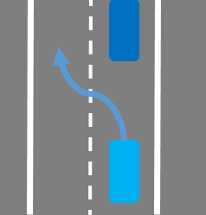
Examples of a more detailed use case description
Use Case
Changing Lanes, initiated by the system
Description
Assists the driver in performing lane changes when deemed reasonable
ODD
Domain:
Highway
Multilane roads without oncoming traffic
Speed:
No restriction
Assumed driver supervision/involvement:
To be ensured
General Tasks (in that scenario, regardless of who (system/driver) performs them)
Identify the need to change lane
Identify the availability of an appropriate target lane
Indicate the planned manoeuvre to other road users
Change into target lane
React to other road users
Control lateral and longitudinal movement
Research/Data/Statistics
Accidentology (GIDAS*, ego rear-end in left/middle lane after lane change)
Highway: 787 accidents with injuries
Other: 371 accidents with injuries
occur when being rear-ended after lane change to the left.
→ <0,5% of accidents with injuries
* GIDAS 2020_2 extrapolated to Germany, DESTATIS 2019
Max. system support
Min. system support
System identifies the need for a lane change
System identifies availability of free target lane
System informs the driver on the intention and execution to change the lane
System changes the lane automatically
System controls lateral and longitudinal movement of the vehicle on a sustained basis
System identifies the need for a Lane change
System suggests a lane change to the driver and waits for a dedicated confirmation
System controls lateral and optional the longitudinal movement
General Requirements to address this use case
Ensure driver supervises the vehicle behavior and environment
Ensure vehicle behavior is predictable to the driver (e.g. information's and warnings) .
Ensure vehicle behavior remains controllable by the driver.
Ensure system has sufficient environmental perception/information

Slide 7
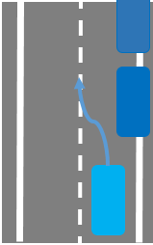
Examples of a more detailed use case description
Use Case
Driving around obstacles being in the driving lane
Description
Assisting the driver in following a driving path around obstacles, which are blocking the current driving lane.
(this is not an emergency situation)
ODD
Domain:
Urban
Interurban
Speed:
Usually in urban scenarios <[50]km/h
In inter-urban environments < [100]km/h
Assumed driver supervision/involvement:
To be ensured
General Tasks (in that scenario, regardless of who (system/driver) performs them)
Identify, if ego lane is blocked by an obstacle
Identify availability of target lane
If target lane is not available, slow down and wait
Steer into the target lane to drive around the obstacle
Keep a safe lateral distance to other road users and infrastructure e.g. parked vehicles
Research/Data/Statistics
Accidentology (GIDAS*)
Urban: 2367 accidents with injuries
Rural: 493 accidents with injuries
occur when driving into obstacles in the driving path.
→ ~1% of accidents with injuries.
* GIDAS 2020_2 extrapolated to Germany, DESTATIS 2019
Specifics:
the adjacent lane may used by traffic moving in the same or in the oncoming direction
Max. system support
Min. system support
System supports the driver in following the required driving path by identifying an appropriate trajectory, taking surrounding traffic into account.
System supports the driver in following the required driving path by identifying an appropriate trajectory only on roads where there is traffic moving in the same direction in the adjacent lane, taking traffic from behind into account.
General Requirements to address this use case
Ensure driver supervises the vehicle behavior and environment
Ensure vehicle behavior is predictable to the driver.
Ensure vehicle behavior remains controllable by the driver.
Ensure system has sufficient environmental perception/information

