Slide 1
A modular tool for safety assessments of human-machine-interaction for assisted driving functions (SAE Level 2)
André Wiggerich

Slide 2
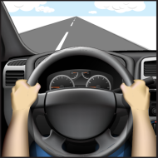
Why do we need safety assessments of L2?
SAE J3016 – Level 2
Object and Event Detection and Response (OEDR)
Detection
Recognition
Classification
Response
Preparation
Response
Execution

Slide 3
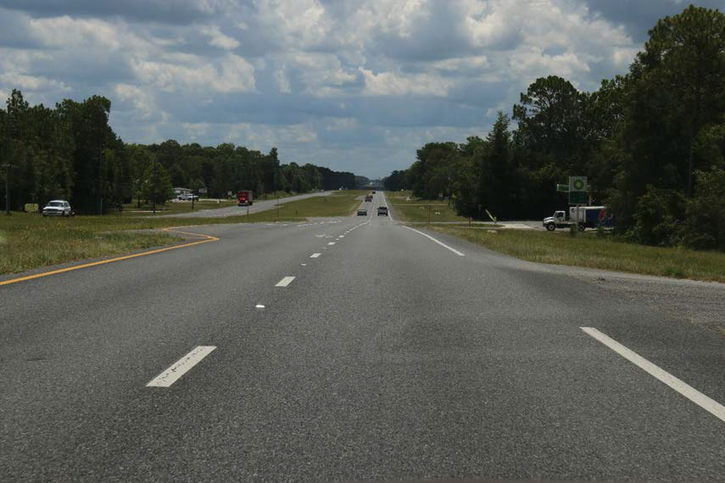
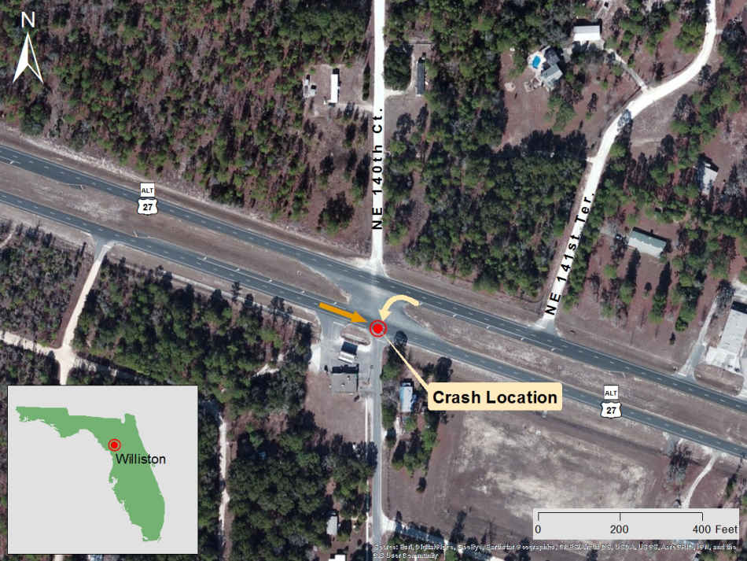
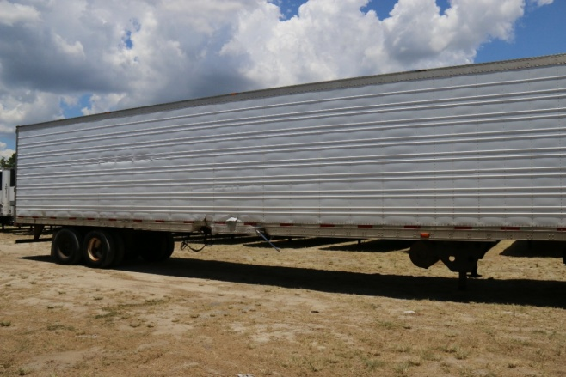
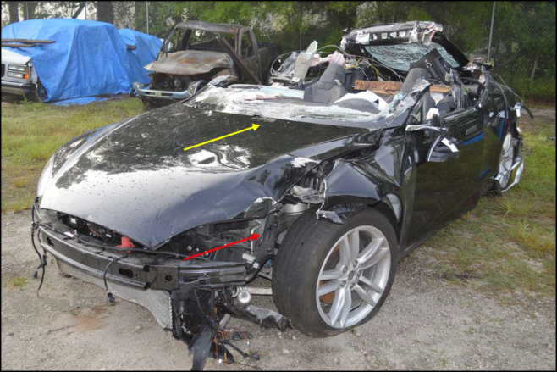
Why do we need safety assessments of L2?
NTSB/HAR-17/02
PB2017-102600
Notation 56955
Adopted September 12, 2017
Tesla driver´s view
“Collision Between a Car Operating With
Automated Vehicle Control Systems
and a Tractor-Semitrailer Truck
Near Williston, Florida
May 7, 2016“

Slide 4


Why do we need safety assessments of L2?
Low Reliability System Design
Detection
Recognition
Classification
Response
Preparation
Response
Execution
Driver-Vehicle-Interaction
Time

Slide 5
Why do we need safety assessments of L2?
High Reliability System Design
Detection
Recognition
Classification
Response
Preparation
Response
Execution
Driver-Vehicle-Interaction
Time

Slide 6
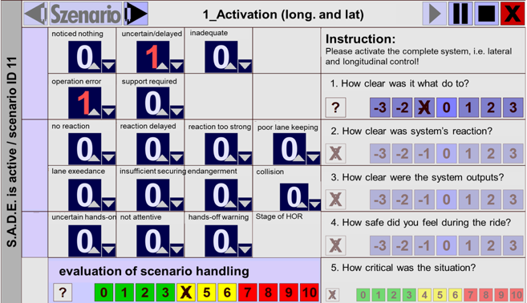
User Based Assessment
Assessment Categories
System Control Related Problems
General Vehicle Guidance Related Problems
Monitoring Behaviour and Misuse
General Safety Rating of Human-Machine-Interaction

Slide 7
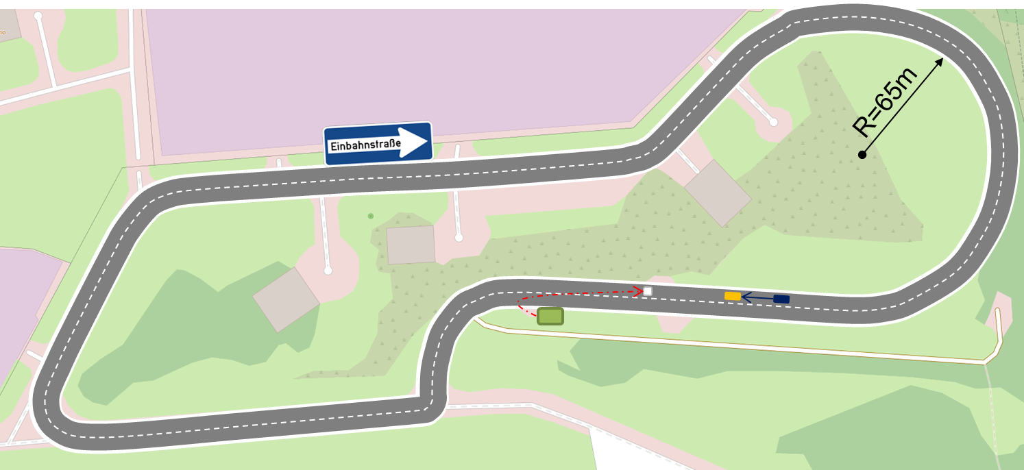
Test Track Validation Study
2 Testvehicles/-systems
40 Participants in total
14 Laps á 1.6km
50 kph
1 Test Scenario
© OpenStreetMap

Slide 8
Test Track Validation Study
System A
© OpenStreetMap

Slide 9
Test Track Validation Study
System B
© OpenStreetMap

Slide 10
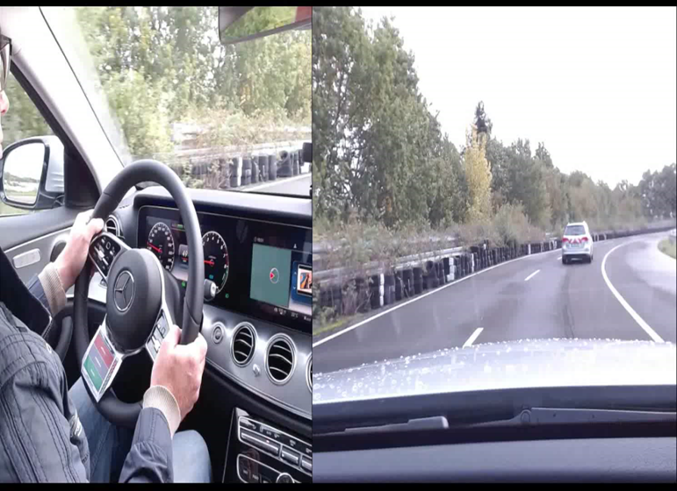
Test Track Validation Study
System A
© OpenStreetMap

Slide 11
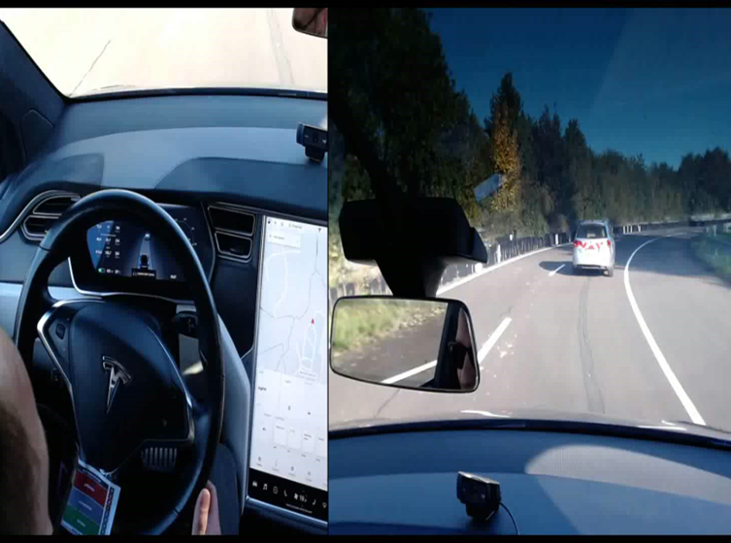
Test Track Validation Study
System B
© OpenStreetMap

Slide 12
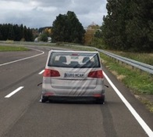
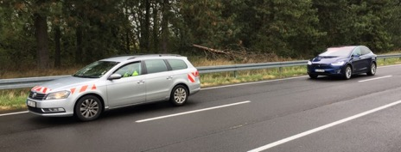

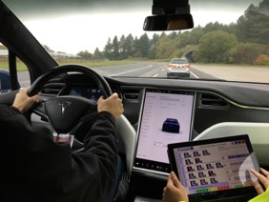
Test Track Validation Study

Slide 13
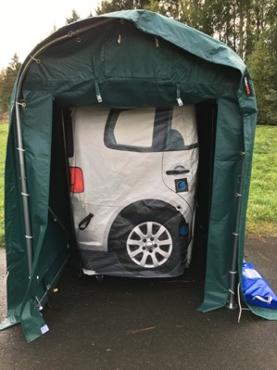
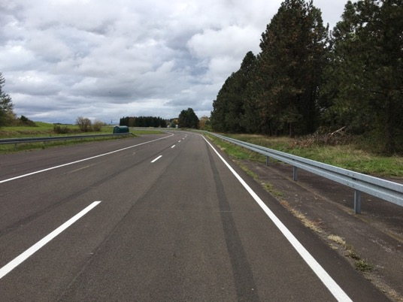
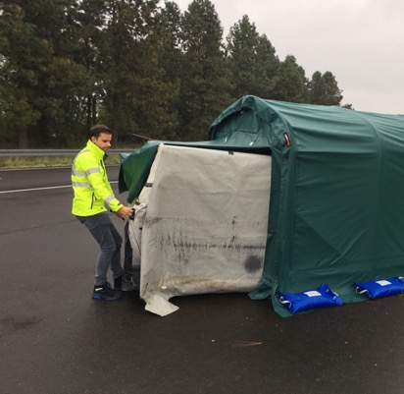
Test Track Validation Study

Slide 14
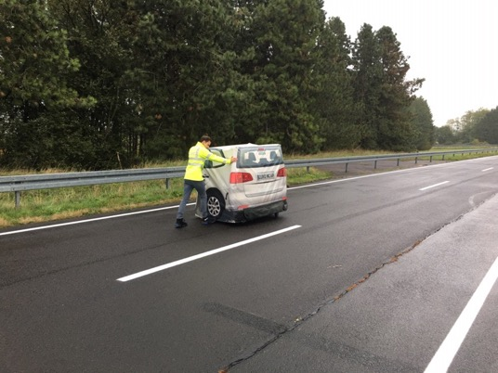
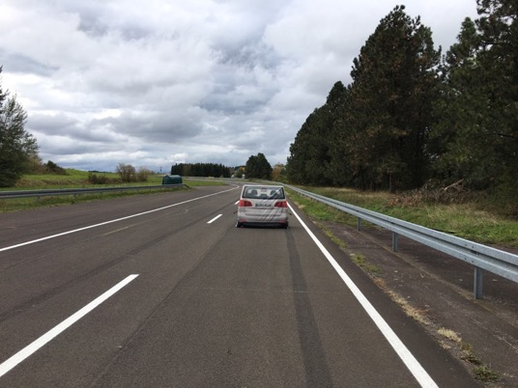
Test Track Validation Study

Slide 15
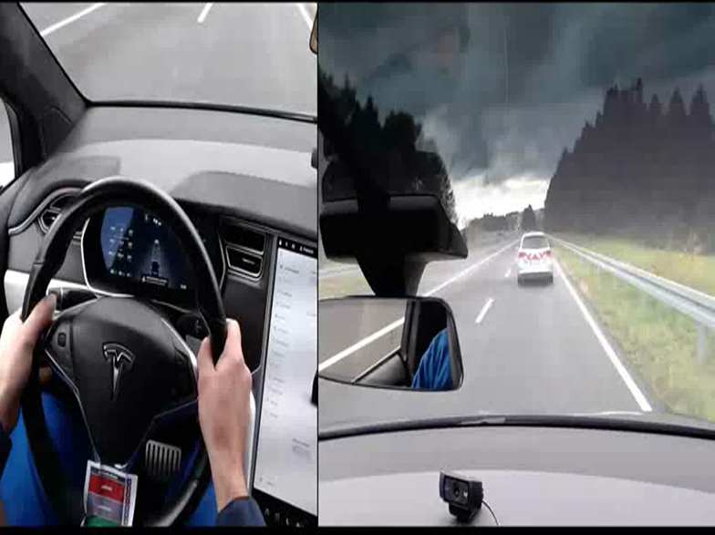
Test Track Validation Study

Slide 16
Test Track Validation Study
Test scenario is failed as soon as at least one out of three criteria is not met:
  All (100%) of 20 participants avoid a collision with the stationary target in the cut-out situation.
  The mean TTC_min value to the stationary target is >1.0s.
  Participant´s reaction in the cut-out situation is assessed at least ‘acceptable’ (<7) on the standardized scale by the trained rater.

Slide 17

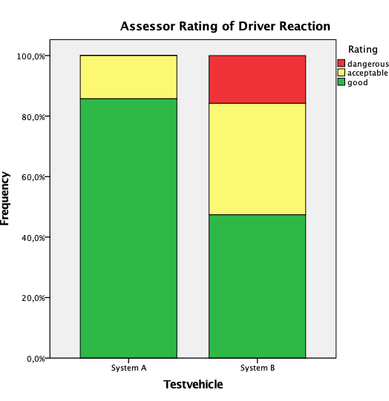
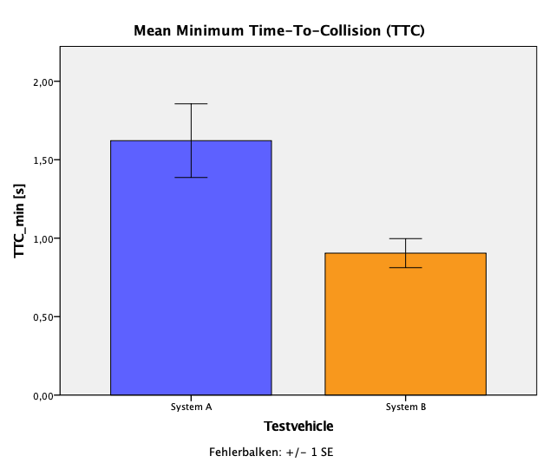
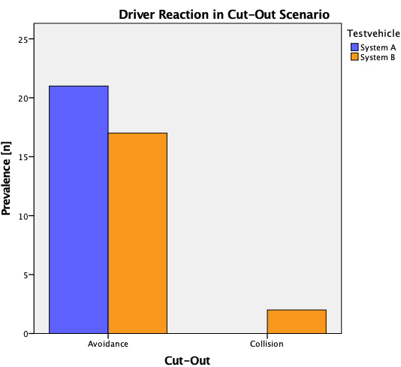
Test Track Validation Study
r=-.58**
→ 10% of System B drivers collide with target vehicle, 0% of System A drivers
→ Significant more System B drivers react in dangerous ways
→ System B drivers have significantly lower TTC minimum (on average <1s)

Slide 18
Thank you for your kind attention!

