Slide 1
Position Paper
ADVANCED DRIVER ASSIST SYSTEM
Lone Otto,
FIA Representative UNECE
^{5th} ADAS TF on ADAS
14-15 JUNE 2021

Slide 2


Slide 3
Advanced Driver Assistance Systems (ADAS) promise to deliver a substantial contribution to road safety.
In May 2019, the European Parliament agreed that several safety systems like driver drowsiness and intelligent speed assistance must be present on new car models from July 2022 and on all existing models from 2024.
To reap the potential safety benefits of ADAS, a variety of conditions should be met.

Slide 4
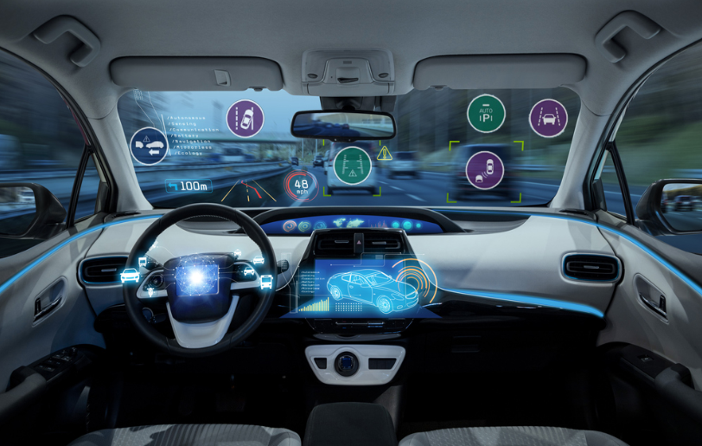
The technical optimization of ADAS is crucial, both in terms of system limitations and Human Machine Interface (HMI).
At the same time, measures should be taken to increase drivers’ awareness of ADAS.

Slide 5
All existing ADAS functions need a minimum set of requirement to support the next generation/ level of ADAS.
We do recommend regulation for all ADAS, but even more than that, we would like to draw attention to the limitation of the current ADAS- from a consumer perspective.
All new technology in the margin of ADAS (and soon ADS) is dependent on the existing ADAS like AEB, LKA etc. and as long these systems are not approximately reliable in all conditions or similar the way it is designed and how to act and behave, no new technology will ever perform better that the poorest factor. This is also in relation to the categorization of the systems, whether it is to perceived as a comfort- or safety systems.

Slide 6
We do believe that any ADAS must be more reliable and trustworthy, not to mention transparent, which will result in the system will be used more active in the future and the consumer will achieve the feeling that system is a help instead of a jungle of complexity, which demands deep insight in each car, each model when ever the driver must change cars.
In the FIA ADAS sub working group we support the transparency and therefore we recommend the names to be identical too.

Slide 7
“To meet the demands of the future”
We should ensure the shortcomings and limitations of existing systems from a safety perspective…..

Slide 8
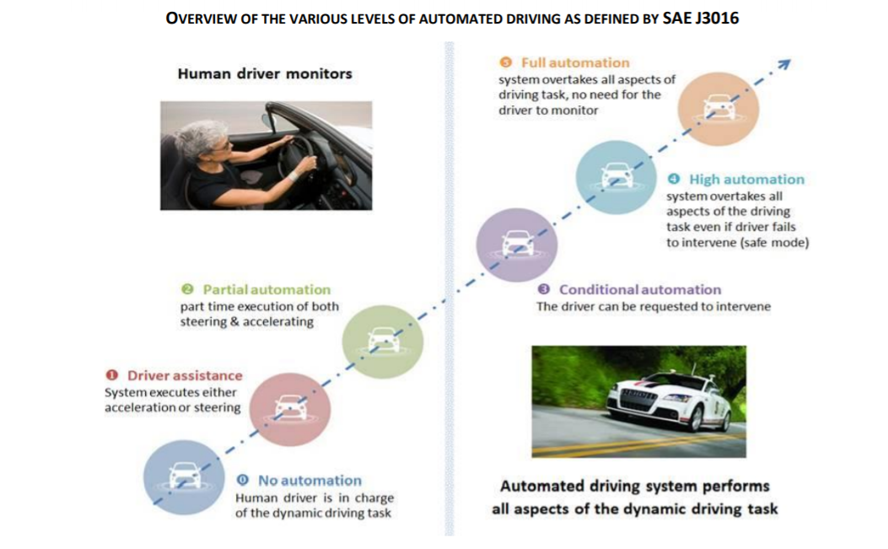

Slide 9
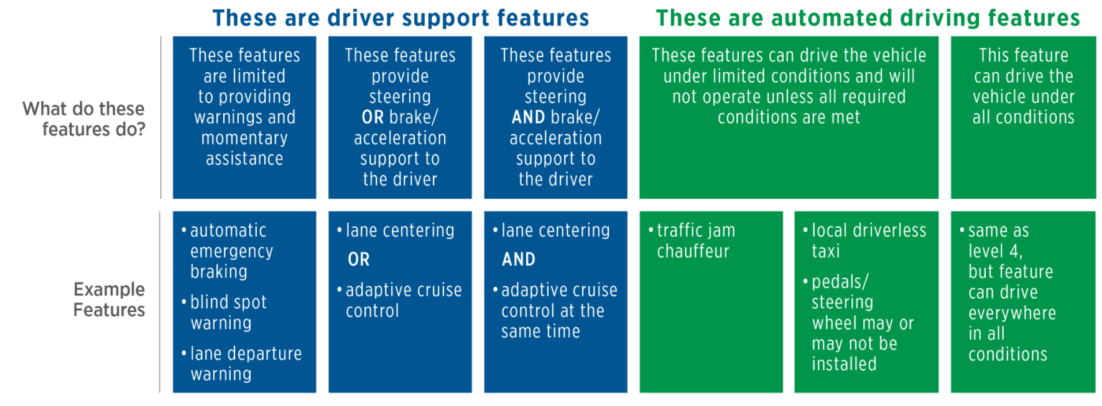
All Systems are dependent on each Other……….
ADAS….
ADS….

Slide 10
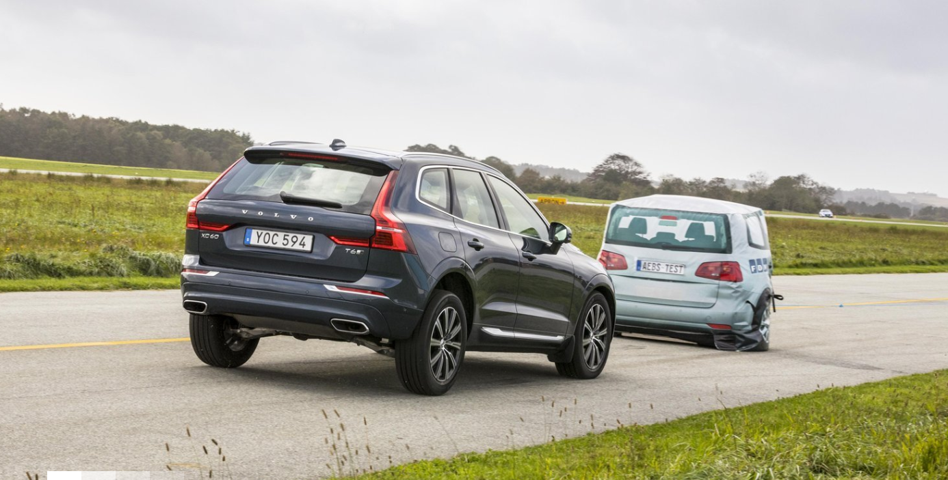
Thank you for your attention

