Slide 1
Overview on the
Hydrogen and Fuel Cell Vehicles and
Electric Vehicle Safety
Global Technical Regulations
Edoardo Gianotti
UNECE/WP.29/GRSP

Slide 2
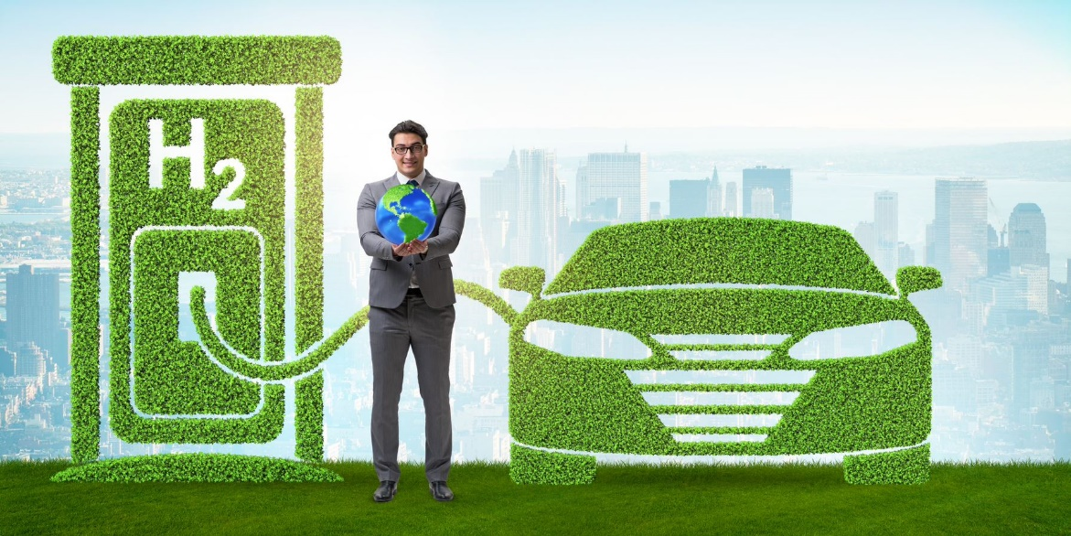
THE NEED FOR A STRATEGIC DEPLOYMENT OF HYDROGEN VEHICLES
Regulatory pressure to lower CO₂ and pollutant emissions is helping to drive an increasing market penetration HFCV
Many governments support the development and deployment of HFCV by financing research
The production capacity for hydrogen vehicles, at a scale not seen in the past
Notes:
Hydrogen is widely recognized as the key bridge to achieving carbon neutrality of the energy system, especially in hard-to-abate sectors. In a future sustainable energy system, it is argued, hydrogen—and other renewable and low-carbon gases—will be used in transport.
Furthermore, many governments support the development and deployment of HFCV and EV by financing research or offering incentives for consumers. Consequently, the automotive industry is investing in research and development, as well as the production capacity for HFCV and EV, at a scale not seen in the past.
Hydrogen essential to support the EU’s and other countries commitment to reach carbon neutrality by 2050 and for the global effort to implement the Paris Agreement while working towards zero pollution.
Renewable electricity is expected to decarbonise a large share of the EU energy consumption by 2050, but not all of it. Hydrogen has a strong potential to bridge some of this gap, as a vector for renewable energy storage, alongside batteries, and transport, ensuring back up for seasonal variations and connecting production locations to more distant demand centres.
It can offer solutions for hard to abate parts of the transport system, in addition to what can be achieved through electrification
In transport, hydrogen is also a promising option where electrification is more difficult. In a first phase, early adoption of hydrogen can occur in captive uses, such as local city buses, commercial fleets (e.g. taxis) or specific parts of the rail network, where electrification is not feasible.
Hydrogen fuel cells should be further encouraged in heavy-duty road vehicles, alongside electrification, including coaches, special purpose vehicles, and long-haul road freight given their high CO2 emissions.

Slide 3
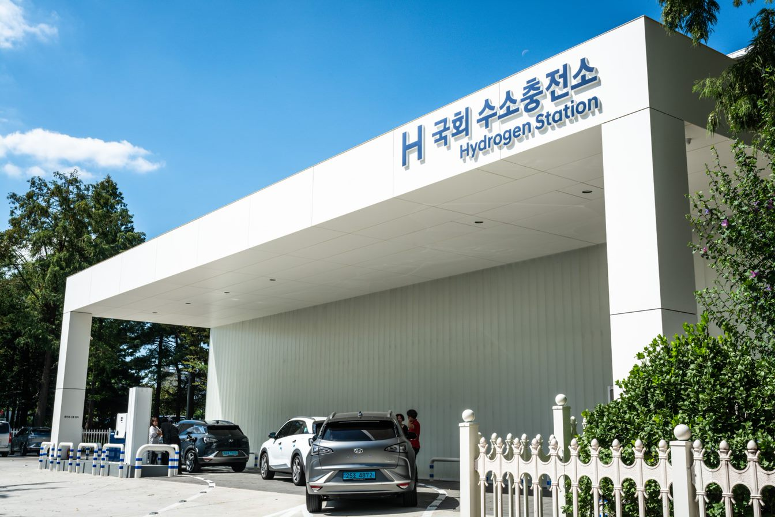
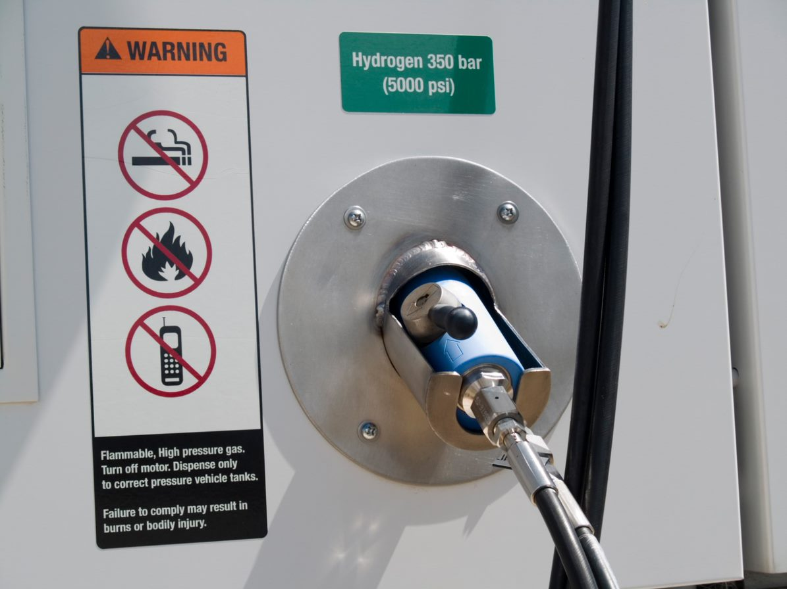
HYDROGEN COMPLEMENTARY TO ELECTRIFICATION
In transport, hydrogen is a good option where electrification is more difficult.
Early adoption of hydrogen can occur in captive uses, such as local city buses, commercial fleets or specific transport sector, where electrification is not feasible.
Hydrogen fuel cells would be further encouraged in heavy-duty road vehicles, alongside electrification, including coaches, special purpose vehicles, and long-haul road freight given their high CO2 emissions.

Slide 4



UN GTR & SUSTAINABLE DEVELOPMENT GOALS
Notes:
In 2015 the United Nations General Assembly (UNGA) set an ambitious 2030 developmental agenda as expressed in the United Nations Sustainable Development Goals (SDGs). Among the 17 interconnected SDGs are, for example, SDG 7 (affordable and clean energy), SDG 13 (climate action).
Hydrogen is widely recognized as the key bridge to achieving carbon neutrality of the energy system, especially in hard-to-abate sectors. In a future sustainable energy system, it is argued, hydrogen—and other renewable and low-carbon gases—will be used in transport, homes, industry, and power generation. It will enable the creation of an integrated service-based society. However, hydrogen, although clean and versatile, is not an energy source but an energy vector: it must be produced, transported and stored before being converted to other forms of energy, such as electricity or heat, or to other feedstocks. Therefore, it shall be produced in a sustainable way.
I particularly appreciate the efforts of the Chinese government in converting Cities like Datong, that was famous for being the coal capital, but now converting to hydrogen. It is a poignant example of efforts to decarbonize the energy system.
Harmonized Regulations, such as this UN GTR on HFCV, will complement these efforts by creating economies of scale in vehicle production especially in Emerging Economies, as a result, new technologies can be made available to a high number of vehicles using hydrogen and electricity.
The UN GTR providing this regulatory convergence is not only addressing SdG 13 on "Climate Action" but also Goal 7 to "Ensure access to affordable, reliable, sustainable and modern energy for all".

Slide 5


Better safety for all users
Performance based and technology neutral.
Not design specific requirements that might prevent future technologies
Address potential safety risks of HFCV either of vehicles in use or after a crash event
Potential scope revision to address additional vehicle classes
Requirements for material compatibility and hydrogen embrittlement
Requirements for the fuelling receptacle
Notes:
UN Global Technical Regulations administered by WP.29, are performance based and technology neutral. This UN GTR introduces performance-oriented requirements not design specific requirements that might prevent future technologies that address potential safety risks of HFCV either of vehicles in use or after a crash event.

Slide 6
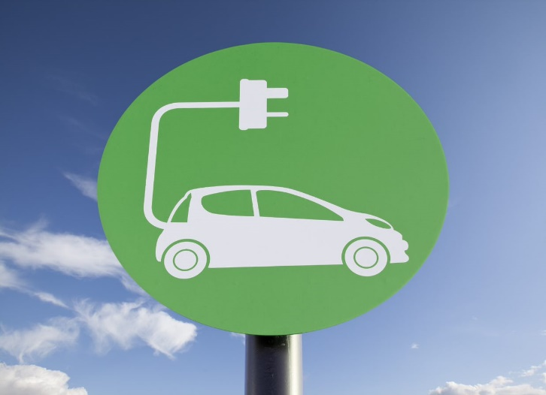
Risks
Hope that a large number of countries will accede to the 1998 Agreement and then transpose the UN GTR without any changes.
There is a small risk that countries will transpose the UN GTR with changes or just partially.
This will create “differentiating technology” disrupting the harmonization process for establishing global standards to keep pace with new innovative technologies.

