Slide 1
BSIS
Clarification on long TTCs, temporary sensor blockage and calibration
VRU-Proxi-19-04

Slide 2

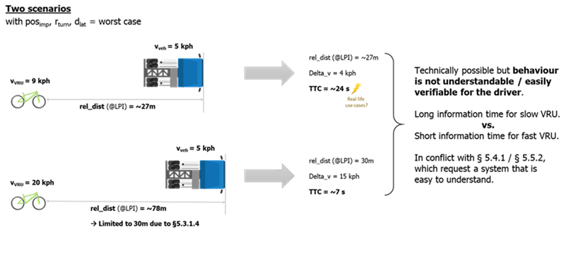
Long TTC
Proposal
Similar to limitation of the FoV (30m to the rear and 7m to the front) we propose to limit the TTC. The value must be decided within the VRU Proxy group. Example: “Information signal shall be provided, at least, when a potential collision with cyclist is less than [X] TTC”

Slide 3
Temporary Sensor blockage
Doors from buses or other auxiliary equipment might temporary block the FoV and prevent the system from fulfilling the requirements.
Proposal for a new requirement
System must only be active in case the vehicle is ready to take off.
Justification
As long as the doors of a bus are open, it could be treated as “not ready to take off”. Same applies for garbage collection vehicles and other “special purpose” vehicles that are performing actions not related to driving.

Slide 4
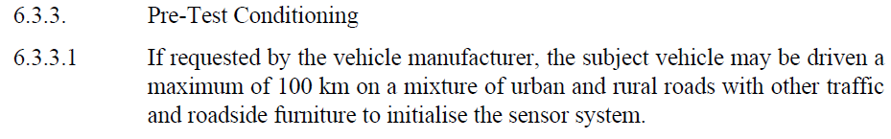
Pre-Test Conditioning
MOIS regulation
Clarification
Something similar allowed for BSIS?

