Slide 1
18th Session GRSG informal group on awareness of Vulnerable Road Users proximity in low speed manoeuvres (VRU-Proxi)
BSIS regulation
8th, 9th and 10th of June 2021
VRU-Proxi-19-06

Slide 2
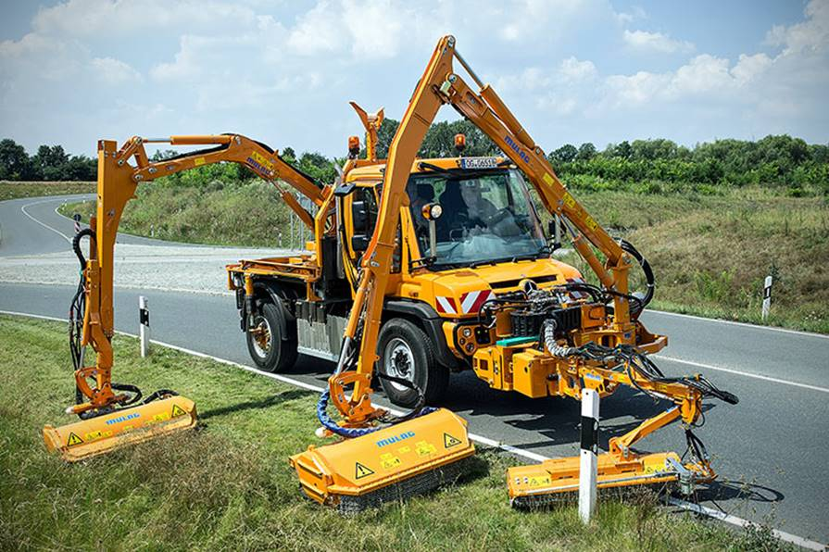


Scope exemption
Justifications:
There are some vehicle configurations for which BSIS may not work correctly (because of the vehicle body, the vehicle use…). As introduced in some UN regulations (UN-R58, UN-R73, UN-R151, UN-159…), we propose to exempt vehicles from this regulation when BSIS is not compatible with the vehicle use and if it is agreed by the Type Approval Authority.
Proposal:
Paragraph 1.3., to be added:
“1.3. The following vehicles of category M₂, M₃, N₂ and N₃ shall be exempted from this Regulation:
Vehicles where installation of any device for blind spot information system is incompatible with their on-road use may be partly or fully exempted from this Regulation, subject to the decision of the Type Approval Authority.”

Slide 3


Scope exemption - Issue
N3
UN-R 151 Applicable
O4
UN-R 151 Not Applicable
We ask VRU-Proxi members guidances for this issue
Special type O
(Maximum width 4.000mm)
2.500mm
4.000ｍｍ
Undetectable range

