Slide 1
Front and Lateral Close Proximity Awareness Update
VRU-Proxi IWG #19
216.8
JAPAN
VRU-Proxi-19-07

Slide 2
Looking out compensation for the driver’s side Eyepoint
(Annex 10 Table 3)
Vehicle category | Measures in [mm] | Forward/rearward compensation distance (+: rearward, −: forward) | Lateral compensation distance (+: right, −: left) | Upward/downward compensation distance (+: upward, −: downward)
M1 | Looking out with stretching forward side of the driver | 20 | 30 | -5
 | Looking out with stretching upper side of the driver | 10 | 30 | 0
 | Looking out as much as possible for outer side of the driver | 5 | 35 | -5
N1 | Looking out with stretching forward side of the driver | 20 | 25 | -10
 | Looking out with stretching upper side of the driver | 10 | 30 | -5
 | Looking out as much as possible for outer side of the driver | 5 | 35 | -10
* Values defined based on the study.

Slide 3
Looking out compensation for the driver’s side Eyepoint
Justification (1) Methods
Eyepoint measurements had done with using typical actual vehicles.
45 Participants
  Male 22, Female 23
  Average Age 44.8 years old (Min 20, Max 77)
  Average Height 164.2 cm (Min 146.5 cm, Max 187.3 cm)
  Average sitting height 88.6 cm (Min 79.7 cm, Max 99.7 cm)
Used vehicle
M1 Toyota Noah, N1 Toyota Dyna

Slide 4
Looking out compensation for the driver’s side Eyepoint
Justification (2) Methods
Measurements
Eyepoint was measured under 4 conditions.
Basic posture: Normal driving posture
Forward stretching posture: The posture with looking out and put eyepoint forward
without hip lifting from the seat
Upper stretching posture: The posture with looking out and put eyepoint upward
without hip lifting from the seat
Outer stretching posture: The posture with looking out and put eyepoint outward
without hip lifting from the seat
Amounts of eyepoint movement from basic posture were calculated for three stretching postures.
Eyepoint center of both eyes
Measurements had done with
- original vehicle
M1 only added
- +100 mm (upper side) modified door waist line
- +50 mm (inner side) modified door trim thickness

Slide 5
Looking out compensation for the driver’s side Eyepoint
Justification (3) Results (Average movement)
Outer stretching
(1) Original
(2) +100mm Upper
Outer stretching
Upper stretching
(3) +50mm Inner
Upper stretching
Forward stretching
Forward stretching
Adjusting values decided based on worst case (small amount of movement)
Upper stretching
(2) +100mm Upper
Upper stretching
(3) +50mm Inner
(1) Original
Forward stretching
Outer stretching
Outer stretching
Forward stretching
M1
N1

Slide 6
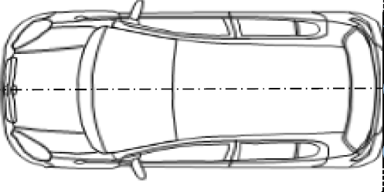
Justification for EC’s query about passenger’s side blind spot exemption (1) Concept
Normal vehicle has blind spot for passenger‘s side by A-pillar and side mirror mount.
If no blind spot allowed, basically all vehicle need to have mirror or camera.
Therefore, Japan studied non-critical condition for accident before domestic application.
Accident case is run over by rear wheel in this bind spot.
To determine the condition of vehicle speed and VRU location in order to vehicle can stop safely.
Vehicle starts
(No recognition of VRU)
VRU recognition
Recognition distance x at vehicle speed V_{x}
x
L
If Ls<=L,
vehicle can stop before run over by rear wheel.
Ls is in proportion to Vx.
Therefore, formula can express as
x<=aL+b
Vehicle stops
Stop distance after recognition
L_{s}

Slide 7
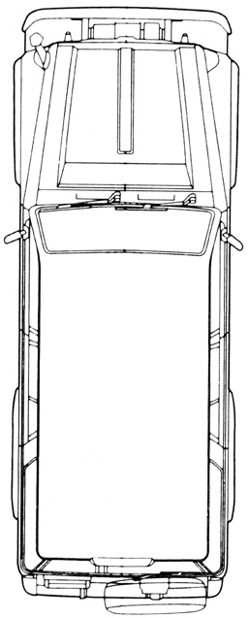
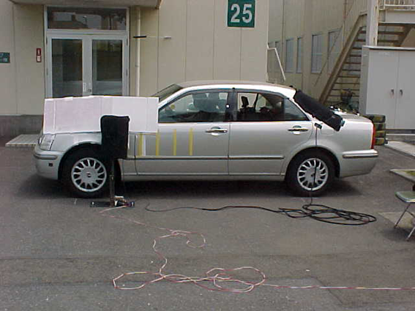
Justification for EC’s query about passenger’s side blind spot exemption (2) Methods
30 Participants (20s~50s, Male 14, Female 16)
Blind spot by A-Pillar and side mirror mount
Vehicle speed at VRU is not run over by rear wheel: v
1m height object
Blind spot length X [m]:
(Distance between objects
0, 0.2, 0.4, 0.6, 0.8 m)
Vehicle speed when object recognition by peripheral vision
: V [m/s]
95%ile line
Stop distance after recognition
: L_{s} [m]
Vehicle speed v
Vehicle speed v
Distance between recognition and rear wheel: L [m]
5%ile line
Stop distance after VRU recognition Ls
Blind spot length X
Blind spot length at VRU is not run over by rear wheel x
(Limit of blind spot exemption)
Distance to real wheel front side

Slide 8
Justification for EC’s query about passenger’s side blind spot exemption (3) Results
Median
5%tile
Blind spot exemption x<0.292L-0.203
Vehicle speed at VRU is not run over by rear wheel v [m/s]
x
L
Stop distance after VRU recognition Ls [m]
Limit of blind spot exemption: x=0.292 L -0.203
Median
95%tile
Vehicle speed at VRU is not run over by rear wheel v [m/s]
Stop Blind spot length x [m]
Range of blind spot exemption
Stop Blind spot length x [m]
Distance between blind spot to rear wheel front L [m]

Slide 9
Appendix

Slide 10
Example of blind spot projection
Blind spot at 1m height
Blind spot on the ground
Imported MPV (1-Box)

