Slide 1
Alternative Procedures for Direct Vision Assessment for “Low-End” M2/N2 Vehicles
OICA Discussion Paper for IG VRUproxi #19
Intention: simplify the compliance process for vehicles that are deemed not to be a major contributor to direct vision related accidents. In particular this refers to van-type small trucks and buses of categories M2 and N2:
  M2:
  Qualification for alternative compliance per default (denominated by “All” in right-most column of table), as GVM limited to 5t.
  N2 < 7.5t GVM:
  Additional form factors would have to be met (“Y” in right-most column), like e.g.:
    “cab-forward” design per ECE-46 or ECE-29
    existence of Class V mirrors
    height of SgRP or height of daylight opening lines
    another potential criterion was existence of air-brakes
The vehicle type meet above criteria could choose an alternative “simplified procedure”, either:
  “Default compliance”. Justification:
    Accidentology, confirming that these vehicles are typically designed for best urban mobility anyway, as this is a strong customer want
    DVS-eye point not suitable and could lead to mis-optimization and thus to deteriorated direct vision, i.e. opposite of what is intended
    DVS methodology does not fit to vehicles without Class V and VI mirrors.
  ECE-125, but not all vehicles in this class meet ECE-125. (If a DVS procedure is agreed that is simplified enough then the ECE-125 compliance-option may not be necessary.)
  Any other compliance method perceivable?
VRU-Proxi-19-09

Slide 2
Discriminator “Cab forward design”
Idea: DVS method only to be applied to vehicles with “cab forward design”/“forward control design”, as such criterion differentiates between “van” and “truck” designs
ECE-46.04:
12.5. "Forward Control" means a configuration in which more than half of the engine length is rearward of the foremost point of the windshield base and the steering wheel hub in the forward quarter of the vehicle length.
ECE-29.03:
2.5. "Cab-over engine vehicle" means a vehicle where more than half of the engine length is rearward of the foremost point of the windshield base and the steering wheel hub is in the forward quarter of the vehicle length.
Issues:
How is “engine length” defined? How would it be defined for an EV powertrain?
Does this exclude Non-Forward Control vehicles that subjectively should not be excluded, e.g. large trucks with hoods?
Nearly all trucks on EU-market that are “cab forward”, but some have very good visibility and may be derived from N1 as well.
What about future EVs that may have totally different engine arrangement even though have a flat front design → probably more “forward control types” than with ICEs.
→ Suitability: Poor
¹/₄
¹/₄
¹/₄
¹/₄
¹/₄
¹/₄
¹/₄

Slide 3
Discriminator “Class V or VI Mirror”
Idea: DVS method only to be applied to vehicles equipped with Class V or VI mirrors.
ECE-46.04:
15.2.1.1. Minimum Number of Compulsory Devices for Indirect Vision
…
15.2.2.7. Class V and Class VI mirrors shall be mounted on vehicles in such a way that, regardless of their position after adjustment, no part of these mirrors or their holders is less than 2m from the ground when the vehicle is under a load corresponding to its technically permissible maximum laden mass.
These mirrors shall not, however, be mounted on vehicles the cab height of which is such as to prevent compliance with this requirement. In this case another device for indirect vision is not mandatory.
Issue:
With a CMS a height restriction is not applicable, however the determination as to whether devices of Class V or IV are required are already resolved and answered within ECE-46 certification for each vehicle type.
If the vehicle in question cannot fit a mirror it does not need to have a CMS either, so the discriminator could be:
“Vehicles the cab height of which is such as to prevent mounting of a Class V and/or VI of which no part of or its holder is mounted below 2m from the ground” … would qualify for the alternative procedure.
→ Suitability: Justified and feasible.

Slide 4
Discriminator “Driver Eyepoint-” or R-Point-Height
Idea: Vehicles with eyepoint higher than certain limit would be exempt from DVS method.
→ Suggestion:
A Class V mirror lower limit of 2,000mm may correspond with a ~2,000mm V₁-point height which leads to ~1350mm R-point height.
This would cover all van-type vehicles.
To allow for more robustness V1 could even be lowered to 1,900mm or 1,800mm, corresponding to R-point of ~1250mm or 1150mm.
→ Suitability: Suitable to describe smaller trucks without Class V or VI mirror fields, but then why do the detour via R-point and not directly look at mirror fitment?!
~0.13m = tan4° * 2m
V₁
V₂
>2m

Slide 5
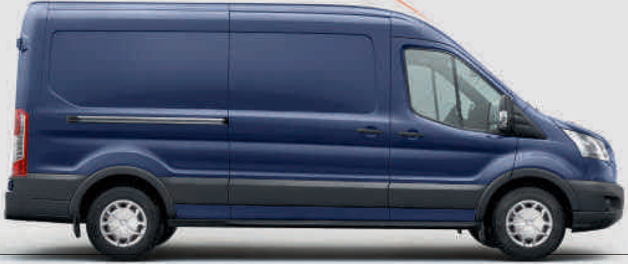
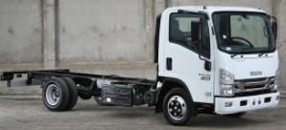
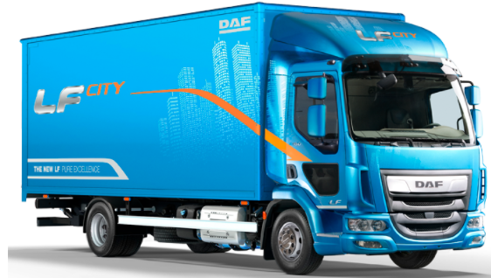
Check of Form Factors/ Discriminators
 | Vans | Small Trucks | Medium Trucks
Examples “Truck” characteristics
“Forward Control” Design | No | Yes | Yes
R-Point Height (>1250mm) | No | ~Yes / No | Yes
Class V or VI mirrors | No | No | Yes
GVM > 5t | No (some vehicles yes) | Yes | Yes
GVM > 7.5t | No | No | No (variants yes)
Pneumatic brakes | No | No | Yes
Desired limit determines selection of form factor
Existence of Class V or VI mirrors is form factor most closely related to DVS

Slide 6
Summary – Alternative Certification Procedure
1. Preference: Vehicles meeting agreed form factor are assumed to be compliant with DVS regulation.
Justification:
  Accidentology indicates there is no issue with these vehicles confirming that these vehicles are typically designed for best urban maneuverability anyway. There is no necessity for regulatory limits.
  DVS-eye point not representative for many vehicles in this category and could lead to mis-optimization and thus to deteriorated direct vision
  DVS methodology as such does not fit as typically these vehicles are not equipped with Class V and VI mirrors.
Alternative: Vehicles meeting agreed form factor and meeting UN R-125 are assumed to be compliant with DVS regulation.
Justification:
  For vehicles not equipped with Class V or VI mirrors the assessment volume defined within the DVS method is not meaningful. The direct forward vision requirements of UN-R125 may be more stringent assessing the same safety characteristic as DVS method.
  The eye-point proposed by the DVS regulation is not representative to many vehicles of this category.

