Slide 1

Sensitivity analysis between HIC & actuator pressure
IWG-DPPS
Issue date : 29/06/2021
PUBLIC
INTERNAL
CONFIDENTIAL
SECRET

Slide 2
Context of discussion
When performing STATIC tests, the actuator could have an influence on the results which could depend on the pressure and the type of hinge.
During the impact period, the actuator can have a higher pressure than when executing static tests, so the stiffness that the actuator has during the real-time impact might not be the same as in the test.
The manufacturer shall demonstrate that the test represents the real conditions. If demonstration cannot be fulfilled, then the tests must be conducted dynamically.

Slide 3
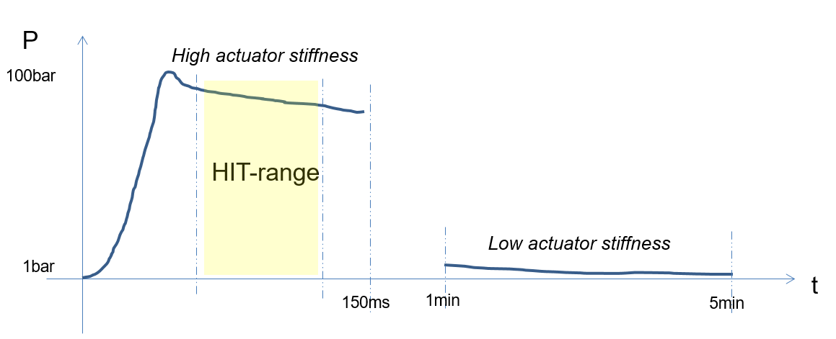
Supplier information and evaluation criteria
The necessary information to be provided to the technical service shall have the following information:
  Force vs. Time diagram or Pressure vs. Time diagram
When the deviation is greater than [10%] of the range of real-time impacts, then the tests shall be conducted dynamically
Fig1. Scheme representing Pressure vs Time provided by actuator supplier

Slide 4
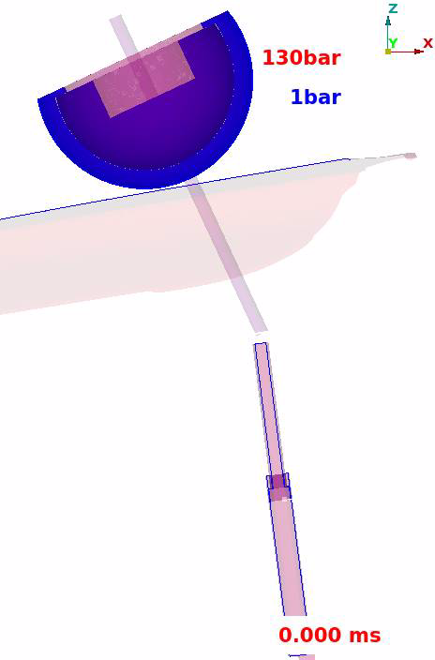
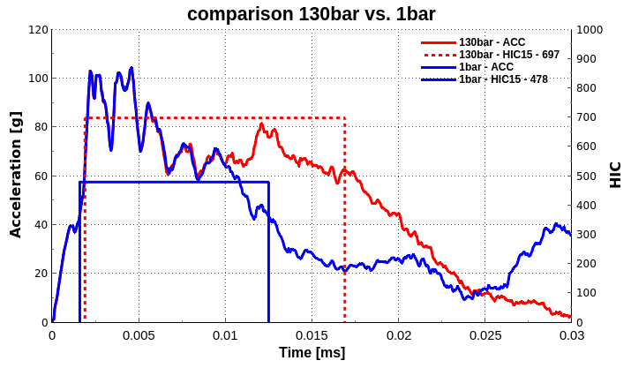
HIC comparison – 130bar & 1bar
Notes:
4

Slide 5
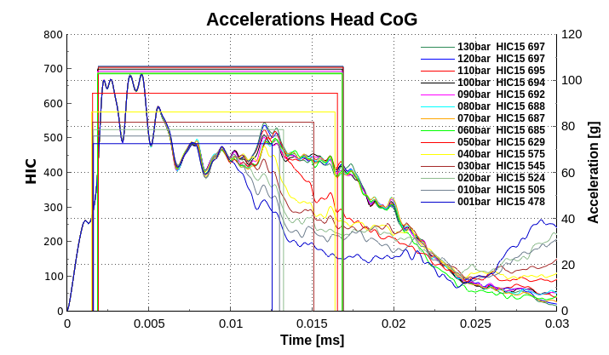
HIC comparison – All pressure range

Slide 6
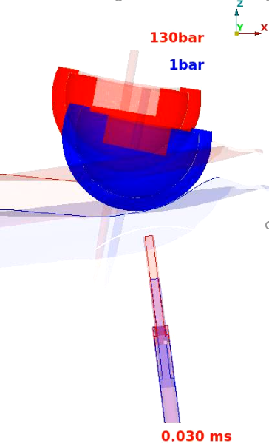
HIC comparison – All pressure range
>10%

Slide 7
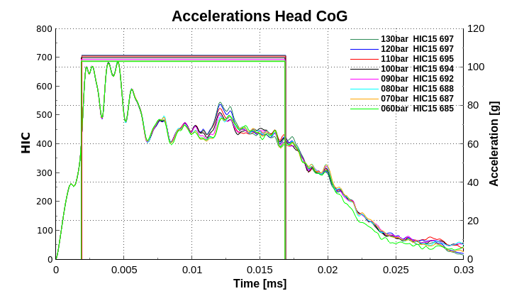
HIC comparison – Within 10% deviation

Slide 8
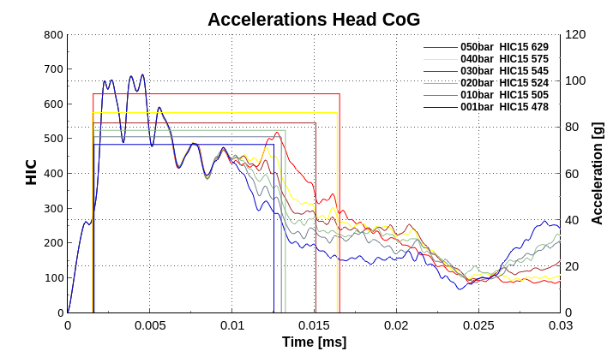
HIC comparison – More than 10% deviation

Slide 9
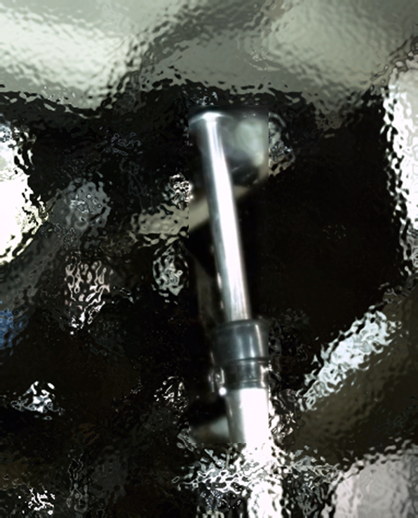
Conclusions
The actuator studied in this document, due to its configuration, has a significant time dependent influence on the head impact results.
Depending on the actuator/hinge configuration the influence of the stiffness could have more or less influence during the time.
In this image, the direct contact of the actuator to the bonnet can make the stiffness more time dependent with the deforming bonnet/hinge.
The evaluation of the technical service will decide if the tests must be done in static or not.
Fig2. Example of actuator

