Slide 1



DPPS - “HIT Regression Discussion Summary and Action Items”

Slide 2
IWG-DPPS-6 5.2.3. HIT & WAD calculation
Korea (IWG-DPPS-6-05) and OICA (IWG-DPPS/6/06) presented their argumentation. Japan reminded former WG-DPPS_Difference_of_HIT_by_Calculation_Method_rev1_JP.pdf and IDIADA former IWG_DPPS-6- xx -feedback_IDIADA_linear_regression.pdf from the Nov. 2019 skype confcall.
Mr. Lee (Korea) stated there could be a big difference between actual HIT value and regressed HIT even though the R² value is close to 1, showing KNCAP OEM data. OICA wondered if WAD 2980 on the sedan is on DPPS. O. Zander stated, the other values are close to R²=1, so linear regression should be the favored method.
M. Harvey mentioned that the Coherent method is enforced since 2017, so maybe some older data from Korea may reduce the R², and only statures that contact the DPPS should be used. H. Lammers confirmed to not consider areas outside the DPPS.
JASIC asked what the justification of regression method is compared to dot-to-dot method. O.Zander and OICA answered the regression method is applied to Euro NCAP and manufacturers are familiar with the method. Extrapolation could be an additional benefit.
CP positions:
Regression: UK, Netherlands, Germany, Spain (also OICA)
Dot-to-Dot: Japan, Korea
After the vote, the Chair proposed regression method but dot-to-dot in case R² ≥ 0.99.
Remarks:
Any particular cases to be discussed in a specific confcall (e.g. WAD 1000: dynamic test; HIT<50ms; TRT= 50ms; linear regression line; WAD point between static & dynamic test would be different).
Euro NCAP protocol deals with the 6yo: if HIT>TRT => static; if HIT<TRT => dynamic
Decision by vote: linear regression based on HIT of the HBM statures which hit the DPPS only. between the 4 HBMs : 6yo and 95th % HBMs extrapolation of regression line with 2 or 3 points until end of DPPS is allowed dynamic test for below 6yo WAD point or above 95% WAD point: use HIT of 6yo and 95% HBM for HBM head contact, whole surface of DPPS is considered

Slide 3
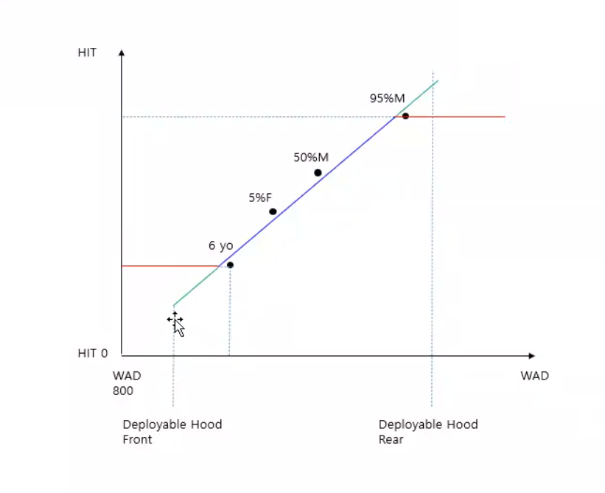
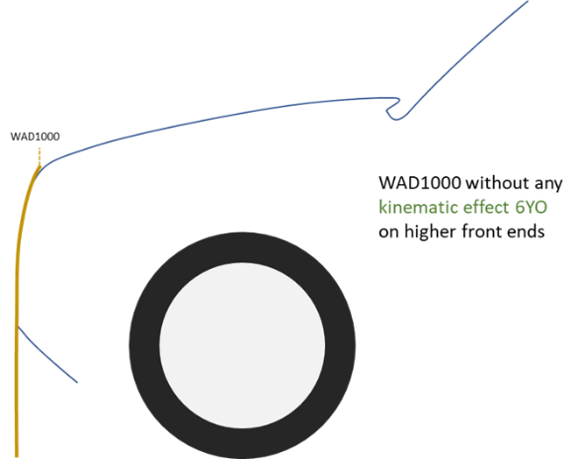
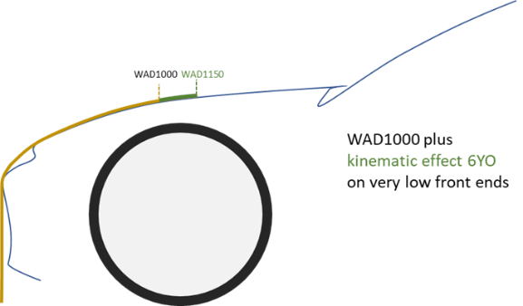
IWG-DPPS-11 5.iii. Decision List
Information HIT vs WAD | Majority (IWG-DPPS-6) Linear regression with HIT vs WAD (on DPPS) points | T.B.D. - below or above WAD of 6yo or 95%M
Chair asked for clarification on HIT values by regression method below WAD of 6yo and above WAD of 95%M.
Mr. Harvey mentioned that the extrapolated line should be used for dynamic testing. : until WAD1000.
Mr. Buenger (OICA) : when comparing smallest HIT to TRT (in order to decide between static & dynamic test), there is no extrapolation: only the smallest stature is 6yo and 95th is the biggest used for decision. The red lines are the limits for regulation. Mr. Maurer (OICA): OICA needs to discuss internally first.
Mr. Zander (BAST): until now, there was no drawing with horizontal lines, only how to define the regression lines from these 4 points. It doesn’t make sense if 1 point is on the windscreen or roof. Same feeling as M. Harvey (OICA).
Chair: made this drawing to clarify the meaning of the extrapolation of the curve for the dynamic testing: valid only within the DPPS system.
Action: Clarification requested for next meeting:
How to proceed before the 6yo and after 95th y.o.?
No extrapolation for HIT values in order to determine static vs. dynamic testing. Extrapolation only to generate timing information for dynamic tests to complete head test area.
How to decide the test mode when we compare the HIT to the TRT ?
From any point of the head test area where the HIT is shorter than TRT, then static testing is possible.
If HIT is greater than TRT, dynamic testing is required.
WAD limit changes because of kinematic behaviour of the HBM with the smallest appropriate stature (min: 6yo)

Slide 4
Clarification and draft proposal - page 1
(based on Euro NCAP) For static or dynamic decision:
Where the manufacturer has demonstrated, by numerical simulations or alternative means (vehicle speed of 40km/h), that a system is fully deployed and remains in the intended position prior to the head impact time of the smallest appropriate stature pedestrian, then all head form tests shall be performed with the bonnet in the fully deployed position.
4.1 Determination of headform test procedure
Decide if static or dynamic test based on HIT smallest appropriate stature : “smallest HIT = 1 value”
In a low front end vehicle: 6yo may be behind WAD 1000
In an SUV, it could be 5th female (as a 6yo would be before the hood test area)
=> no extrapolation for the smallest HIT.
§4.1. The HIT for the relevant pedestrian statures is calculated in the deployed position of the outer surface. Relevant are those statures amongst the 6-year old child, the 5%ile female, the 50%ile male and the 95%ile male, [whose heads] contact the outer surface in the headform test areas. The smallest appropriate stature defines the earliest HIT value. If the DPPS does not have a permanently deployed position, then HIT is calculated with the DPPS in closed position.

Slide 5
Clarification and draft proposal - page 2
For dynamic test: extrapolate until WAD 1000 towards the front of the bonnet and until the rear of test area
=> the regression is only used for the dynamic testing.
For dynamic testing :
For the timing of the DPPS in the dynamic testing, the regression line of the relevant statures is extrapolated for complete head impact test area coverage, if R2 is equal to or above 0.99.
If the R2 is below 0.99, then the connecting line segment of the [adjacent] 2 statures will be elongated in the right direction for complete head test area coverage .
If the manufacturer choses to perform only dynamic testing, then there is no need to do a full TRT check, only a ST time determination is necessary.
For static test : no extrapolation of the regression line is needed because no triggering of the DPPS is required during the testing.
When there is a combination of static & dynamic tests, then apply B & C appropriately.

