Slide 1
Transmitted by the IWG on DETA informal document WP.29-185-XX
185th WP.29, agenda item 4.5
(document DETA-42-05e rev1)
Report to 185th WP.29 session
from
the 42nd IWG on DETA meeting

Slide 2
Database for the Exchange of Approval documentation
DETA
The secure internet database for exchanging approval
documentation between the Contracting Parties of the 1958 Agreement, as required to be established by the UNECE,
according to Revision 3 of this Agreement.

Slide 3
State of play
DETA is still under development but since May 2019 ready to be used for it base purpose:
33 Contracting Parties have notified their DETA Focal Point
App. 12400 approvals uploaded (13 CP)
App. 5560 manufacturers are uploaded and could be selected by TAA
13 Manufacturer have access to DETA (only to their own approvals)
(manufacturer’s access is to be requested via their approval authority and to be forwarded to the DETA Administrator)

Slide 4
State of play – Developments – state of play
Contracting and implementation UI
  → contract for financial participation of industry is drafted
Mass Upload Functionality
→ purchase order finalized in KBA
Two factor authentication
  → proposal of SW-house under review

Slide 5
State of play – Extension of scope
Extension of scope DETA following WP.29/AC.2 assignment
  → The IWG on DETA discussed the proposal to extend DETA
  to store the ‘traffic scenarios catalogue for automated vehicles’:
          The access to the traffic scenarios catalogue is beneficial to all CPs to the 1958 and 1998 Agreements;
          If agreed by WP.29, the IWG on DETA will investigate the possibilities and work in conjunction with the IWG on VMAD/SG1 to deliver the proper solutions for the description of traffic scenarios;
          The intention is to provide access to the traffic scenarios for stakeholders to allow them building their own concrete scenarios from the available elements relevant to the scenario layers;
          This proposal may contribute to unblock DETA financing from the UN budget.
          References: ECE/TRANS/WP.29/2021/61, VMAD-SG1-12-04, VMAD-SG1-11-03, VMAD-08-04

Slide 6
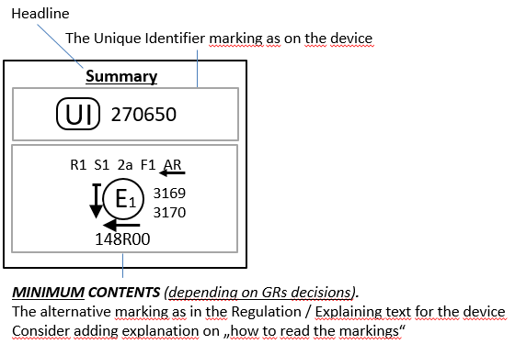
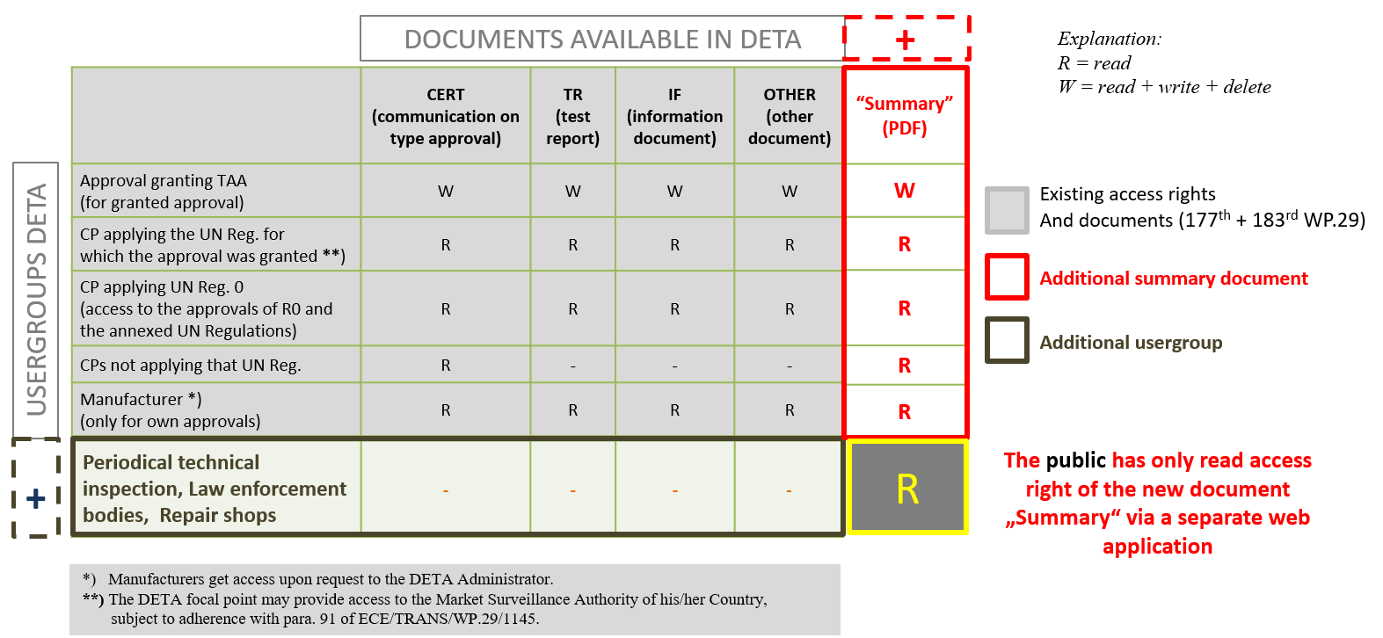
State of play – Developments – open issues
DETA summary documents on UI marking:
→ presentations to all GR’s ongoing

Slide 7
Questions to WP.29
WP.29 is requested to consider:
The amendment of the UI guidelines doc. WP.29/2019/77.
To allow the IWG to further explore the broadening of the
scope of DETA to accommodate the needs of the CPs to all
Agreements, including
- the investigation of the possibilities of storing the traffic
scenarios catalogue in DETA, and
- the exchange of information on PTI.

