Slide 1
Transmitted by the IWG on DETA informal document WP.29-185-XX
185th WP.29, agenda item 4.5
(document DETA-42-05e)
Report to 185th WP.29 session
from
the 42nd IWG on DETA meeting
This document is to be discussed and amended during the IWG on DETA session of November before submitting to WP.29.

Slide 2
Database for the Exchange of Approval documentation
DETA
The secure internet database for exchanging approval
documentation between the Contracting Parties of the 1958 Agreement, as required to be established by the UNECE,
according to Revision 3 of this Agreement.

Slide 3
State of play
DETA is still under development but since May 2019 ready to be used for it base purpose:
33 Contracting Parties have notified their DETA Focal Point
App. 12400 approvals uploaded (13 CP)
App. 5560 manufacturers are uploaded and could be selected by TAA
13 Manufacturer have access to DETA (only to their own approvals)
(manufacturer’s access is to be requested via their approval authority and to be forwarded to the DETA Administrator)

Slide 4
State of play – Developments – state of play
Contracting and implementation UI
  → contract for financial participation of industry is drafted
Mass Upload Functionality → purchase order ✓
Two factor authentication →

Slide 5
State of play – Financing – Extension of scope
Financing of DETA by UNECE → no news for WP.29
Extension of scope DETA following WP.29/AC.2 assignment
  →….

Slide 6
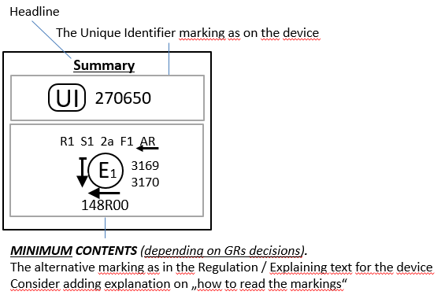
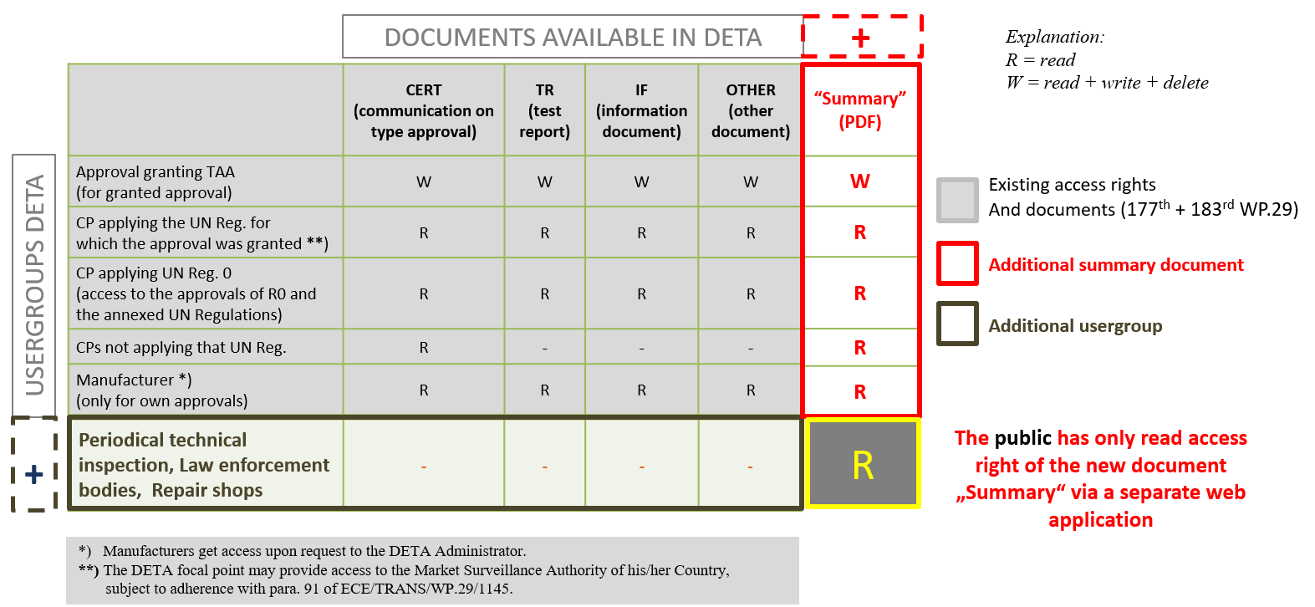
State of play – Developments – open issues
DETA summary documents on UI marking:
→ presentations to all GR’s ongoing

Slide 7
Questions to WP.29
WP.29 is requested to consider:
The amendment of the UI guidelines doc. WP.29/2019/77:
….

