Slide 1
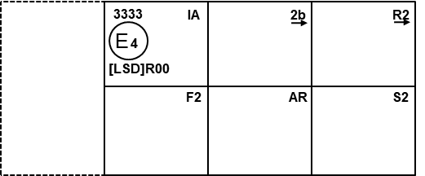
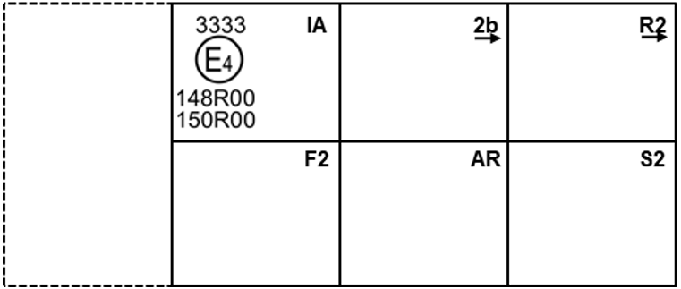
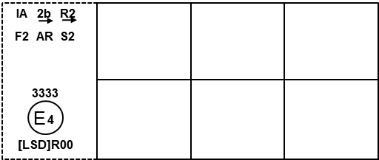
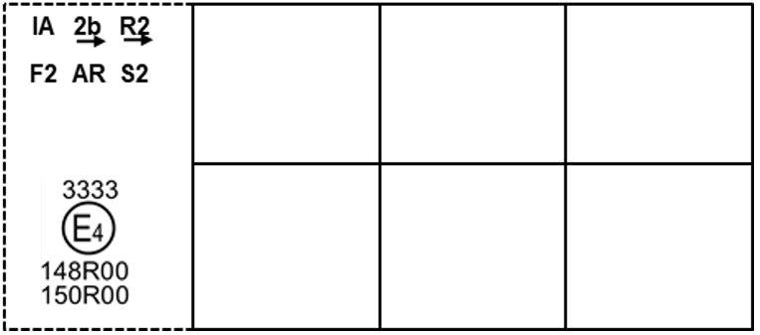
SLR-49-17
UNECE R148.00
Annex 7
proposal
Figure A7-III Figure A7-III
Marking example 3 Marking example 3

Slide 2
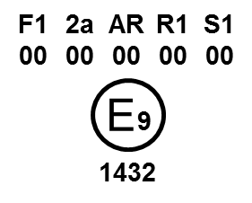
UNECE R148.00
Annex 7 proposal
Figure A7-IV Figure A7-IV
F1 2a AR R1 S1
E9
148R00-1432

Slide 3
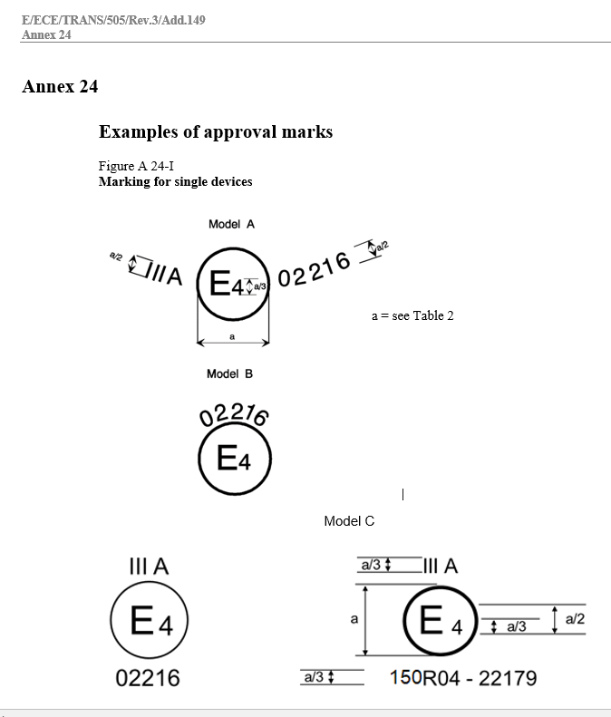


Proposal
Figure A 24-I
Marking for single devices
Model A
Model B
Model C
UNECE R150.00
E4
IIIA
a/3
E4
a = see Table 1
a/2
a/3
a
150R00-02216
a/3

Slide 4
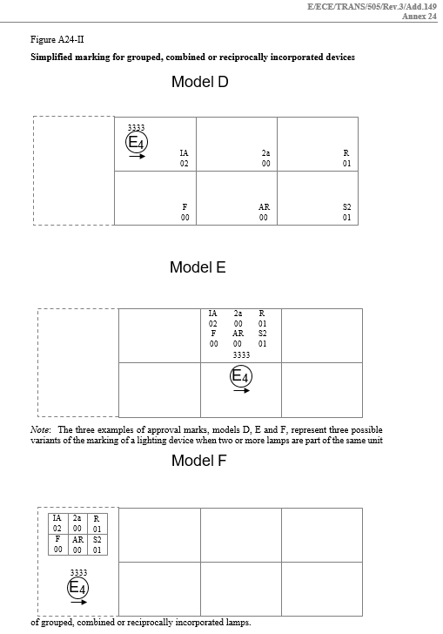
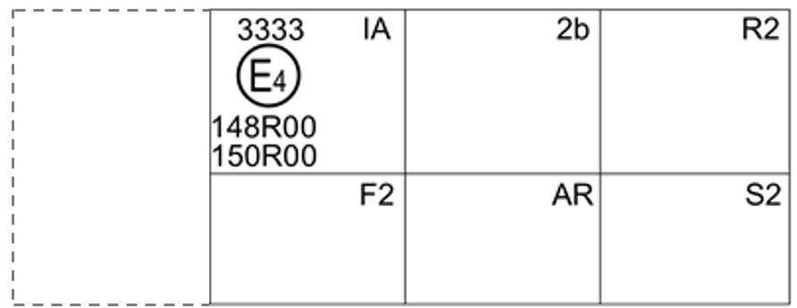
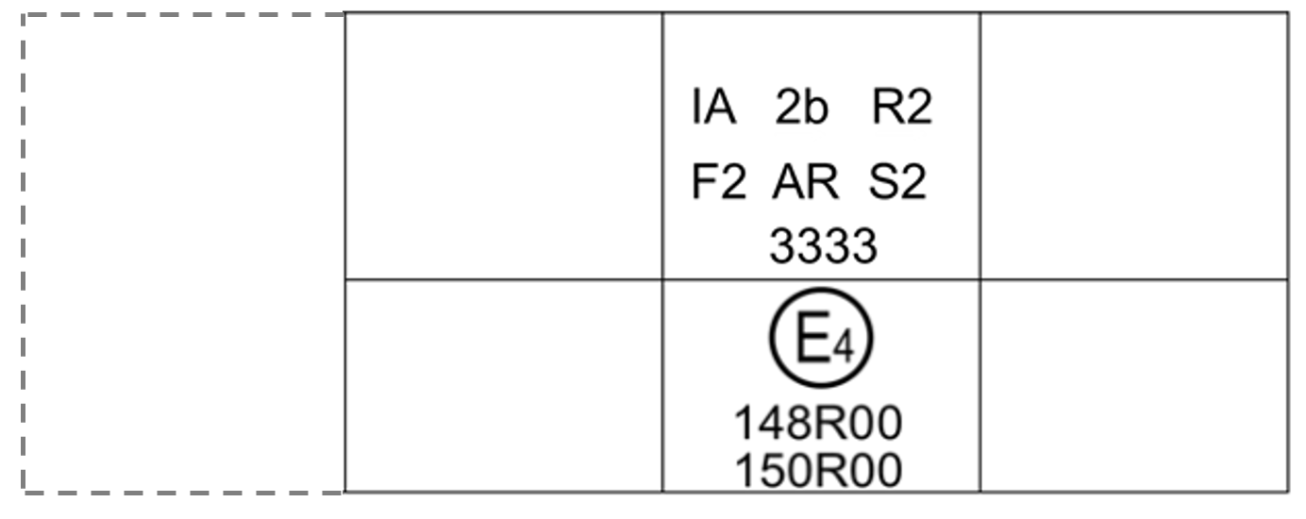
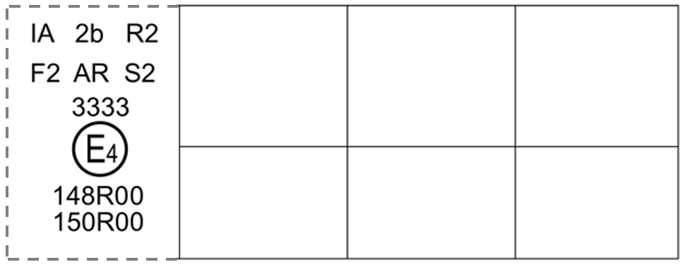
Proposal
Figure A 24-II
Simplified marking for grouped, combined or reciprocally incorporated devices
Model D
Model E
Model F
UNECE R150.00
Note: The three examples of approval marks, models D, E and F, represent three possible variants of the marking of a lighting device when two or more lamps are part of the same unit of grouped, combined or reciprocally incorporated lamps.

