Slide 1
AEBS-HDV IWG
Input from industry
AEBS-HDV-05
June 30 and July 1, 2021

Slide 2
Content
Open items
  Brake delay time (pneumatic braking)
  Time to 1g - LCV hydraulic
  City vs highway driving
  M2N2 derived from M1N1
  Follow shark fin curve up to 110
  Solo tractors
  New: speed range
  New: vehicle longitudinal centre planes (offset)
V2C
  Summary
  Follow shark fin curve up to 110
V2P
  Reminder of 04 meeting
  New: Another approach for V2P
  Summary
V2B
Backup slides

Slide 3
Open items

Slide 4
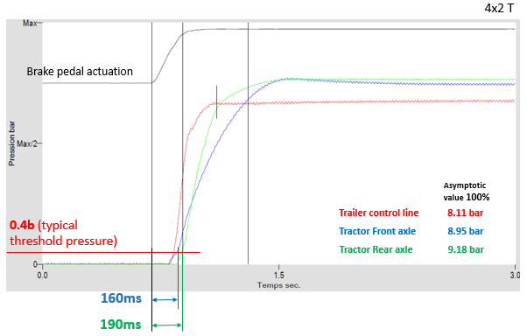
Brake delay time (pneumatic braking)
Reminder from AEBS-HDV-04-04
AEBS M1N1 IWG took as an assumption that the time-to-1g (T1g) was applicable immediately once the brake demand starts
This assumption is not realistic for HCVs due to the existence of an extra-delay time on pneumatic braking, compared to hydraulic braking:
  Compressibility of air
  Lower control pressure (10 bars pneumatic vs 150-200 bars hydraulic), leading to bigger actuators volume
Assuming the same detection time, this pneumatic brake is adding on top.
Reminder from AEBS-HDV-04-04
Industry proposal for HDVs with pneumatic braking:
Assuming an absolute delay time of 150ms is used in the calculation model, a T1g of 1s can be considered as relevant.

Slide 5
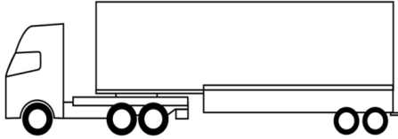
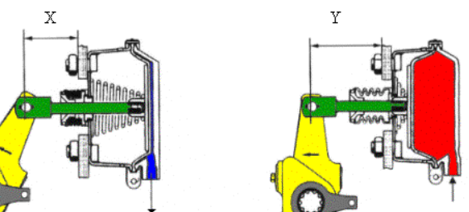
Brake delay time (pneumatic braking)
Pre-filling of brakes
Prefilled (Short delay)
Not Prefilled (long delay)
This typically creates a Jack-knifing risk
Prefilling trailer brakes may solve this, but the truck cannot “blindly” pre-fill the trailer brakes (without knowing the threshold pressures of the actual trailer being towed)
Pre-filling of the pipe between brake valve and cylinder would not reduce the delay significantly
Pre-filling of cylinder would create a risk that the pads leak the disc
→ this may create functional
safety issues
Industry does not look at brakes pre-filling as a potential solution
The additional brake delay of pneumatic braking is there, and we have to account for it in the AEBS strategy, as proposed in AEBS-HDV-04-04

Slide 6


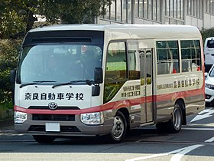
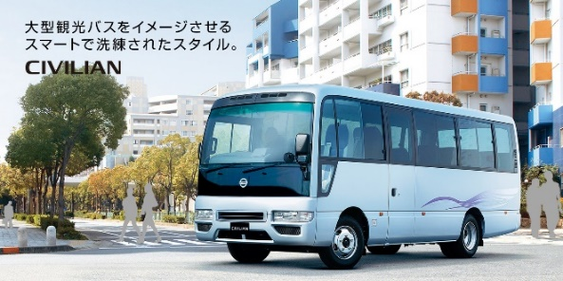
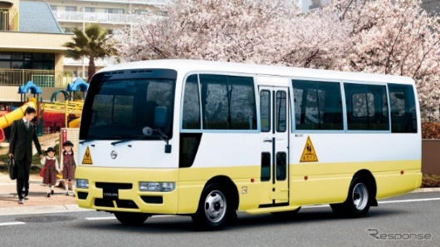
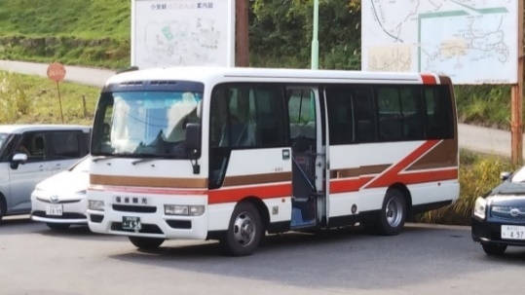
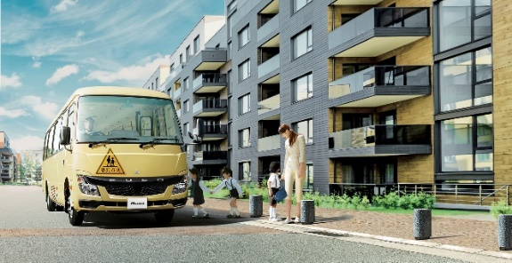
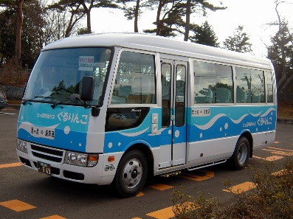
Time to 1g – LCVs with hydraulic braking
M3 with hydraulic brake in Japan
GVW 4.5～6t
21～29 passengers
Examples of usage: hotel shuttle, nursery school bus

Slide 7
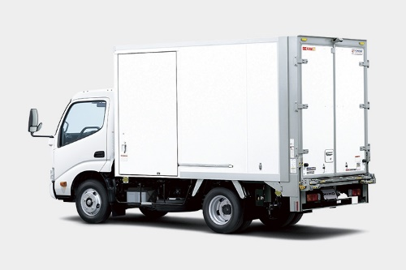
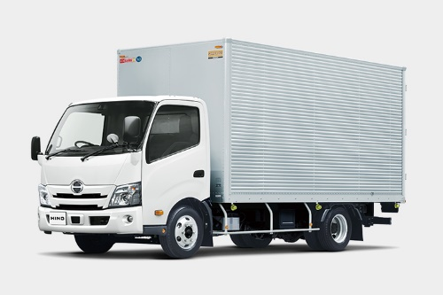
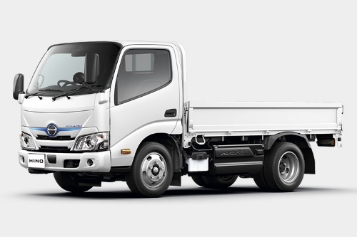
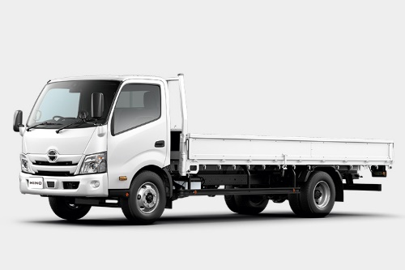
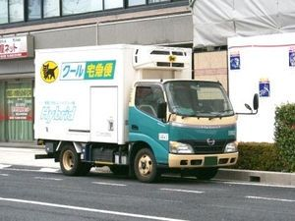
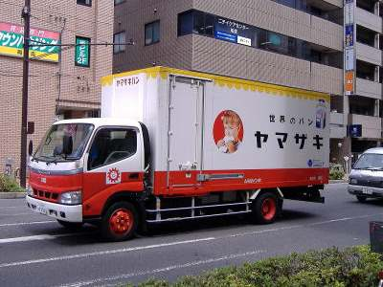
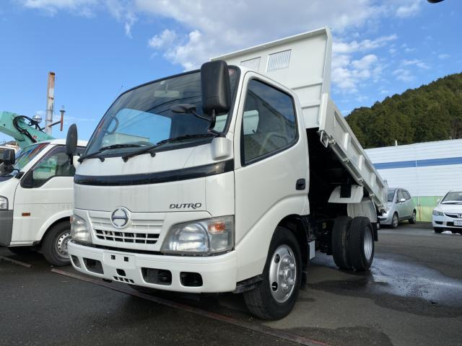
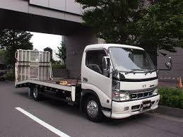
Time to 1g – LCVs with hydraulic braking
N2 with hydraulic brake in Japan
GVW 4.5～8t
Examples of usage: deliveries, construction,

Slide 8
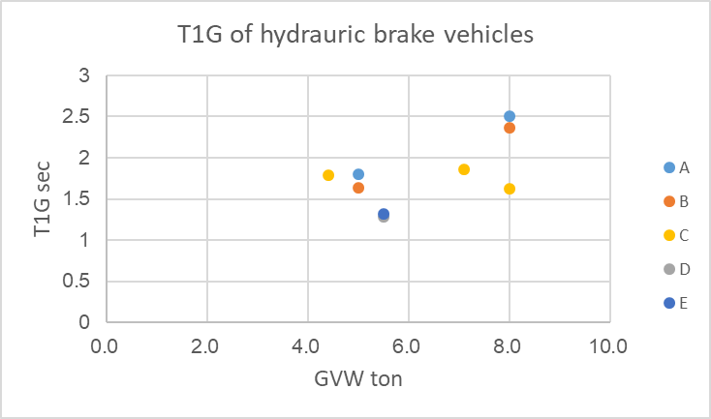
Time to 1g – LCVs with hydraulic braking
New Data
Industry compromise proposal
Take an average of 1.7s
Keep same assumptions as in AEBS-HDV-04-04:
  Deceleration of 6m/s²
  LPS of 1.3s
The avoidance speed becomes 35kph (was 26.5kph in AEBS-HDV-04-04)
This value is consistent with N1 requirements in R152 series 01 (38kph for the N1 maximum mass)
To get the average value, first the values of each OEM (A… E) were averaged, then the average of OEMs was calculated.

Slide 9

City vs highway driving
5.2.1.4. Speed reduction by braking demand
…
(h) In unambiguous situations (e.g. no motorcycle nor bicycle in between rows of vehicles, no laterally waving vehicle in the adjacent lanes)
Without (h)
With (h)
Domain where the performance is expected (avoid collision up to 70kph)
Domain where the performance is expected (avoid collision up to 70kph)
Ambiguous situations

Slide 10
City vs highway driving
5.2.1.4. Speed reduction by braking demand
…
Notwithstanding the table above, for those vehicle able to detect urban areas where the speed is limited to 60kph or below, the speed reduction shall not be lower than 40 kph, for actual vehicle speed between 10 and 60kph. In this case, the means used by the vehicle to detect the urban areas as specified above shall be described by the vehicle manufacturer, and the safety concept assessed by the Technical Service according to Annex 3 of this regulation.
Without “notwithstanding”
With “notwithstanding”
Domain where the performance is expected (avoid collision up to 70kph)
Domain where the performance is expected (avoid collision up to 70kph)
Urban areas (40kph)

Slide 11
City vs highway driving
5.2.1.4. Speed reduction by braking demand
…
In unambiguous situations (e.g. no motorcycle nor bicycle in between rows of vehicles, no laterally waving vehicle in the adjacent lanes)
…
Notwithstanding the table above, for those vehicle able to detect urban areas where the speed is limited to 60kph or below, the speed reduction shall not be lower than 40 kph, for actual vehicle speed between 10 and 60kph. In this case, the means used by the vehicle to detect the urban areas as specified above shall be described by the vehicle manufacturer, and the safety concept assessed by the Technical Service according to Annex 3 of this regulation.
We need both…
With both (h) and “notwithstanding”
Domain where the performance is expected (avoid collision up to 70kph)
Urban areas (40kph)
Ambiguous situations

Slide 12
M2N2 derived from M1N1
HDV-04 outcome
Agreement on the principle that M2N2 derived from M1N1 may be approved to either R131 or R152
This option applies to V2C/P/B as a whole (no mix possible, e.g. V2C with R131 and V2P/B with R152)
Industry homework: Provide discriminative criteria for identifying LCVs derived from M1N1
Industry input for HDV-05
Industry explored the opportunity to define technical criteria to differentiate ‘M2N2 derived from M1N1’ from other vehicles, and found out that it was a dead-end:
  Quite difficult to define specific technical criteria which would differentiate such vehicles
  The only criteria to select one or the other regulation should be technical (the vehicle dynamics, the braking capabilities etc.)
  This approach has a fundamental disadvantage: a M2N2 can only be approved to R152 if it is derived from an existing/approved M1N1…
Industry then explored another alternative:
  to provide the option to either use R131 or R152 to all M2 and N2<8t vehicles (possibly limited to hydraulic braking)
  Industry wondered what could be the safety drawback, and actually found none (see next slide)
  We thus recommend to follow that 2nd approach.

Slide 13
M2N2 derived from M1N1
What would be the safety drawback to give the option to either use R131 or R152 to all M2 and N2<8t vehicles?
This approach is the same as the one used for N1 vehicles in R13 and R13H.
What do we learn from this situation:
The choice is left to the vehicle manufacturer, who knows what regulation best applies to its own vehicle, based on technical criteria. This leads to:
N1s with a “M1 twin” follows R13H.
N1s with a “heavier twin” follows R13.
Performance level quotation
M2 N2 < 8t
R152
R131
-
+
Conclusions: using R152 is not safer than using R131 (and the other way round), just different / more adapted to the technical characteristics of the vehicle.
The vehicle manufacturer of M2 and N2<8t should be able to choose R152 or R131, the same way as for N1 with regard to R13 / R13H.
V2C
+
-
V2P
+
-
V2B

Slide 14
M2N2 derived from M1N1 - Proposal
Proposal to amend UN R131:
Add a footnote to scope:
*/ For vehicles of category M2 and for N2 with a maximum weight below or equal to 8t, Contracting Parties that are signatories to both Regulation No. 152 and this Regulation shall recognize approvals to either Regulation as equally valid.
Proposal to amend UN R152 :
1. Scope
This Regulation applies to the approval of vehicles of Category M1 and N1 * with regard to an on-board system to
a. Avoid or mitigate the severity of a rear-end in lane collision with a passenger car,
Avoid or mitigate the severity of an impact with a pedestrian.
Footnote */ This Regulation offers an alternative set of requirements for Category M2 and for N2 with a maximum weight below or equal to 8t to those contained in UN Regulation No. 131. Contracting Parties that are signatories to both Regulation No. 131 and this Regulation shall recognize approvals to either Regulation as equally valid.
5.2. Specific Requirements
For vehicles of category M2 and N2 covered in the scope of this regulation, the requirements of category M1 and N1 (respectively) shall apply.
(same wording as for N1 in UN R13 and R13H)

Slide 15
Solo tractors
2.20 “Situations where the deceleration is limited in empty conditions” are situations where the vehicle’s brake system limits the deceleration value in order to prevent a rear axis lift-off, such as braking with certain short-wheelbase solo tractor vehicles. This shall be demonstrated to the satisfaction of the type approval authority.
5.1.8. In situations where the deceleration is limited in empty load conditions, and provided this would be demonstrated by the vehicle manufacturer to the technical services, the requirements applicable to the vehicle with a mass in running order in the tables of paragraphs 5.2.1.4., 5.2.2.4. and 5.2.3.4. shall be deemed fulfilled if the impact speed requirements are met with an added mass on the rear axle, calculated to implement an α value equal to 1.3 [+0.2 / -0.0],
with α = W_{r}/W × L/H, where :
    W_{r} is the rear axle load.
    W is the subject vehicle mass in running order.
    L is the subject vehicle wheelbase.
    H is the subject vehicle centre of gravity height in running order.
[Additionally, the relative impact speed shall be measured with a vehicle mass in running order, and the result appended to the test report.]

Slide 16

Speed range
*/ Typical use of LCVs is short distance, urban; unlike HCVs, more focused on long haulage
Proposal to use same speed range as for R152 (with regard to performance)
System activation range can be kept with 10-100 (M) and 10-90 (N).
V2C | R152 | R131
 | M1, N1 | LCV * | HCV
System activation | At least 10 - 60 | At least 10 – 100 (M) 10 - 90 (N) | At least 10 – 100 (M) 10 - 90 (N)
Performance requirements | 10 - 60 | 10 – 100 (M) 10 - 90 (N) → 10 – 60 | 10 – 90 (N) 10 – 100 (M)
(current R131) System activation |  | At least 15 – maximum design speed | At least 15 – maximum design speed
Performance requirements |  | At 80 | At 80
V2P | R152 | R131
 | M1, N1 | LCV | HCV
System activation | At least 20 - 60 | At least 20 - 60 | At least 20 - 60
Performance requirements | 20 - 60 | 20 - 60 | 20 - 60

Slide 17
Vehicle longitudinal centre planes (offset)
Target
Target
0.2m
(d) In situations where the vehicle longitudinal centre planes are displaced by not more than 0.2 m;
0,2m
It may be understood that each centre plane (the one of the target vehicle and the one of the subject) should be displaced (in opposite directions, that would mean +/-0.4m)
Requirement section:
(d) In situations where the target vehicle longitudinal centre planes are is displaced by not more than 0.2 m compared to the subject vehicle longitudinal center plane;
Interpretation
Test section:
6.5 The subject vehicle and the moving target shall travel in a straight line, in the same direction, for at least two seconds prior to the functional part of the test. with a subject vehicle to target centreline offset of not more than 0.2m.
subject vehicle
subject vehicle

Slide 18
Vehicle longitudinal centre planes (offset)
0.2m
0,1m
Requirement section:
(e) In situations where the anticipated impact point is displaced by not more than 0.2 m compared to the vehicle longitudinal centre plane;
Interpretation
Test section:
6.6.1. The subject vehicle shall approach the impact point with the pedestrian target in a straight line for at least two seconds prior to the functional part of the test with an anticipated subject vehicle to impact point centreline offset of not more than 0.1 m.
Subject vehicle
Subject vehicle

Slide 19
V2C

Slide 20
Summary (V2C) Peak avoidance speed in relative speed situation – for all load conditions*
*requirements to be eased for those facing difficulties in empty conditions (solo tractors)
Extract from AEBS-HDV-04-06-Rev.1
Updated for AEBS-HDV-05
Vehicle category |  |  | CLEPA/OICA | D | AEBS-HDV-04
M2 N2 < 8t | derived from M1N1 | Hydraulic braking | 50 km/h | 40 | 50 (R152 as alternative) | R152 as alternative
 | derived from / based on “heavies” | Hydraulic braking (including M3) | 26.5 km/h 35 km/h | 40 | Industry compromise proposal (based on slide “T1g – LCV”) Reduce speed range to 10-60km/h
 |  | Pneumatic braking | 68 km/h (highway) 40 km/h (city) | 40 | 68 km/h (highway) 40 km/h (city)
N2 > 8t M3 (except hydraulic braking) N3 |  |  | 68 km/h (highway) 40 km/h (city) | 70 | [70] km/h (highway) 40 km/h (city)* | *CLEPA/OICA to propose a definition of “city” inspired from R152

Slide 21
Follow shark fin curve up to 110
5.2.1.1. Collision warning
    When a collision with a preceding vehicle of Category M1, in the same lane with a relative speed above that speed up to which the subject vehicle is able to avoid the collision, is imminent, a collision warning shall be provided as specified in paragraph 5.5.1., and shall be triggered at the latest [1.4] seconds before the start of emergency braking.
Data
The system shall warn 1.4s ahead of the collision
The system shall brake 1.9s ahead of the collision
Design margin 0.2 / 0.3s
Total: 3.6s
Calculation
At 110kph, a sensor range of 110m is required
AEBS Performance Calculation Tool
Maximum Deceleration [m/s²] | 6 |  | Peak Avoidance [km/h] | 69,5
Time-To-1g [s] | 1
TTC_{Brake} [s] | 1,9
Test Speed [km/h] | Speed Reduction [km/h] | Impact Speed [km/h]
10 | 10,00 | 0,00
… | … | …
60 | 60,00 | 0,00
70 | 63,92 | 6,08
80 | 50,74 | 29,26
90 | 46,85 | 43,15
100 | 44,48 | 55,52
110 | 42,97 | 67,03

Slide 22
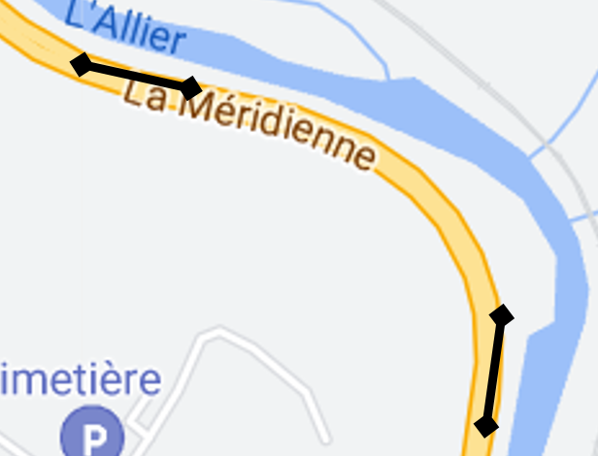
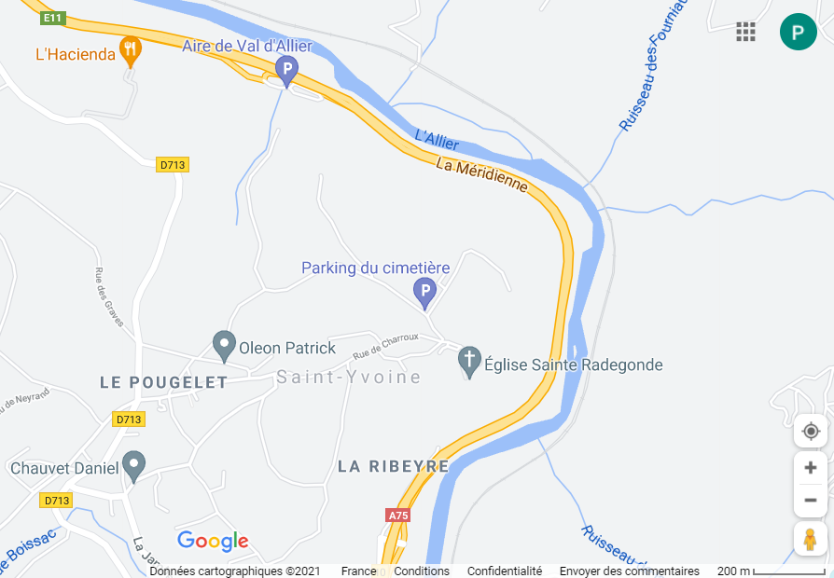
Follow shark fin curve up to 110
Data:
Motorway
E11 / A75,
Speed limit
110kph.
Required sensor range (to warn and brake in time): 110m.
At such speed and distance, there is a risk to for example detect a vehicle on the hard shoulder as being on the ego lane.
Recommendation to limit the requirements at 100kph.
Scale :
110 m
200 m

Slide 23
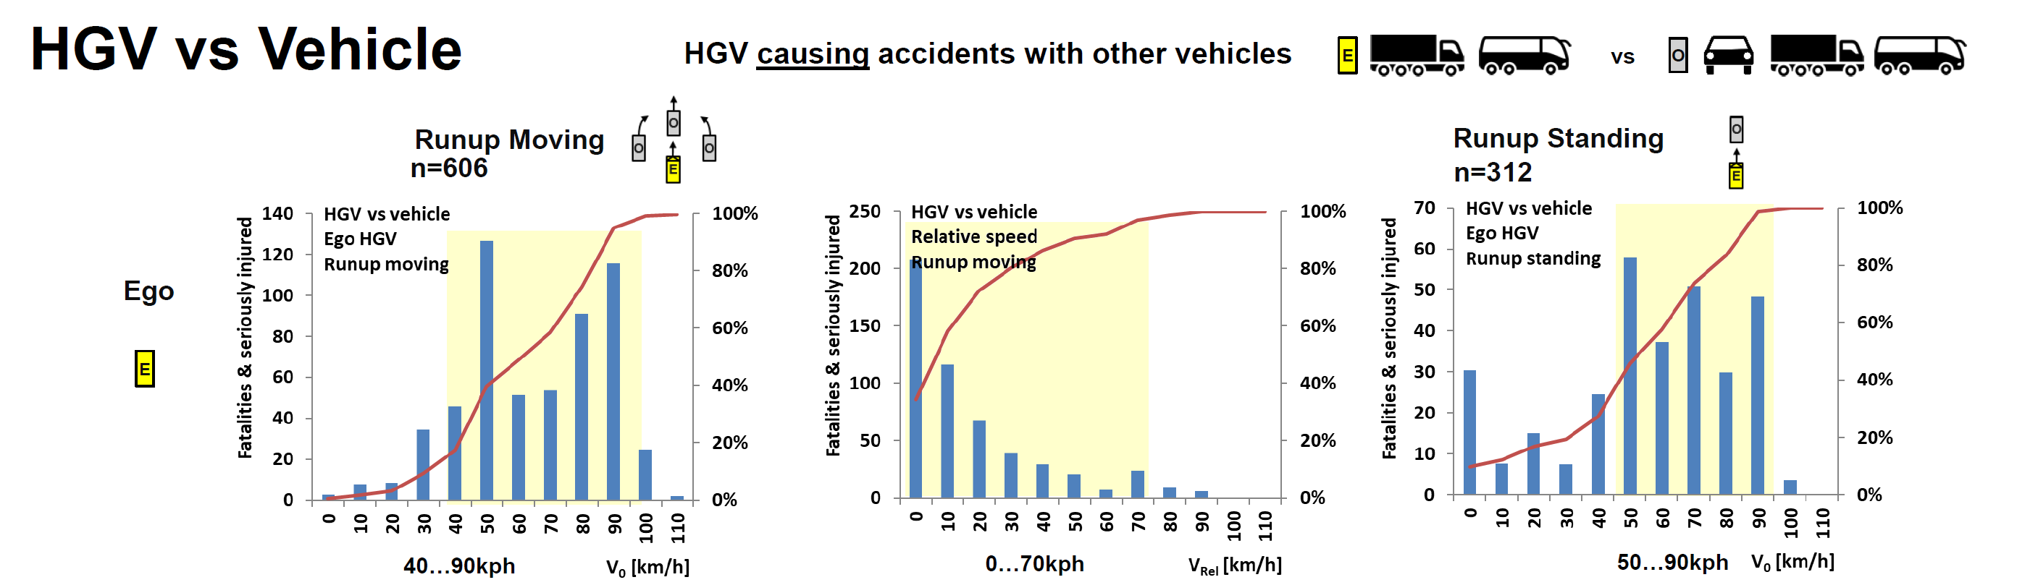
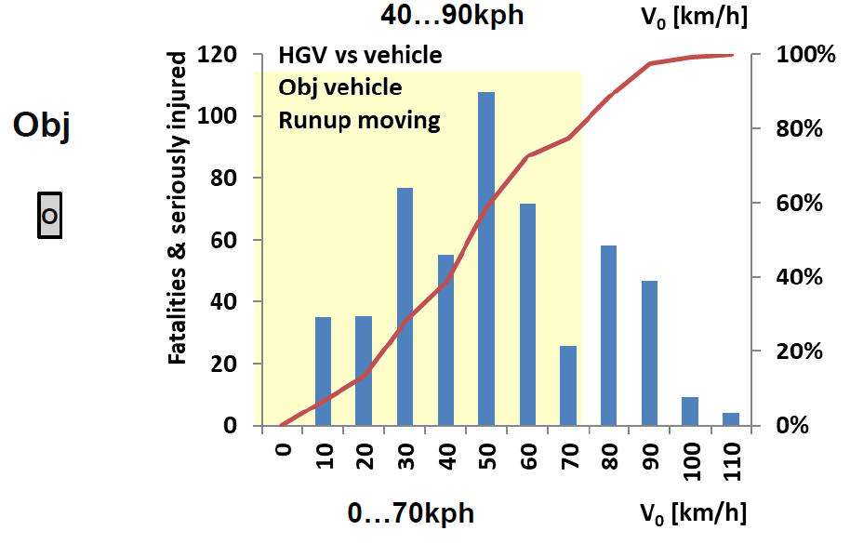
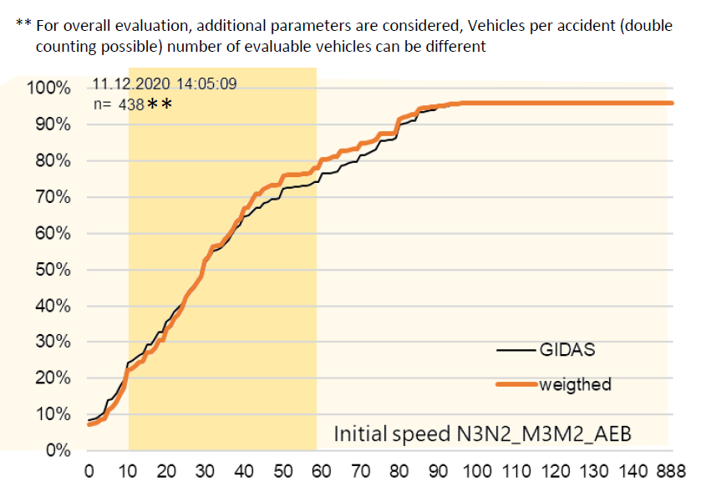
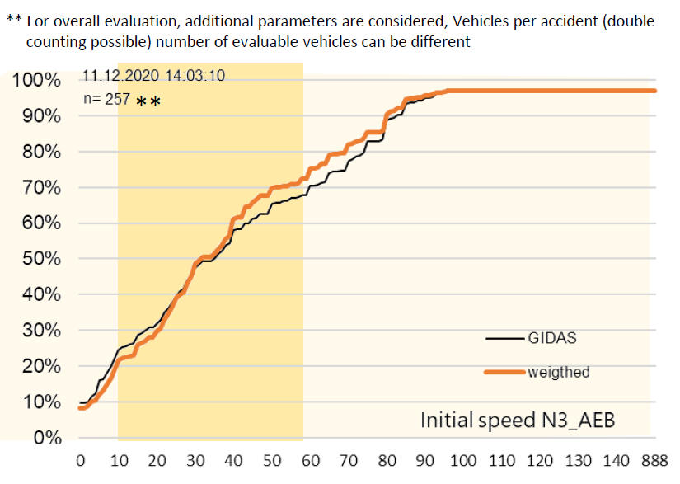
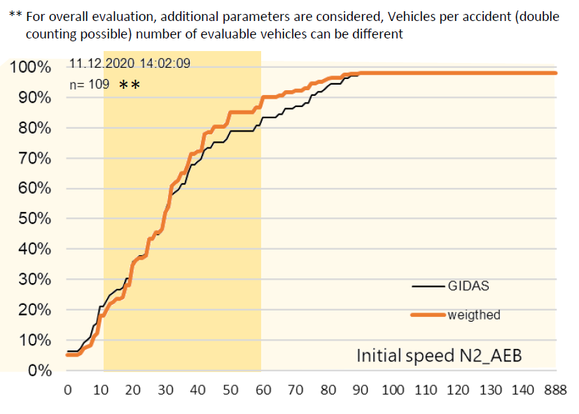
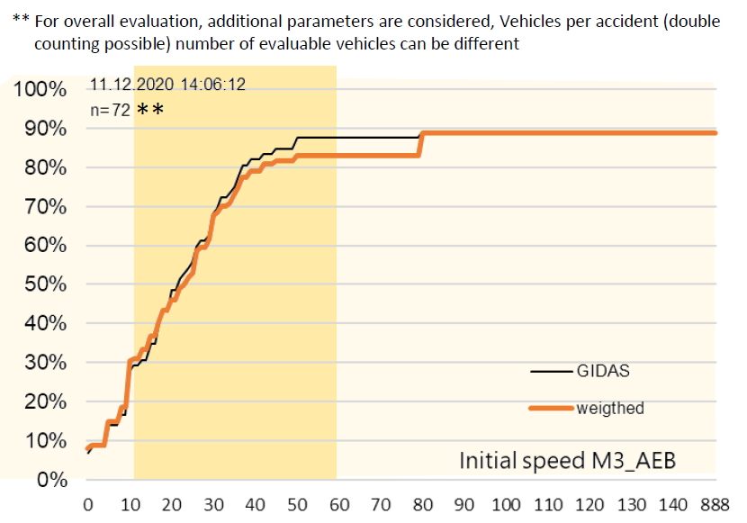
Follow shark fin curve up to 110
N3/N2 and M3/M2
N3
N2
M3
Based on the accident analysis (AEBS-HDV-SP-02-05) there is no need to enlarge the speed range mandatory to 110 kph
=> Keep current draft AEBS-HDV-04-08 as it is (100 kph)

Slide 24
V2P

Slide 25
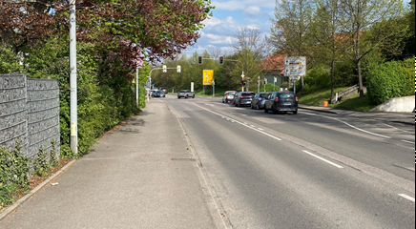
Safety zone for HDVs in „real life“ conditions
Reminder from AEBS-HDV-04-04 (industry proposal)
3.20m
Side-walk
Safety zone
In general, it should be avoided to brake on pedestrian on the sidewalk (to limit the risks of false positive).
HDVs safety zone should not be more than 10 or 20 cm
?
Small drifts of +/- 15cm to maintain the vehicle in the path
3.00 m
3.20 m
HDV
Conclusions:
HCVs are driving closer to the side of the road compared to passenger cars.
This creates a higher risk of getting false positive, which is a challenge HDV industry cannot take, given our low experience on V2P collisions.
HDVs are wider than passenger cars, thus are driving closer to the sidewalk, which is increasing the risk of getting false positives.
Additionnaly:
A vehicle cannot be driven 100% in the center of the lane. Small drifts with e.g. +/- 15cm or 20cm to both sides are normal for a HDV. (Reminder: R131 specifies a „target centreline offset of not more than 0.5 m”, in test section 6.4.1).
Lanes in urban areas are often narrower than the 3.5m considered during the M1N1 discussions (3m or 3.30m are more common).
A lot of roads in urban areas don‘t have lane markings in the middle (leading to some tendency to drive closer to the sidewalk).
2.55 m
2.85 m

Slide 26
Proposed approach for HDVs
Reminder from AEBS-HDV-04-04 (industry proposal)
Updated for AEBS-HDV-05
Whereas:
  HDV Industry has little experience on VRU and city-AEB;
  Very few systems are available on the market, e.g. to support IWG discussions with actual measurements (as during the AEBS M1N1 IWG);
  Available systems does not provide a comparable performance with those of the passenger cars available on the market.
  State of the art on one EU vehicle: 20kph collision avoidance
Industry proposes to define HDVs requirements on the base of R152 step 1,
and to value the state of the art measurements.
The values could be reviewed once practical experience will be available.

Slide 27
LCVs and HCVs – Peak avoidance - Calculations
Reminder from AEBS-HDV-04-04 (industry input)
Updated for AEBS-HDV-05
 | M1N1 (step 1) | LCVs (M2 and N2<8t) |  |  | HCVs (N2>8t M3 N3)
 |  | derived from M1N1 | derived from / based on “heavies” |  | 4x2T N3 |  | Multi-axles, construction…
 | Hydraulic braking | Hydraulic braking | Hydraulic braking | Pneumatic braking | Pneumatic braking |  | Pneumatic braking
Vehicle width (m) | 2 | 2 | 2 | 2 | 2.55 |  | 2.55
TTC (s) | 0.72 | 0.72 | 0.72 | 0.72 | 0.92 |  | 0.92
TTC - 0.15s * | - | - | - | 0.57 | 0.77 |  | 0.77
Decel (m/s²) | 9 | 7 | 6 | 6 | 7 (laden) | 5.5 (solo) | 6 (disc) | 5.5 (drum)
T1g (s) | 0.6 | 0.6 | 2.5 → 1.7s | 1 | 1 | 1 | 1 | 1
Peak avoidance (km/h) | 30 | 26 | 6 → 12 | 12.5 | 22.5 | 20 | 21 | 20
 |  |  | This column also applies to M3 with hydraulic braking |  | “Special case” for solo 4x2 tractors |  | This column does not apply to M3 with hydraulic braking
 |  | R152 as an Alternative (to the choice of the vehicle manufacturer)

Slide 28
Summary (V2P) Peak avoidance speed in relative speed situation – for all load conditions*
*requirements to be eased for those facing difficulties in empty conditions (solo tractors)
Reminder from AEBS-HDV-04-06-Rev.1 (IWG summary slide)
Updated for AEBS-HDV-05 (industry)
Vehicle category |  |  | CLEPA/OICA | D | J
M2 N2 < 8t | derived from M1N1 | Hydraulic braking | 26 km/h | 20 | [20]
 | derived from / based on “heavies” | Hydraulic braking (including M3) | 6 km/h → 12 km/h | 20 | [20]
 |  | Pneumatic braking | 12.5 km/h | 20 | [20]
N2 > 8t M3 (except hydraulic braking) N3 |  |  | 20 → 22.5 km/h | 20 | [30]

Slide 29
Proposed approach for HDVs - summary
Another approach for V2P
General approach
Technical principles
Whereas:
  HDV Industry has little experience on VRU and city-AEB;
  Very few systems are available on the market, e.g. to support IWG discussions with actual measurements (as during the AEBS M1N1 IWG);
  Available systems does not provide a comparable performance with those of the passenger cars available on the market.
  State of the art on one EU vehicle: 20kph collision avoidance
Industry proposes to define HDVs requirements on the base of R152 step 1,
and to value the state of the art measurements.
The values could be reviewed once practical experience will be available.
In order to keep the risk of false positive identical to those of M1N1s, HDVs shall not be expected to start braking earlier than M1N1s.
Even with such an assumption, the challenge is already higher for HDVs compared to M1N1s:
  Due to a bigger width, the position of the pedestrian when emergency braking must start is “shifted to the side” (on the sidewalk)
  The effect of chassis-cab relative movement is unknown.
The safety zone (defined as the distance needed for a pedestrian to stop at 5kph) is independent from the ego vehicle. No vehicle should be expected to start braking before the pedestrian enters that “safety zone”.
Last but not least, the lower braking performance of HDVs vs M1N1’s shall be taken into account in the calculation of the required AEBS performance.

Slide 30
V2P braking time logic in R152
Another approach for V2P
Step 1
00 series
Step 2
01 series
Safety zone
5kph
1.39 m/s
5kph
1.39 m/s
TTC=1/1.39
=0.72 s
TTC=(1+0.3)/1.39
=0.94 s
1 m
1 m
M1, N1
M1, N1
0.3 m
2 m
2 m
Vehicle width
Vehicle width

Slide 31
V2P braking time logic applied to a Fiat 500
Another approach for V2P
Step 1
00 series
Same criticality for the pedestrian
Step 2
01 series
Safety zone
5kph
1.39 m/s
5kph
1.39 m/s
TTC=1/1.39
=0.72 s
TTC=(1+0.3)/1.39
=0.94 s
1 m
1 m
Fiat
500
Fiat
500
0.3 m
1.627 m
1.627 m
Vehicle width
Vehicle width

Slide 32
V2P braking time logic applied to a Range Rover Sport
Another approach for V2P
Step 1
00 series
Same criticality for the pedestrian
Step 2
01 series
Safety zone
5kph
1.39 m/s
5kph
1.39 m/s
TTC=1/1.39
=0.72 s
TTC=(1+0.3)/1.39
=0.94 s
1 m
1 m
Range Rover Sport
Range Rover Sport
0.3 m
2.07 m
2.07 m
Vehicle width
Vehicle width

Slide 33
V2P braking time logic applied to a HDV
Another approach for V2P
Same criticality for the pedestrian
5kph
1.39 m/s
TTC=1/1.39
=0.72 s
1 m
HDV
2.55 m
Vehicle width

Slide 34
Summary
Another approach for V2P
Adopt the principle of an “ISO-criticality” for the pedestrian to HDVs
(No intention to change R152 principles)
Calculations
  Decel 6m/s² 7m/s²
  T1g 1s 1s
  TTC 0.72s 0.72s
  Peak avoidance speed 19 kph 20 kph
Conclusion:
  Both approaches are consistent with a peak avoidance speed around 20kph, which also reflects the state-of-the-art (of one OEM)

Slide 35

V2B

Slide 36
Proposed approach for HDVs
Industry is not in a position to make a proposal for this session of the IWG, thus suggests focusing the efforts on V2C and V2P for the time being.

Slide 37
Back-up slides

Slide 38
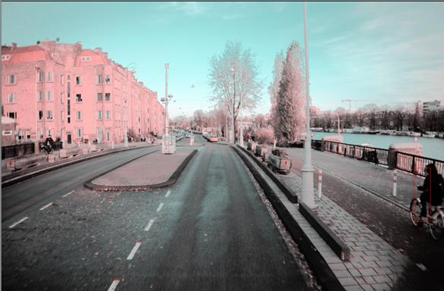
City vs highway driving - Ambiguous situations
Picture from AEBS camera

Slide 39
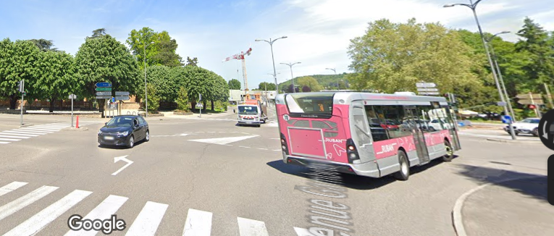
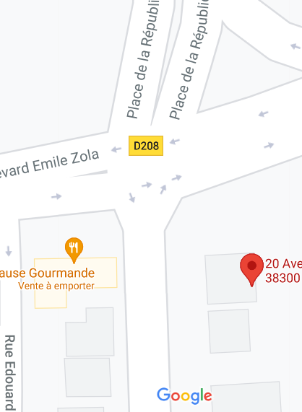
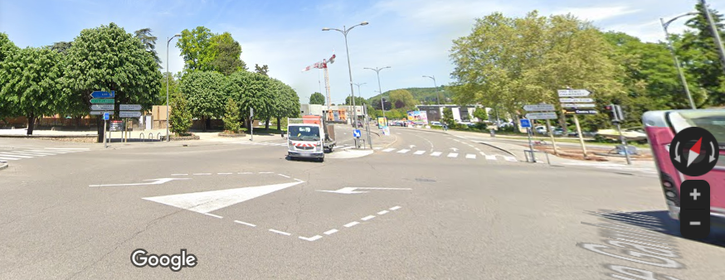
City vs highway driving - Ambiguous situations

Slide 40
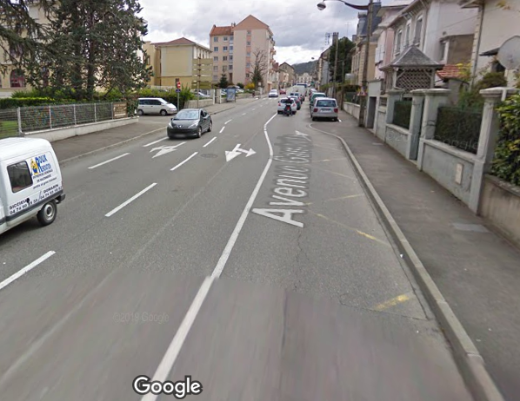
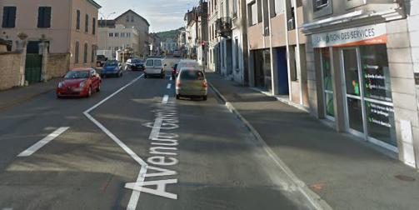
City vs highway driving - Ambiguous situations

Slide 41
“it is also recognized…”
5.2.1.4. Speed reduction by braking demand
...the AEBS shall be able to achieve a relative impact speed… as shown in the following tables :
  (a)… (g)…
  It is recognised that the performances required in this table may not be fully achieved in other conditions than those listed above. However, the system shall not deactivate or unreasonably switch the control strategy in these other conditions. This shall be demonstrated in accordance with Annex 3 of this Regulation.
Conditions (a) to (g)
are all fulfilled:
Full performance
Partial performance
At least one condition among (a) to (g) is not fulfilled
The system does not perform

Slide 42
“it is also recognized…”
5.2.1.4. Speed reduction by braking demand
...the AEBS shall be able to achieve a relative impact speed… as shown in the following tables :
  (a)… (g)…
  It is recognised that the performances required in this table may not be fully achieved in other conditions than those listed above. However, the system shall not deactivate or unreasonably switch the control strategy in these other conditions. This shall be demonstrated in accordance with Annex 3 of this Regulation.
Brake temperature
500dC
The issue is that some conditions are not named in the list (a) to (g);
Thus, it could be interpreted that the full performance is expected whatever status these conditions have (e.g. hot brakes), provided conditions (a) to (g) are all fulfilled… which is obviously not the original intention…
Conditions (a) to (g)
are all fulfilled:
Full performance
Cold
Partial performance
At least one condition among (a) to (g) is not fulfilled
The system does not perform

