Slide 1

18th Session
Status Review and Session Orientation
Document FRAV-18-03
Web Conference
9 September 2021

Slide 2
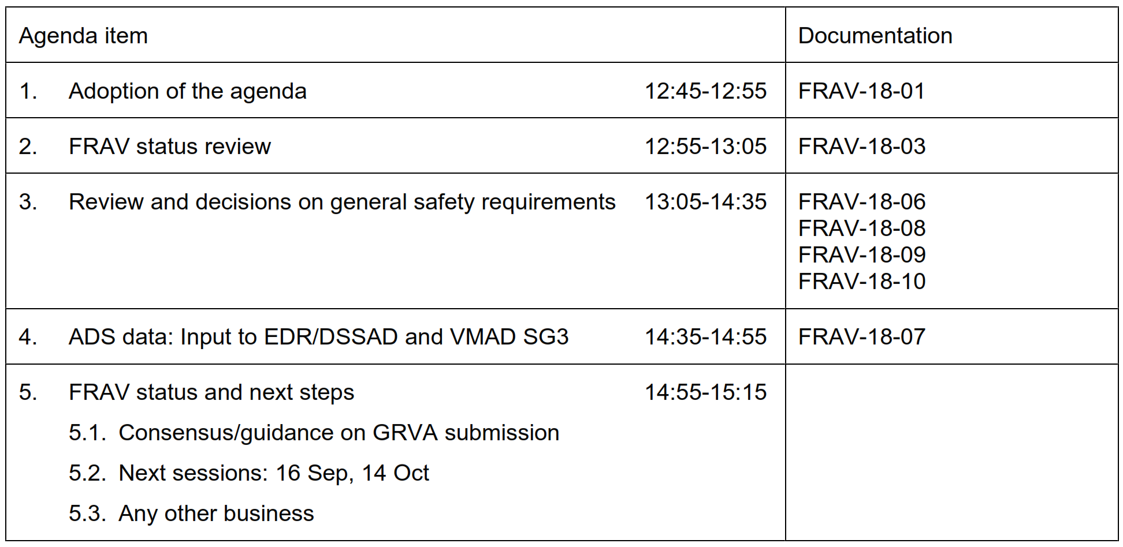
Agenda item 1
Adoption of the agenda

Slide 3
Agenda item 2
FRAV status
Diversity of ADS and ODD
142 safety proposals
Five “Starting Points”
List of “Safety Topics”
Safety topics review
Tasks/Objectives
Common Understanding
Safety Needs
General Requirements
Specifications
ADS descriptions
Package Delivery
GRVA-11: Initial GSR
GRVA-12: Draft Package
ADS driving performance
ADS user roles-based safety
ORU properties-based safety
Clarification of safety topics: Derive DDT-relevant safety requirements
Driver/User differentiation: Derive safety requirements based on user roles
Detectable ORU properties and responses based on functional/behavioral properties
FRAV-VMAD leadership discussions suggest growing need to collaborate and align work

Slide 4
Agenda item 3
General Safety Requirements
FRAV-18-06 consolidates input from the FRAV workstreams (DDT, ADS Users, ORU)
  FRAV-18-09 is the worksheet used to reach consensus on items in FRAV-18-06
FRAV-18-08: Update from ADS Users workstream
FRAV-18-10: Input from Japan on 17th session discussion of revised safety topics and DDT-relevant general requirements (FRAV-17-06)
For GRVA, need to confirm whether stakeholder object to any items in FRAV-18-06
  Items are work-in-progress, not final or formal proposals
  Items provide basis for linking FRAV and VMAD work

Slide 5
Agenda item 4
ADS Data Collection
FRAV sent FRAV-18-07 to EDR/DSSAD on 2 September
Discussion during the last session
  Data element examples and their categorization
    Review and comment on FRAV-16-13 draft examples
  Input to VMAD SG3 and request for feedback
    Concept for “flagging” ADS operations/user inputs per FRAV requirements
  EDR/DSSAD has lead—Coordination among activities to meet common interests
Next steps?

Slide 6
Agenda item 5
Outlook for next steps (thru 2021)
FRAV-19 (16 September)
  Approval of FRAV submission to GRVA
  Status and expectations (GRVA will report to November WP.29)
GRVA-11: 27 September-1 October
Four months to prepare submission to GRVA-12 (February 2022)
  [Session 20: 14 October]
  [Session 21: 17-18 November]
  [Session 22: 15-16 December]
General Requirements
Specifications
ADS descriptions
Package Delivery
Draft package by February 2022
Are we on task? Any course corrections?

