Slide 1

20th Informal Working Group on
Validation Methods for Automated Driving (VMAD) Web-conference
VMAD-20-11-rev.2
United Nations Economic Commission for Europe (UNECE)
Working Party on Automated/Autonomous and Connected Vehicles (GRVA)
September 14&15, 2021
WebEx

Slide 2

Purpose
To review a status update on the work of the Validation Methods for Automated Driving (VMAD) Informal Working Group (IWG).
Specifically the following:
  Update from Subgroup leaders
  Debrief on FRAV/VMAD coordination meeting
  Next steps of the NATM Master Document 2nd iteration
  Proposal for report to GRVA in September

Slide 3
Update from Subgroup leaders
SG leaders provide updates on the following:
  Work accomplished by the SGs since last VMAD including proposed revision to the Master Document
  General status update on work towards the 2nd iteration of the NATM for VMAD 21 in October including:
    work to address outstanding issues
    evaluation of NATM for the motorway use-case
  Unresolved issues for consideration by VMAD members
  Upcoming SG meetings planned from now to the end of October

Slide 4
Debrief on FRAV/VMAD coordination meeting
FRAV and VMAD co-chairs continue to meet regularly to facilitate the accomplishment of their respective deliverables.
FRAV and VMAD co-chairs extended the joint meeting to SG leaders and FRAV Stream leaders.
FRAV and VMAD agreed to select a few concrete test cases to work on collaboratively to develop a better synchronization between our two groups.
Co-chairs will continue to update the VMAD members on the progress of the joint meeting.
The next two-slide-presentation is an example from SG1 (used as a basis for discussion with FRAV)

Slide 5
FRAV
SG1
Having the major target aligned
Each group has been ‘digging through the tunnel’
Establish General safety requirements
Cover Functional Scenarios for Motorway use-case under NATM MD Annex2
DONE in main point
DONE in main point
From this point forward,
we need to clarify the order and the role/responsibility of the following works
Functional Scenario
NEXT STEP is HERE！
For each Functional Scenario
describe expected roles of the ADS
(or translate Detailed Safety Requirement for each Functional Scenario)
Identify parameters in each Functional Scenario based on the expected roles of ADS
Define the data range of parameters
At the same time, numbers of Concrete scenarios are made
Logical Scenario
Establish Measurable and Verifiable criteria based on the expected roles of ADS (and data range of parameters if needed)
Concrete Scenario
Assessment/Validation using the multi-pillar testing methodologies
To decide which concrete scenario should be used is out of scope of SG1

Slide 6
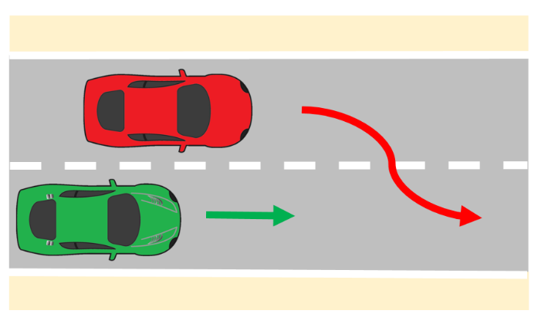
Ex. Cut-in in front of the ego vehicle
FRAV
SG1
Having the major target aligned
Each group has been ‘digging through the tunnel’
(NATM MD Annex2 p.33)
Another vehicle is driving in the same direction as the ego vehicle in an adjacent lane. The other vehicle makes a lane change, such that is becomes the LV from the ego vehicle’s perspective. Depending on the distance and lateral velocity of the LV, the severity of the cut-in manoeuvre changes.
Establish General safety requirements
Cover Functional Scenarios for Motorway use-case under NATM MD Annex2
(Detailed Safety Requirements)
Adapt its behaviour to the surrounding traffic conditions (e.g., by avoiding disruption to the flow of traffic)
One example：
ADS shall avoid collision after the other vehicle’s lane change
DONE in main point
DONE in main point
From this point forward,
we need to clarify the order and the role/responsibility of the following works
Functional Scenario
NEXT STEP is HERE！
For each Functional Scenario
describe expected roles of the ADS
(or translate Detailed Safety Requirement for each Functional Scenario)
Identify parameters in each Functional Scenario based on the expected roles of ADS
Example:
Initial velocity of Ego and LV, Initial distance (3D), Lateral motion of LV, Deceleration of Ego, etc.
Example:
According to a level of safety (C&C (+α) driver, for example), ADS shall avoid a collision, taking into account the combination of every parameter
Define the data range of parameters
At the same time, numbers of Concrete scenarios are made
Logical Scenario
Example:
Initial velocity of Ego and LV: 80-130 km/h,
Distance: 0-60 m,
Lateral velocity of LV: 0-3 m/s2, etc.
Establish Measurable and Verifiable criteria based on the expected roles of ADS
(and data range of parameters if needed)
Concrete Scenario
Assessment/Validation using the multi-pillar testing methodologies
To decide which concrete scenario should be used is out of scope of SG1

Slide 7
Next steps of the NATM Master Document 2nd iteration
September 29: VMAD members are asked by the date to send written comments to the proposed revisions of the Master Document (VMAD-20-04(SG1), -05 and -06(SG2), -07 to -09(SG3) ) to secretariat, co-chairs and the responsible subgroup leader
October 13: Updated texts from subgroups are submitted to secr + co-chairs
October 18: co-chairs/ subgroup leaders meeting is held to prepare draft second iteration of the Master Document
October 19: the draft second iteration is distributed to VMAD members
October 27: VMAD21 is held to review and finalize the draft second iteration
October 29: the draft second iteration is submitted to GRVA Secretary
(November 9-10: VMAD22 is held to consider WP29 guidelines for NATM)
February 7-11, 2022: the draft second iteration is tabled at GRVA as formal doc.
March 8-11, 2022: the second iteration is tabled at WP29 as informal doc.
June 21-24, 2022: the second iteration is tabled at WP29 as formal doc.
Replaced with accelerated one after VMAD20

Slide 8
Proposal for report to GRVA in September
To provide a status update on the work of the Validation Methods for Automated Driving (VMAD) Informal Working Group (IWG) specifically the progress made by each subgroups
To inform that draft second iteration of the NATM Master Document will be submitted to the next GRVA
To inform that FRAV and VMAD agreed to select a few concrete test cases to work on collaboratively to develop a better synchronization between the two groups.

Slide 9
Upcoming VMAD Sessions
  VMAD IWG plans to hold next session in October.
    The 21st session on October 27 (Wednesday) 12:00-14:00 CEST
    The 22nd session on [November 9-10]
    The 23rd session on January 25 – 26
    The 24th session on March 1 – 2

Slide 10
Thank you!

