Slide 1

Overview SG4 Activities
VMAD-20-13
VMAD meeting 14 & 15 September 2021

Slide 2

Test methodology: Test Matrix
Presented earlier…..
As a start for development of methodology; a possible approach
2

Slide 3
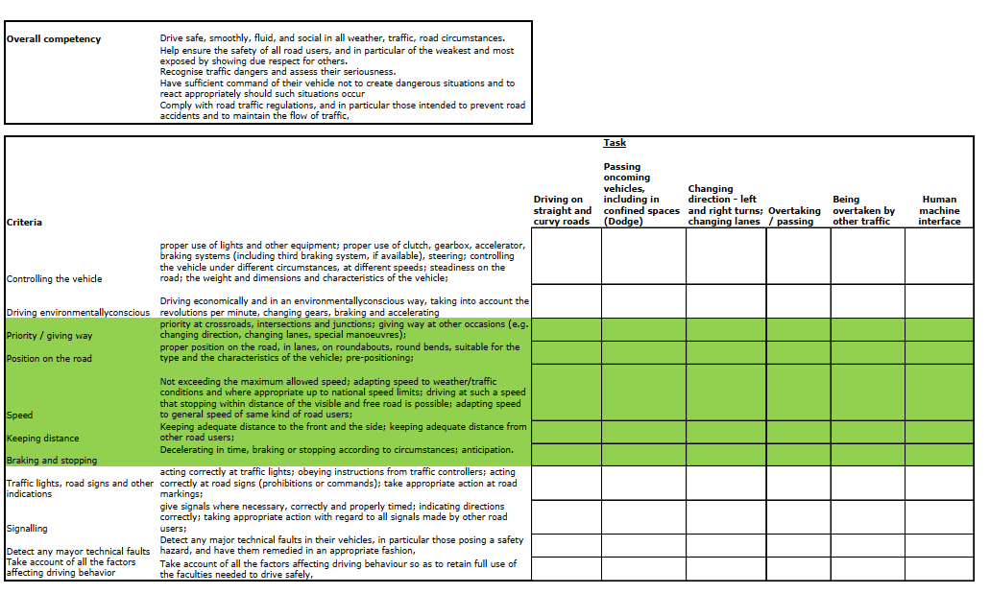
Possible approach for a test matrix
3

Slide 4
Example of Test Matrix
4

Slide 5
”Content” of the test methodology: How to proceed?
FRAV’s Topics for (functioning of) ADS (functional requirements)
Commented in general by SG4
“Content” for Track- and Real world testing
Things to be done:
How to elaborate functional requirements…
Specifications: what is exactly meant by each safety topic?
5

Slide 6
Next steps
Elaboration criteria (by FRAV; in “measurable terms”)
Discussed with FRAV (SG4 / FRAV)…
Also discussed with co-chairs / FRAV / SG leaders
From there:
Design / elaboration of the test matrix
Pass / Fail criteria (FRAV)
Development test protocols
Try outs / validation
6

Slide 7
Status:
Development of latest input SG4 for NATM, containing:
- Description inventory best practices TT / RWT (for NATM).
- General description of (possible) test methodology.
- Methodology connected with general requirements FRAV.
- Delivery before next VMAD meeting (October?)
7

Slide 8
Status (2)
For now:
- Use case motorway.
- Which of the requirements to prioritize (as an example)?
- Within each requirement: also priorities (elaboration of each requirement in measurable terms); also as an example.
- Aim: delivering test model with focus on a use case
Ongoing meetings FRAV / SG4 regarding requirements
8

