Slide 1
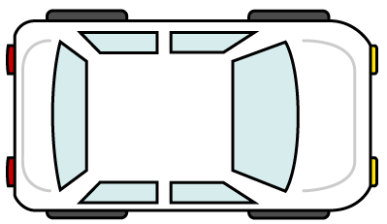
Start timing of MRMLC
UNR157-11-06
11^{h} SIG on R157
09,10 December 2021
If an event happens, transition demand starts.
If the driver dose not respond
transition demand, MRM starts.
5s
Time (second)
0
15
Warning to driver
by transition demand.
10
Warning to ORU
by hazard warning lights.
Call attention, but Not warning to ORU by direction indicator
the hazard warning lights : OFF
the direction indicator : OFF
the hazard warning lights : ON
the direction indicator : OFF
the hazard warning lights : OFF
the direction indicator : ON
Other road user should be warned that ALKS is in emergent situation because MRM LC dose not have enough capability of doing LC safely unless other road users specially take care of the ALKS movement.
Without this “5s”, other road user has no chance to be warned before the ALKS starts MRM LC.

