Slide 1
BSIS Alternative Test Procedure
VRU-Proxi-20-02

Slide 2
Motivation
Regulation 151-00 guarantees that drivers of heavy vehicles are notified about endangered bicyclists in due time.
Main critisicm: Information signal is given too early
Solution: New, alternative test procedure
Alternative test procedure allows verification of AEBS for BSIS (original test procedure does not)

Slide 3
Introduction & Recapitulation

Slide 4

Possible information signal timings
1 before potential swerving (as implemented in current R151)
2 for comfortable stopping (as proposed in initial document)
3 possible auto-brake activation
Figure qualitative
1
2
3
Sufficient
to initiate braking
Sufficient
for Auto-Brake!

Slide 5
R151 requirements …
The BSIS shall inform the driver about nearby bicycles that might be endangered during a potential turn, by means of an optical signal, so that the vehicle can be stopped before crossing the bicycle trajectory.
It shall also inform the driver about approaching bicycles while the vehicle is stationary before the bicycle reaches the vehicle front, taking into account a reaction time of 1.4 seconds. This shall be tested according to paragraph 6.6.
The BSIS shall warn the driver, by means of an optical signal, acoustical signal, haptic signal or any combination of these signals, when the risk of a collision increases.
Needs additional
definitions or at
least interpretation
Clear performance
requirement
Needs interpretation

Slide 6
Proposal for alternative test method
1. When using driving and dummy robots, all vehicle movements are pre-programmed
2. Every vehicle location is known at all times
3. It is possible to verify the signal activation without impact to the dummy
4. It is possible to verify the signal activation in more realistic scenarios (including swerving to the outside)
5. It is safe to return to the „old“ pass-fail-criteria!
6. NO changes to actual specification section in R151 required

Slide 7
Technical Feasibility

Slide 8
Central question:
„Will it be possible to drive the vehicle naturally and add a bicycle dummy to verify the functionality of the system?“
Driving Robots
Dummy Robots
Recording of Trajectories

Slide 9
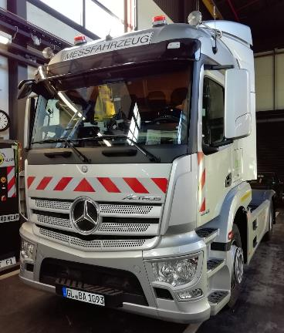
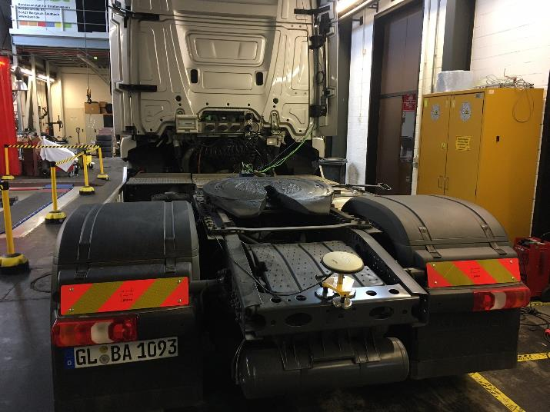
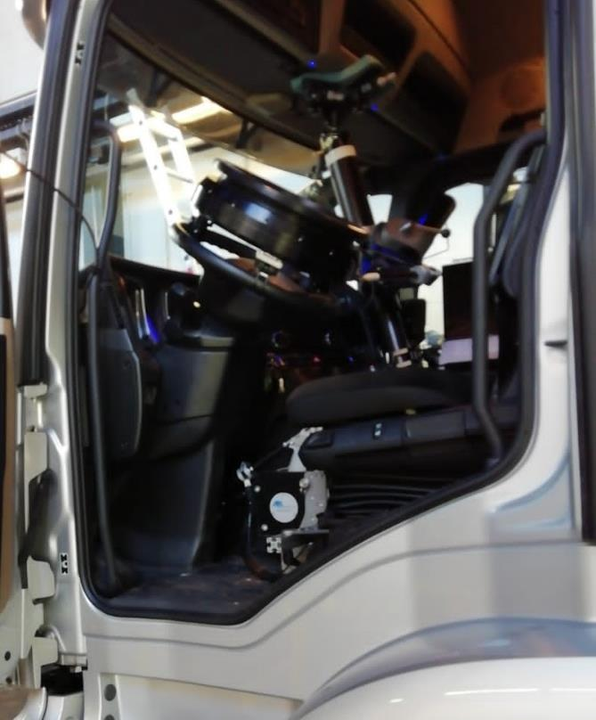
Robot Implementation Overview
Vehicle
Sensor: ADMA G DGPS IMU
Actor: ABD SR 60
(60 Nm steering robot)
Actor: ABD CBAR
(combined brake +
accelerator robot)

Slide 10
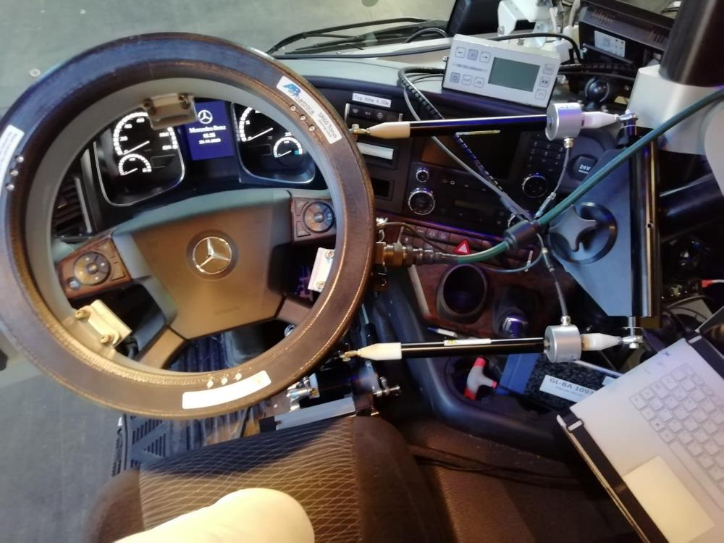
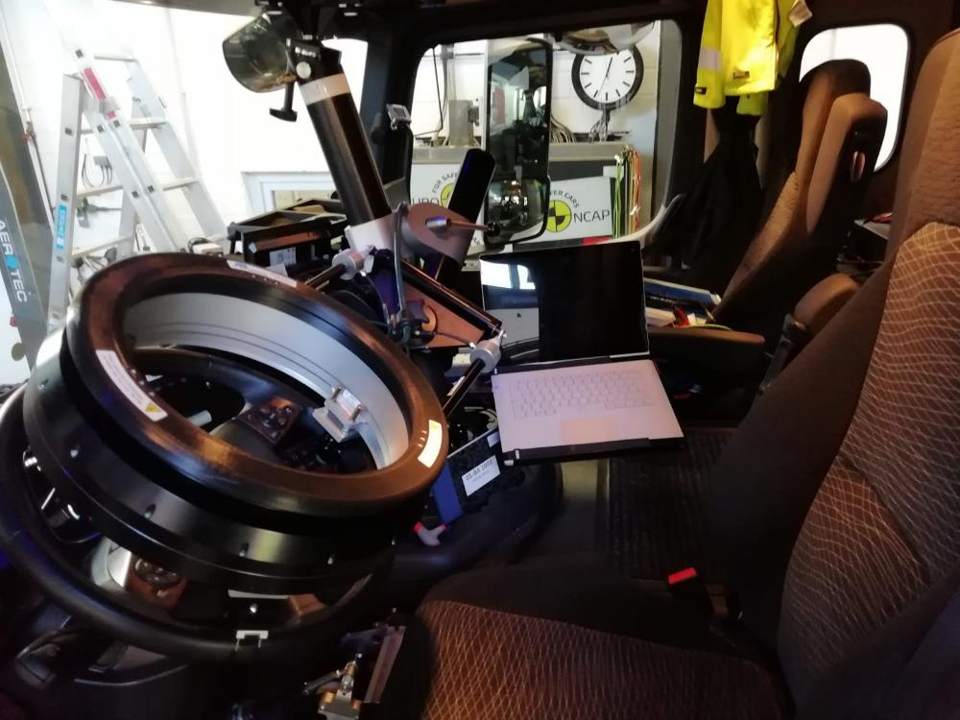
Steering Controller (Details)

Slide 11
Investigated Variants
Replay recorded trajectory from other vehicles
→ not promising
Replay recorded trajectory from same vehicle
→ accuracy sufficient, speed control critical
Synchronise trajectory with bicycle dummy
→ accuracy sufficient, solves speed control issue

Slide 12
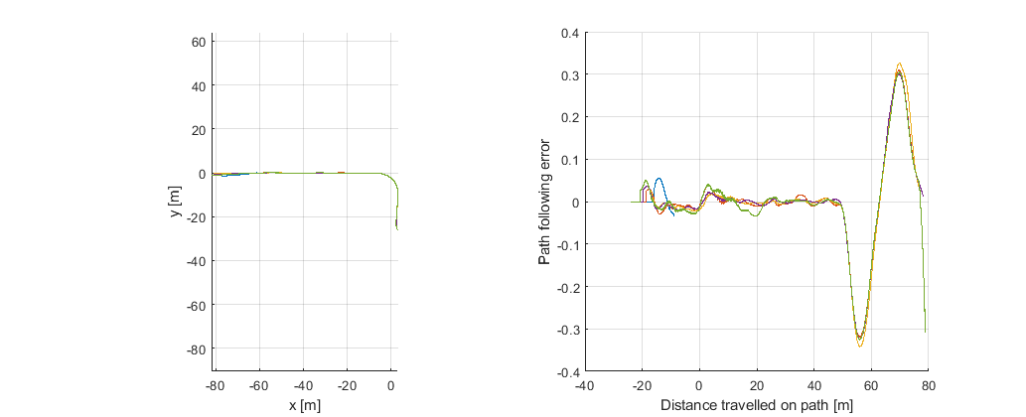
Accuracy results for trajectories from other vehicles:
15 km/h, Klothoide → ±0.35 m error

Slide 13
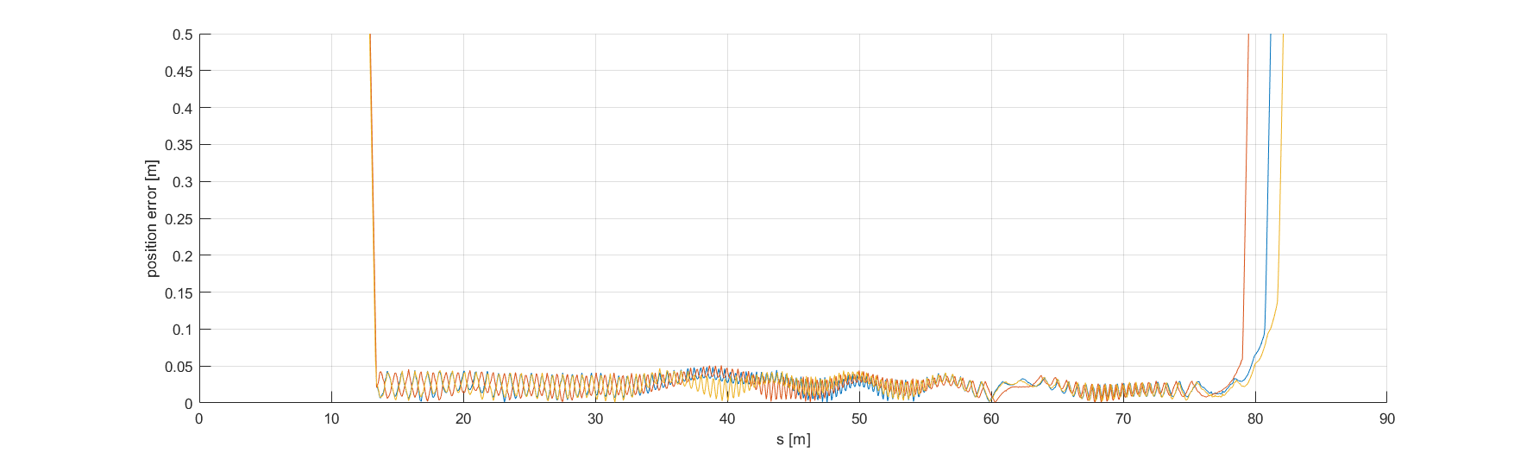
Position accuracy if trajectory recorded with the exact same vehicle: approx. 5 cm!

Slide 14
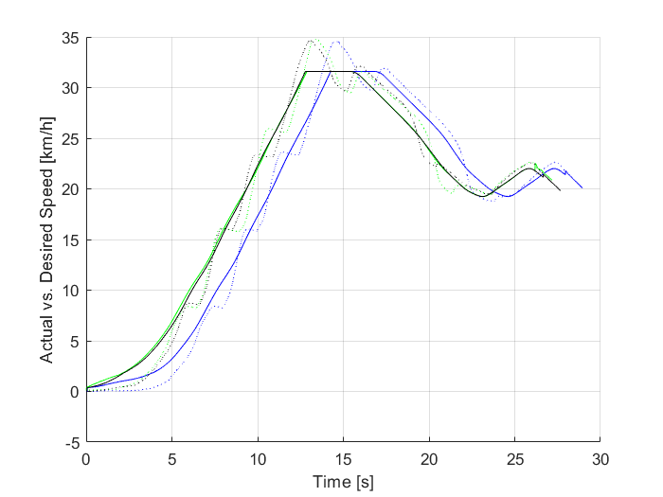
Actual vs.
Desired Speed:
Speed accuracy is not as good as expected due to shifting
(slow gearbox).
Possible to improve with sync‘ed dummy.

Slide 15
Procedure
1. Record turn without dummy
Record trajectory
(path+speed) of realistic turn
Replay trajectory
without dummy and record again
with dummy controller
2. Add dummy
Add dummy trajectory with
dummy controller software
Define impact position
3. Perform test with
vehicle and dummy
Perform sync‘ed test without dummy to
check repeatability (overrun platform!)
Test synchronized (abort before impact)

Slide 16
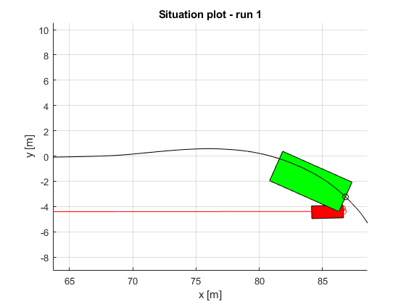
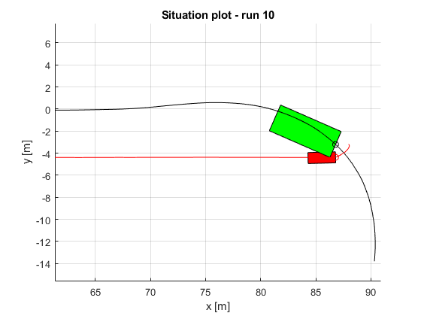
Videos
Videos removes for presentation size

Slide 17
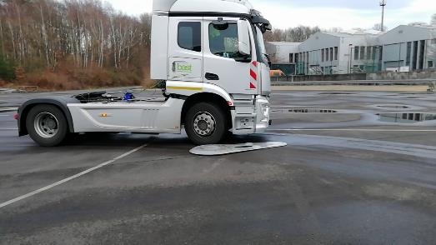
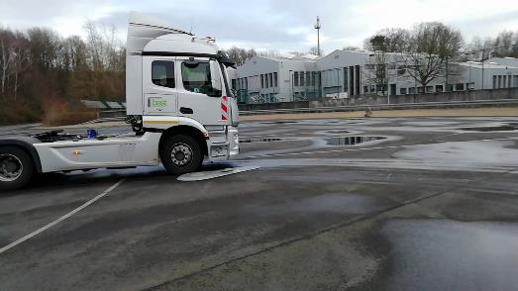
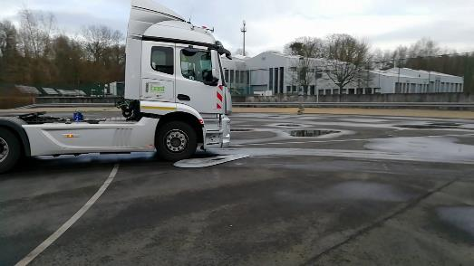
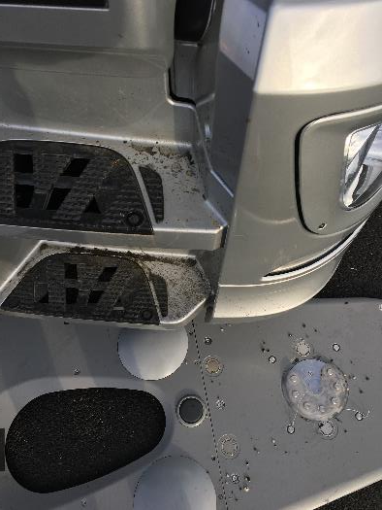
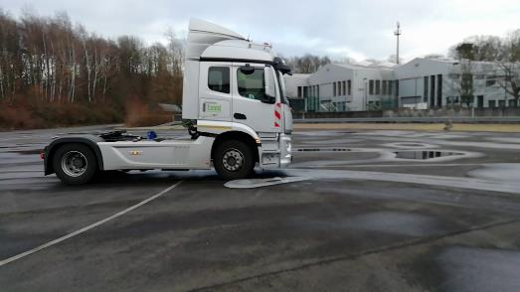
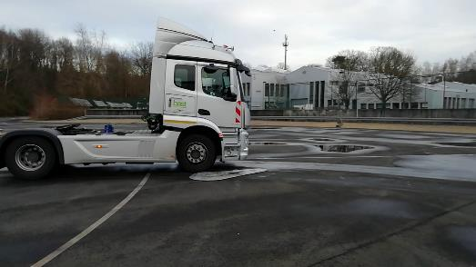
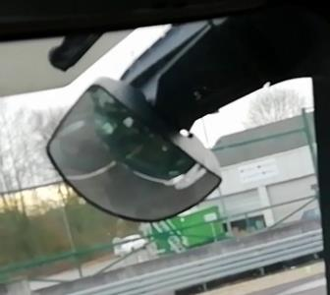
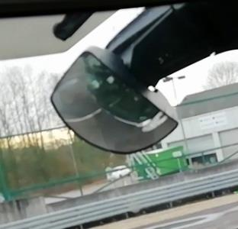
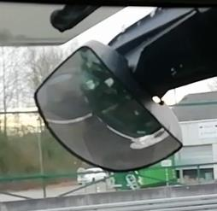
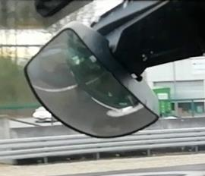
Results: Repeatability of Impact Situation
1
2
3
„Teached“ impact
4
5
6
7
8
9

Slide 18
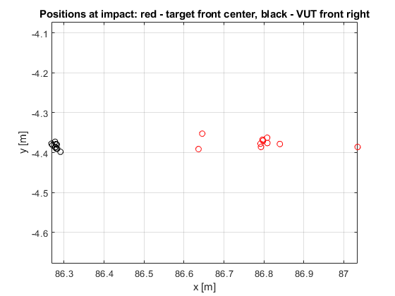
Measurement Data
Outlier within ±20 cm
≤10 cm
≤10 cm

Slide 19
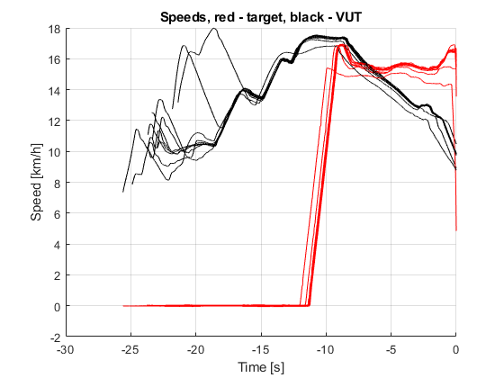
Speed Profiles – Vehicle (recorded) & Dummy (sync‘ed)
Desired Speed
± 1 km/h

Slide 20
Equipment (for reference)
Daimler Actros (last generation), driven in automatic transmission mode
ABD „SR60“ + „CBAR“ Driving robots
Genesys „ADMA-G“ Version 3 DGPS-IMU
4active Systems „FreeBoard Small“ self-driving dummy platform
Syncronisation via ADMA protocol and WiFi network

Slide 21
Conclusion
Robot testing allows a robust assessment of Blind Spot Assist Systems
Robot testing would allow assessment of Blind Spot AEB systems as well (R151 test procedure does not!), sync tuning needed
Repeatability and accuracy is sufficient (when synchronized with dummy)
How should the vehicles be driven in turns?

Slide 22
Trajectories for VUT

Slide 23
Trajectory Definition for Alternative Test Procedure
Several runs for different kinds of vehicle available
  All manufacturers were invited to supply data
  Truck
  Truck & Trailer
  Tractor & Semitrailer
  Different lane width of target lane
Required is a generic specification for the turning path
Vehicles should be driven according to specification (without dummy), this will be recorded as basis for the robot control
This is independent from dummy lateral distance!

Slide 24
Overview and combination of available data
4 = 1 + 3, so not necessary

Slide 25
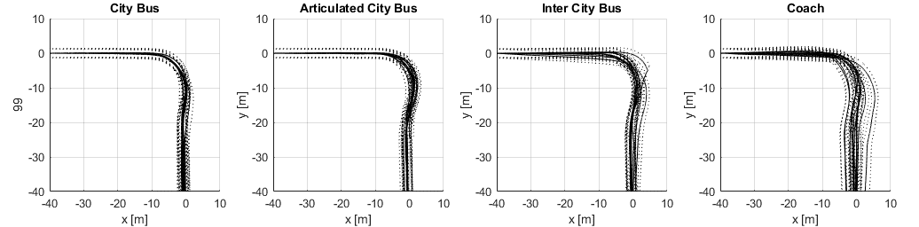
Busses
4
5

Slide 26
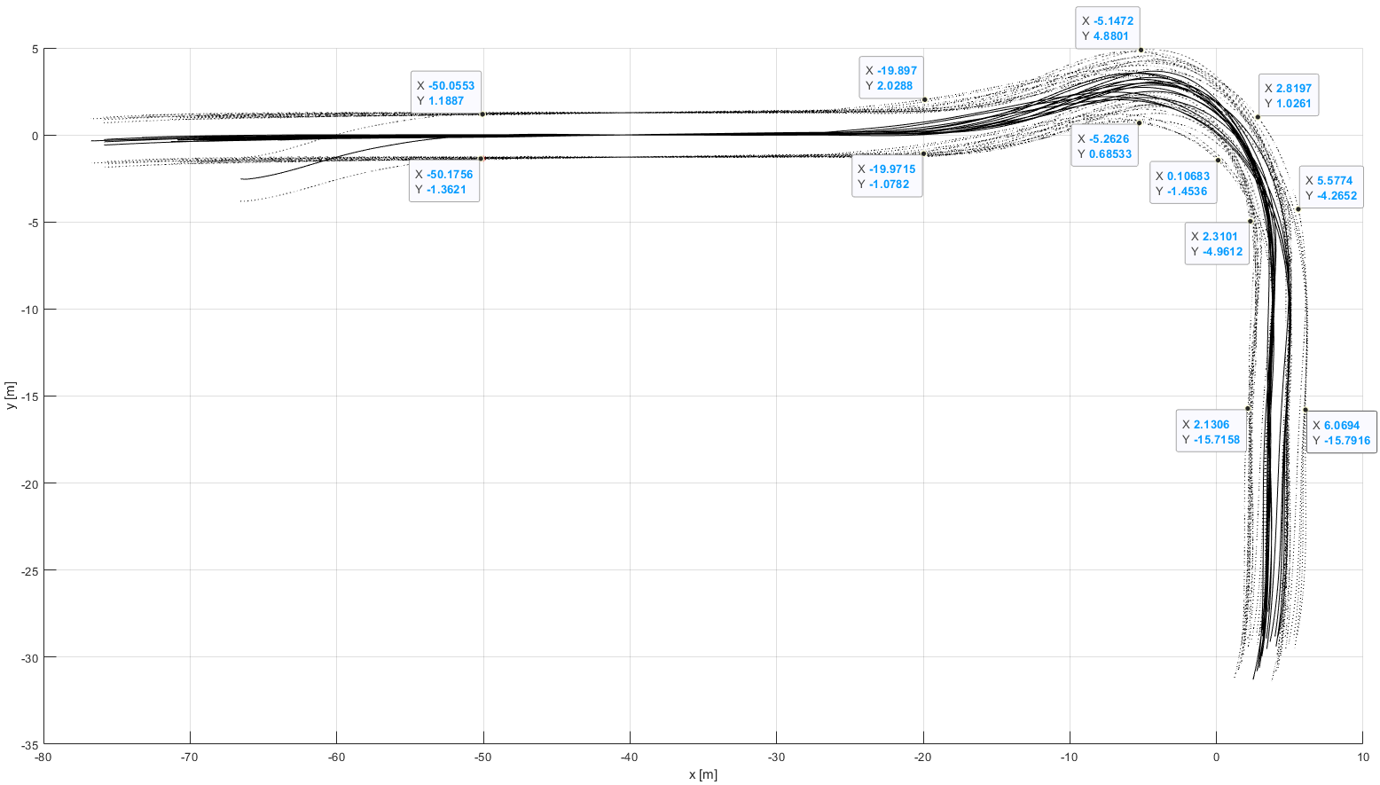
Envelope 1
Several test runs of a single truck
Target lane width: 5 & 6 m
„Envelope“ for all test runs
„Envelope“ given per dedicated positions
Vehicle should be driven in the envelope
Envelope given per dedicated points as shown
Speed control open to the driver

Slide 27
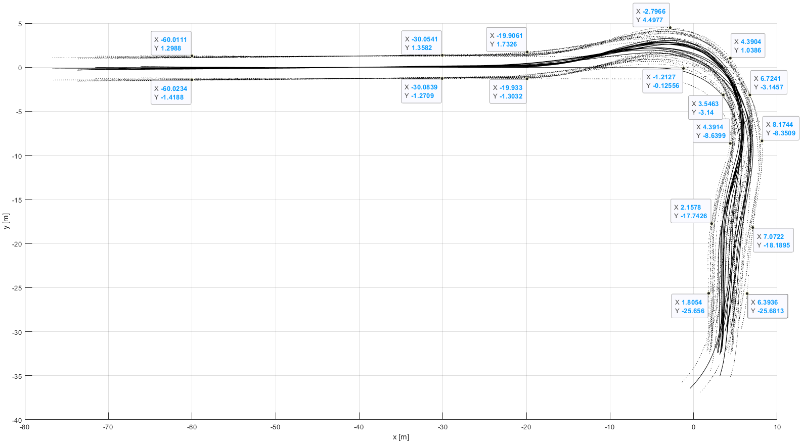
Envelope 2
Outlier
Several test runs of a truck & trailer
Target lane width: 7 & 9 m
„Envelope“

Slide 28
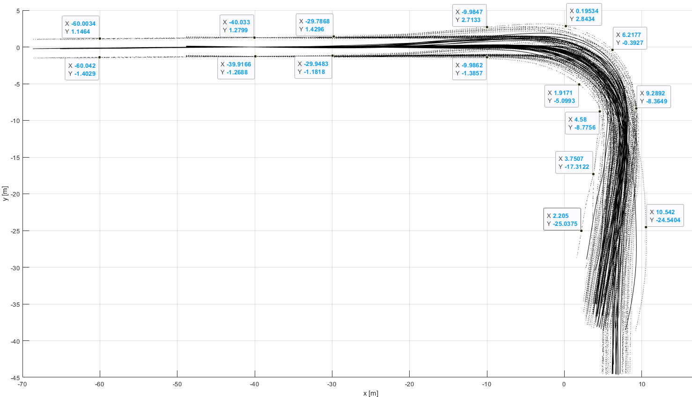
Envelope 3
Several test runs for single truck
& tractor-semitrailer
Target lane widths: 7, 11 (truck)
& 11 (tractor-semitrailer)
„Envelope“

Slide 29
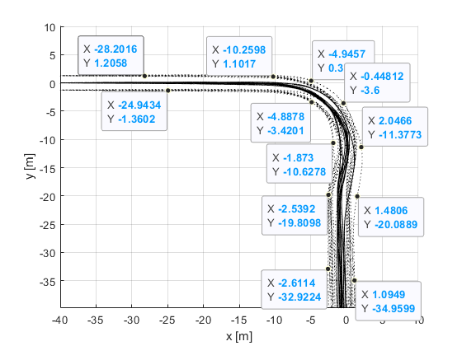
Envelope new 4 (Bus 1)

Slide 30
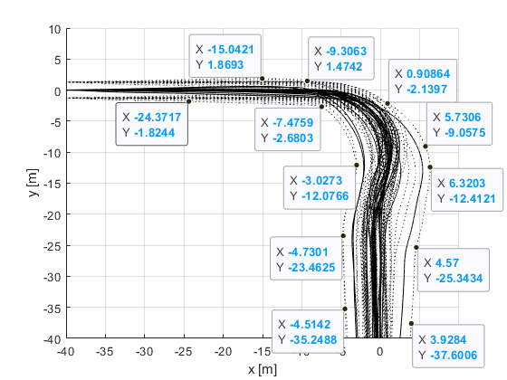
Envelope new 5 (Bus 2)

Slide 31
Conclusion
Kind of vehicle | Relevant envelope
Single trucks, single tractors | 1, 3
Single trucks equipped to tow trailers | 1, 2, 3
Tractors equipped to tow semitrailers | 3
M3 Class I | 4,5
M3 Other | 5

Slide 32
Bringing it all together

Slide 33
Changes to the core test
“6.5.7. Verification of Blind Spot Information signal
Verification of the Blind Spot Information signal can be made by following two methods, at the manufacturer's choosing:
(a) Verify if the Blind Spot Information signal has been activated before the vehicle crosses line C in Figure 1 of Appendix 1 to this Regulation, and if the Blind Spot Information signal has not been activated before the vehicle crosses line D in Figure 1.
(b) The activation of the blind spot information signal may be checked using the test procedure as specified in Annex 4 to this regulation.”

Slide 34
Annex 4: Prerequisites
1. Test procedure
1.1. Verify that the vehicle and the test track are in the condition as required per section 6 and its subparagraphs.
1.2. Equip the vehicle with the following equipment:
1.2.1. A position measurement system, able to measure the vehicle position with an accuracy of [5] cm, such as a differential GPS and inertial measurement unit fusion system, sampling at no less than 100 Hz.
1.2.2. A driving system that is able to modulate the direction, deceleration and acceleration of the vehicle under test in order to follow recorded trajectories with an accuracy of [50] cm when comparing recorded and replayed trajectory over time.
If the driving system does not allow a sufficient manual control, it may be absent during the recording of the trajectory as defined in paragraph 1.3 below.
1.2.3. A system to detect the information and warning signals after their activation with a time delay of not more than [25] ms.

Slide 35
Annex 4: Procedure to record the trajectories
1.3 Drive manually and record vehicle position over time for all relevant envelopes described in Appendix 1 for the vehicle under test. Modulate the speed as necessary during the turn while staying in the performance requirements as specified in section 5.3.1. (e.g. up to 30 km/h vehicle speed). The initial speed as specified in Appendix 1 should be maintained until passing a line corresponding to x=-30 in the coordinate system as specified in Appendix 1.
The vehicle shall be driven in such a way that the vehicle front is inside the envelopes at all times. This shall be verified with the measured data.
A marking of the positions using markers is permitted but not necessary.
If deemed justified by the technical service, any other trajectories that would be driven with the given vehicle to negotiate 90° turns may be tested as well.

Slide 36
Annex 4: Procedure to perform the actual tests
1.4 Drive the tests according to the table in appendix 1, using the driving system and the trajectories as recorded while performing paragraph 1.4 of this annex, ensuring the bicycle dummy robot is synchronized to impact the vehicle under test at the respective impact position (the front right corner or a position 6 m behind the front right corner of the vehicle) and is travelling on the respective y coordinate.
It may be necessary and shall be allowed to synchronize the dummy robot against a replay of the VUT trajectories (with full driving system control over speed and steering) rather than against the originally recorded trajectory while driving manually.
The dummy speed shall be at the respective speed with a tolerance of +- 2 km/h at all times. The dummy shall be moving at speed sufficiently ahead for the blind spot information system to pick it up as a moving target.
If the correct collision position for each VUT trajectory has been verified with a test run without a dummy on the carrier platform and repeatability of the test setup has been verified as well, the test may be aborted after detection of the information signal.

Slide 37
Annex 4: Calculation of LPI
1.5. Calculate the stopping distance with respect to passing the bicycle trajectory for each individual trajectory and each available sampling point, taking into account a possible vehicle deceleration of 5 m/s² and a reaction time of 1.4 seconds.
The calculation may be performed in the following manner:
Calculate the required braking distance d_{brake} for each data point on the trajectory, using the following equation:
using the actual vehicle speed v in m/s.
The distance of the VUT front right corner on its path to the bicycle line of movement shall be d_{Bicycletrajecrory.}
The position of the last point of information then is given by the first time where the following condition applies:
|d_{Bicycletrajecrory.} - d_{brake,total} | < [0.35] m

Slide 38
Annex 4 – Final paragraphs
1.6 The test procedure is considered to be passed, and consequently the vehicle is deemed to have fulfilled paragraphs 6.5.6, 6.5.7 and 6.5.10, if the information signal is given at a distance (on the path coordinate of the individual trajectories) greater than the stopping distance (on the path coordinate of the individual trajectories) as calculated in paragraph 1.4 above for all required test runs conducted according to paragraph 1.5 above.
1.7 All measurement data (in the form of plots) and all calculations done in paragraph 1.4 shall be included in a test report with regard to this annex. The test report shall be annexed to the certificate.

Slide 39
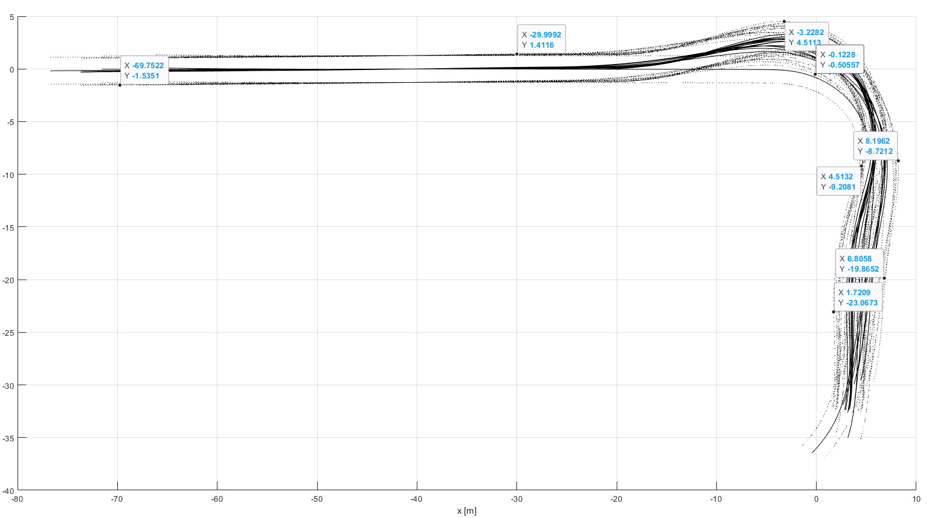
Appendix 1 to Annex 4
Suggestion to just
put the envelope
pictures

Slide 40
Appendix 1 to Annex 4 – What to do

