Slide 1
Task Force Direct Vision: Progress & Status of the draft regulation & Key discussion points
Iain Knight & Johannes Peter Bauer on behalf of the Task force
VRU-Proxi-20-05

Slide 2
Objectives
High Level overview of the latest status
  Implementing agreed (VRU Proxi 19) ‘Hybrid’ approach and limit values in regulatory text
  Physical test method
  Developing a simplified approach for M2/N2 [and M3] vehicles
  The potential for small exemptions for existing vehicle types compensated by active safety
  The potential to reduce unnecessary design constraints associated with the frontal limit value

Slide 3
Core Regulatory Text
Initial draft incorporating latest agreements complete (except information doc)
Text added to define separated views to each side, separated by A-pillars, to enable agreed hybrid approach
Limit values applied as shown
 | Minimum Volume (m³) by Direct Vision Level
 | 1 | 2 | 3
Visible Volume (Nearside) | 3.4 | Not Specified | Not Specified
Visible Volume (Front) | 1.8 | 1.0 | 1.0
Visible Volume (Offside) | 2.8 | Not Specified | Not Specified
Visible Volume (Total) | 11.2 | 8.0 | 7.0

Slide 4
Physical test Method
Practical testing has been completed by LDS with no major difficulties, some small refinements
Results from simulating the physical method show there is no single height for measurement that accurately represents volume across all truck designs studied.
  Evaluating at 5th female shoulder height under-estimates volume for tall vehicles.
  Evaluating at top of assessment zone (95th male shoulder height) under-estimates volume for low vehicles
Options for solution
  Evaluate at 3 heights (improved accuracy, additional test effort)
  Evaluate at top of zone (vehicles that are under-estimated pass by a large margin so does not affect approval. Risk: unintended consequence, new designs?)
Initial decision - implement in regulatory text at 3 heights and simplify later if further analysis concludes it is reasonable.

Slide 5
M2, N2 and [M3] Vehicles
Draft Regulatory text developed, subject to validation by OICA
Principle
  M2/N2 derived from N1 can be approved according to revised R125 as alternative
  Other M2/N2 [and M3] in practice will usually greatly exceed level 1 requirements and can be deemed to comply if certain geometrical criteria showing they are suitably low to the ground are met

Slide 6
Small Exemptions for existing types & compensation by Active safety
Agreed to add a proposal for an amendment with Transitional Provisions to enable this
Aim: to develop proposal in parallel with finalisation of core proposal so CPs are informed of all intentions when deciding on core proposal
Initial discussions around:
  The use of height measures to identify the relevant vehicles and any risks of incentivising height increases
  Mechanisms to ensure only partial exemptions – i.e. vehicles still apply all vision improvements (e.g. CMS, lower door windows) even if they still can’t meet main limit value
  The format of the active safety compensation required (e.g. “Motion Inhibit” system for moving off situation)

Slide 7
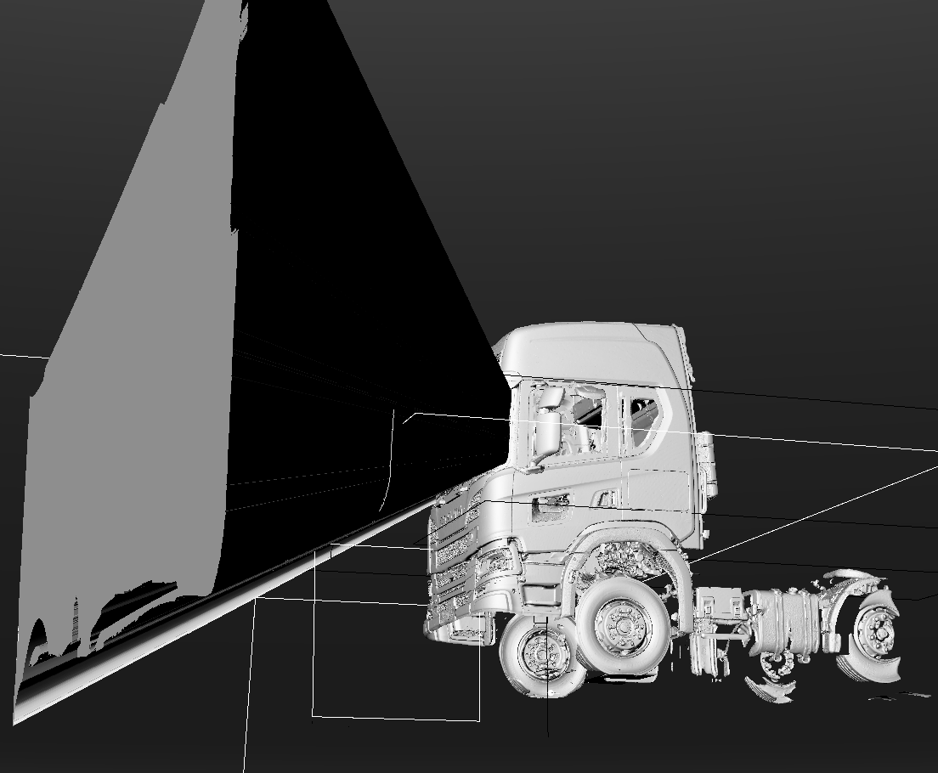
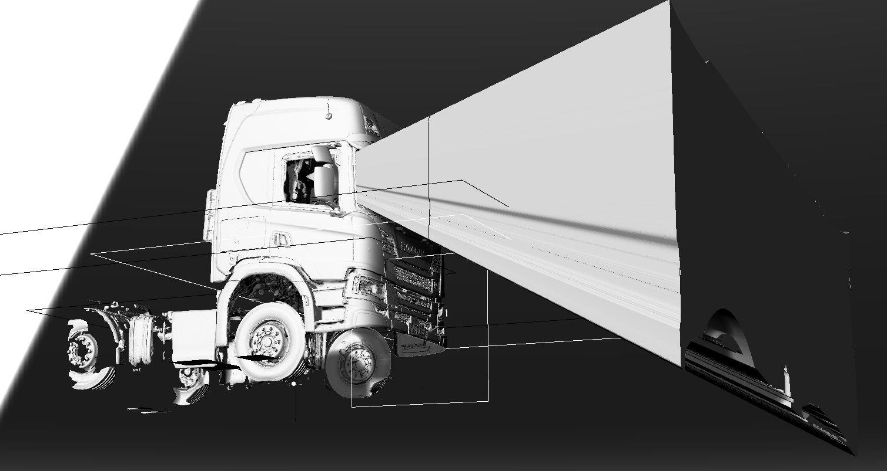
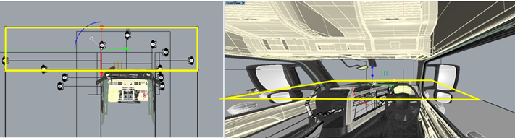
Minimising design constraints associated with application of a ‘separated approach’ with limits to each side
Agreed that this is necessary but not straight forward
Very likely it will need to be implemented as a subsequent amendment to 1st core regulatory proposal
Will be developed in parallel and as quickly as possible
Agreed that a method similar to T&E proposal (Option 2) appears most likely to succeed
  Front Zone – full width ahead of frontal plane
  Nearside – residual area to nearside of nearside plane
  Offside – residual area of offside of offside plane
Agreement that ACEA & LDS will work together to solve
Funding support for LDS contribution is sought
Current front volume is between the A-pillars
Proposed to change to all of assessment volume ahead of frontal plane

Slide 8
Summary
Progressing well on proposal for a 1st core regulatory text, based on agreements at VRU-Proxi 19
Significant issues still open and likely to become parallel or subsequent amendments
  Exemptions existing types compensated by active safety
  Reducing the design dependency of limits to each side

