Slide 1
New regulation proposal on uniform provisions concerning the approval of devices and motor vehicles with regard to the driver’s awareness of vulnerable road users existing front and lateral side close-proximity of vehicles
JAPAN,
on behalf of
VRU-Proxi Informal Working Group.
VRU-Proxi-20-08 Rev2

Slide 2
Background
Pedestrians account for 35.6% (1,258) of total fatalities in Japan (2018)
Injuries (529,378)
Fatalities (3,532)
Others
0.1%
Others
0.3%
Pedestrian
9.5%
Cyclist
15.9%
Vehicle
33.9%
Pedestrian
35.6%
Vehicle
64.1%
Motorbike
10.3%
Motorbike
17.4%
Cyclist
12.8%
Source: 2018 Road traffic accident statics (National Police Agency)

Slide 3
Background
M1/N1 contributes to more than half of total fatalities and injuries among pedestrians, at low speed (below 20km/h).
Injuries
Fatalities
M3
(3.0%)
N3
(0.7%)
N3
(10.0%)
N2
(11.5%)
M2
（0.6%）
M3
(10.7%)
M1/N1
58.5%
M1/N1
84.2%
N2
（18.2%）
M2
（2.5%）
Source: Road traffic accident statics from 2014 to 2018 (5-year-accumulation) (ITARDA)
M1 and N1 M2 N2 M3 N3
Number of Injuries: 135,932 Number of fatalities：998

Slide 4
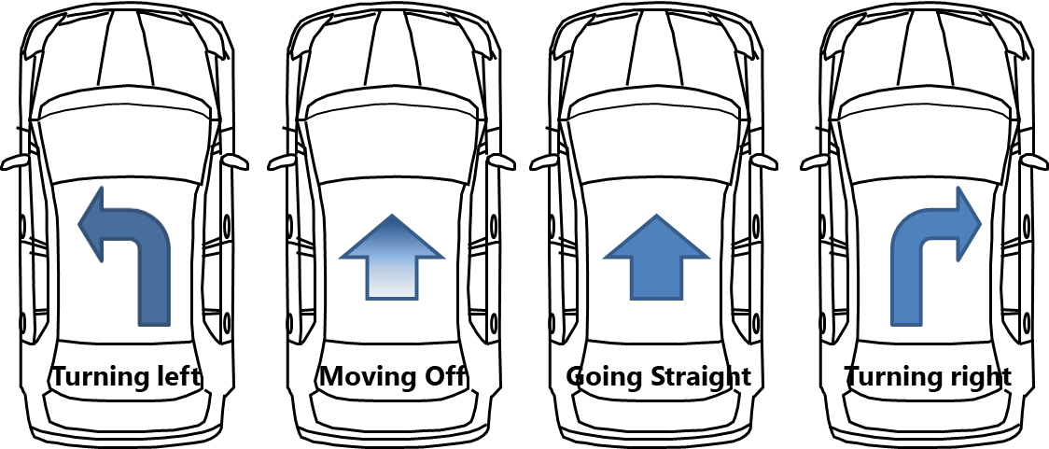
Background
Over 30 percent of accidents occur while vehicle moving off or going straight at low speed (below 20km/h).
Injuries
Fatalities
10.4%
12.7%
29.5%
42.2%
14.3%
14.1%
17.3%
54.3%
Source: Road traffic accident statics from 2014 to 2018 (5-year-accumulation) (ITARDA)
Number of Injuries: 125,471 Number of fatalities：736 (*excluding other hitting points)

Slide 5
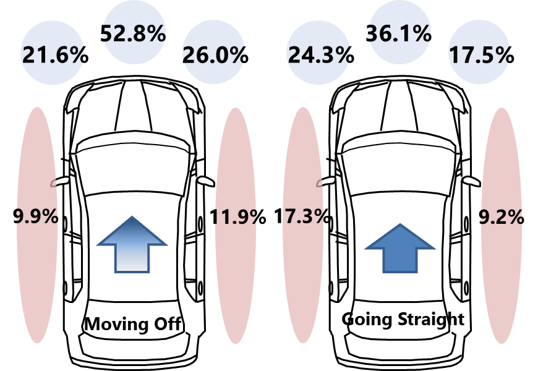
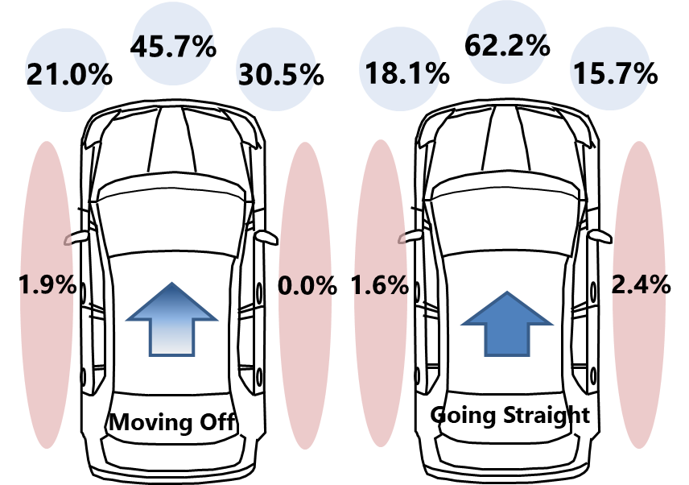
Background
Most of the hitting position is the front. But about 20% are side in the accidents occur while vehicle moving off or going straight at low speed (below 20km/h).
Injuries
Fatalities
Source: Road traffic accident statics from 2014 to 2018 (5-year-accumulation) (ITARDA)
Number of Injuries: 15,939 Number of fatalities：104 (*excluding other hitting points)

Slide 6
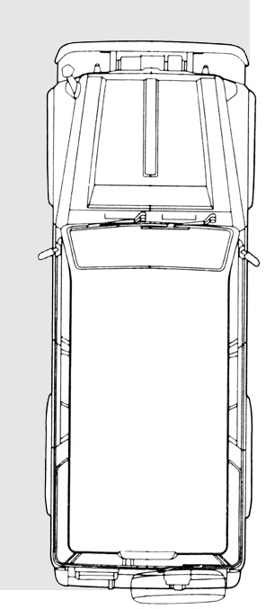
Proposal
Scope: M1 and N1
Vehicle Motion: moving off from stand-still
Detection Target: Pedestrians
Required Performance:
Driver’s awareness of VRU around the vehicle close-proximity field of front and side before moving off.

Slide 7
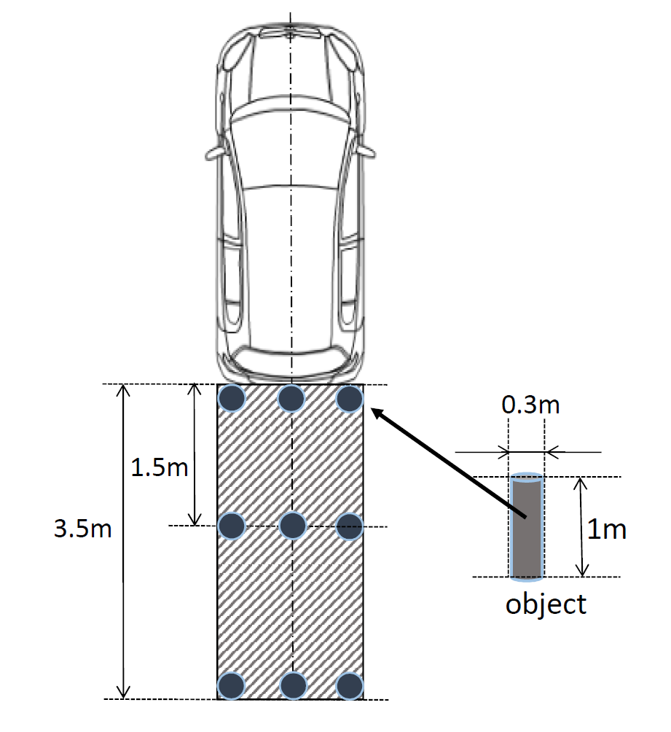
Requirements
Φ0.3m×1.0m pole
*5 years old child
0.3m
Field of driver’s front and lateral side close-proximity awareness
Center of side mirror (UN-R46 class III)
0.3m
Any part of pole to be seen.
Means of driver’s front close-proximity awareness
- Direct vision from adjusted driver’s ocular point.
- Indirect vision (cameras, mirrors without periscope)
- Detection
* When the class III mirror mounted in front of entire vehicle, field of vision is limited to the front side only.

Slide 8
Requirements
Direct vision
Any part of pole to be seen from adjusted driver’s ocular point.
Methods of driver’s ocular point adjustment
(1) Based on back angle *Same as R125
(2) Based on driver’s stretching behavior (passenger’s side and front side)
(3) Based on driver looks out of the side window (driver’s side)
 | Adjustment distance [mm]
 | Forward/ rearward | Lateral | Upward/ downward
Upward stretching | 0 | −10 | 40
Forward stretching | −140 | −15 | 10
Lateral stretching | 30 | −110 | 15
 | Adjustment distance [mm]
 | Forward/ rearward | Lateral | Upward/ downward
Upward stretching | 20 | 25 | -5
Forward stretching | 10 | 30 | 0
Lateral stretching | 5 | 35 | -5
Eyepoint center of both eyes
* Adjustment values defined based on the subject measurements.

Slide 9
Requirements
Indirect vision
Any part of pole to be seen in the camera image or mirror surface.
Detection
Φ0.3m×1.0m pole
0.3m
Detection needs 0.2m distance from vehicle.
Center of side mirror (UN-R46 class III)
Pole to be detected in the 0.1m range (rest of filed of vision).
0.3m

Slide 10
Requirements
Combination of several means for awareness
Close-proximity field of awareness shall be fully covered by the single or the combination of means for driver’s awareness.
Example *Right-handed drive case
Detection system
Front close-proximity mirror
Camera
Direct vision
Direct vision
Direct vision
Camera

Slide 11
Requirements
On-off conditions of the Close-proximity camera system or detection system
Direct vision or mirrors always provide vision.
On the other hand, electrical system can not always active due to power or other static purposes.
Therefore, driver’s on-demand activation allowed.
- Close-proximity front and lateral side view camera system and detection system shall be activated easily by the driver’s operations when the gear in the out of parking range.
- Close-proximity camera system or detection system that can not cover all field of means for driver awareness at the same time shall be easily show area of the driver’s interest by the driver’s operations.
- The front and lateral side view image may change the camera view by the driver’s operation or automatically without the driver’s operations.

Slide 12
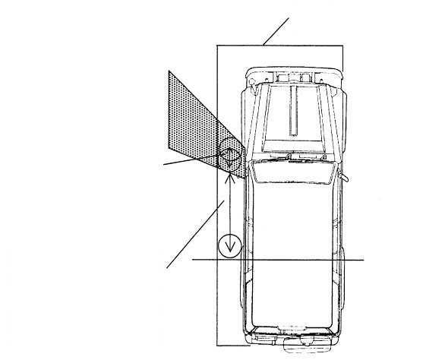
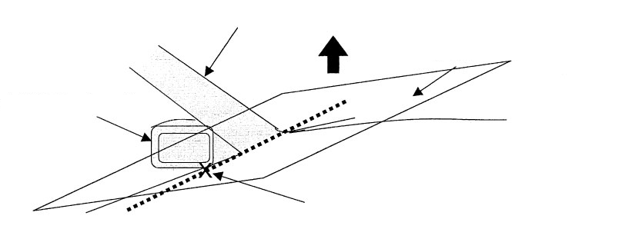
Requirements
Exemption by blind area caused by A-pillar and side-mirror mount
Range of field of vision
Blind area created by A-pillar
Plane parallel to the vehicle centre line and passing through point a
Distance between the centre of a cylinder in contact with the front edge of the blind area and the centre of a cylinder in contact with its rear edge: X (m)
Blind area created by exterior rear-view mirror
Lowermost point of the side glazing's transparent area where the ground surface can be viewed through the side glazing when the left side of the vehicle is checked from the reference eye-point centre (point a)
Front edge of the rear wheel
Distance between the rear edge of a cylinder in contact with the rear edge of the blind area and the front edge of the rear wheel: L (m)
The range of the blind area created by the A-pillar or exterior rear-view mirror in paragraph 15.2.4.10. shall be an area that meets the following formula. In this case, if there are more than one blind area, each blind area shall meet the conditions of the formulae.
X ≤ 0.292∙L − 0.203
Where:
X [m]: is the limit of the excluded area, i.e. the distance between the centre of a cylinder in contact with the front edge of the blind area and the centre of a cylinder in contact with its rear edge.
L [m]: is located inside the blind area created by the A-pillar or exterior rear-view mirror. Distance between the rear edge of a cylinder in contact with the rear edge of the blind area and the front edge of the rear wheel.
Range of exemption was defined based on the study about blind area that driver can stop vehicle after awareness of VRU before contact.
(See Appendix).
*Right-handed drive case

Slide 13
Structure of the regulation
Common structure with reversing regulation (R-158).
Part I only for mirror
  Static test of mirrors covered by other regulations.
Part II Installation
  Technology neutral approach applied.
  Add new requirements for each means.
    Field of driver’s close-proximity awareness.
    Direct vision from adjusted driver’s ocular point.
    Requirements for camera and detection system.
    Test method for detection.
  Field of driver’s front close-proximity awareness to be satisfied by the combination of means for driver’s front close-proximity awareness.

Slide 14
Status
Discussion almost finished in the IWG.
We plan to propose this regulation to the next GRSG in April.
Additional discussion and line-by-line review for finalizing proposal
to be held at the next VRU-Proxi IWG #21 on 24-26, November.
If you have interest for the discussion, please attend next VRU-IWG.
Please review our draft and give feedback to us before the IWG.
Depends on the feedback, we will have e-mail or taskforce discussion in advance
if needed.
Contact: JAPAN Akinari Hirao, Ph. D. (akinari.hirao@aist.go.jp)

Slide 15
Appendix

Slide 16
Study about passenger’s side blind spot exemption (1) Concept
Normal vehicle has blind spot for passenger‘s side by A-pillar and side mirror mount.
If no blind spot allowed, basically all vehicle need to have mirror or camera.
Therefore, Japan studied non-critical condition for accident before domestic application.
Accident case is run over by rear wheel in this bind spot.
To determine the condition of vehicle speed and VRU location in order to vehicle can stop safely.
Vehicle starts
(No recognition of VRU)
VRU recognition
Recognition distance x at vehicle speed V_{x}
x
L
If Ls<=L,
vehicle can stop before run over by rear wheel.
Ls is in proportion to Vx.
Therefore, formula can express as
x<=aL+b
Vehicle stops
Stop distance after recognition
L_{s}

Slide 17
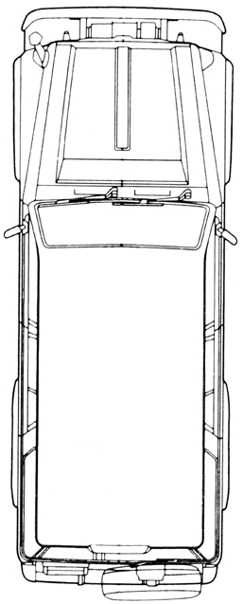
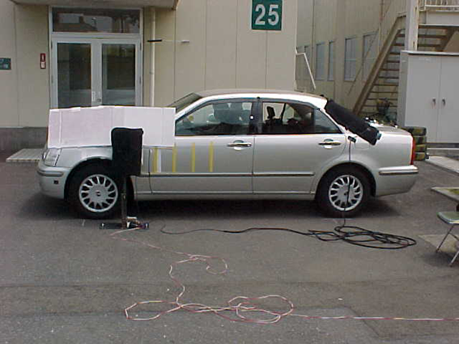
Study about passenger’s side blind spot exemption (2) Methods
30 Participants (20s~50s, Male 14, Female 16)
Blind spot by A-Pillar and side mirror mount
Vehicle speed at VRU is not run over by rear wheel: v
1m height object
Blind spot length X [m]:
(Distance between objects
0, 0.2, 0.4, 0.6, 0.8 m)
Vehicle speed when object recognition by peripheral vision
: V [m/s]
95%ile line
Stop distance after recognition
: L_{s} [m]
Vehicle speed v
Vehicle speed v
Distance between recognition and rear wheel: L [m]
5%ile line
Stop distance after VRU recognition Ls
Blind spot length X
Blind spot length at VRU is not run over by rear wheel x
(Limit of blind spot exemption)
Distance to real wheel front side

Slide 18
Study about passenger’s side blind spot exemption (3) Results
Median
5%tile
Blind spot exemption x<0.292L-0.203
Vehicle speed at VRU is not run over by rear wheel v [m/s]
x
L
Stop distance after VRU recognition Ls [m]
Limit of blind spot exemption: x=0.292 L -0.203
Median
95%tile
Vehicle speed at VRU is not run over by rear wheel v [m/s]
Stop Blind spot length x [m]
Range of blind spot exemption
Stop Blind spot length x [m]
Distance between blind spot to rear wheel front L [m]

