Slide 1
Proposal for Alternative Procedures for Direct Vision Assessment for “Low-End” M2/N2 Vehicles
VRU-Proxi-20-10

Slide 2
General Approach for M2 and N2
For N2/M2 vehicles to avoid unnecessary regulatory burden a simplified procedure is requested. This comprises of:
either compliance through UN R-125, as many types in that vehicle class are derived from M1 or N1, with the only difference being the payload, or
compliance through alternative geometric criteria.
  Considering that these vehicles robustly meet the proposed level-1 thresholds, as shown below, a simplified assessment is justified. Nevertheless, this simplified method should prevent bad designs regarding direct vision characteristics.
  Additionally, it could be an option to exclude vehicles with mirrors of Classes V or VI from the simplified method, as such mirrors indicate a high roof, thus a high R-point and consequently mean a more truck-like construction.
  Regarding a simplified method, as discussed at VRUproxi #19, interior and exterior beltline heights were looked at, that either enable direct visibility of vulnerable road users due to low exterior beltline height or ensure a good downward vision angle to nearby VRUs due to low interior beltline height.

Slide 3
M2/N2 EU Fleet Results (table)
total limit | frontal limit | driver side limit | passenger side limit
11.2 | 1.8 | 2.8 | 3.4
 |  | DVS volume based on TfL method [m3]
OEM | Vehicle Type | total volume |  | frontal volume |  | driver side volume |  | passenger side volume
OEM 1 | Van & Bus | 32.8 | 293% | 15.4 | 856% | 6.4 | 229% | 11.0 | 324%
OEM 2 | Van & Bus | 26.0 | 232% | 13.1 | 728% | 5.2 | 186% | 7.7 | 226%
OEM 3 | Forward controlled (Cabin over Engine) | 25.2 | 225% | 5.0 | 278% | 7.2 | 257% | 13.0 | 382%
OEM 4 | Forward controlled (Cabin over Engine) | 21.4 | 191% | 6.9 | 381% | 6.3 | 226% | 8.2 | 241%
OEM 4 | Forward controlled (Cabin over Engine) | 16.0 | 142% | 4.1 | 228% | 5.8 | 207% | 6.1 | 178%
OEM 5 | Forward controlled (Cabin over Engine) | 15.6 | 139% | 3.2 | 177% | 6.3 | 225% | 6.1 | 181%
OEM 5 | Forward controlled (Cabin over Engine) | 21.1 | 188% | 5.3 | 296% | 7.4 | 266% | 8.3 | 244%
OEM 6 | Truck (Cab over Engine) (NARROW) | 25.2 | 225% | 5.0 | 278% | 7.2 | 257% | 13.0 | 382%
OEM 6 | Truck (Cab over Engine) (WIDE) | 25.9 | 231% | 6.5 | 361% | 7.8 | 279% | 11.6 | 341%
OEM 6 | Bus | 25.1 | 224% | 6.0 | 334% | 5.9 | 212% | 13.1 | 385%
OEM 6 | Bus | 25.5 | 227% | 6.2 | 343% | 6.0 | 214% | 13.3 | 391%
OEM 6 | Bus | 25.3 | 226% | 9.1 | 506% | 6.8 | 243% | 9.4 | 276%
OEM 6 | Bus | 32.1 | 287% | 12.6 | 700% | 7.7 | 275% | 11.8 | 347%
OEM 7 | Bus | 25.0 | 223% | 9.3 | 517% | 6.7 | 239% | 9.0 | 265%
Vehicles identified to have Class VI mirrors and be N2G

Slide 4
M2/N2 EU Fleet Results (graphics)
Uncritical ✓

Slide 5
Proposed Concept
Exclusion of vehicles fitted with Class V and VI mirrors would exclude vehicles with high seating positions (V-points ≥ 2m).
If vehicle is derived from M1 or N1 it may be proven to the Technical Service that the M2/N2 version does not differentiate and equally meets UN R-125.
Irrespective of downward vision angle, if exterior beltline is up to [145cm], direct visibility to VRU is assumed (5% Ital. female height 1.505m).
If ext. beltline is above [145cm], then V₂ to beltline vertical distance shall be minimum [26cm]. This equates to min. 10° downward vision angle.
The interior and exterior beltline criteria should be met in a longitudinal range between a y-z-plane through the V-point and the a-plr (exact method tbd, but excluding holders of mirrors or required trim radii, may be handled within test method.)
DVS method shall remain open to all vehicles of categories M2 and N2.
N2 or M2?
No
Yes
Neither Class V nor VI mirrors?
No
Yes
Ext. Beltline
≤[145]cm?
No
V₂-Beltline-Height
≥[26]cm?
No
Yes
Yes
UN R-125
Ext. Beltline Height Compliance
Int. Beltline Height Compliance
DVS Method

Slide 6
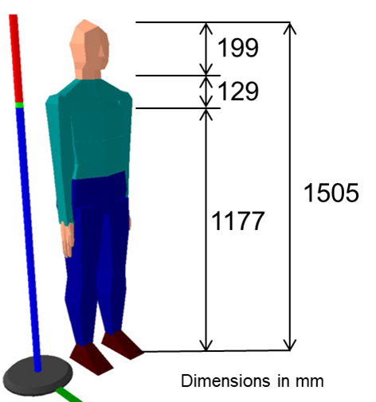
Justification Concept – Case 1
An exterior beltline height to ground of [145cm] allows recognition of VRU directly besides vehicle
(This is irrespective of interior beltline height. Typically, int. beltline rises the lower the vehicle.)
V₂
5% Italian Female
head: 150.5cm
shoulder: 126.7cm
<[145]cm
~145cm

Slide 7
Justification Concept – Case 2 (slide 1)
A vertical offset of V₂ versus the passenger side beltline of [26]cm leads to a downward vision angle of 10° (2.5 times that required by UN-R 125 (=4°)), allowing detection of a VRU directly besides vehicle. Given the dependency of V-points from R-point this directly translates into an interior beltline height to R-point of [34]cm (for 20° seatback angle).
V₂
5% Italian Female
~tan10° * 145cm ~ [26]cm
(25°)
head: 150.5cm
60cm-26cm =
<[34]cm
58.9cm
+ ~1⁽¹⁾cm
=~60cm
shoulder: 126.7cm
>[145]cm
(~55cm)
~145cm
R-point
SAE J1100: H5-1
~100cm⁽²⁾
veh. ctr-line
¹ Correction for typical seat back angle <25° (typically between 10°-20° for commercial vehicles).
² Assuming a 10° downward vision angle, an ext. beltline height of 145cm allows full visibility of 5% Ital. female head & neck at 1m distance

Slide 8
Justification Concept – Case 2 (slide 2)
According to the proposed reference targets for the volumetric assessment, the passenger side volume for the level 1 corresponds to a VRU distance of 2.5m. At the observed and assumed min. downward vision angle this corresponds to an exterior beltline height >170cm and would lead to V₂>196cm (V₁>204cm). It is assumed such vehicles would fit mirrors of Class V or VI, and it would be assumed to be the upper limit of vehicles granted the simplified method.
> [26]cm
V₂
5% Italian Female
~34cm
~60cm
tan10° * 250cm + 126.7cm = 170cm
head: 150.5cm
(→~55cm)
~145cm
R-point
shoulder: 126.7cm
SAE J1100: H5-1
~100cm
veh. ctr-line
250cm⁽¹⁾
¹ Volume-correlated distance for pass. side Level-1 = 250cm

Slide 9
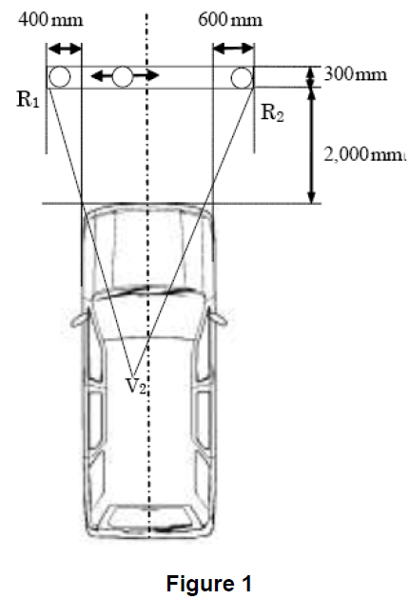
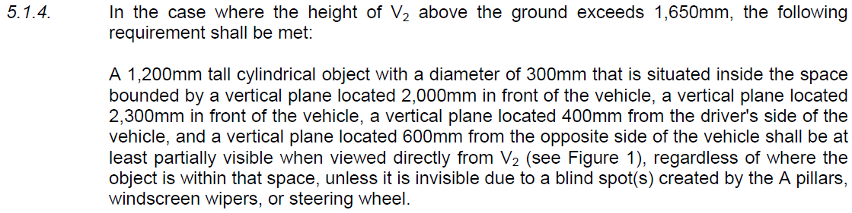
Concept for Front Vision
UN-ECE in 2012 amended UN R-125, adding provisions for direct vision in front of the vehicle for vehicles with higher seating positions. Due to the higher variety of frontal vision determining design characteristics this provision is seen as reasonable and preferable to the definition of frontal downward vision angles.
UN R-125.01:

Slide 10
Why V₂ and not R-point?
At IG VRUproxi #19, it was suggested to relate the lower window lines to the R-point. Due to the interdependency between the V-points and the R-point, the V-points can as well be used, while having the advantage that they are adjusted to the seatback angle and therefore provide for higher design neutrality regarding the seatback angles.
It should be further noticed that assessment of field of view per UN-R 125 is also assessed from V-points.
Figure right shows V₂ relative to R-point dependent on seatback angle.
V₂(10°)
V₂(20°)
69
14
24
V₂(25°)
11
68
589
z
x
R-point

