Slide 1
CRSs installation in row #2 (behind the driver seat)
IWG-STCBC 7th meeting
07/09/2021
OICA

Slide 2
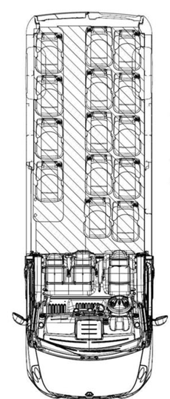
CRS installation check in row 2
CRS fixture ISO enveloppes installation check for:
seats 4, 5 and 8
8
7
6
5
4
3
2
1
X
Z
Y

Slide 3
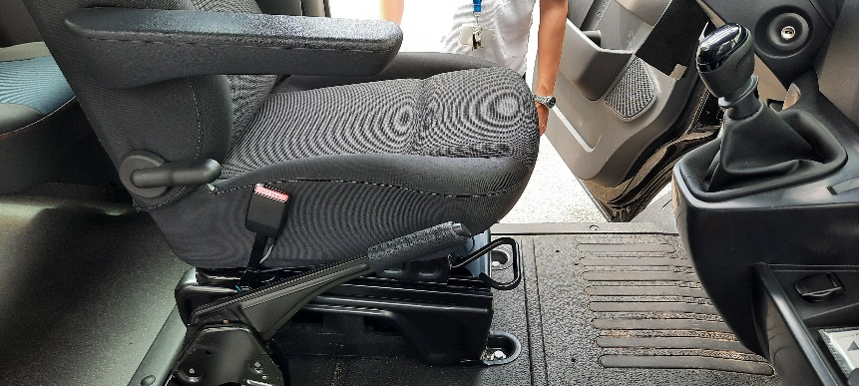
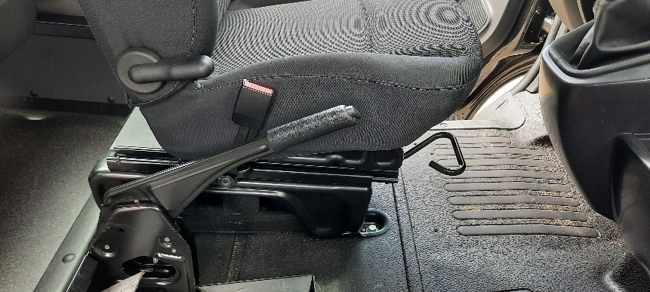
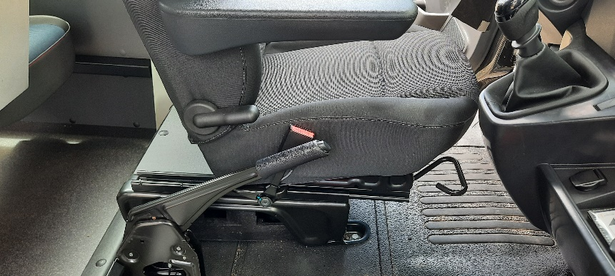
Driver seat adjustment
Driver seat x-range ~210 mm
1
8
7
6
5
4
3
2
1
210 mm
X
Z
Y

Slide 4
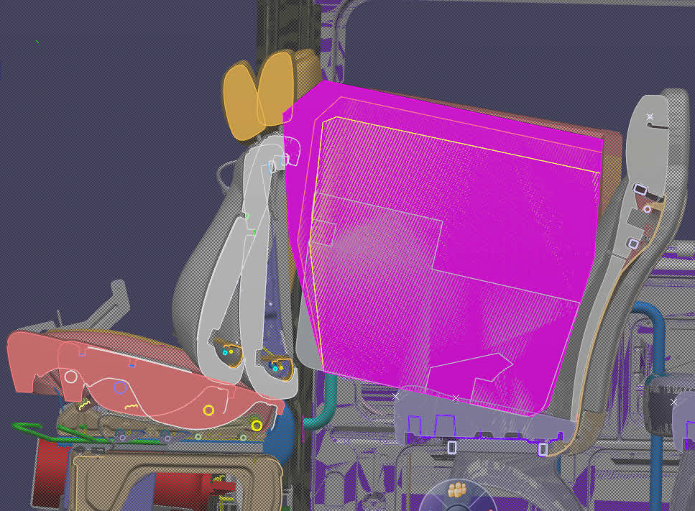
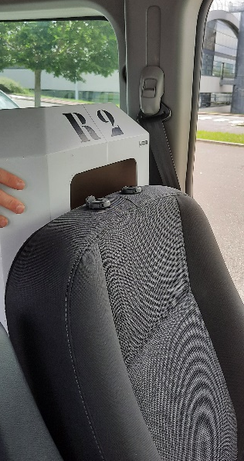
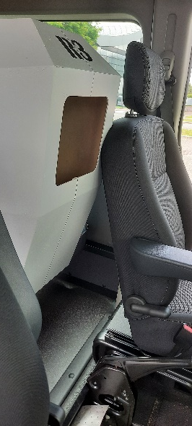
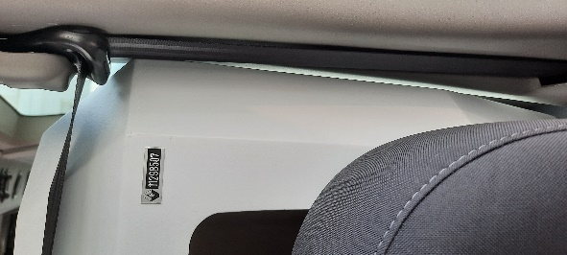
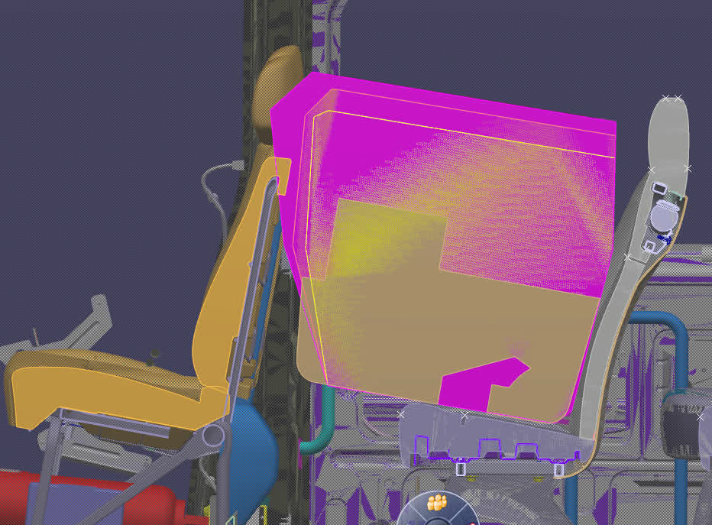

CRS Rear-facing installation in seats 4 & 5
ISO/ R1, R2 & R3 envelopes
4
5
4
4
8
7
6
5
5
4
3
2
1
X
Z
Y
Check install with driver seat in position ~mid-track
ISO/R3 in seat 4 & 5 (overlap with front seats 1 & 2)
ISO/R2 in seat 4 (ovelap seat 1/side trimmings + overlap with bench seat 2)
ISO/R1 OK in seat 4 & 5 if driver seat in mid-track position
1
110 mm
210 mm

Slide 5
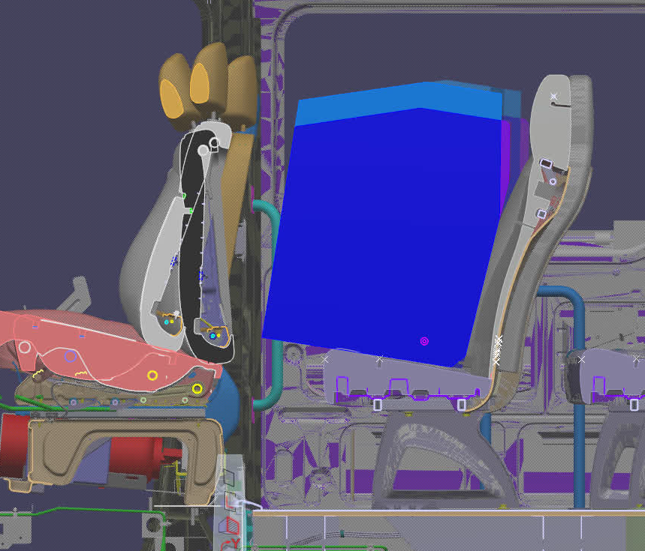
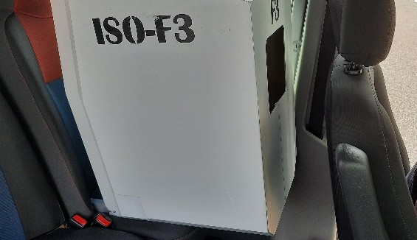
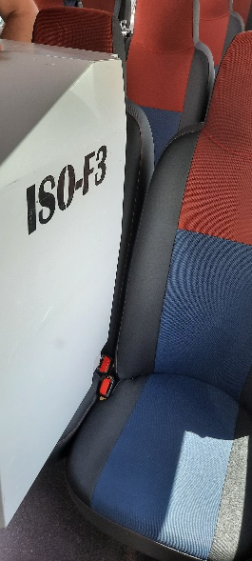
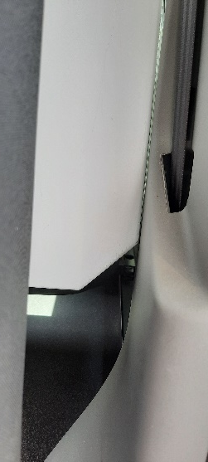
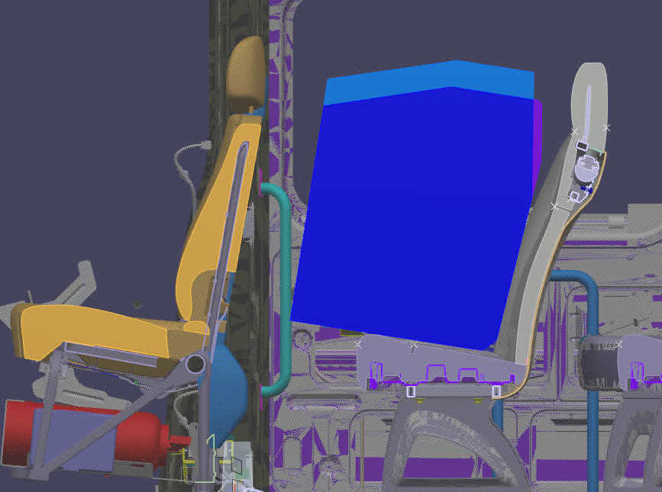
CRS Forward-facing installation in seats 4 & 5
ISO/ F2, F2X & F3 envelopes
4
5
4
4
8
7
6
5
5
4
3
2
1
X
Z
Y
Check install with driver seat in position ~mid-track
ISO/F2X in seat 4 (ovelap with side trimmings B-pillar)
ISO/F2X OK in seat 5
1
110 mm
210 mm

Slide 6
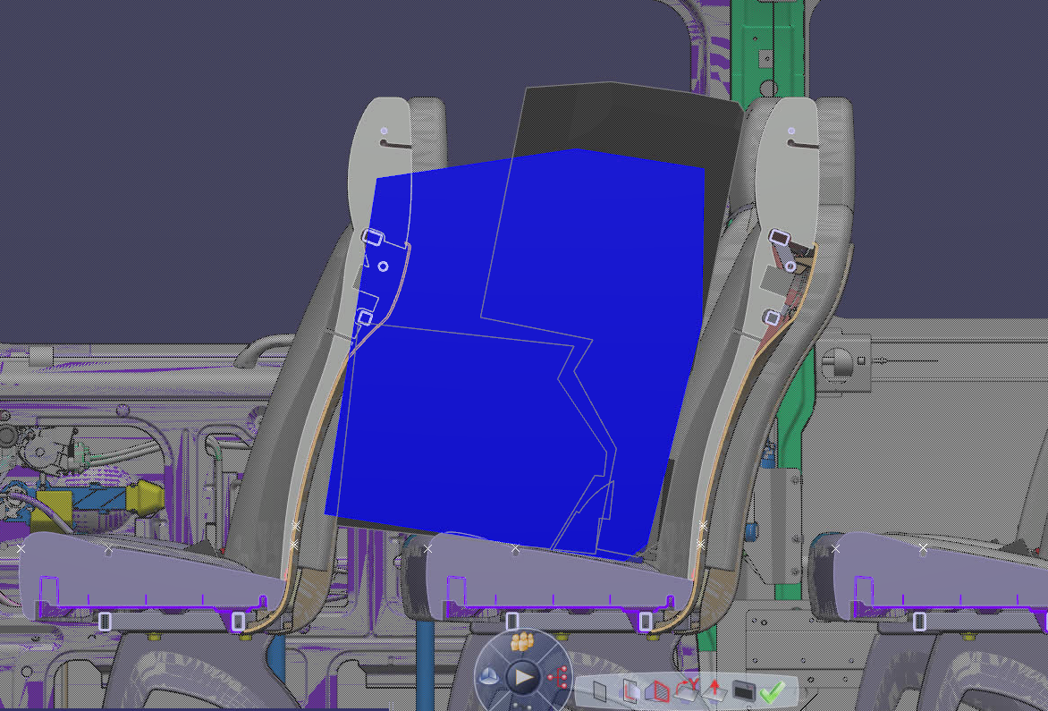
CRS Rear-facing installation in seats 4 & 5
ISO/ B2 envelopes
6
8
7
6
5
4
3
2
1
X
Z
Y
Seat spacing = 650 mm for M2 category
ISO/B2 in seat 6 (ovelap with front seat)
ISO/B2 OK in seat 4 & 5

Slide 7
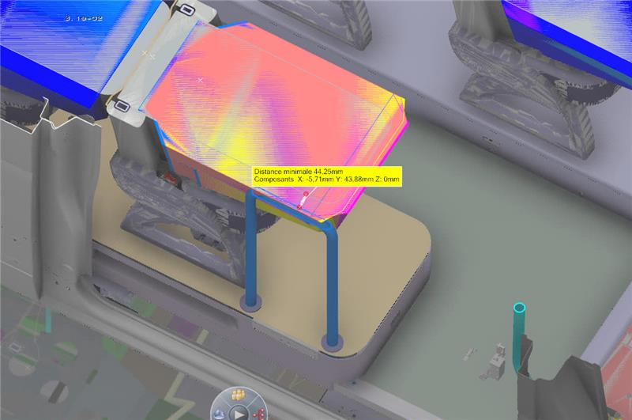
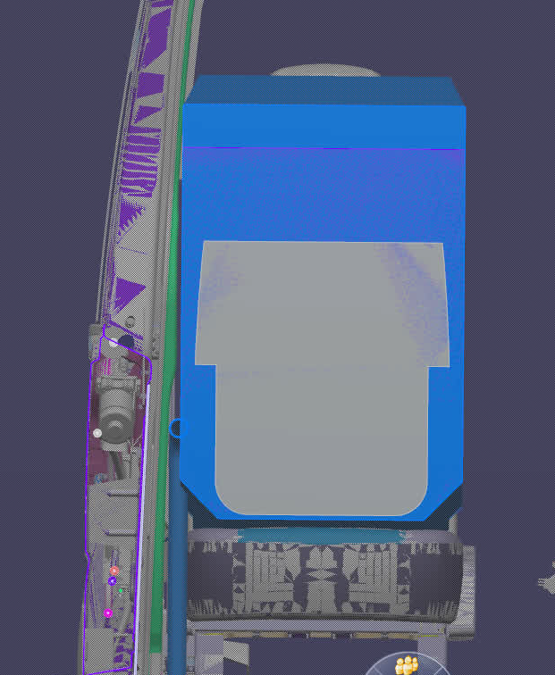
CRS Rear-facing installation in seats 4 & 5
ISO/ F2, F2X & F3 envelopes
X – view
8
Intersections
8
8
7
6
5
4
3
2
1
Handrail
X
Z
Y
ISO envelops in seat 8 (ovelap with handrail and/or side trimmings)

Slide 8
Summary
CRS enveloppes that can be installed in seats 4 & 5
ISO/B2
ISO/F2X in seat 5 (seat 4=intersection with B-pillar interior trimmings)
If the driver seat is in mid-track position the following rearward-facing enveloppes can
Be installed:
ISO/R1
ISO/R2 only in seat 5
ISO/B2 enveloppes installation in seats 6 & 7:
Not compatible with seat spacing 650 mm
8
7
6
5
4
3
2
1
X
Z
Y

