Slide 1

Ronald Vroman
7th Meeting of the Informal Group
Safe Transport of Children in Buses
7 September 2021

Slide 2
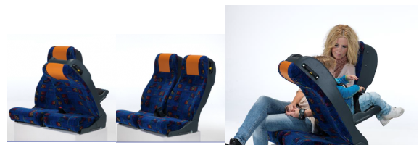

Integrated Rearward Facing Child Seat for M1/M2/M3 Vehicles
In Swedish Public Transport?

Slide 3
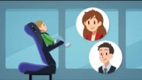

Slide 4
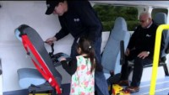

Slide 5
https://trinorth.se/barnstol-for-buss/

