Slide 1
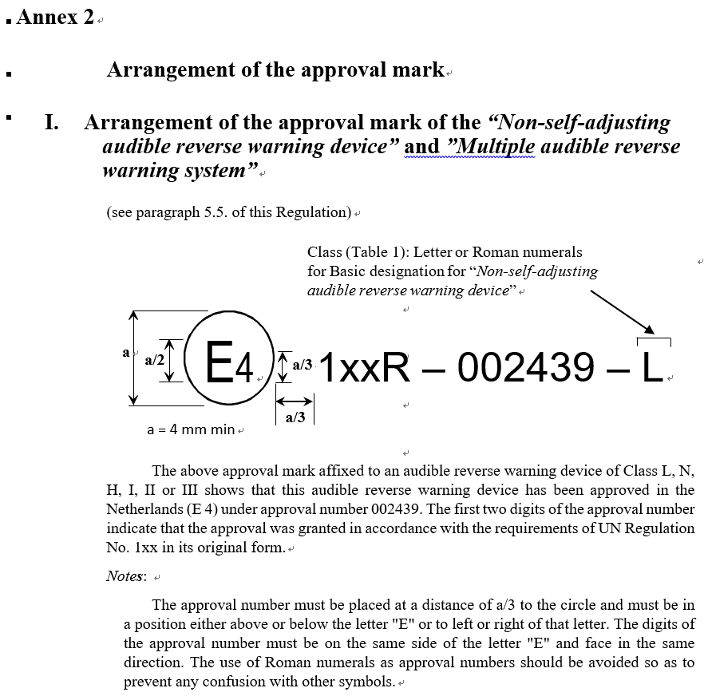
Japan proposes to change the following items
1/6
Regarding Annex 2
Proposal 1
We would like to delete the dimension of “a/3 “
that defines the distance between the circle and letters on Annex 2. Ⅰ, Ⅱ, Ⅲ, Ⅳ, and would like to define the letters position close to the circle for visibility.
e.g.
“The approval number must be placed close to the circle and must be in a position either above or below the letter "E" or to left or right of that letter.”
(The same as UNR#28 Audible warning device)
Justification
To provide the flexibility of marking design and its arrangements in the small space on audible reverse warning devices.
Close
Annex 2. Ⅰ Page.37 on TFRWS-28-02 Rev1

Slide 2
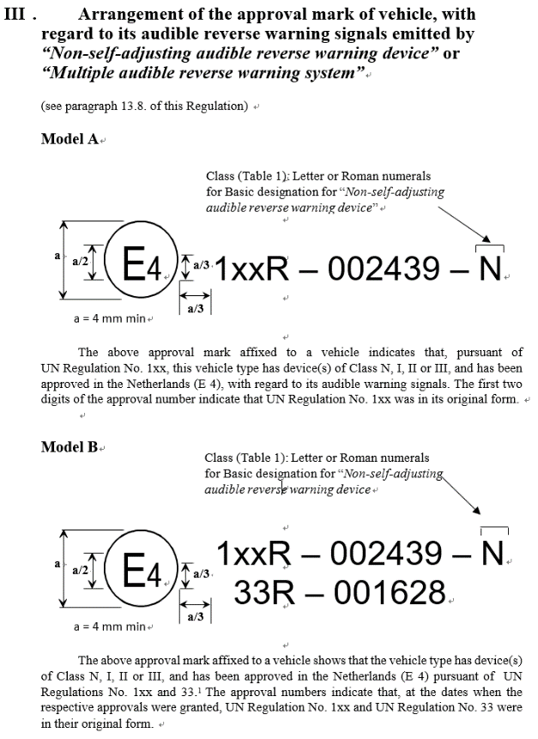
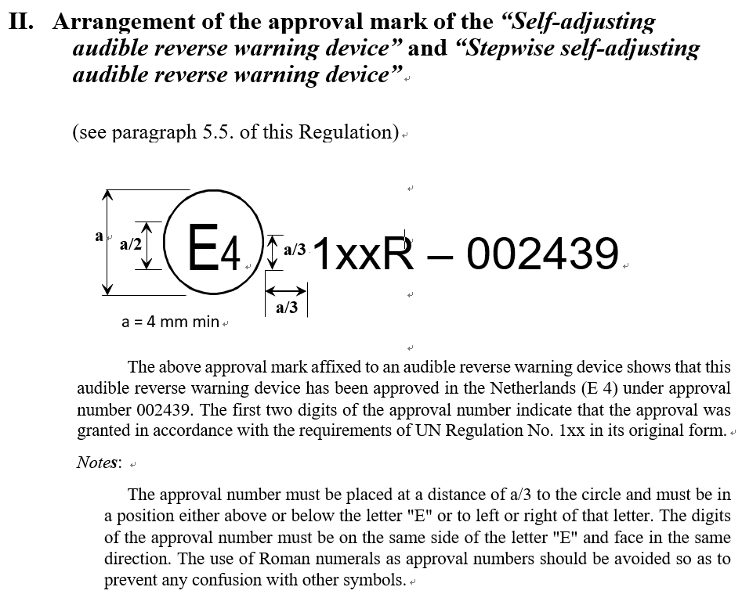
Japan proposes to change the following items
2/6
Please delete “a/3”
close
Please change “at a distance of a/3” to “Close”.
Annex 2 Ⅱ. Page.38 on TFRWS-28-02 Rev1
Annex 2. Ⅲ Page.39 on TFRWS-28-02 Rev1

Slide 3
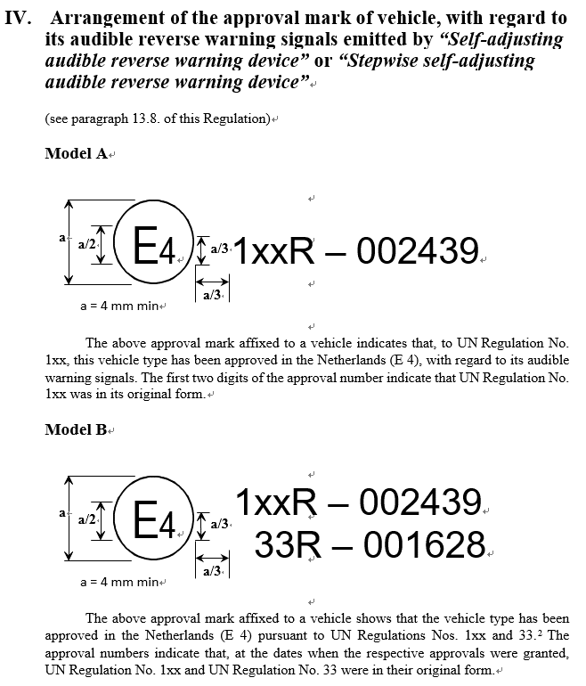
Japan proposes to change the following items
3/6
Please delete “a/3”
Annex 2 Ⅳ. Page.41 on TFRWS-28-02 Rev1

Slide 4
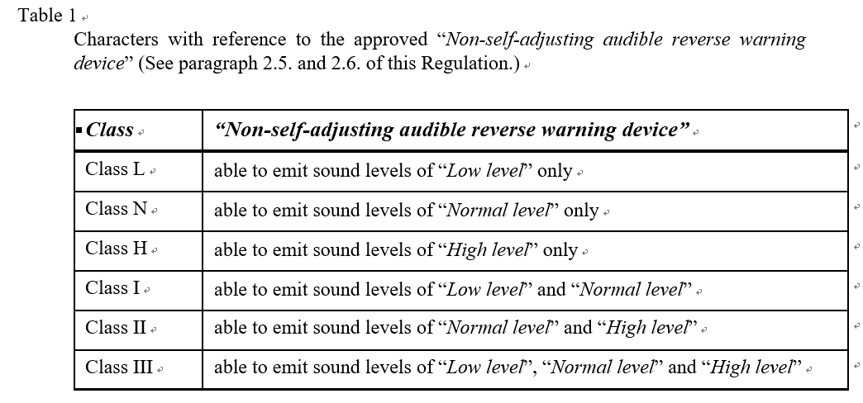
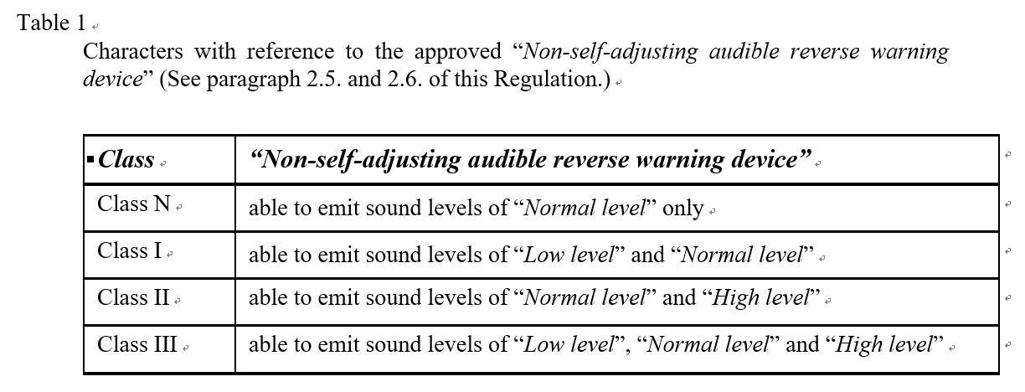
Japan proposes to change the following items
4/6
Regarding Annex 2
Correction 1
“Multiple audible reverse warning device”
shall be added to Annex 2 table 1.
Justification
“Multiple audible reverse warning device”
also have Class Ⅰ, Ⅱ, Ⅲ.
Refer to §2.6. Page 5 on TFRWS-28-02 Rev1
The excerption of Annex 2. Page.37 on TFRWS-28-02 Rev1
The excerption of Annex 2. Page.40 on TFRWS-28-02 Rev1

Slide 5
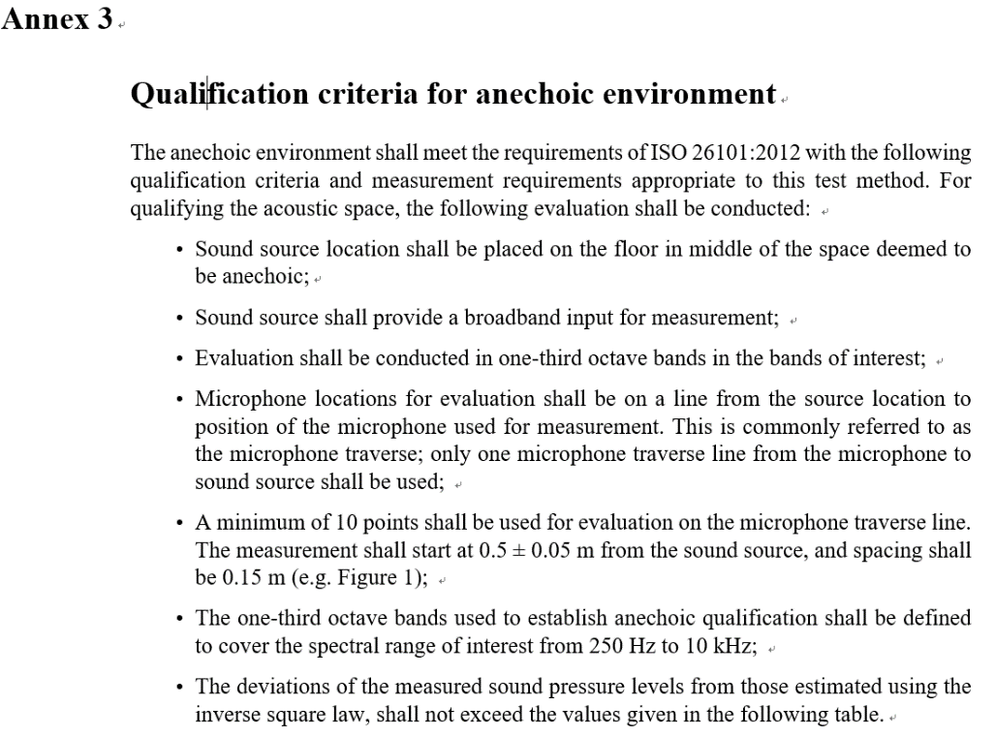
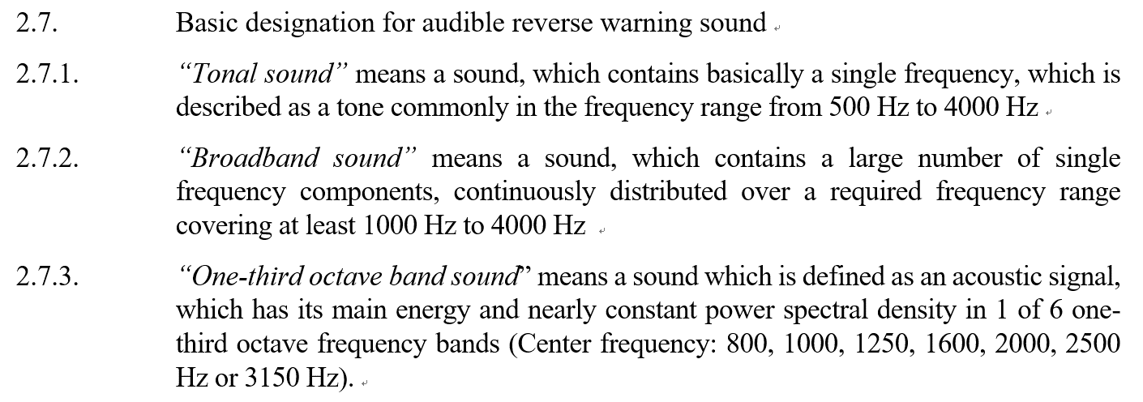
Japan proposes to change the following items
5/6
Regarding Annex 3
Qualification criteria for Anechoic chamber
Proposal 2
We would like to change the frequency range
of qualification criteria for anechoic chamber.
From 250Hz to 10kHz → From 500Hz to 4,000Hz
Justification
Audible reverse warning sound frequencies
are defined from 500 Hz to 4,000 Hz based on §2.7.
250Hz to 10kHz is over spec for anechoic chamber.
Over spec can be a capital investment burden for parts suppliers.
The excerption of Annex 3. Page.42 on TFRWS-28-02 Rev1
§ 2.7, Page.5 on TFRWS-28-02 Rev1

Slide 6
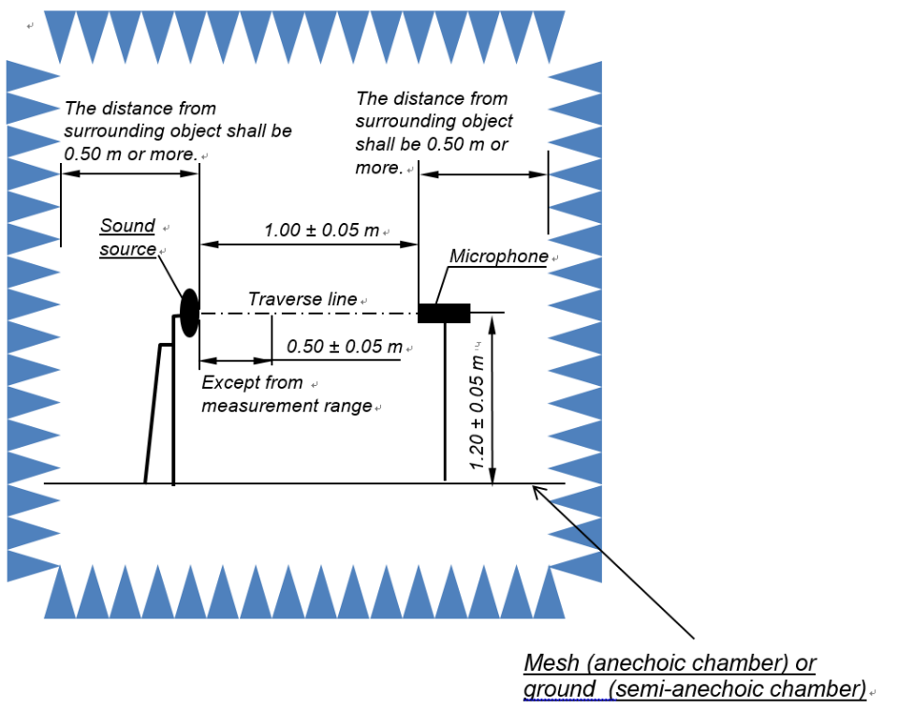
Japan proposes to change the following items
6/6
Regarding Annex 3
Qualification criteria for Anechoic chamber
Correction 2
Measurement points shall be “A minimum of 4 points ”
Justification
Measurement point start at 0.5m with 0.15m of spacing to 1m, physically 10 points are not possible to measure…
The excerption of Annex 3. Page.42 on TFRWS-28-02 Rev1
0.15m
: Measurement
points
Figure. 1

