Slide 1
GRE
IWG
SLR
GRE IWG „Simplification of Lighting and Light-Signalling Regulations“
Reg. 150 Stage II, Step 1 – Summary
Informal document GRE-85-xx
(85th GRE, 26-29 October 2021,
agenda item 4 (d))
UN Regulation No. 150
Retro-Reflective Devices (RRD)
Main changes in Stage II, Step 1
SLR-51-18

Slide 2
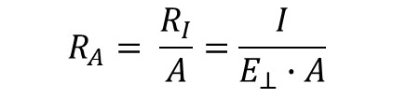
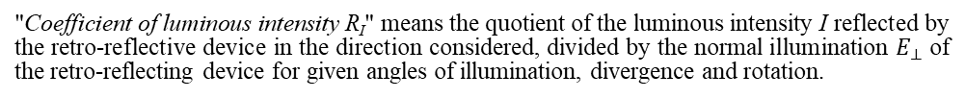
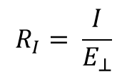
Update of definitions
Correction of the Photometric Definitions
Referenced Document:
CIE Publication 54.2:2001
”Retroreflection: Definition and measurement”
In the current version of Reg 150 (based on former Reg 3) – no definition of the CIL value is given
NEW
"Coefficient of luminous intensity R_{I}" means the quotient of the luminous intensity I reflected by the retro-reflective device in the direction considered, divided by the normal illumination $E_{⊥}$ of the retro-reflecting device for given angles of illumination, divergence and rotation.
$$R_{I}= \frac{I}{E_{⊥}}$$
NOTE 1 R_{I} is often referred to as CIL. The unit is cd/lx.
Old definition of R´
R´ → R_{A}
“Specific coefficient of retro-reflection (symbol R')" means the quotient of the coefficient of luminous intensity R of a plane retro-reflecting surface and its area A
"Specific coefficient of retro-reflection (symbol R_{A})" means the quotient of the coefficient of luminous intensity R of a plane retro-reflecting surface and its area A
$$R_{A}= \frac{R_{I}}{A}=\frac{I}{E_{⊥}∙A}$$
The coefficient of retro-reflection R_{A} is expressed in candelas per m² per lx (cd∙m⁻²∙lx⁻¹)

Slide 3
Update of definitions
Correction of the Photometric Definitions
Referenced Document:
CIE Publication 54.2:2001
”Retroreflection: Definition and measurement”
Luminance factor
(symbol ß) - means the ratio of the luminance of the body to the luminance of a perfect diffuser under identical conditions of illumination and observation;
(symbol β) → (symbol R_{F})
"Luminance factor (symbol R_{F})" means the ratio of the luminance of the body to the luminance of a perfect diffuser under identical conditions of illumination and observation;
All definitions for angles are Greek symbols (α, β, …) – to prevent mix-ups.
Definition of the angles for the measuring geometry setup
In Reg. 150 there is a mix of the definitions for the observation angles.
E.g. β_{V} , β_{H} or V , H or β₁ , β₂
Depending on Regulation 3 or 70, 104, …
Consistently using β₁ and β₂
"Entrance angle (symbol β)" means the angle from the illumination axis to the reference axis. The entrance angle is usually not larger than 90° but, for completeness, its full range is defined as 0° < β < 180°. In order to specify the orientation in full, this angle is characterised by two components, β₁ and β₂;
"Observation angle (symbol α)" means the angle between the illumination axis and the observation axis. The observation angle is always positive and, in the case of retro-reflection, is restricted to small angles;

Slide 4
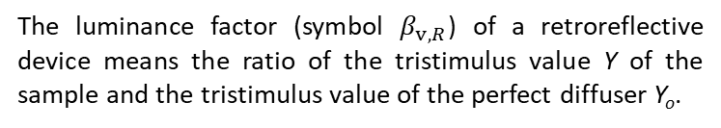

Referenced Document:
CIE Publication 54.2:2001
”Retroreflection: Definition and measurement”
Definition of the Luminance Factor
Current: β
Proposal in GRE-83-26: R_{F}
luminance factor (at a surface of a non-self-radiating medium in a given direction, under specified conditions of illumination) [β_{v}]
NOTE For photoluminescent media, the luminance factor consists of 2 components:
the reflected luminance factor, β_{v,R}, and the luminescent luminance factor, β_{v,L}.
The sum of the reflected and luminescent luminance factors is the total luminance factor, β_{v,T}: β_{v,T} = β_{v,R} + β_{v,L}.
The subscript R is used here for the reflected luminance factor because it is more intuitive than the traditional S and avoids confusion with the use of S to denote a state of polarization.
The luminance factor (symbol $β_{v,R}$) of a retroreflective device means the ratio of the tristimulus value Y of the sample and the tristimulus value of the perfect diffuser Y_{o}.
 | $$β_{v,R}= \frac{Y}{Y_{0}}$$
New proposal: β_{v,R}

Slide 5
Resistance to weathering
Annex 6 – Part 6 (new)
Annexes 13, 21 and 22 (current)
Weathering with xenon-arc weathering device
Defined time of 500 h
Evaluation by set up minimum level for specific coefficient of retroreflection at 80% of required values
Evaluation of colour as defined in R48
Weathering with xenon-arc weathering device
Evaluation by reference materials blue wool – grey scale
Replaced by
Justification
State-of-the-art test, defined parameters in referenced ISO 4892-2:2013

Slide 6
Resistance to weathering
Method applicable for retro-reflective sheeting material used for
  Retro-reflective markings of
  Classes C, D, E, F
  Classes 1, 2, 3, 4, 5
  and SMV Class 1 and 2
Method NOT applicable for retro-reflectors of
  Classes IA, IB, IIIA, IIIB and IVA
  Advance Warning Triangle of Type 1 and 2

Slide 7
Arrangement of approval markings
Adjustment of the sizes of the approval marks
  In Table 1, to reduce the number of minimum sizes of “a”:
  - the value “4 mm” will become “5 mm”
  - the value “12 mm” will become “8 mm”
Changes in the examples of the approval markings arrangement
  - Space removed for class IIIA
  - Size aligned
  - “104R” removed
  - “27R” replaced by WT

Slide 8
Table 1
List of retro-reflective devices and their symbols
Retro-reflective devices | Symbol | Minimum “a” in Annex 10 (in mm) | Paragraph
Retro-reflector for motor vehicles (independent) | IA | 5 | 5.1.
Retro-reflector for motor vehicles (combined with other signal lamps which are not watertight) | IB | 5 | 5.1.
Retro-reflector for trailers (independent) | IIIA | 5 | 5.1.
Retro-reflector for trailers (combined with other signal lamps which are not watertight) | IIIB | 5 | 5.1.
Wide-angle retro reflector | IVA | 5 | 5.1.
Conspicuity marking (material for contour/strip marking) | C | 8 | 5.2.
Conspicuity marking (material for distinctive markings/graphics intended for a limited area) | D | 8 | 5.2.
Conspicuity marking (material for distinctive markings/graphics intended for an extended area) | E | 8 | 5.2.
Conspicuity marking (materials for distinctive markings or graphics as base or background in printing process for fully coloured logos and markings of class "E" in use which fulfil the requirements of class "D" materials) | D/E | 8 | 5.2.
Retro-reflective materials for extremities marking of class F | F | 8 | 5.2.
Retro-reflective marking for long or heavy vehicles (retro-reflective and fluorescent materials) Marking plate of class 1 or class 2 | RF | 5 | 5.2.
Retro-reflective marking for long or heavy vehicles (retro-reflective only materials) Marking plate of class 3, class 4 or class 5 | RR | 5 | 5.2.
Marking for slow moving vehicles (retro-reflective and fluorescent materials) Marking plate of class 1 | RF | 5 | 5.2.
Marking for slow moving vehicles (retro-reflective only materials) Marking plate of class 2 | RR | 5 | 5.2.
Advance Warning Triangle (Type 1) | T1 → WT1 | 8 | 5.3.
Advance Warning Triangle (Type 2) | T2 → WT2 | 8 | 5.3.

Slide 9
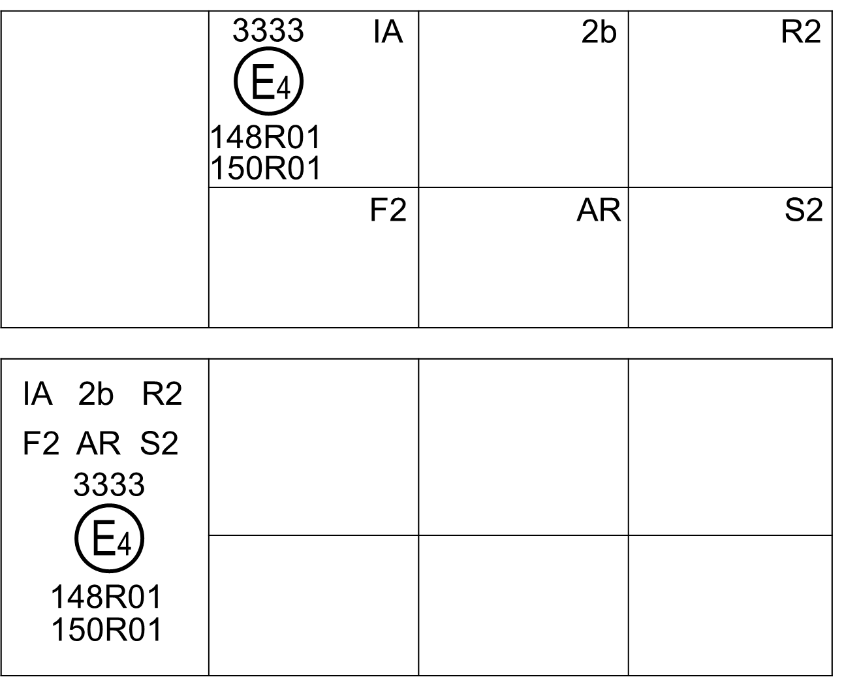
UPDATED DRAWINGS IN ANNEX 10
IIIA
a/3
C
E4
E1
a/2
a/3
1148
a
150R01
150R01 216
a/3
150R01 0216
IIIA 0216
WT1
WT2
RF
IIIA
E4
E4
E3
E3
E1
150R01
150R01
4216
150R01
4217
150R01 22179

Slide 10
Current structure of the Annexes in R150
Annexes
1 Communication
2 Minimum requirements for conformity of production control procedures
3 Minimum requirements for sampling by an inspector
4 Photometric measurements of retro-reflective devices and marking materials
5 Specifications of shape and dimensions
6 Resistance to heat
7 Resistance to water penetration for retro-reflective devices
8 Alternative test procedures of resistance to water penetration for retro-reflective devices of the Classes IB and IIIB
9 Resistance to fuels
10 Resistance to lubricating oils
11 Resistance to corrosion
12 Resistance of the accessible rear face of mirror-backed retro-reflective devices
13 Resistance to weathering
14 Stability of photometric properties
15 Resistance to cleaning in the case of a sample unit of retro-reflective marking devices
16 Bonding strength in the case of adhesive materials
17 Flexing - Retro-reflecting Markings
18 Resistance to impact
19 Rigidity of plates
20 Further test procedure for Advance Warning Triangles of Type 1 and 2
21 Arrangement of approval markings
22 Guidelines for installation of rear marking plates on slow-moving vehicles (by construction) and their trailers
23 Description of the measurement geometry for measurement of the daytime colour and the luminance factor of retro-reflective material

Slide 11
 | Annex Type of testing | Administrativ | Photom. measurment | Drawing | Chemical Test | Mechanical Test | Ad. Warning Triangle only | Environmental Test
1 | Communication | ●
2 | Minimum requirements for conformity of production control procedures | ●
3 | Minimum requirements for sampling by an inspector | ●
4 | Photometric measurements of retro-reflective devices and marking materials |  | ●
5 | Specifications of shape and dimensions |  |  | ●
6 | Resistance to heat |  |  |  |  |  |  | ●
7 | Resistance to water penetration for retro-reflective devices |  |  |  |  |  |  | ●
8 | Alternative test procedures of resistance to water penetration for retro-reflective devices of the Classes IB and IIIB |  |  |  |  |  |  | ●
9 | Resistance to fuels |  |  |  | ●
10 | Resistance to lubricating oils |  |  |  | ●
11 | Resistance to corrosion |  |  |  |  |  |  | ●
12 | Resistance of the accessible rear face of mirror-backed retro-reflective devices |  |  |  |  |  |  | ●
13 | Resistance to weathering |  |  |  |  |  |  | ●
14 | Stability of photometric properties |  | ●
15 | Resistance to cleaning in the case of a sample unit of retro-reflective marking devices |  |  |  |  | ●
16 | Bonding strength in the case of adhesive materials |  |  |  |  | ●
17 | Flexing - Retro-reflecting Markings |  |  |  |  | ●
18 | Resistance to impact |  |  |  |  | ●
19 | Rigidity of plates |  |  |  |  | ●
20 | Further test procedure for Advance Warning Triangles of Type 1 and 2 |  |  |  |  |  | ●
21 | Arrangement of approval markings | ● |  | ●
22 | Guidelines for installation of rear marking plates on slow-moving vehicles (by construction) and their trailers | ●
23 | Description of the measurement geometry for measurement of the daytime colour and the luminance factor of retro-reflective material |  | ●

Slide 12
1 Communication
2 Minimum requirements for conformity of production control procedures
3 Minimum requirements for sampling by an inspector
4 Photometric and colorimetric measurements
4.1 Photometric measurements of retro-reflective devices and marking materials
4.2. Description of the measurement geometry for measurement of the daytime colour and the luminance factor of retro-reflective material
4.3 Stability of photometric properties
5 Specifications of shape and dimensions
6 Environmental Testing
6.1 Resistance to heat
6.2 Resistance to water penetration for retro-reflective devices
6.3 Alternative test procedures of resistance to water penetration for retro-reflective devices of the Classes IB and IIIB
6.4 Resistance to corrosion
6.5 Resistance of the accessible rear face of mirror-backed retro-reflective devices
6.6 Resistance to weathering
7 Chemical Testing
7.1 Resistance to fuels
7.2 Resistance to lubricating oils
8 Mechanical testing
8.1 Resistance to cleaning in the case of a sample unit of retro-reflective marking devices
8.2 Bonding strength in the case of adhesive materials
8.3 Flexing - Retro-reflecting Markings
8.4 Resistance to impact
8.5 Rigidity of plates
9 Further test procedure for Advance Warning Triangles of Type 1 and 2
10 Arrangement of approval markings
11 Guidelines for installation of rear marking plates on slow-moving vehicles (by construction) and their trailers
Re-arrangement of the Annexes in R150

Slide 13
Summary of the main changes in Stage II, step 1
Update of definitions - Correction of the Photometric Definitions
R_{I}, R_{A}, β₁ , β₂ , β_{v,R} ,
Resistance to weathering
500 h xenon - retroreflection at 80% of required values
Arrangement of approval markings
Adjustment of the sizes of the approval marks
and changes in the examples of the approval markings arrangement
Updated drawings of Approval Markings
corrected and updated drawings
New arrangement of Annexes with grouped structure
from 23 Annexes re-arranged and grouped to 11 Annexes
Introduction of scientific notation
in order to assure that not more than 3 significant digits are shown for the required values

