Slide 1


OICA/CLEPA Input
to the
TF ADAS – 08-06
Reflection on types of traffic situations
where safety could be enhanced through assistance

Slide 2
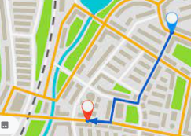
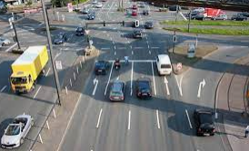
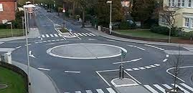
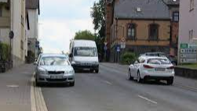
Everyday challenges when driving
The driver needs
to go from A to B.
The route isn‘t familiar to them, so they use the car navigation system.
Finding the right path in traffic can be stressful. One needs to change into the correct lane before making a turn at an intersection, drive through roundabouts or around parked vehicles along narrow streets.
Stressful situations increase the risk of an accident
during manual driving, due to
Distraction by other driving tasks (finding the right way)
Wrong interpretation of the situation and/or surrounding traffic
Inappropriate speed
Non-compliance with traffic rules

Slide 3
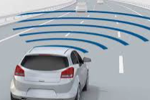
DCAS Example* User Story
The driver programs a route into the navigational system of the vehicle to go from A to B.
The driver activates DCAS providing longitudinal and lateral support.
When approaching an intersection the system will help the driver by
  Knowing what lane to change into to make the correct turn
  Indicating the lane change and turn to other road users
providing longitudinal control to
  Stop at a red light
  Yield to other road users
  Turn at an appropriate speed
and providing steering input to guide the driver to
  steer the vehicle into the correct lane safely
  follow the appropriate trajectory when making the turn
When approaching a roundabout the system will help the driver by
providing steering input to guide him
  In entering, passing through and exiting the roundabout safely
And provide longitudinal control to
  Yield to other road users
  Drive into the roundabout at an appropriate speed
*the level of assistance provided by the systems could differ, this demonstrates a very high level of support

Slide 4
DCAS Example* User Story
When approaching a section of road where the current lane of travel is partly blocked, e.g. by parked vehicles, the system will help the driver by providing longitudinal support to
Approach the scene at an appropriate speed
Bring the vehicle to a stop if needed, e.g. due to oncoming traffic
Accelerate to pass by the obstacle
and providing steering input to guide him
when crossing into the other lane to keep an appropriate distance to other road users and parked vehicles on the side of the road.
In order to provide that assistance, the system needs to be permitted to, e.g.
  Derive an appropriate trajectory on the basis of other input than lane markings
  Assist the driver in changing lanes in an urban environment (no infrastructural separation and VRUs present)
  Cross into a lane with potential oncoming traffic
  Apply a lateral acceleration of more than 3m/s2 (e.g. required to drive through a roundabout at an appropriate speed)
which would not be possible under the existing provisions of UN-R79, which were drafted focussed on a motorway application, where none of the above scenarios oocur and respective system capabilities are needed.

