Slide 1

20th Session
Status Review and Session Orientation
Document FRAV-20-03
Web Conference
14 October 2021

Slide 2
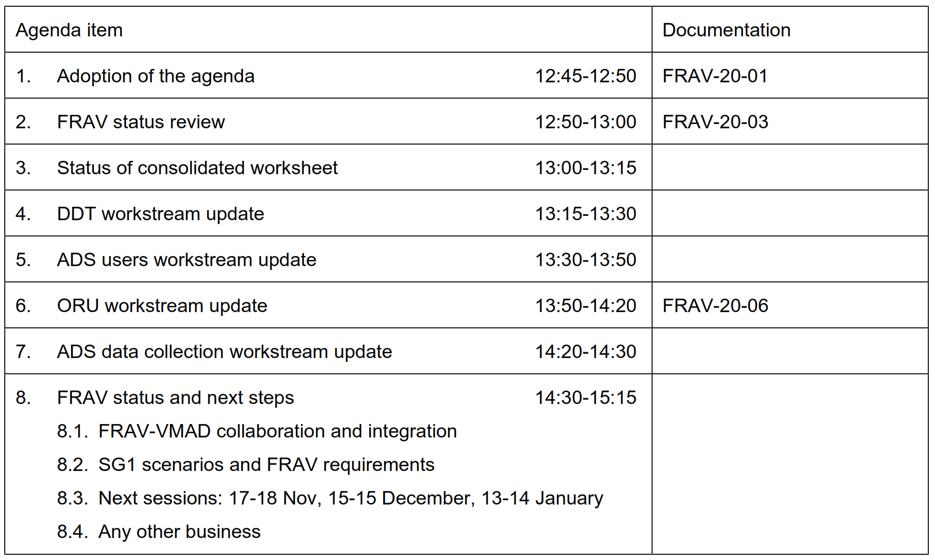
Agenda item 1
Adoption of the agenda

Slide 3
Agenda item 2
FRAV status report to GRVA (27 September)
GRVA-11-24 (Reproduction of FRAV-19-05)
  Opted for discussed Document 5 (D5) version rather than revision not seen by FRAV
GRVA-11-25 (Status report presentation)
  Reviewed starting points and workstreams to develop requirements
    Explained two steps (general description then technical specifications)
  Noted D5 structure
    Terms and definitions, manufacturer ADS descriptions, ADS safety requirements per configurations
  Summarized “roles approach” to user safety and “properties approach” to ORU safety
  Explained GRVA-11-24 as consolidation of interim FRAV working papers
    Highlighted comments received on FRAV-19-05 and stressed ongoing revision
  Summarized data collection input to EDR/DSSAD
  Set expectations
    Build out general ADS safety requirements
    VMAD collaboration to align ADS descriptions and safety requirements with assessment scenarios (e.g., ODD, nominal v. safety-critical)
    Input for EDR/DSSAD and VMAD on data collection

Slide 4
Agenda item 2
FRAV status
FRAV-19-05 referred to workstreams for consideration
  New D5 version will be needed for GRVA-12 (moved from February to 24-28 January)
    GRVA plan for informal consideration of FRAV/VMAD output in January, formal consideration in May with submission to WP.29 for June session
  Evolution of workstream output in this direction desired
  Aim to consider D5-aligned output during 14-15 December FRAV session
    Enable endorsement of GRVA submission during 13-14 January FRAV session
Current focus of workstreams
  CLEPA expert (M. Oldoni) managing consolidation of requirements output
  Today: Discuss workstream status and provide guidance
    Reminder: DDT-M. Oldoni, ADS user safety-Rino Brouwer, ORU safety-Yu Yanhui
  Updated worktable(s) for 17-18 November FRAV session
    Attention to terms and definitions, impact of requirements on ADS descriptions (align with D5 needs)
    Attention to form and precise language (e.g., use of terminology, “may/shall”)
  Input for EDR/DSSAD and VMAD SG3 (in-service monitoring)
    AAPC/SAE/EDR/DSSAD expert (J. Bielenda) managing consolidation of input

Slide 5
Agenda items 3-7
Status of the workstream activities
Consolidated requirements worktable
DDT performance workstream
ADS user safety workstream
ORU safety workstream (FRAV-20-06)
ADS data collection workstream
* Per FRAV-08: “Shall” expresses a requirement, “should” expresses a recommendation, “may” expresses a permission, “can” expresses a possibility or capacity, and “must” expresses an external constraint.

Slide 6
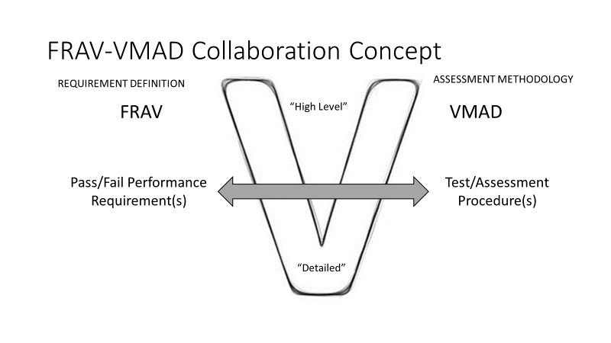
Agenda item 8
Outlook for next steps
VMAD collaboration
  SG1 (Scenarios)
    Attribute safety requirements to traffic scenarios
    Ensure requirements cover scenarios and vice versa as
    needed
    Align outputs to facilitate application of technical
    specifications to logical layer scenarios
  SG3 (Audit/In-Service Monitoring and Reporting)
    ADS descriptions and Audit documentation consistency/integration
    ADS data collection and application to in-service monitoring
  SG4 (Track and Real-World Testing)
    Application of nominal ADS DDT performance and ADS response to safety-critical events requirements to track and real-world test procedures
FRAV and VMAD products consistency/integration
  OICA/CLEPA: ODD framework approach
FRAV-01

Slide 7
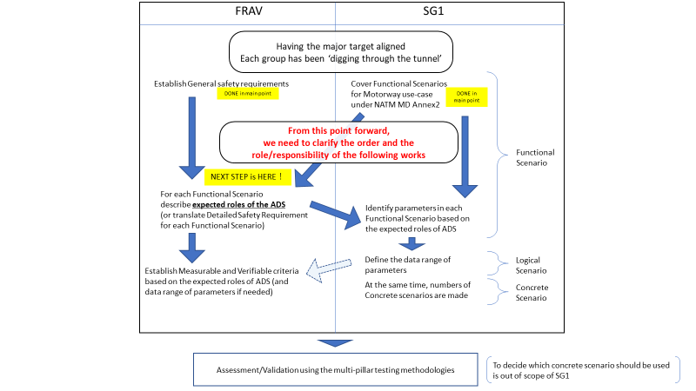
FRAV-VMAD discussion

Slide 8
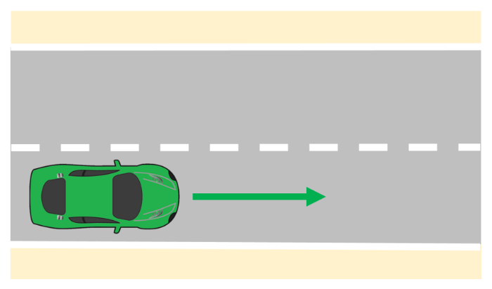
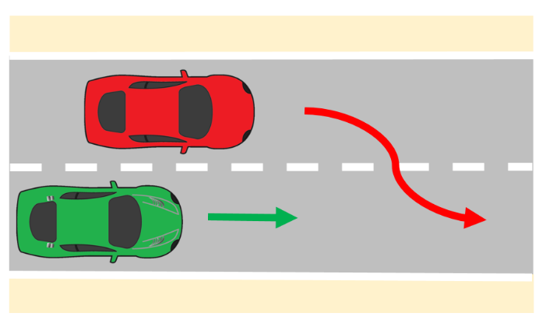
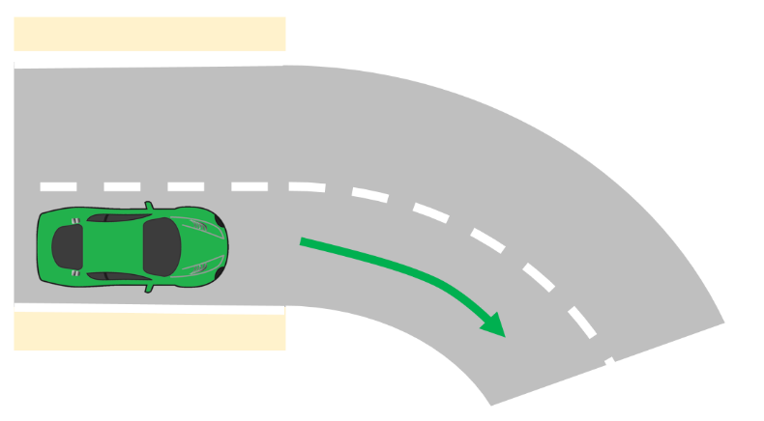
Scenario samples
The ADS feature is moving the vehicle within a straight unobstructed lane of travel.
The ADS feature is moving the vehicle within a straight unobstructed lane of travel with a vehicle moving alongside in an adjacent lane. The adjacent vehicle moves into the path of the ADS vehicle’s lane of travel.
Which requirements would ensure safe ADS navigation of these scenarios? Secondary consideration: What variables might impact ADS performance or response(s)?
The ADS feature is moving the vehicle within a lane of travel along an unobstructed curve.

Slide 9
Agenda item 8
Outlook for next steps
FRAV Calendar
Session 21: 17-18 November
Session 22: 15-16 December
Session 23: 13-14 January
(Physical session same week as VMAD…?)
Session 24: 1 February
  November
    Updated worktable(s) (“proto-D5”)
    SG1 scenarios exchange
    data collection exchange
  December
    D5-aligned updated worktables (“draft D5”)
    SG1 scenarios exchange
    SG3 documentation/ISMR exchange
    SG4 nominal/safety-critical v. track/real-world testing exchange
  January
    Endorsement of new D5 for GRVA
    SG1 scenarios consistency
    SG3 documentation/ISMR consistency
    SG4 nominal/safety-critical v. track/real-world testing consistency

