Slide 1
Industry proposal
False reaction scenario
AEBS-HDV-07
October 26-28, 2021
Including agreed modification during the meeting discussions
Revision 1

Slide 2
5.1.6. False reaction avoidance
    The system shall be designed to minimise the generation of collision warning signals and to avoid advanced emergency braking in situations where there is no risk of an imminent collision.
    This shall be demonstrated in the assessment carried out under Annex 3, and this assessment shall include in particular scenarios listed in Appendix 2 of Annex 3 /footnote 1.
    Additionally the vehicle shall be tested according to paragraphs 6.11.
    /1 until proper values for HDVs are defined, the values for each scenario will be adapted may be changed in agreement between the technical service and the manufacturer.
Agreed modification during the meeting discussions

Slide 3
Annex 3 - Appendix 2
False Reaction scenarios /footnote 1
The following scenarios shall be used to assess the system’s strategies implemented in order to minimize the generation of false reactions.
For each type of scenario the vehicle manufacturer shall explain the principle strategies implemented to ensure safety.
    The manufacturer shall provide evidence (e.g. simulation results, real-world test data, track test data) of the system’s behaviour in the described types of scenarios. The parameters described in subparagraph 2 of each scenario shall be used as guidance if the Technical Service deems a demonstration of the scenario necessary.
/1 until proper values for HDVs are defined, the values for each scenario will be adapted may be changed in agreement between the technical service and the manufacturer. It is recognized that the parameters described in subparagraph 2 of each scenario are based on passenger cars data.
Agreed modification during the meeting discussions

Slide 4
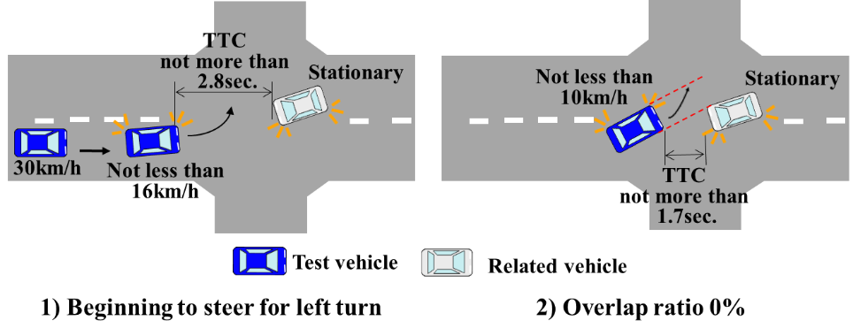
Scenario 1 is not relevant for some HDVs (e.g. M3>8t, N2>8t N3)
(Furthermore, it looks not in accordance with driving licence rules in some countries).
Passenger cars scenario
1. The truck waits for the oncoming car to pass
2. Then, the truck turns
HDVs “typical” scenario
Could this scenario be deleted for the heaviest categories?

