Slide 1

21st Session
Status Review and Session Orientation
Document FRAV-21-03
Web Conference
17-18 November 2021

Slide 2
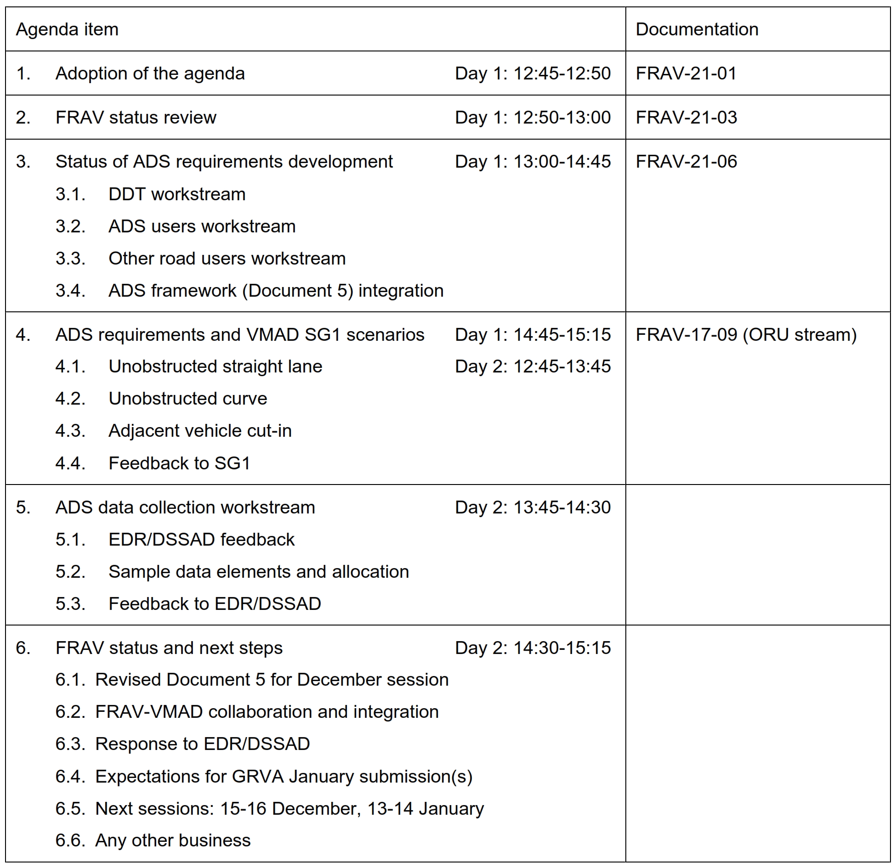
Agenda item 1
Adoption of the agenda

Slide 3
Agenda item 2
FRAV status
Development of ADS safety requirements
  FRAV-23-05: Consensus document for submission to GRVA-12
    FRAV-22-05: Draft document integrating consensus from workstreams
  Document 5 contents
    Terms and definitions
    Guidelines for manufacturer descriptions of the ADS, its features, intended uses, and limitations on use
    ADS safety requirements
      ADS DDT performance
      ADS performance under safety-critical scenarios
      ADS HMI and user safety requirements
      ADS failure mode management
      ADS operational safety over vehicle lifetime
  Alignment with VMAD scenarios and assessment methods
ADS data collection input to EDR/DSSAD

Slide 4
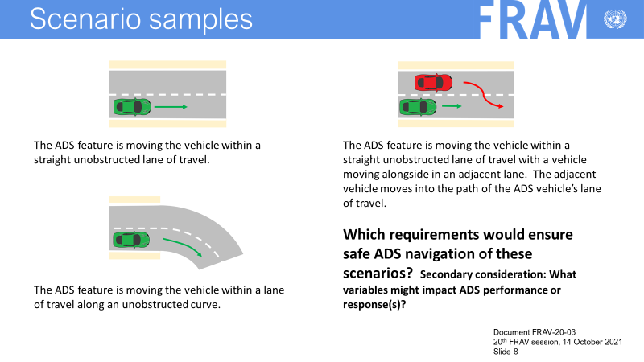
Agenda items 3-4
Elaboration of ADS safety requirements
DDT workstream
ADS users workstream
ORU workstream
Integration into revised Document 5
Alignment with VMAD scenarios
  Consideration of initial three scenarios
  Coverage of all motorway scenarios
  Application of scenarios to VMAD
  assessment methods

Slide 5
Agenda item 5
ADS data collection
Two main uses of data
  Crash reconstruction and analysis under legal frameworks for EDR
  Performance monitoring and reporting under legal framework to be determined
    Manufacturer data collection and processing
EDR/DSSAD request for examples
  Data elements and their categorization
  FRAV framework
    EDR-specific data, ISMR data, and “dual use” data elements
    Differentiation of ADS configurations and relevant data (especially link to HMI aspects)
    Alignment with FRAV framework and requirements: terms and definitions, ADS configurations, ADS requirements (e.g., ADS “states and actions”).

Slide 6
Agenda item 8
Outlook for next steps
FRAV Calendar
Session 22: 15-16 December
Session 23: 13-14 January
(Physical session same week as VMAD…?)
Session 24: 1 February
  December
    D5-aligned updated worktables (“draft D5”)
    SG1 scenarios exchange
    SG3 documentation/ISMR exchange
    SG4 nominal/safety-critical v. track/real-world testing exchange
  January
    Endorsement of new D5 for GRVA
    SG1 scenarios consistency
    SG3 documentation/ISMR consistency
    SG4 nominal/safety-critical v. track/real-world testing consistency

