Slide 1
DRAFT: initial considerations for redefining the volume to the front of the vehicle in case there is a specific requirement to define a minimum limit for a HYBRID or separated approach
Dr Steve Summerskill, Dr Russell Marshall, Iain Knight, James Nix
VRU-Proxi-21-13

Slide 2
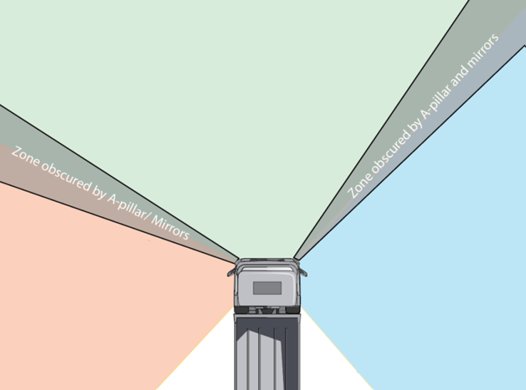
Design dependency separated approach – as discussed yesterday
As per the image the current situation involves the definition of the front volume as between the A-pillars
Current situation is that new designs which bring A-pillar closer together (e.g. more aerodynamic front end) are potentially penalised if there is a requirement to the front
Therefore we are considering options for defining the front volume as part of the assessment volume that is independent of vehicle design
This would be new work
If this work commences we would expect each stage of the design process to be discussed with the Task Force to ensure agreement

Slide 3
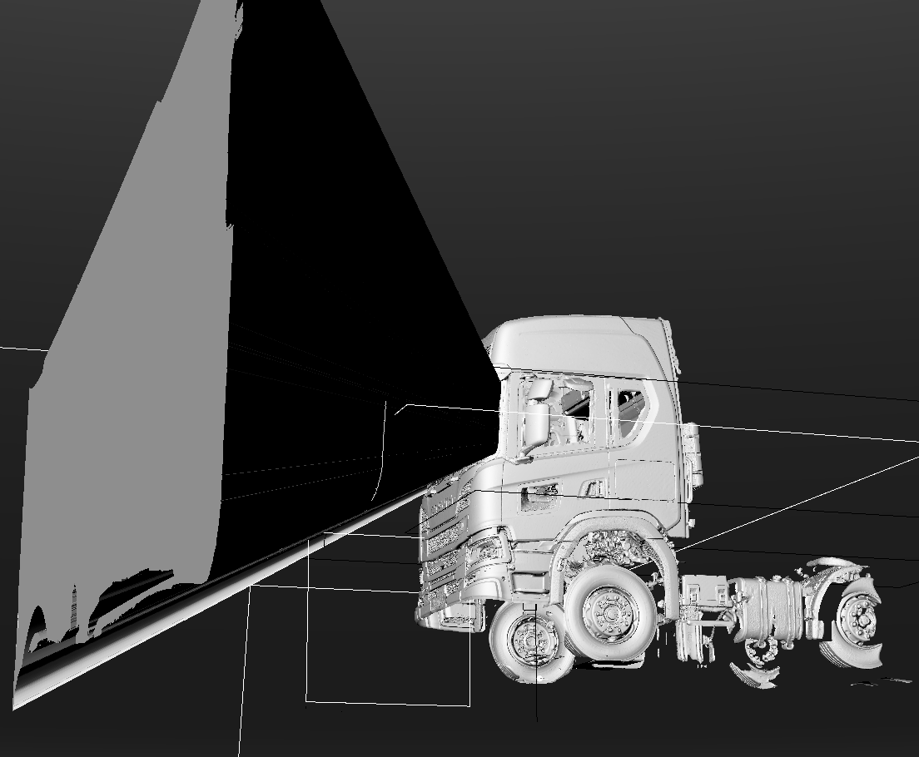
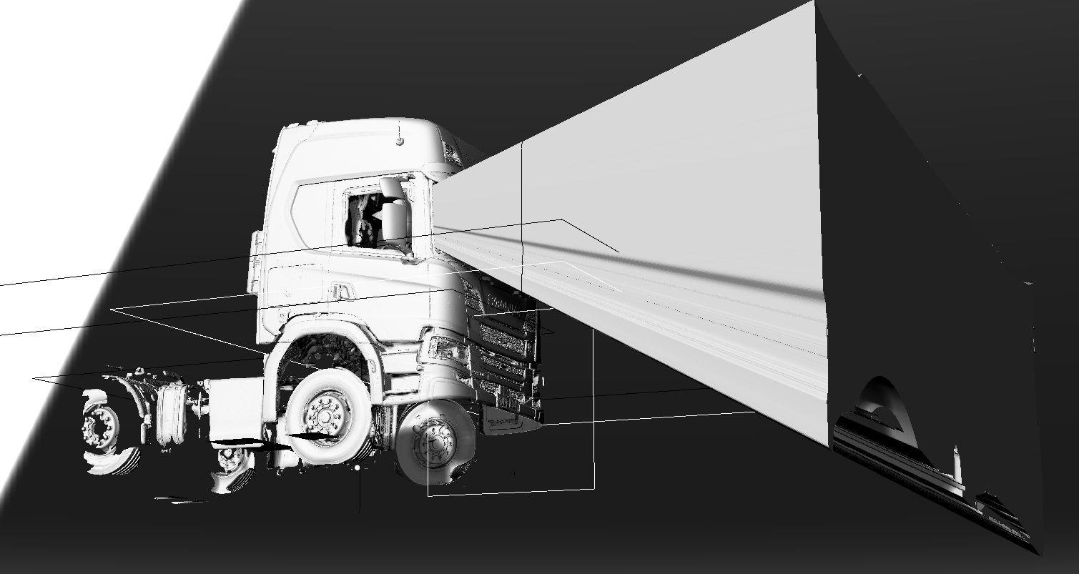
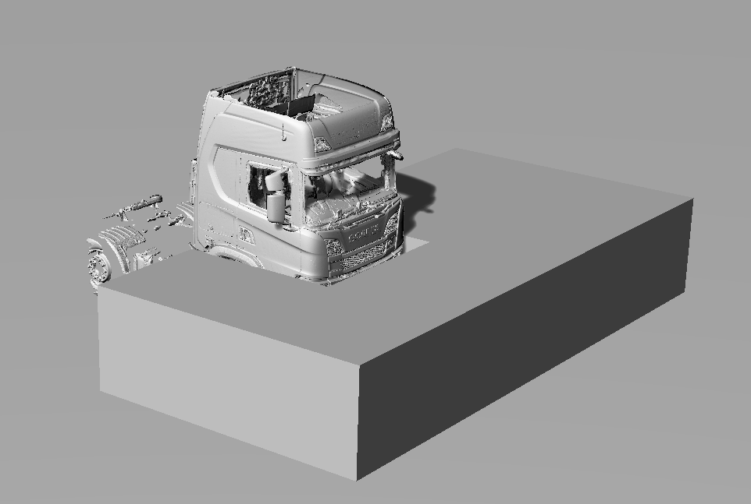
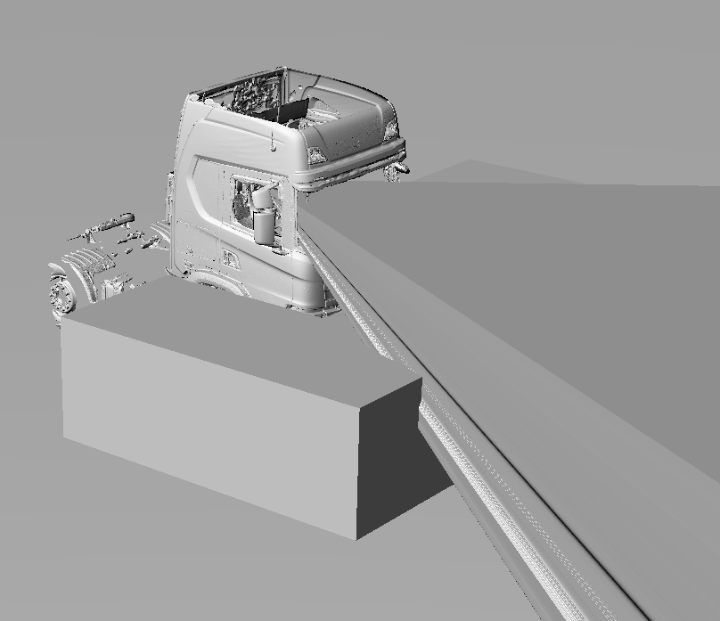
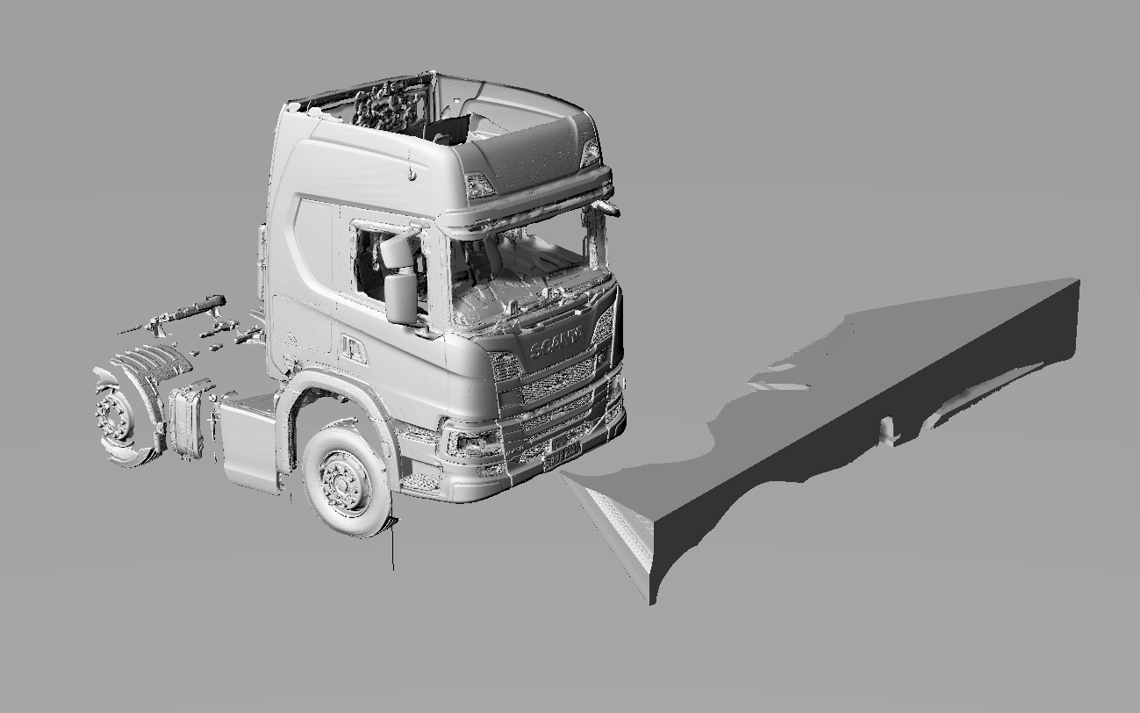
CURRENT SITUATION
Current front volume is between the A-pillars
Assessment volume that is intersected with the
visible volume
Intersection of visible volume and
assessment volume
The result is the volume of the assessment volume that can be seen to the front

Slide 4
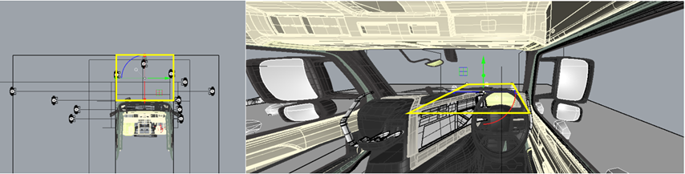
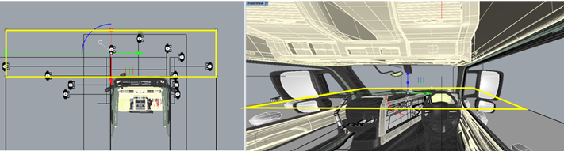
Options for changing the approach so that assessment volume is subdivided
Option 1. Square between a-pillars (although this probably suffers from the same issue of not being technology neutral, narrower cabs perform worse)
Option 2. Whole front of the Assessment volume

Slide 5
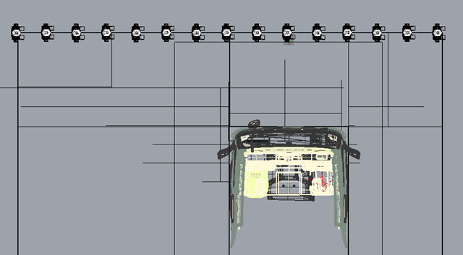
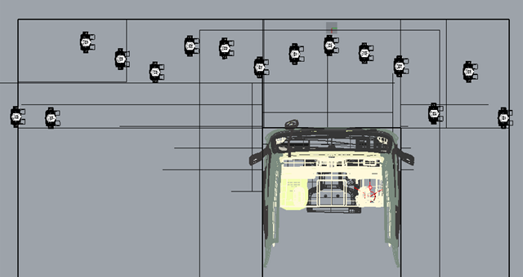
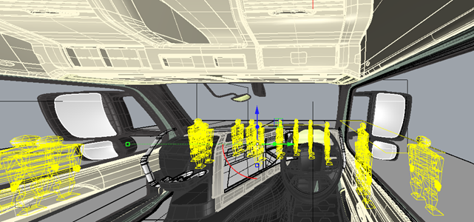
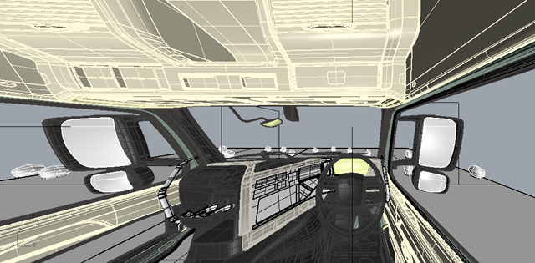
VRUs before adjustment
Option 2. Whole front of the Assessment volume
VRUs after adjustment

Slide 6
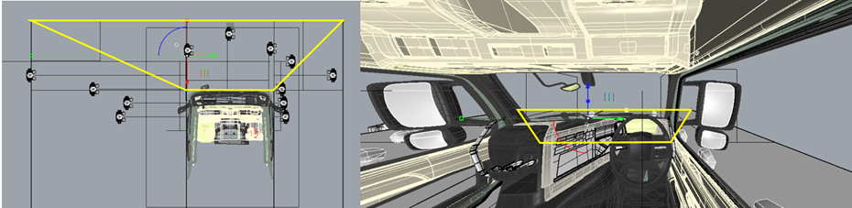
Option 3. Diagonal between a pillar and assessment volume points to the front (technology neutral? Still defines A-pillar)

Slide 7
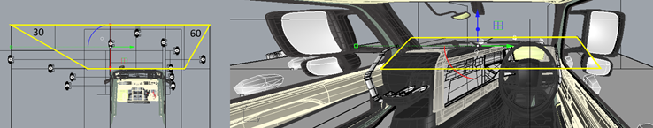
Option 4. Angle from front left to the 2m line of 30degrees, and angle from the front right assessment volume point of 60 degrees

Slide 8
Option 5. Diagonal between a pillar and assessment volume points to the front (technology neutral? Still defines A-pillar)

